Slide 1
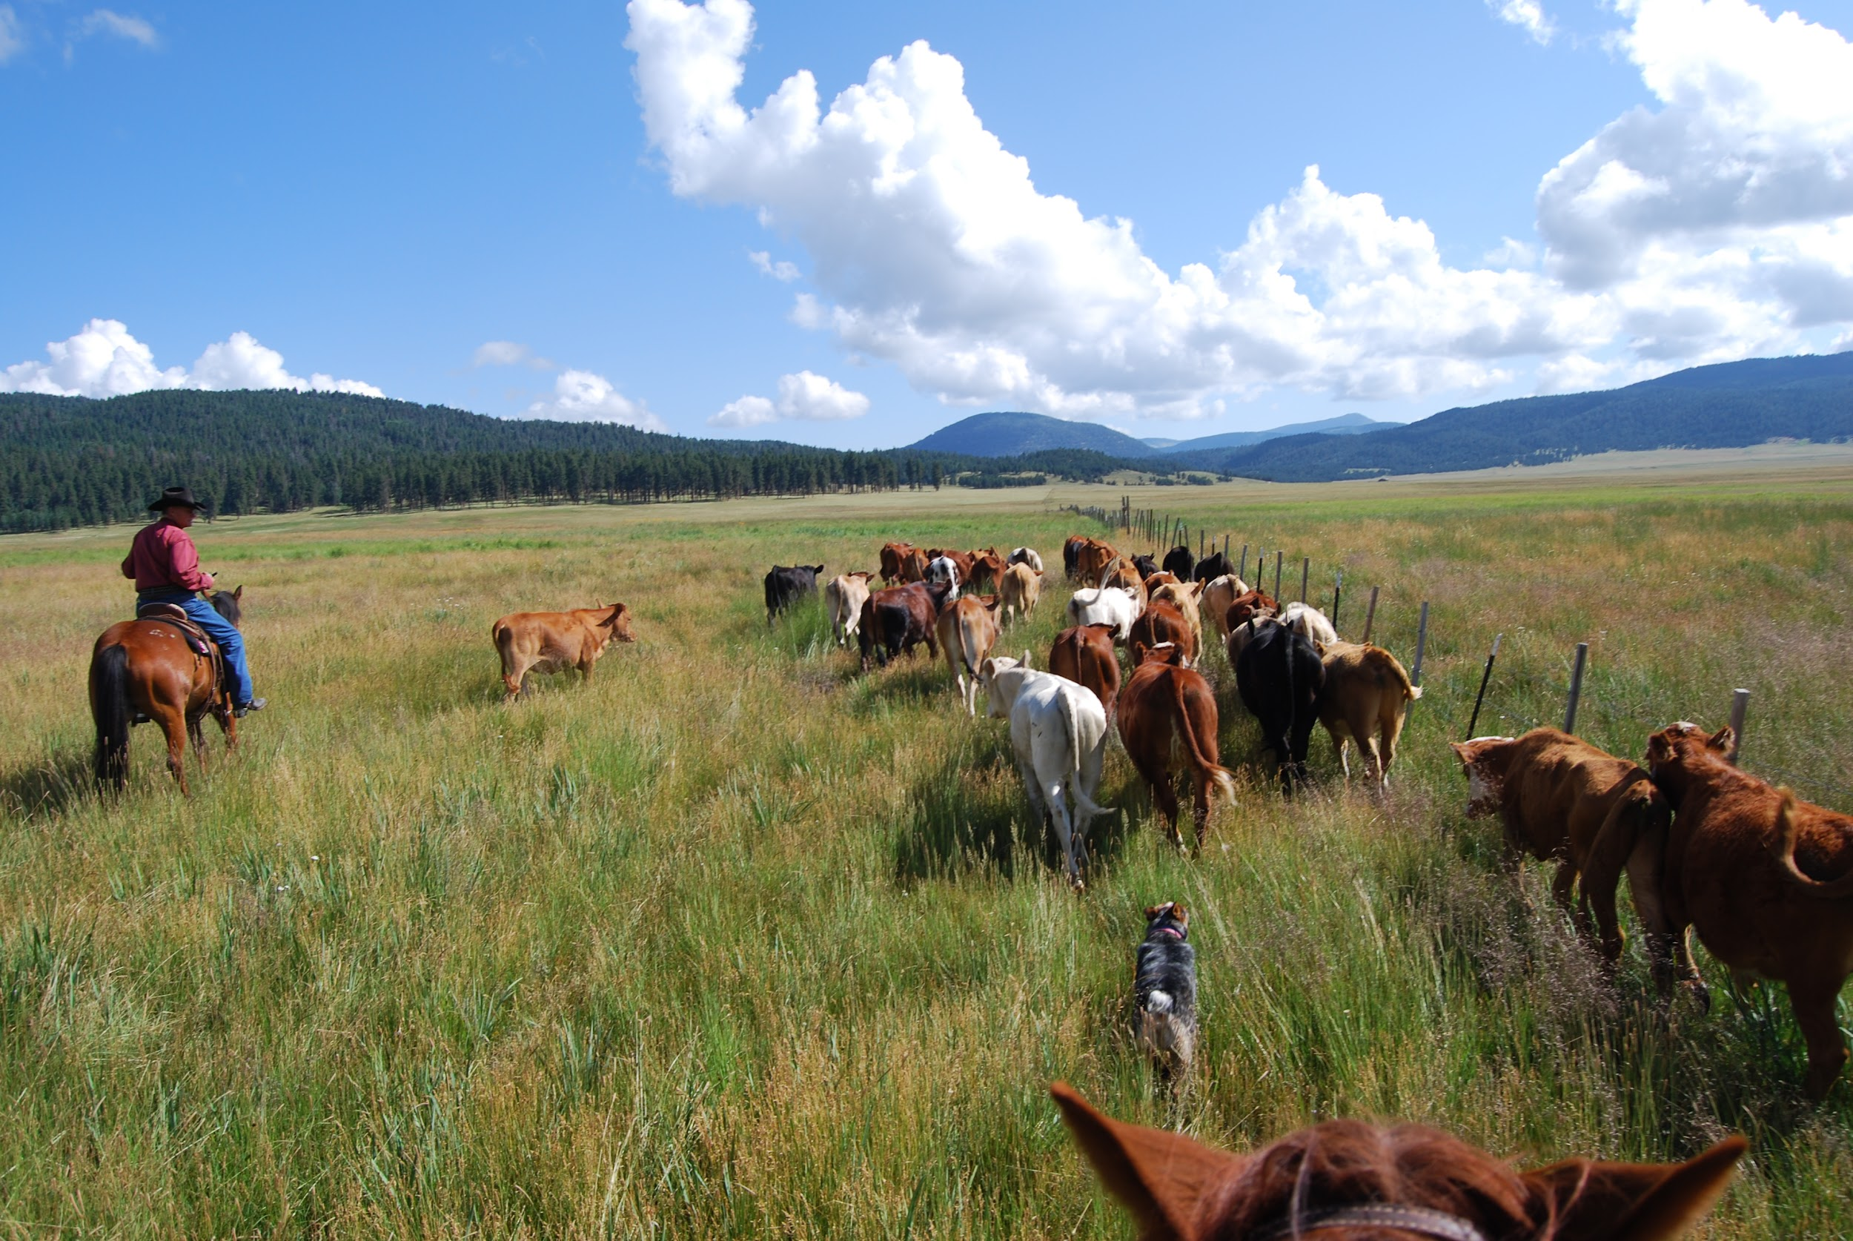


Tierra Seca Meeting
4/11/23

Slide 2
Meeting Schedule: Almost to the end of the semester!
January 17th
January 31st
February 7th ( SRM pre-trip meeting)
NO meeting February 14th (SRM)
February 28th
March 14th
March 28th
April 11th
April 25th
Every other Tuesday: @5:30-6:30 pm, ENR2 room N350
Notes:
Yes finances

Slide 3
Next Meeting: 4/25
Social / hangout before finals
Snacks
Stay tuned for final details - watch Instagram and email

Slide 4
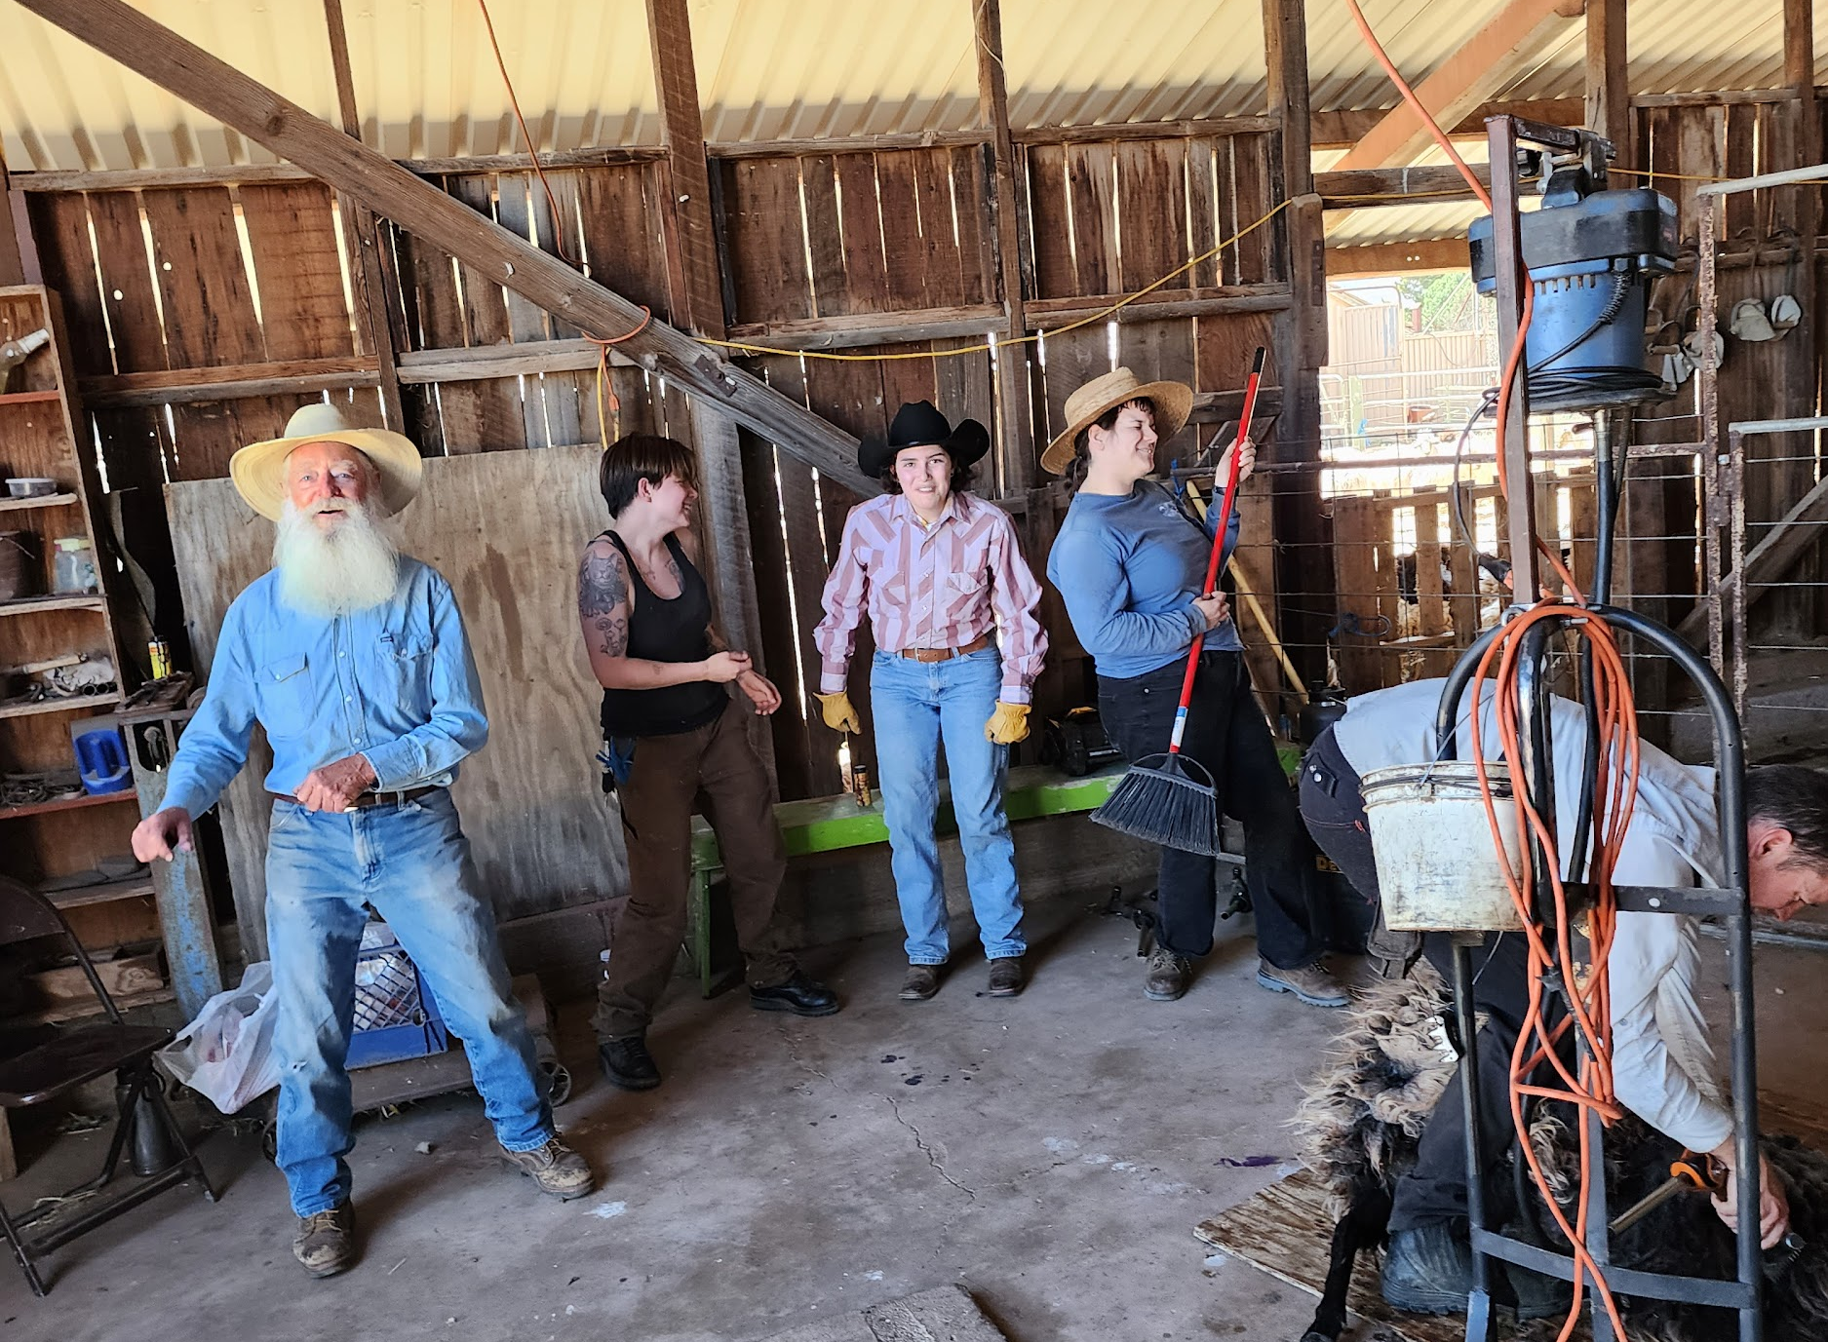
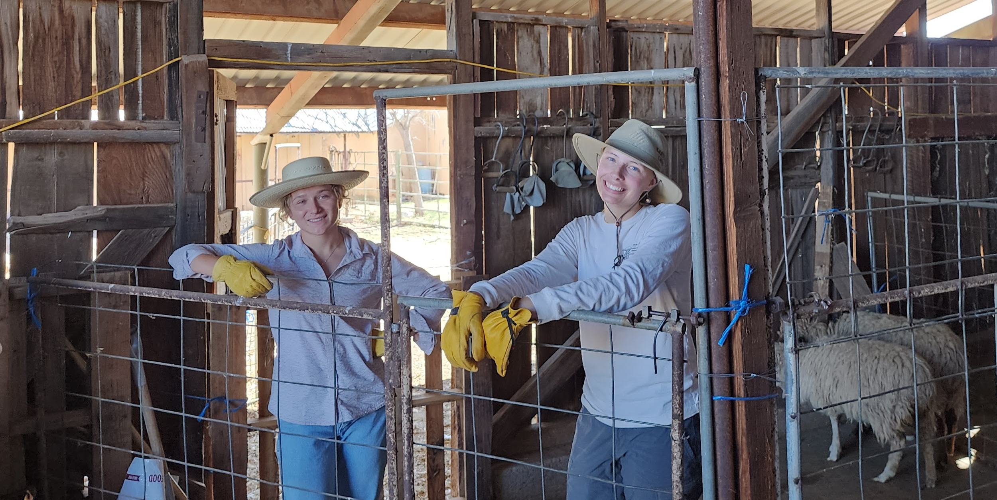
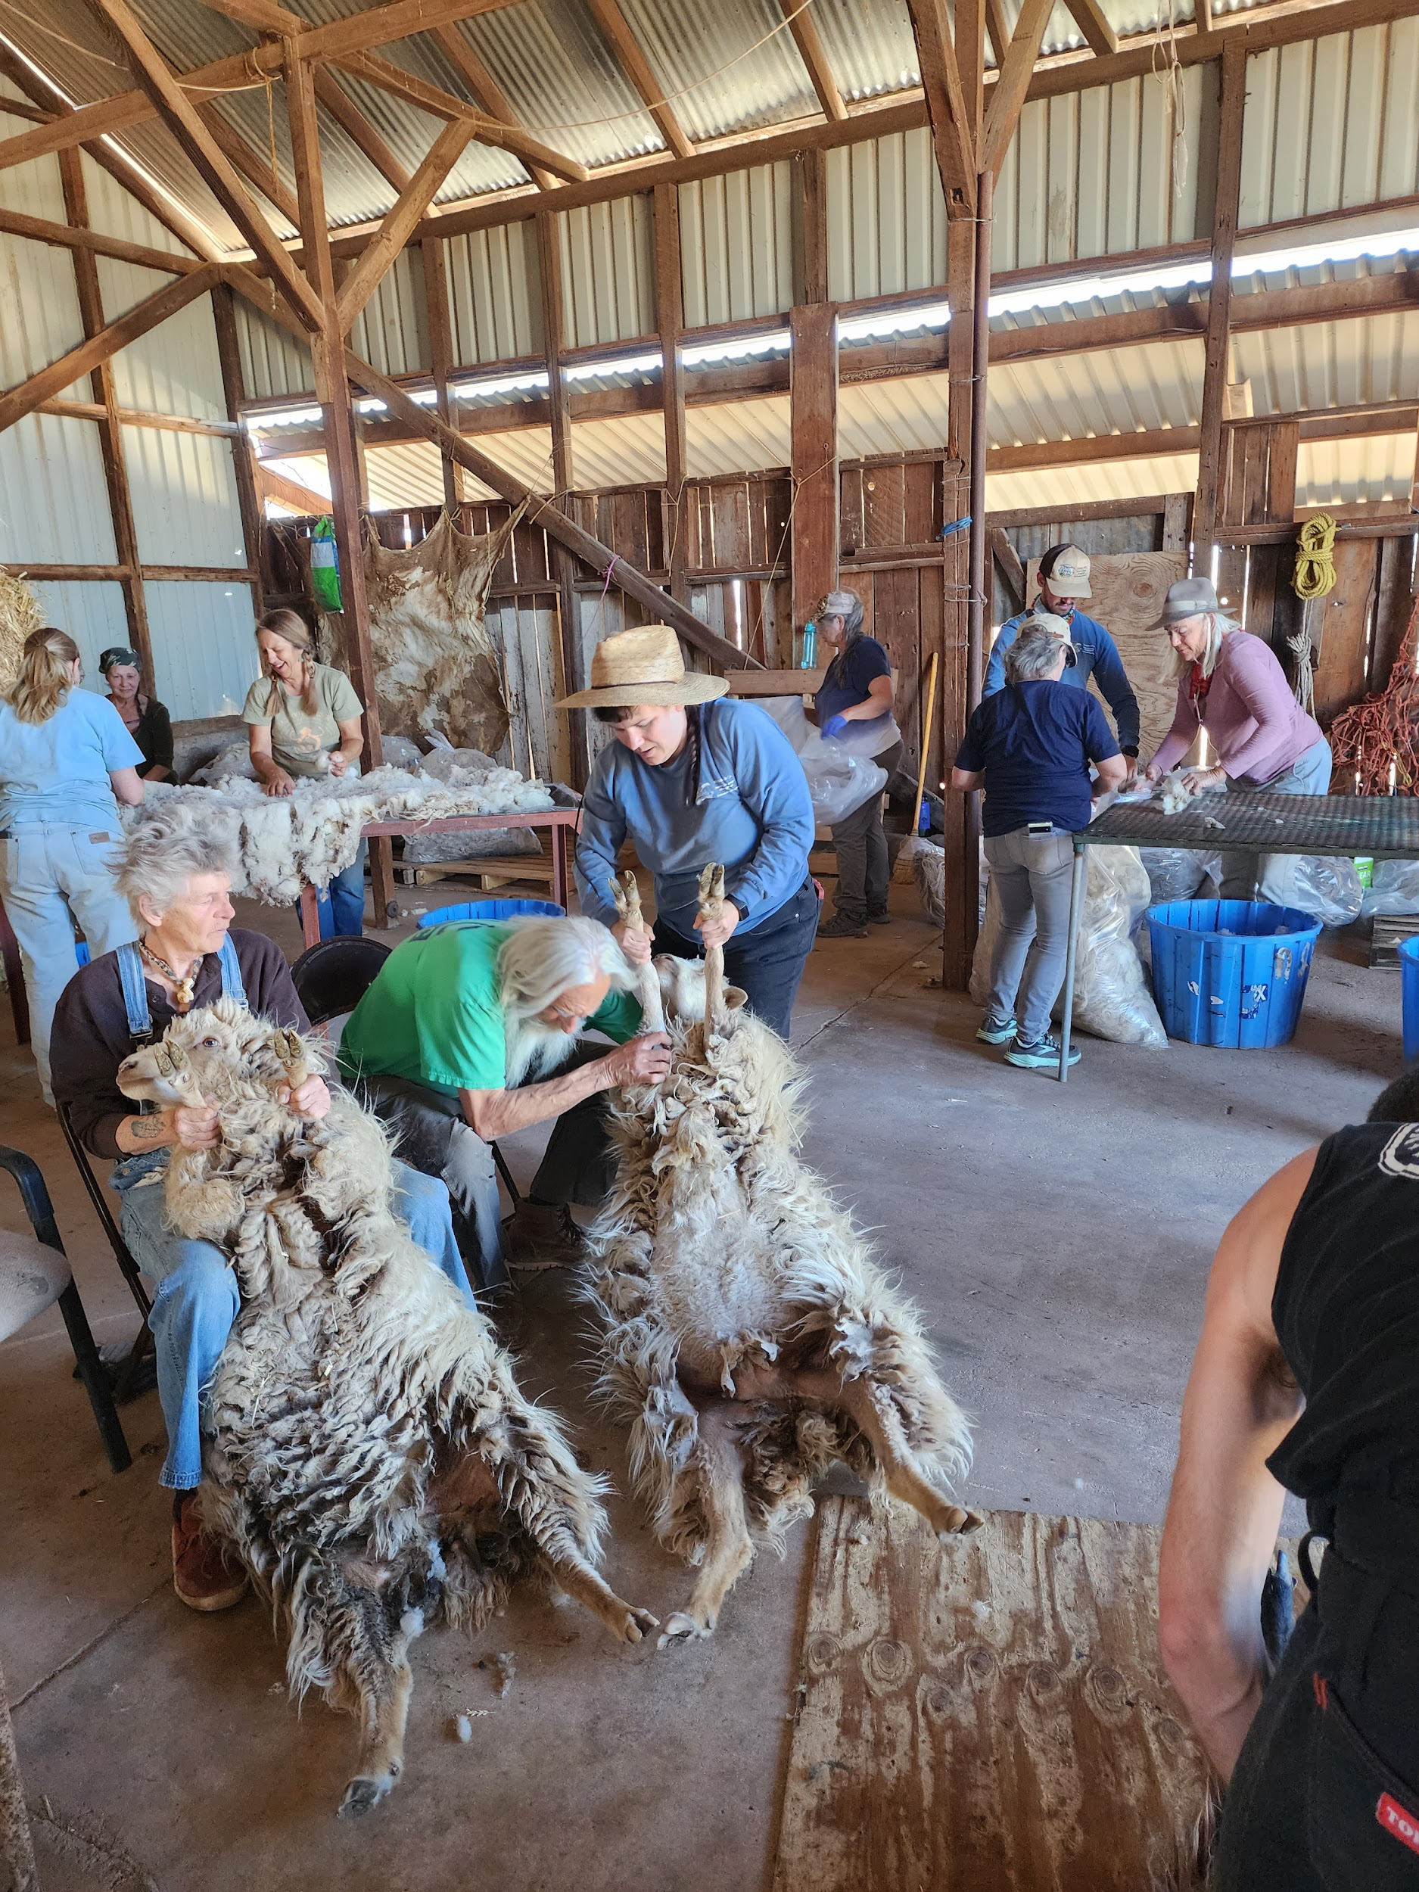
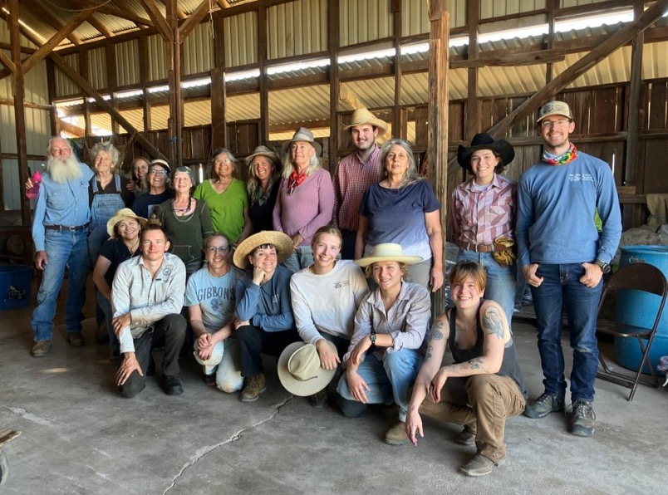
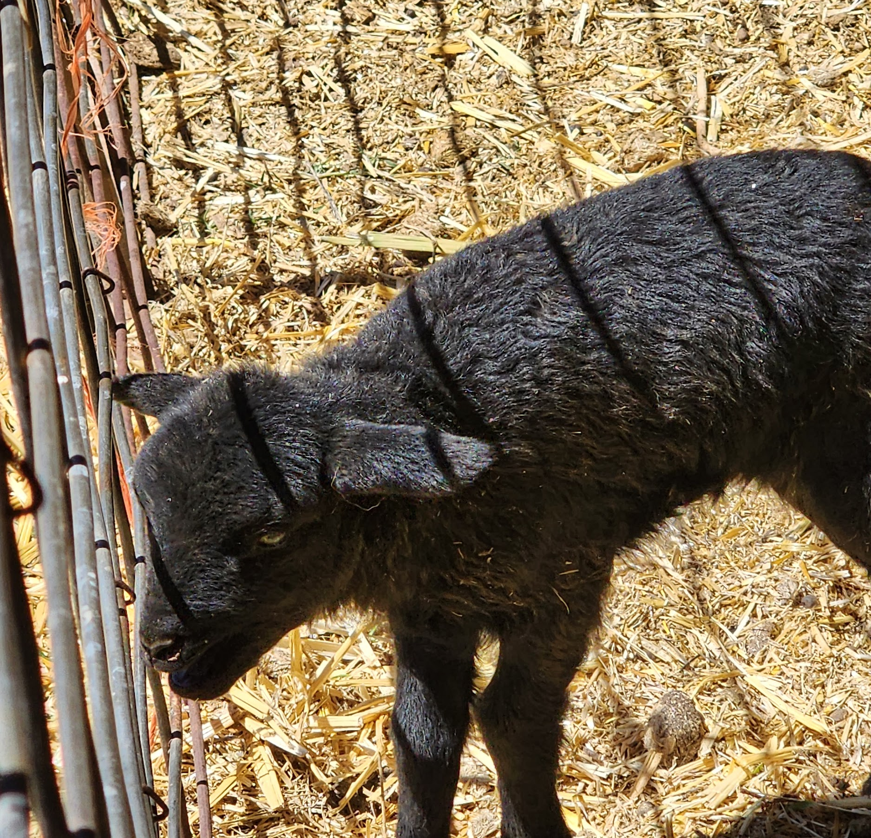
Sheep Shearing

Slide 5
Desert Museum Volunteer Opportunity
Fiesta Sahuarita April 15th
Buffelgrass education booth community outreach
Existing material and guidance given

Slide 6
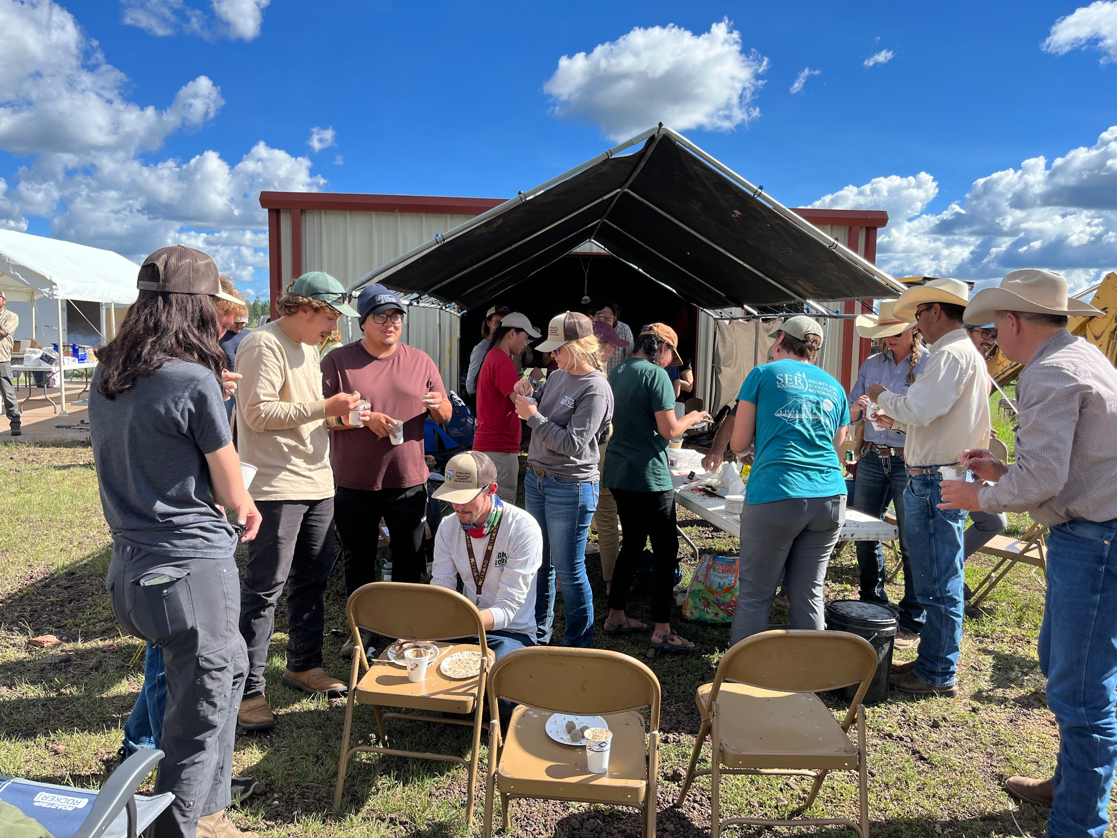
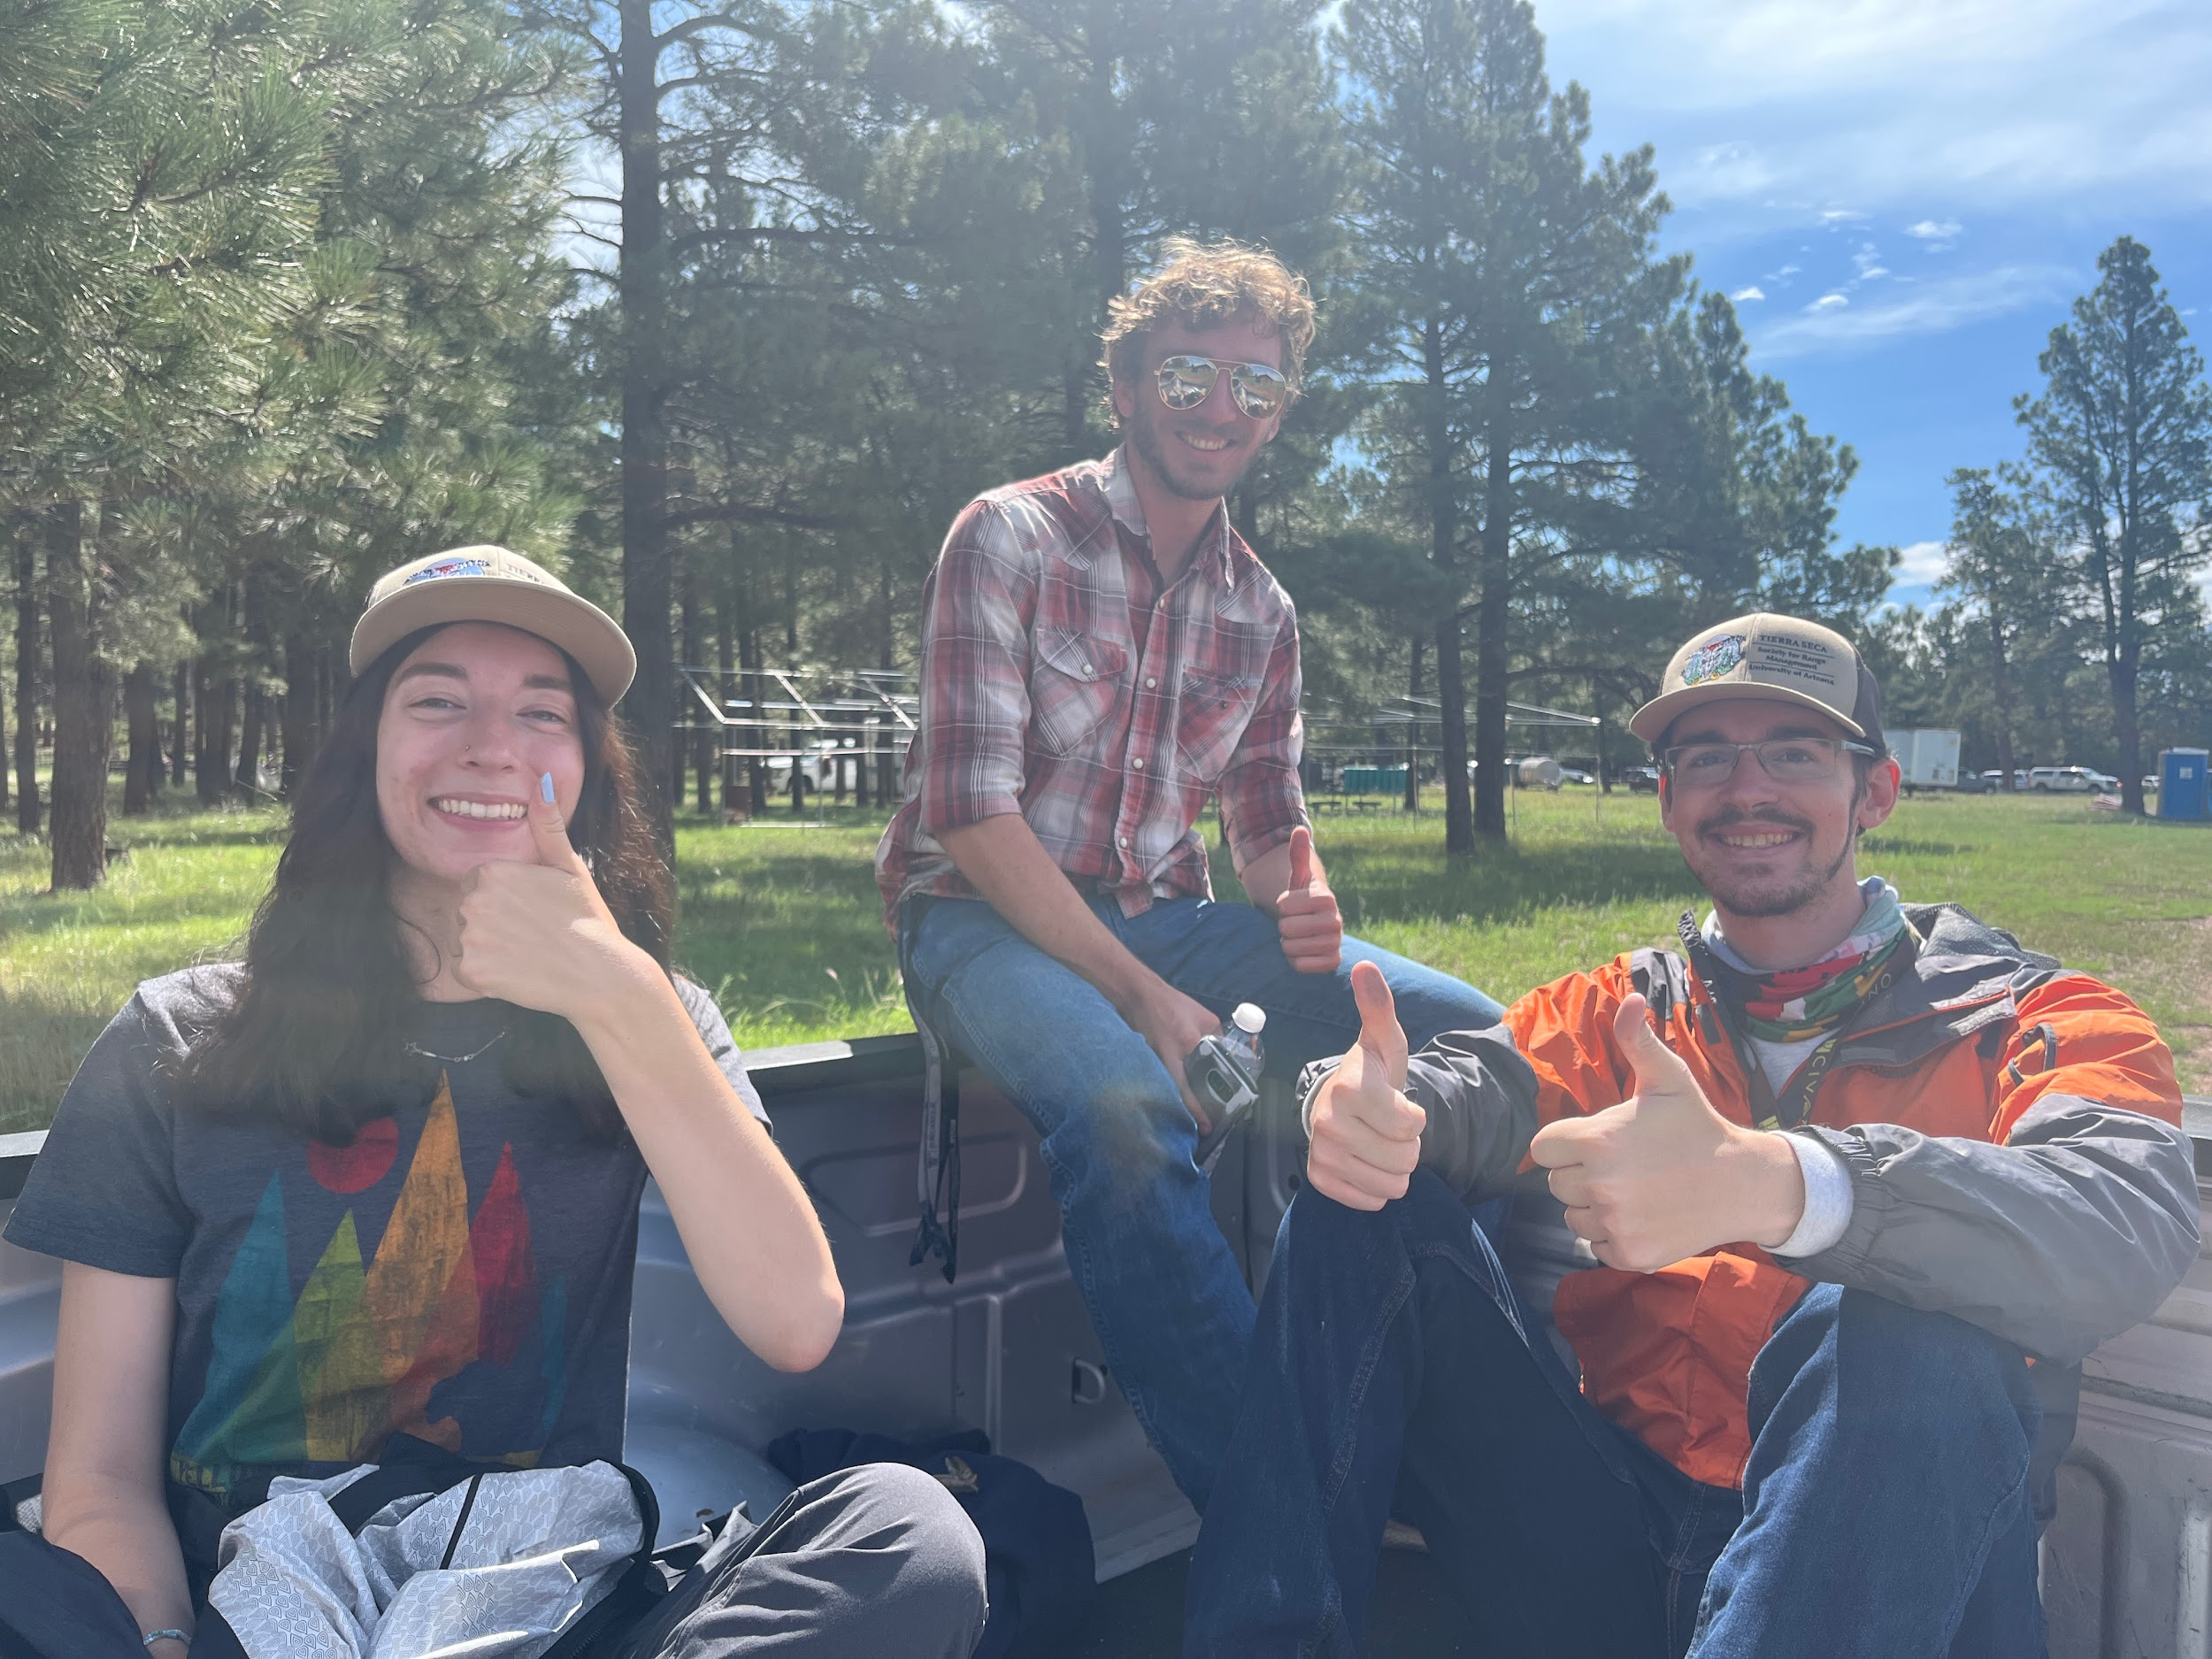
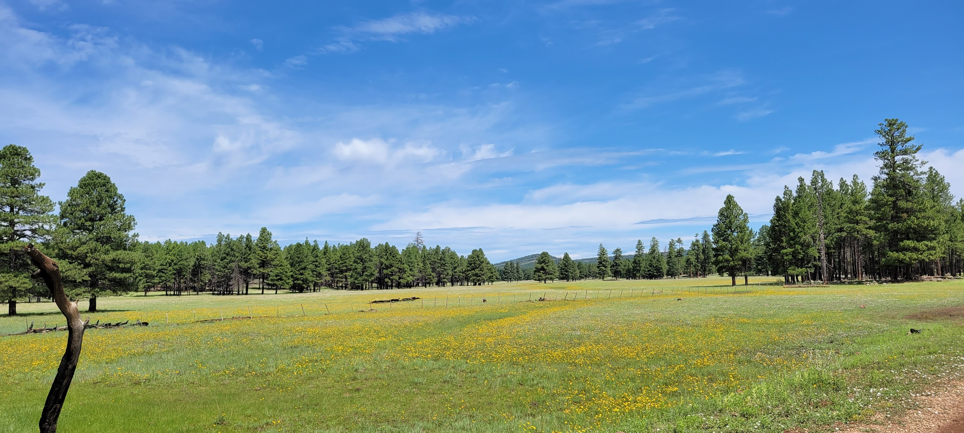
AZ SRM Summer Meeting
Wed. Aug 9, 2:00 PM - Fri. Aug 11, 5:00 PM
Ten- X Campground (about 4 miles from south entrance to Grand Canyon National Park)
https://azrangelands.org/events

Slide 7
Things to see next year

Slide 8
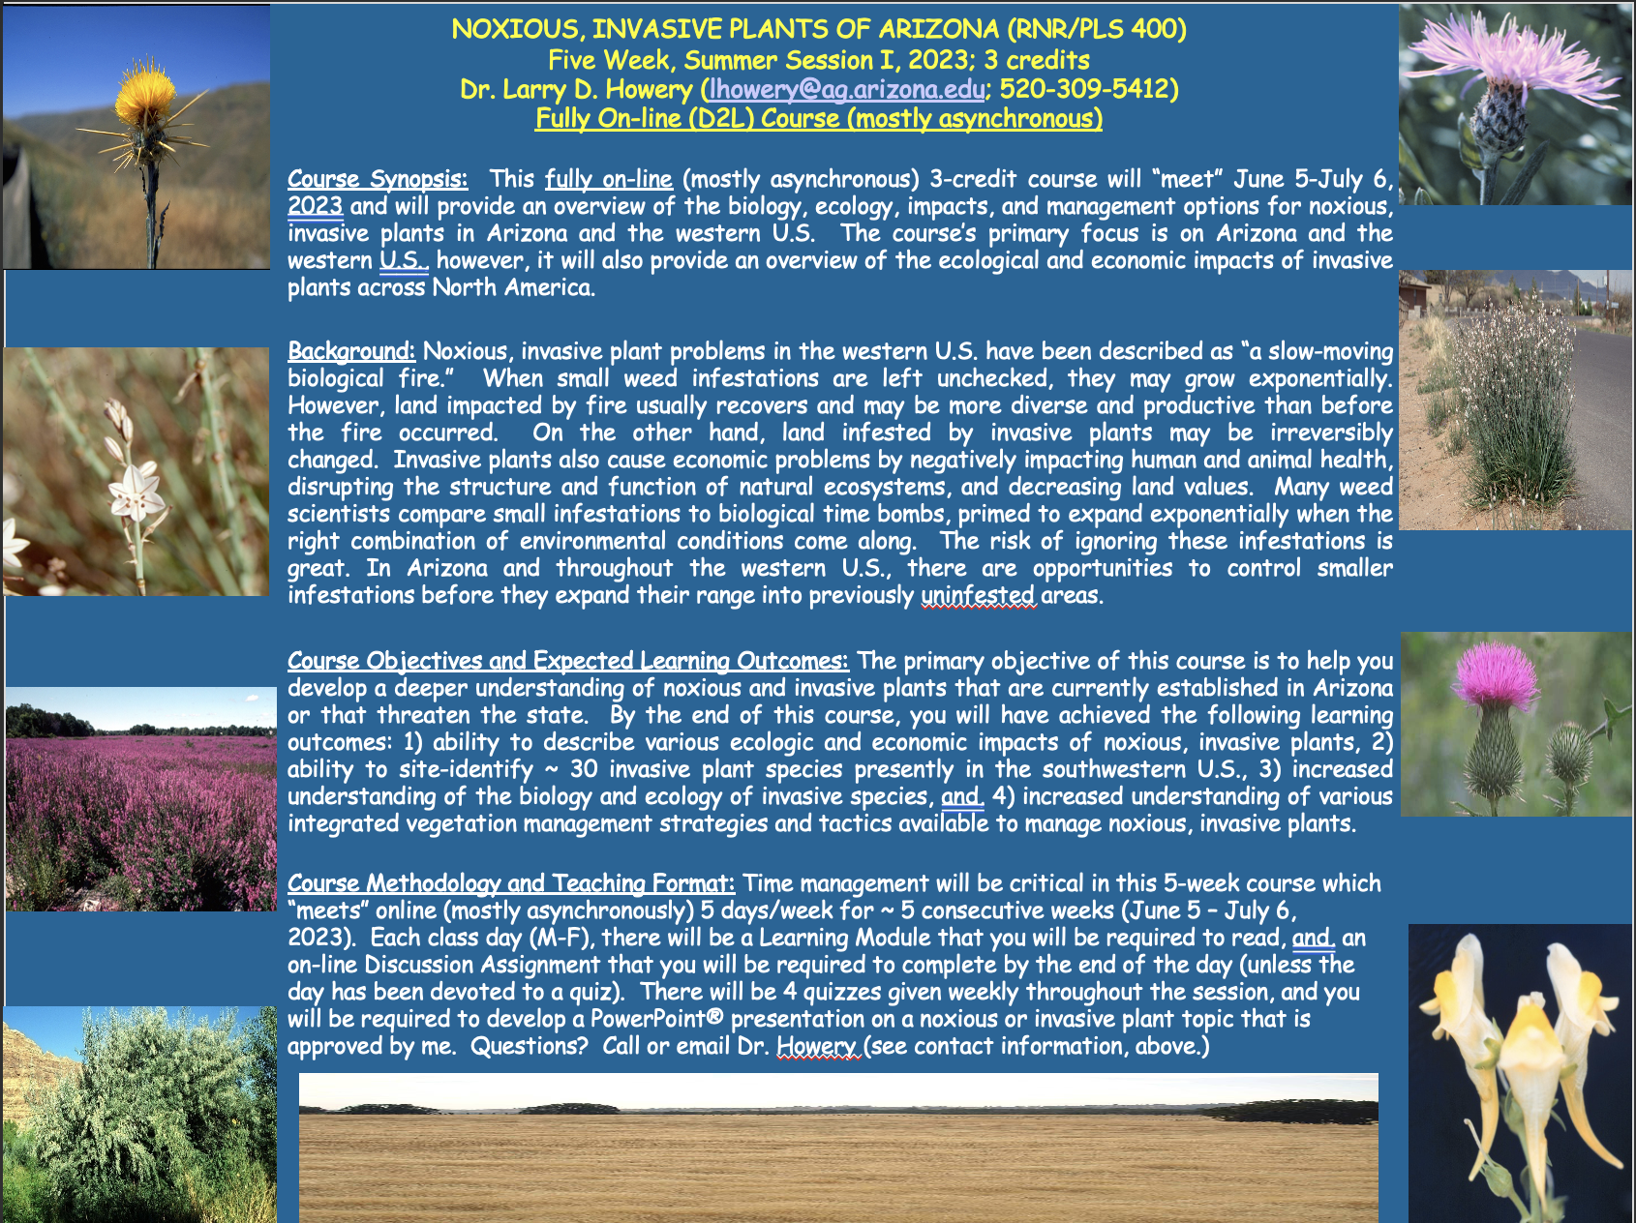

Slide 9

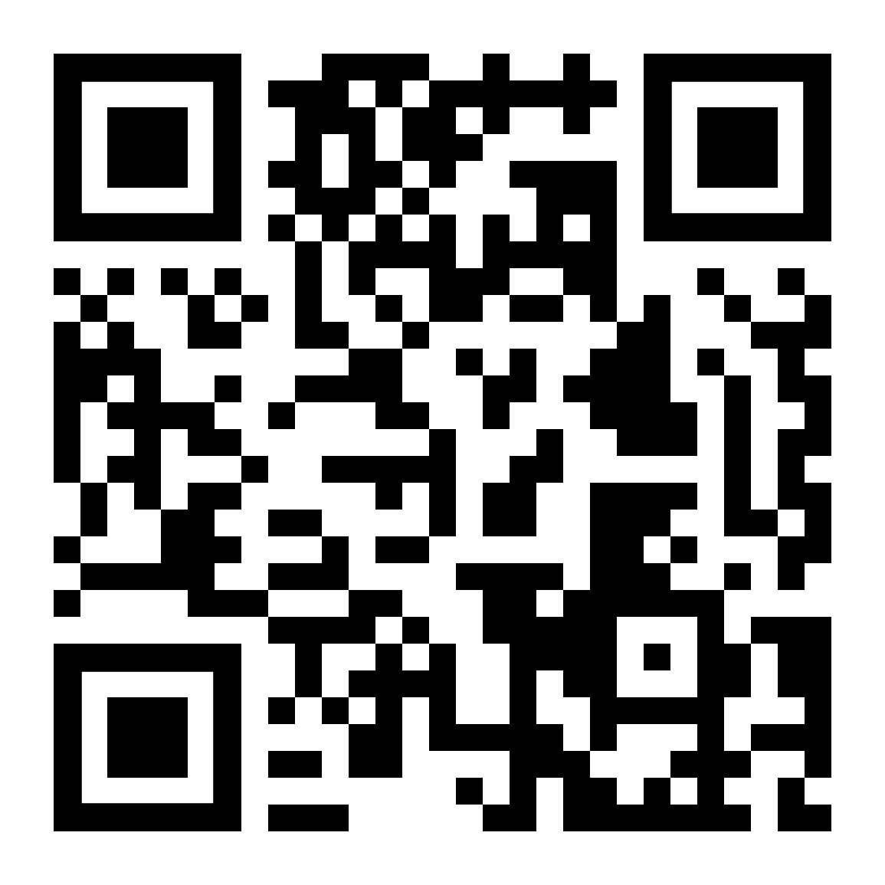
Budget
Venmo QR
Balance: $6,179.65
Club Dues: $15/semester or $30/year
Cash, Venmo, PayPal, Check

Slide 10
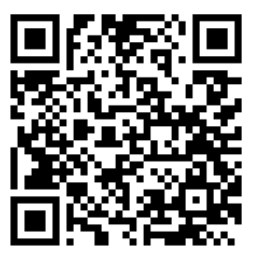
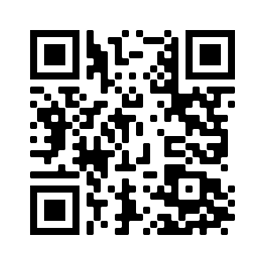

Join our group me!
We’re active on Instagram!
@uatierraseca
Notes:
Remember to pass out list serve form

Slide 11
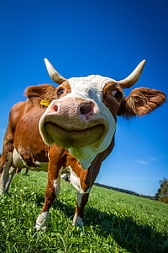
Questions, comments, random thoughts?
Email: uofatierraseca@gmail.com

