Slide 1



Tierra Seca Meeting
3/14/23

Slide 2
Agenda
Guest Speaker John Hall with the BLM!!
General announcements
Officer Elections

Slide 3
Meeting Schedule: Half Way Through the Semester?!
January 17th
January 31st
February 7th ( SRM pre-trip meeting)
NO meeting February 14th (SRM)
February 28th
March 14th
March 28th
April 11th
April 25th
Every other Tuesday: @5:30-6:30 pm, ENR2 room N350
Notes:
Yes finances

Slide 4
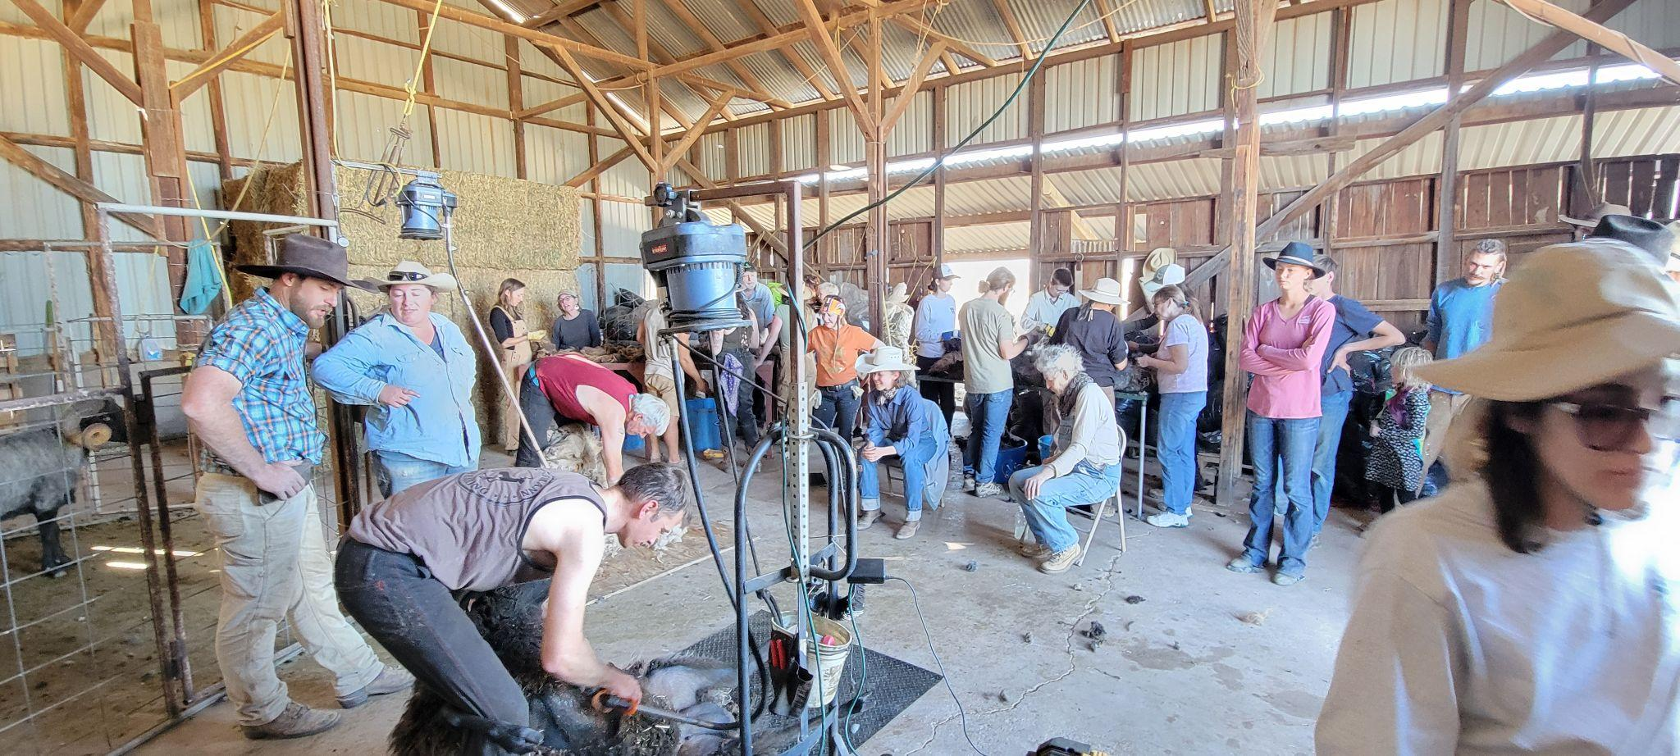
Sheep Shearing
Who: Dennis Moroney and the 47 Ranch
What: Sheeeeeep!!
Where: McNeal, AZ
When: All day Monday April 10th
Sign Up Sheet: https://docs.google.com/spreadsheets/d/16R4ovgN8GhTMplcd6I4iOYzVyC1BhUjTvT9YBpJ60NI/edit?usp=sharing

Slide 5


Slide 6
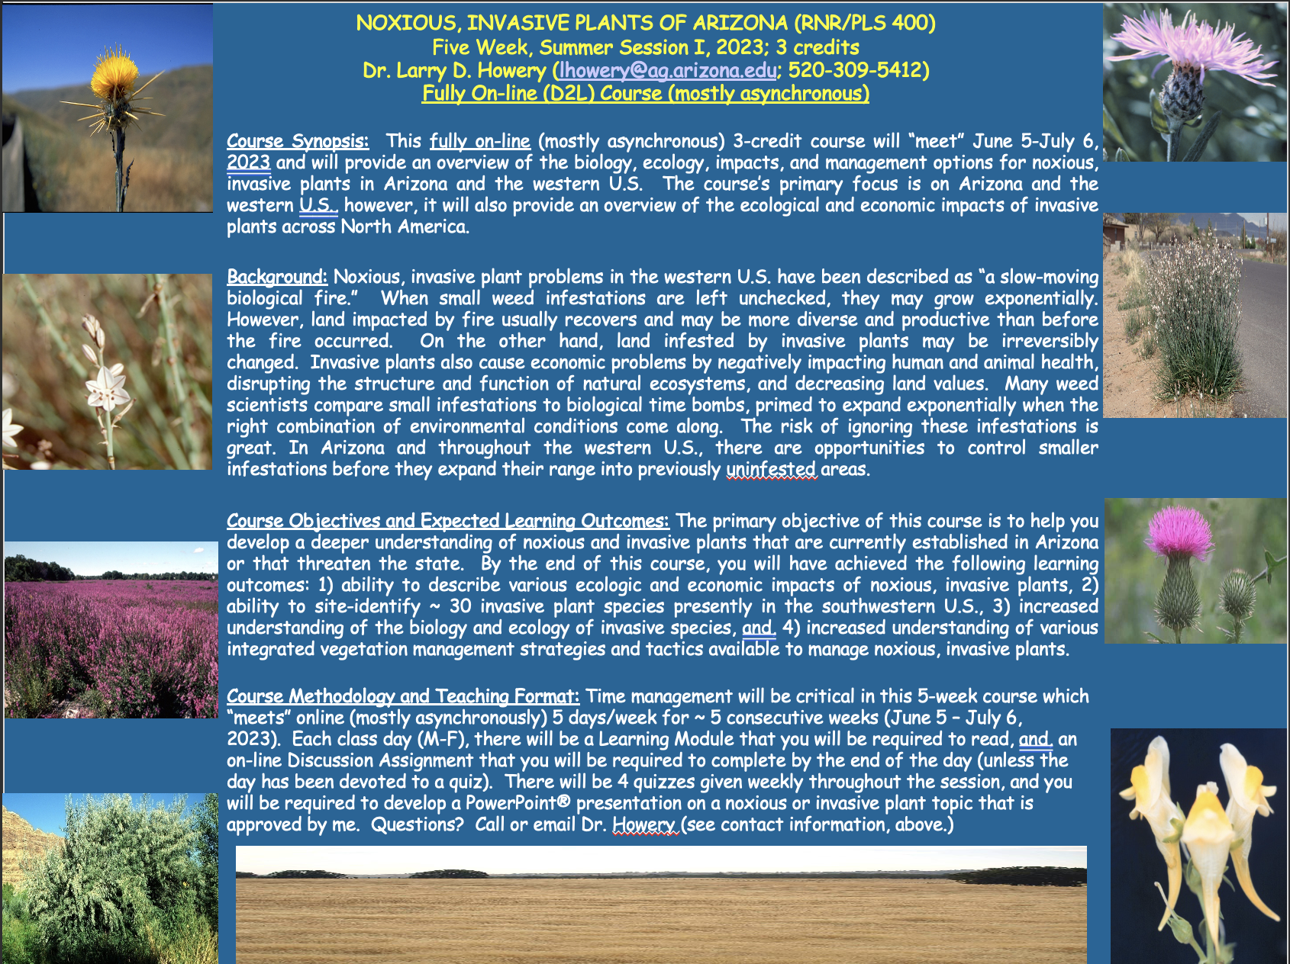

Slide 7
Officer Elections
Upcoming Dates:
Today
  Last minute nominations
  Elections for future officers

Slide 8

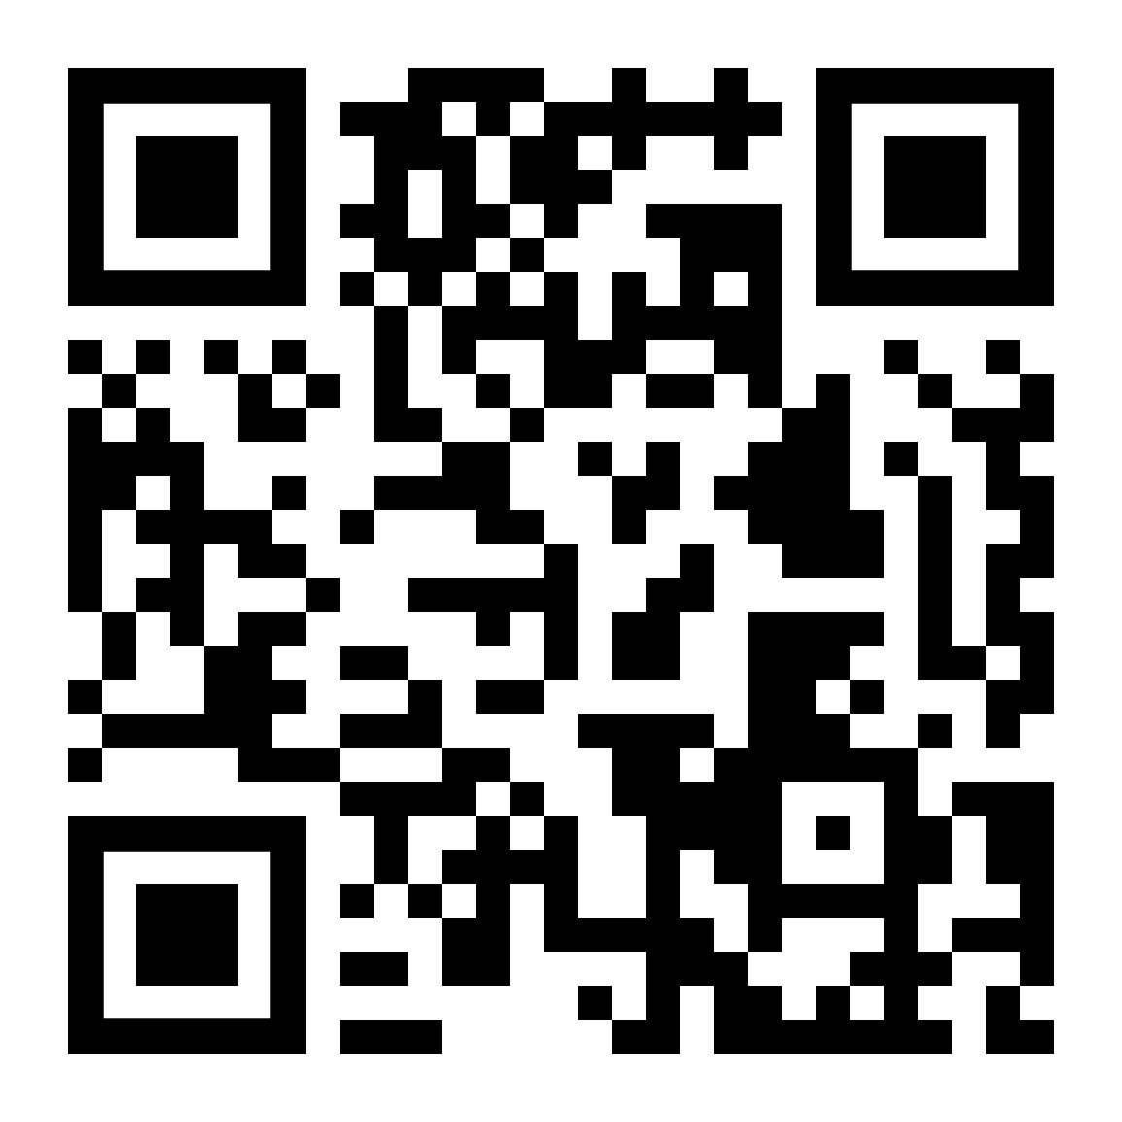
Budget
Venmo QR
Balance: $4,927.63
Club Dues: $15/semester or $30/year
  Cash, Venmo, PayPal, Check

Slide 9
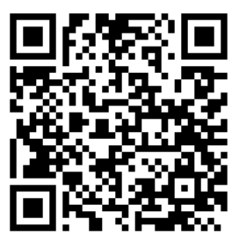
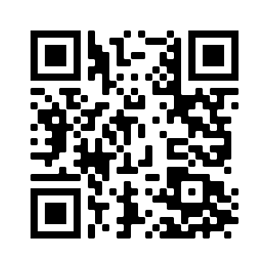

Join our group me!
We’re active on Instagram!
@uatierraseca
Notes:
Remember to pass out list serve form

Slide 10
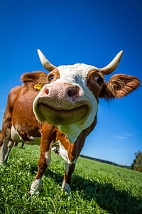
Questions, comments, random thoughts?
Email: uofatierraseca@gmail.com

