Slide 1
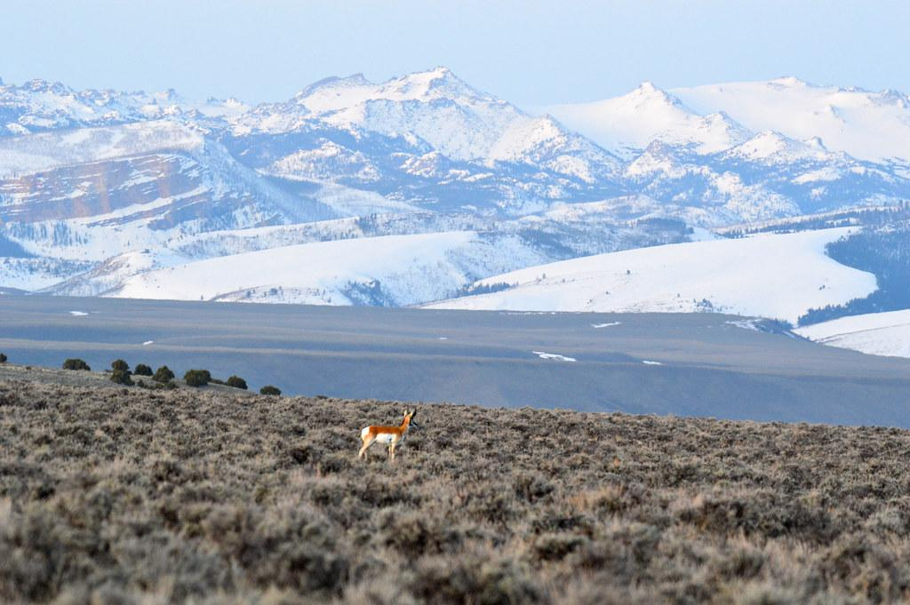


Tierra Seca Meeting
01/31/23

Slide 2
Agenda
Steer Raffle updates
Upcoming events (besides SRM!)
Job Posting
Shirts for SRM!

Slide 3
Meeting Schedule
January 17th
January 31st
February 7th ( SRM pre-trip meeting)
NO meeting February 14th (SRM)
SRM Info Meeting February 7th
February 28th
March 14th
March 28th
April 11th
April 25th
Every other Tuesday: @5:30-6:30 pm, ENR2 room N350

Slide 4
Semester Overview
Less than two weeks left until SRM!
February 11th - 17th
Sheep Shearing
Sometime early March. TBD!
End of Semester Overnight
Late April at the Florida Station. TBD!
Arroyo Chico Clean Up
Larger event w city planned for April
Guest Speakers
Samuel Garcia on beef production
Others TBD
Officer elections!

Slide 5

Beat Back Buffelgrass!
Get volunteer hours and experience removing buffelgrass!
Help in the fight against Buffelgrass take over!

Slide 6
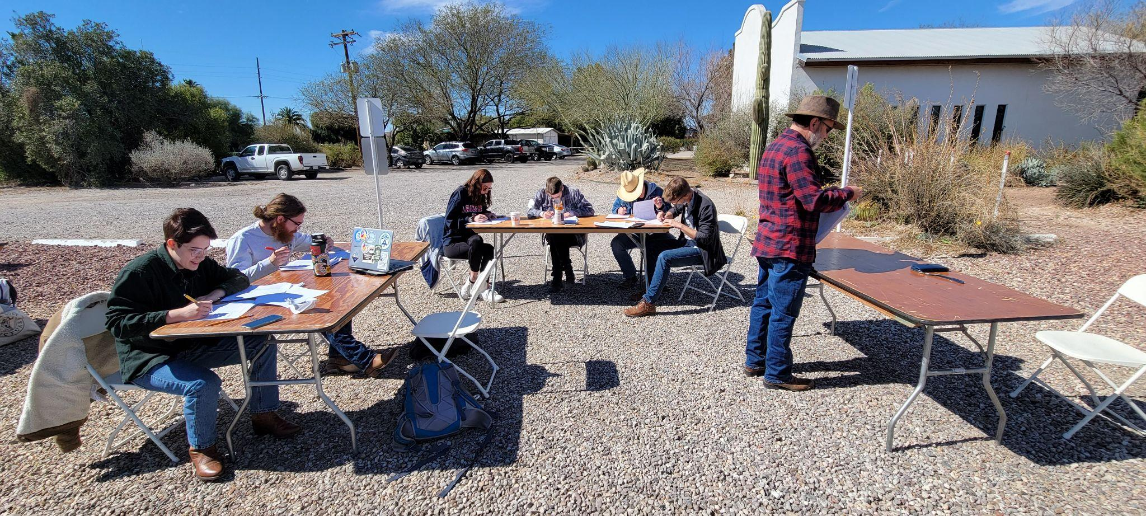
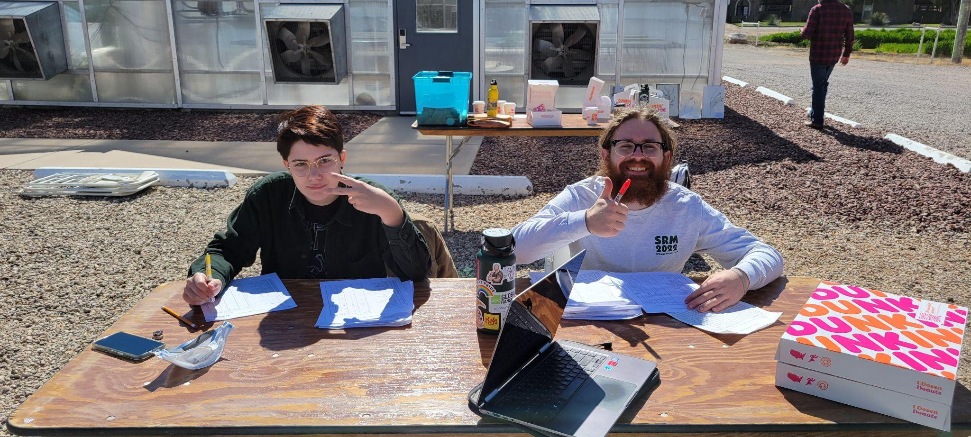
FFA Volunteering
FFA Day (Dr. Fehmi)
When: Friday, 2/24/22 @7am-12pm
Where: East of Campbell Ave. and Roger Rd. Campus Ag Center
What: Set up tables and chairs, grade exams, enter results, etc.
Sign Up Sheet:
https://docs.google.com/spreadsheets/d/1nekq3bTSm3r2UXyWQjFZ9wgsr1Ux2zshtinsLj8Glvw/edit?usp=sharing

Slide 7
Pathways intern Outreach Kaibab National Forest ( in your email)
Montana Conservation Corp (Field Crew Summer Only https://www.mtcorps.org/joinmcc/open-positions/

Slide 8
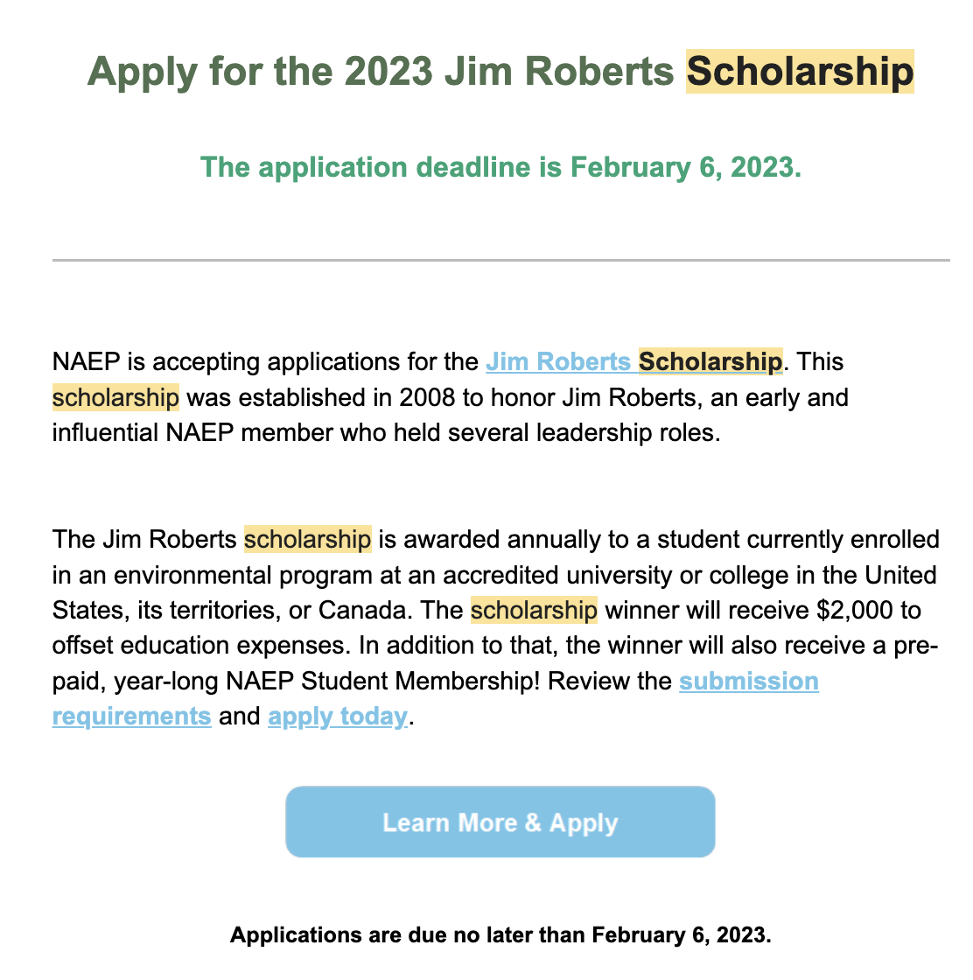
More Information:
https://naep.memberclicks.net/jim-roberts-scholarship

Slide 9

SRM shirts!

Slide 10

Steer Raffle!
Let’s sell these tickets!
We have raffle tickets!!
One Quarter (~125 LBS): $20 each or 6 for $100
Steer provided by Dennis and Debra Moroney (The 47 Ranch)
Local beef producer from Bisbee AZ
Sustainable production, Grass raised and finished!
Drawing on February 7th, 2023.
Information sheet will be attached to meeting minutes!
Share with friends, family, and everyone else!

