Slide 1
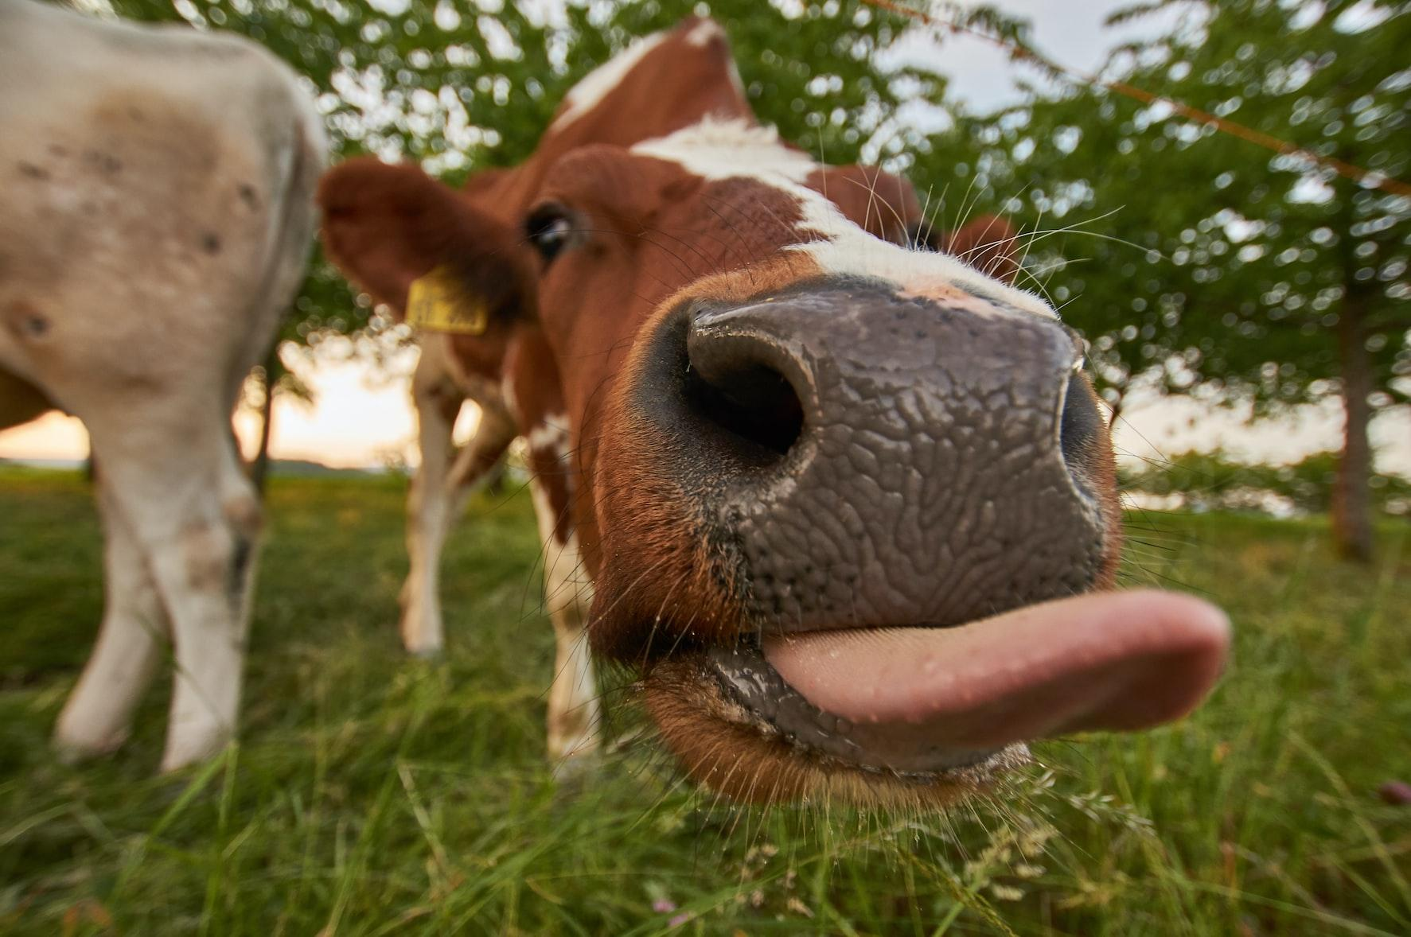


Tierra Seca Meeting 1/17/2023

Slide 2
Agenda
Semester Overview
Ideas for the future
Job Opportunities
SRM Updates

Slide 3
Meeting Schedule
January 17th
January 31st
NO meeting February 14th (SRM)
SRM Info Meeting February 7th
February 28th
March 14th
March 28th
April 11th
April 25th
Every other Tuesday: @5:30-6:30 pm, ENR2 room N350

Slide 4
Semester Overview
Only four weeks left until SRM!
February 11th - 17th
Sheep Shearing
Sometime early March. TBD!
End of Semester Overnight
Late April at the Florida Station. TBD!
Arroyo Chico Clean Up
Larger event w city planned for April
Guest Speakers
Samuel Garcia on beef production
Others TBD
Officer elections!

Slide 5
Q&A on Semester Schedule
Guest Speakers?
Alumni from EMRR
Arizona Conservation Corp
Tierra Seca Events
Kickball is happening!!
V Bar V?
What would you like to see?
Plant ID Hikes after SRM
Volunteering events
The Don
Buffelgrass ect.
After SRM - Begin research planning
More fun events
Fundraising Opportunities
Booth for Rodeo Day or Tucson Rodeo booth?
Steer Raffle at Tucson Rodeo
Finding new ranchers for steer raffle

Slide 6
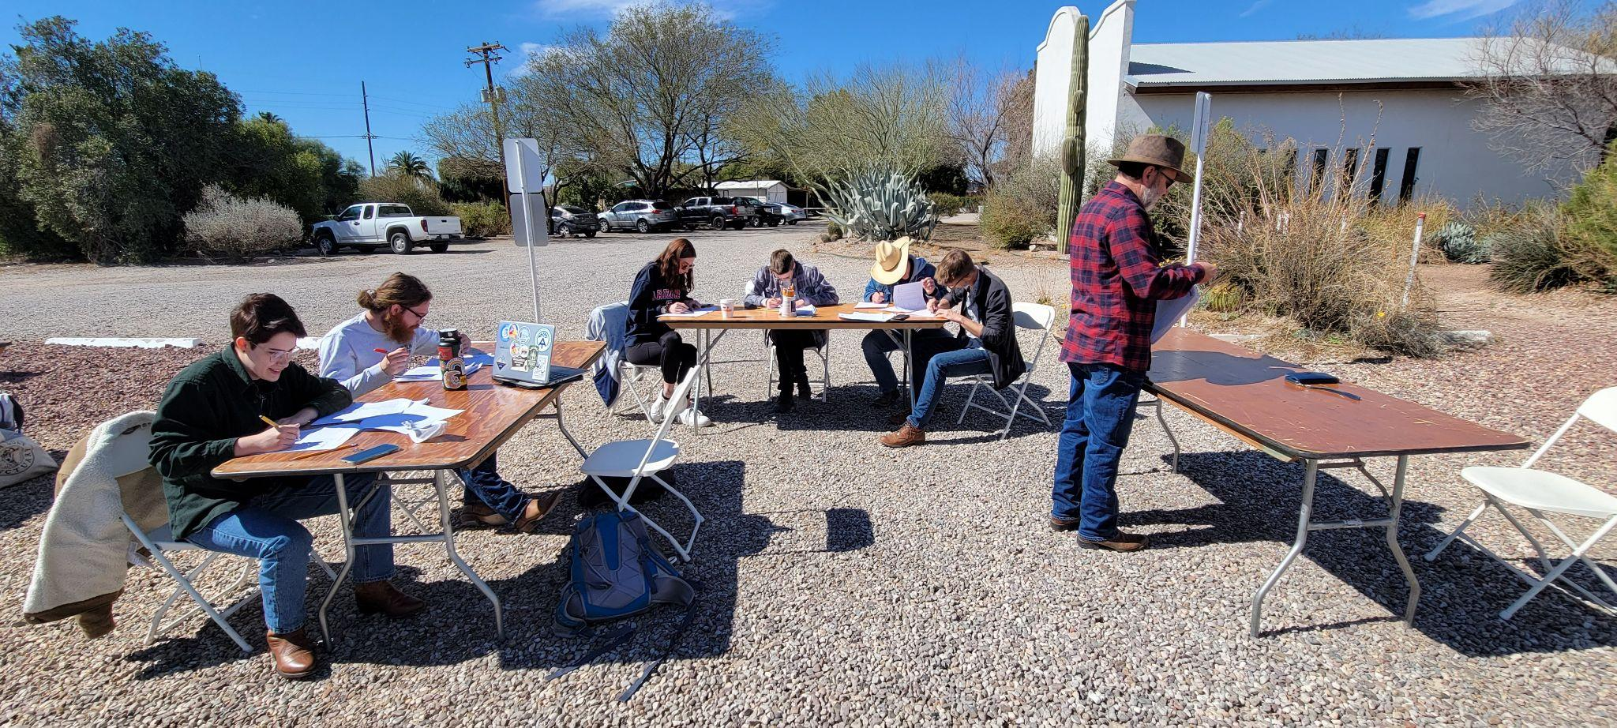
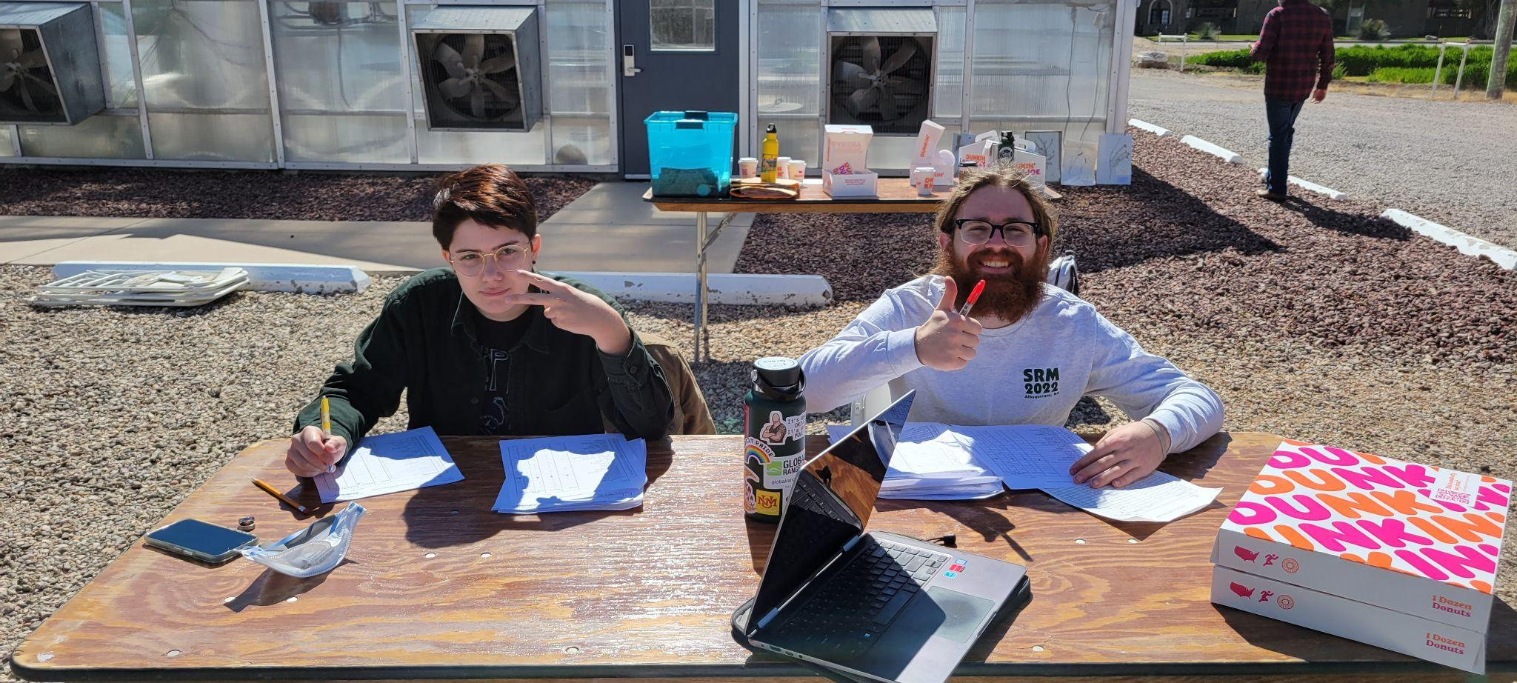
FFA Volunteering
FFA Day (Dr. Fehmi)
When: Friday, 2/24/22 @7am-12pm
Where: East of Campbell Ave. and Roger Rd. Campus Ag Center
What: Set up tables and chairs, grade exams, enter results, etc.
Sign Up Sheet:
https://docs.google.com/spreadsheets/d/1nekq3bTSm3r2UXyWQjFZ9wgsr1Ux2zshtinsLj8Glvw/edit?usp=sharing

Slide 7
Summer Hiring Season is Here!
Each summer, the Rocky Mountain Biological Laboratory (RMBL) offers a 10 week program, where approximately 40 students are matched with mentors from across the country to conduct independent research. Students have opportunities to work on a wide array of ecological and evolutionary field projects. Additionally, students have the opportunity to supplement their research project with additional training in field ecology or wildlife biology. RMBL provides REU funding for approximately 10 students. RMBL also makes available additional scholarships. Consequently, financial need should not preclude students from applying.
This is a wonderful opportunity for students thinking about a career in the sciences. RMBL is located in Gothic, Colorado, a stunningly beautiful location in the Rockies. Because we host more than 150 graduate students and senior scientists, undergraduates have an opportunity to learn about graduate programs from around the world. Many undergraduates end up as co-authors on scientific papers and start building professional networks that foster their career across a lifetime. We have had many undergraduates turn their summer research into a senior thesis project.
Our program does fill. We encourage strongly motivated applicants, including applicants who need financial support, to submit their online application by Feb. 15.
Get on the SRM, CALS, and SNRE list serves
Rocky Mountain Bio Lab Undergrad Research Program
https://www.rmbl.org/students/
Deadline is February 15th
Interested students can also contact the program coordinator directly- Rosemary Smith (rsmith@rmbl.org). Description below

Slide 8
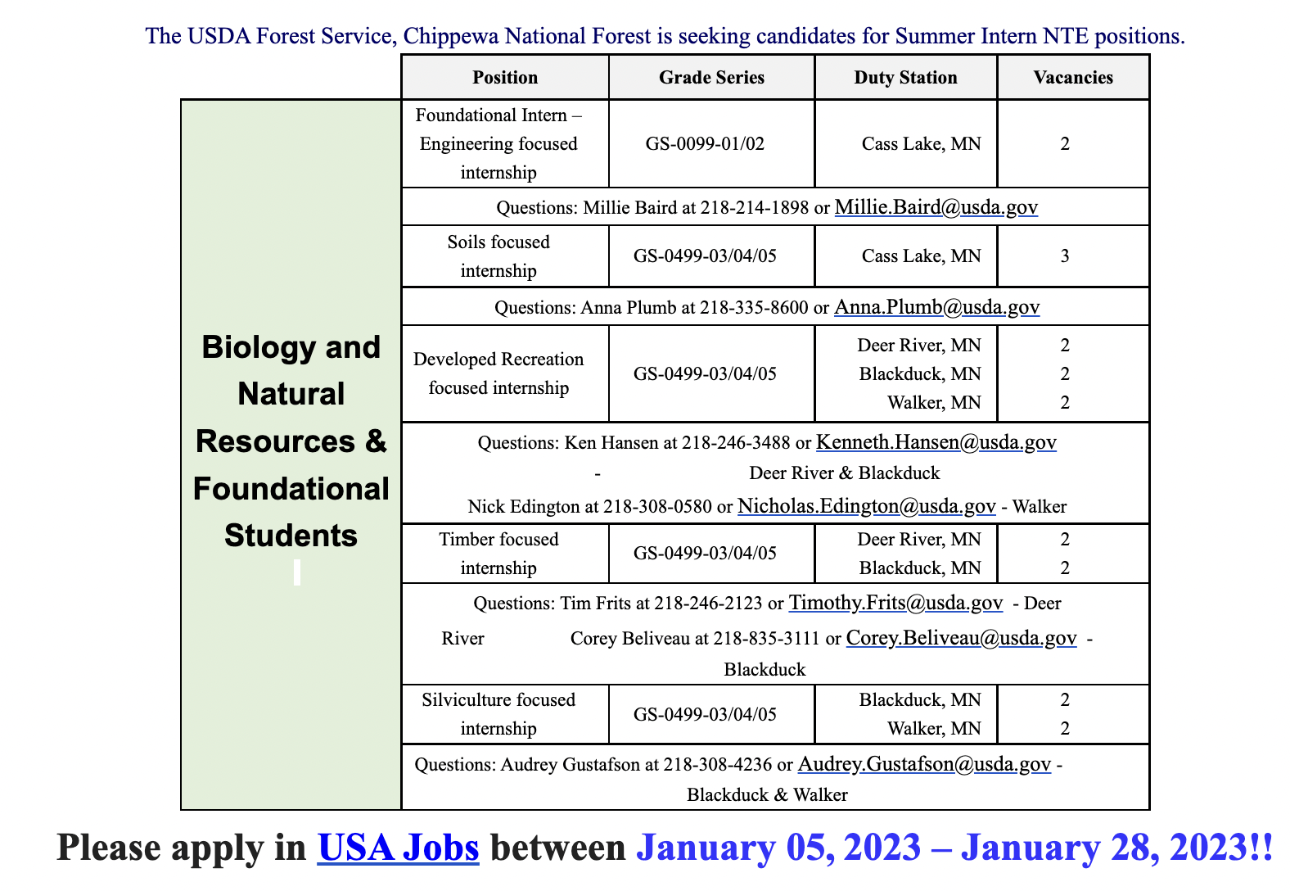
Job Opportunities Continued
General link for current USFS hiring event:
https://www.fs.usda.gov/working-with-us/jobs/summer-internships?utm_source=flyer&utm_medium=email&utm_campaign=recruitment&utm_content=summerInternships
Deadline is January 27th!!

Slide 9
Job Opportunities Continued
Community Mapping Research Assistant(s)
https://docs.google.com/forms/d/e/1FAIpQLSfVx1RCDFt8rHE8AZasmIOV6RcKAFWbsWp7uLauGe2RphnBnA/viewform
Deadline for priority is tomorrow January 18th!!
Students will record the spatial coordinates of various habitat resources and features in the built environment around the University of Arizona campus. These include, but aren't limited to, water sources and features, vegetation sources and features, and nesting/burrowing/roosting sources and features.
*Full time enrollment and advanced standing (years 2+) in SNRE undergraduate program*

Slide 10
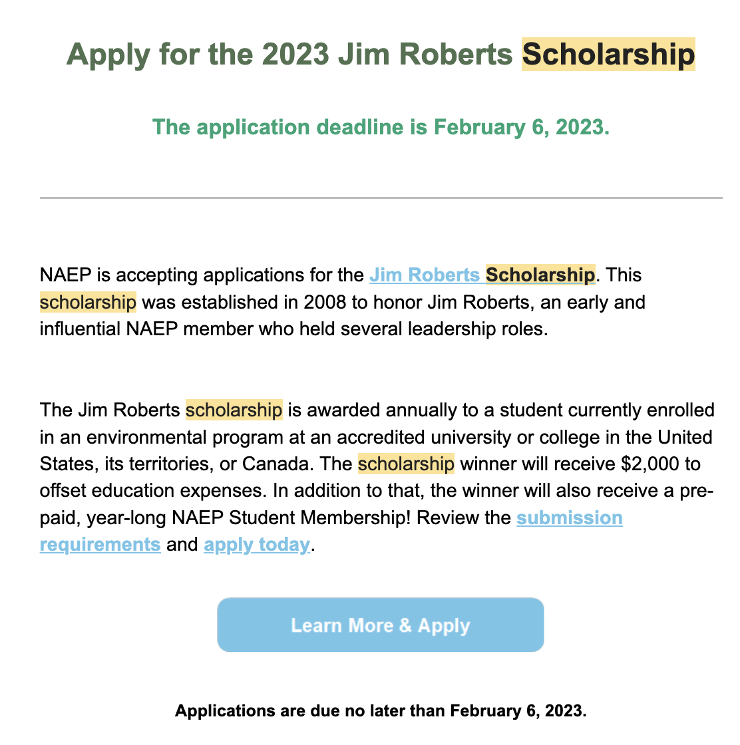
More Information:
https://naep.memberclicks.net/jim-roberts-scholarship

Slide 11
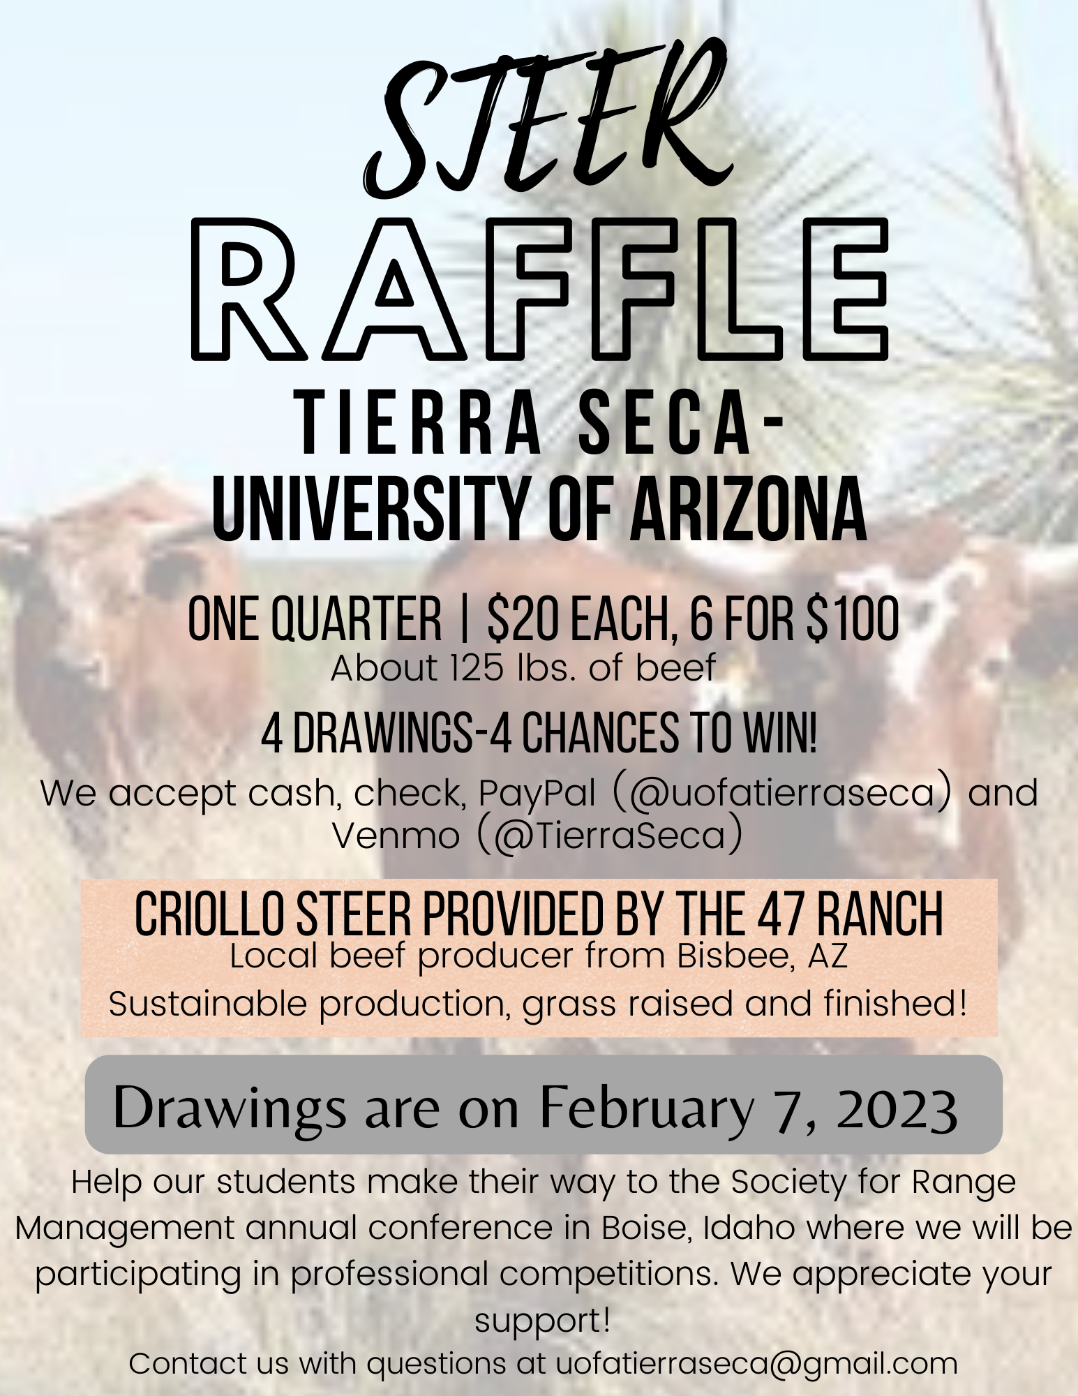
Steer Raffle
Let’s sell these tickets!
We have raffle tickets!!
One Quarter (~125 LBS): $20 each or 6 for $100
Steer provided by Dennis and Debra Moroney (The 47 Ranch)
Local beef producer from Bisbee AZ
Sustainable production, Grass raised and finished!
Drawing on February 7th, 2023.
Information sheet will be attached to meeting minutes!
Share with friends, family, and everyone else!

Slide 12
AZSRM Winter Meeting
Who: Arizona Section for the Society for Range Management
What: Winter Chapter Meeting
Where: The University of Arizona Maricopa Agricultural Center
When: Monday February 6th
https://docs.google.com/spreadsheets/d/1JR59bR3NrMUmEJj5rhU3lfYn0iNZht_6cLqn5Yn0mNE/edit?usp=sharing

Slide 13
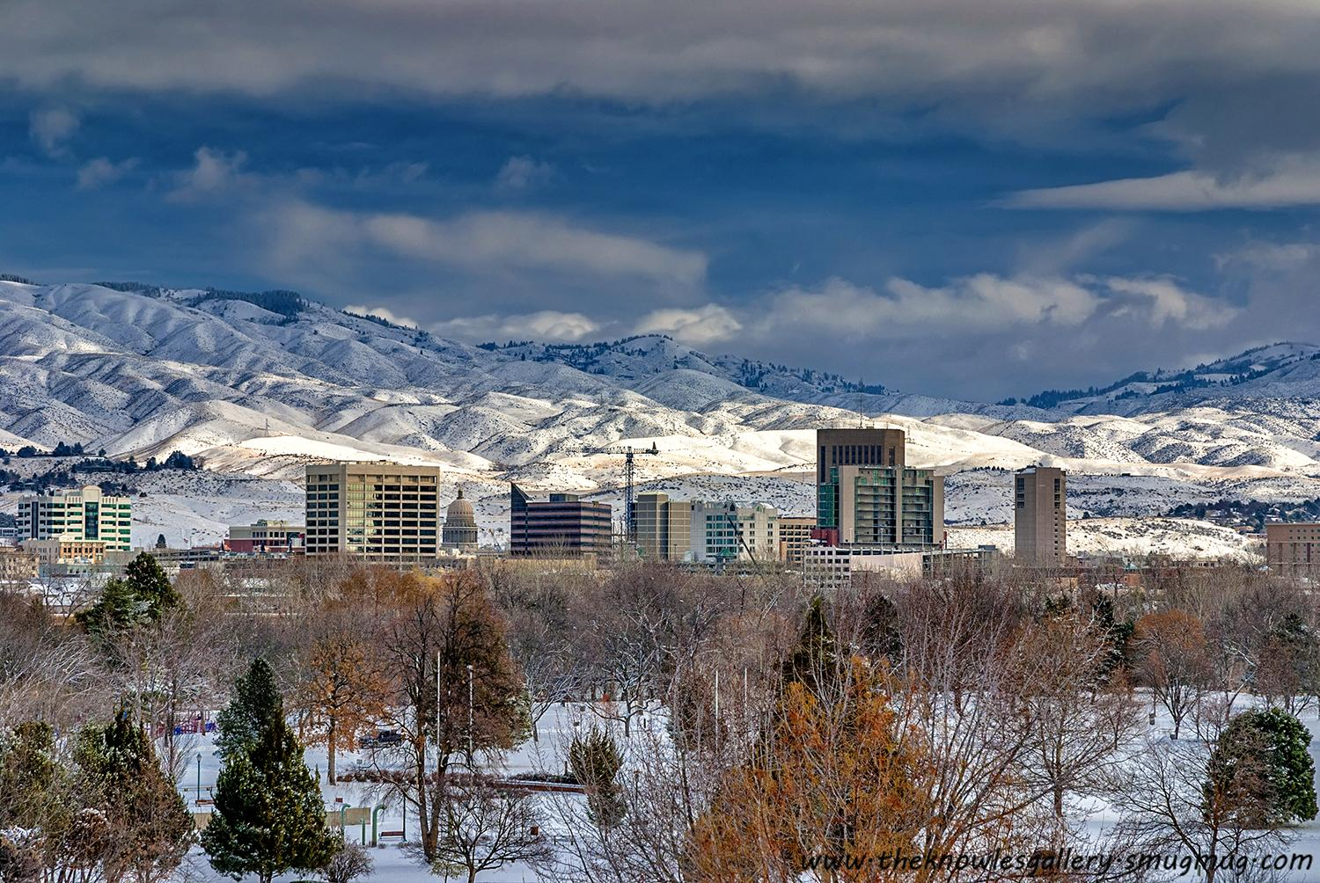
SRM Updates
Hotels are booked!
The Feds
BLM confirmed
Driver Registration
Must give me a copy of their driver's license and complete driver certificate
Ogden Updates?
Dean’s Excuses
Informational Meeting at 5:30 on Tuesday February 7th.

Slide 14
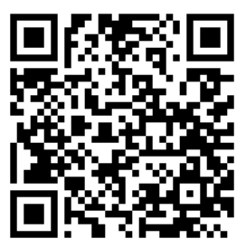
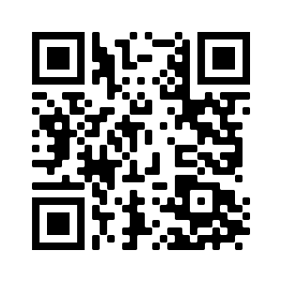

We’re active on Instagram!
@uatierraseca
Join our group me!
Notes:
Remember to pass out list serve form

Slide 15

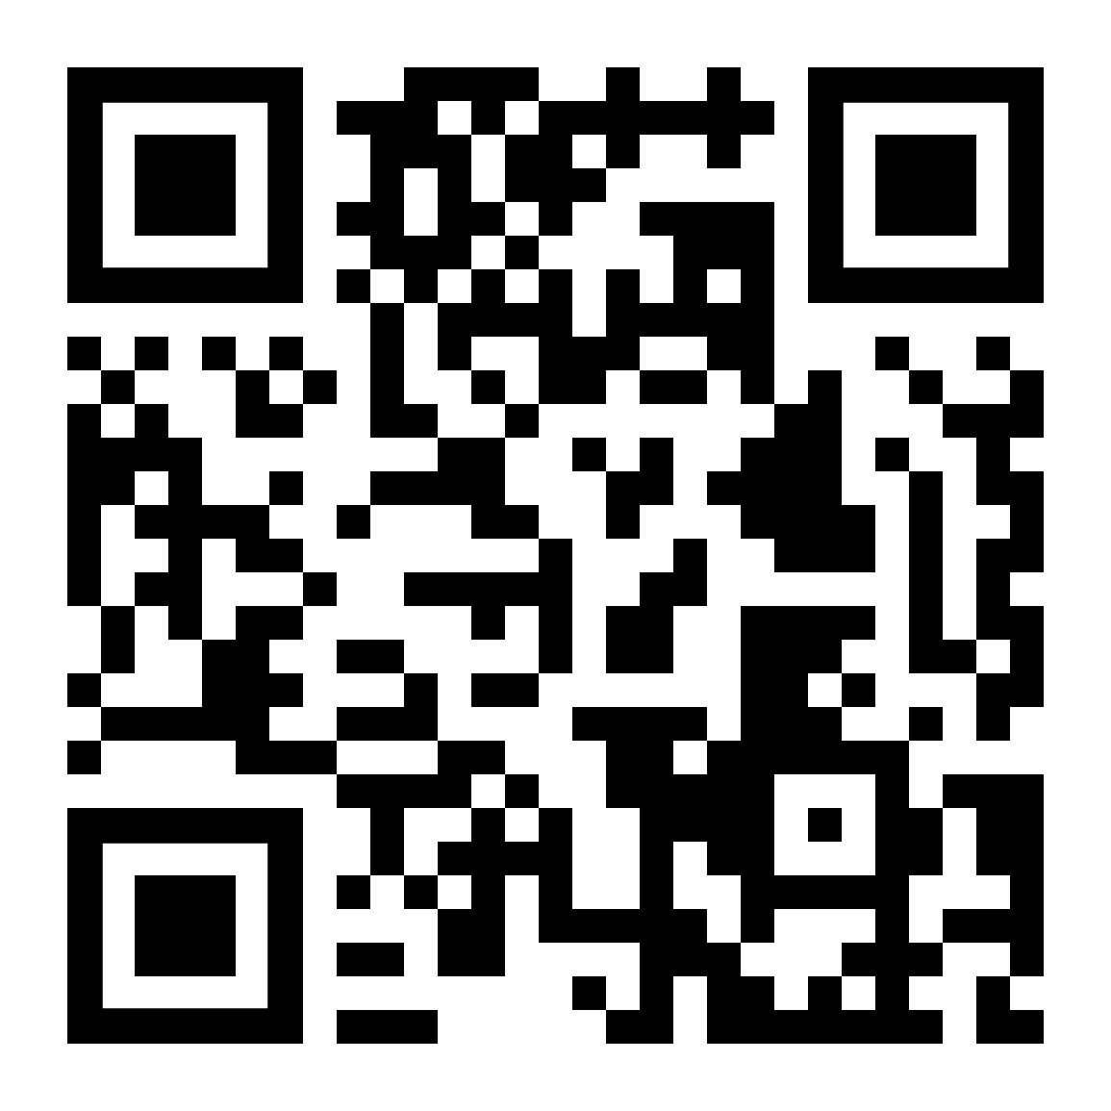
Budget
Venmo QR
Balance: $5900
Club Dues: $15/semester or $30/year
Cash, Venmo, PayPal, Check

Slide 16
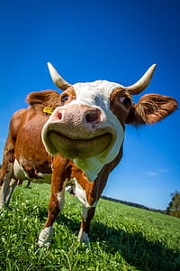
Questions, comments, random thoughts?
Email: uofatierraseca@gmail.com
Good luck with the semester folks!

Slide 17
KNOTS!!!!!!

