Slide 1
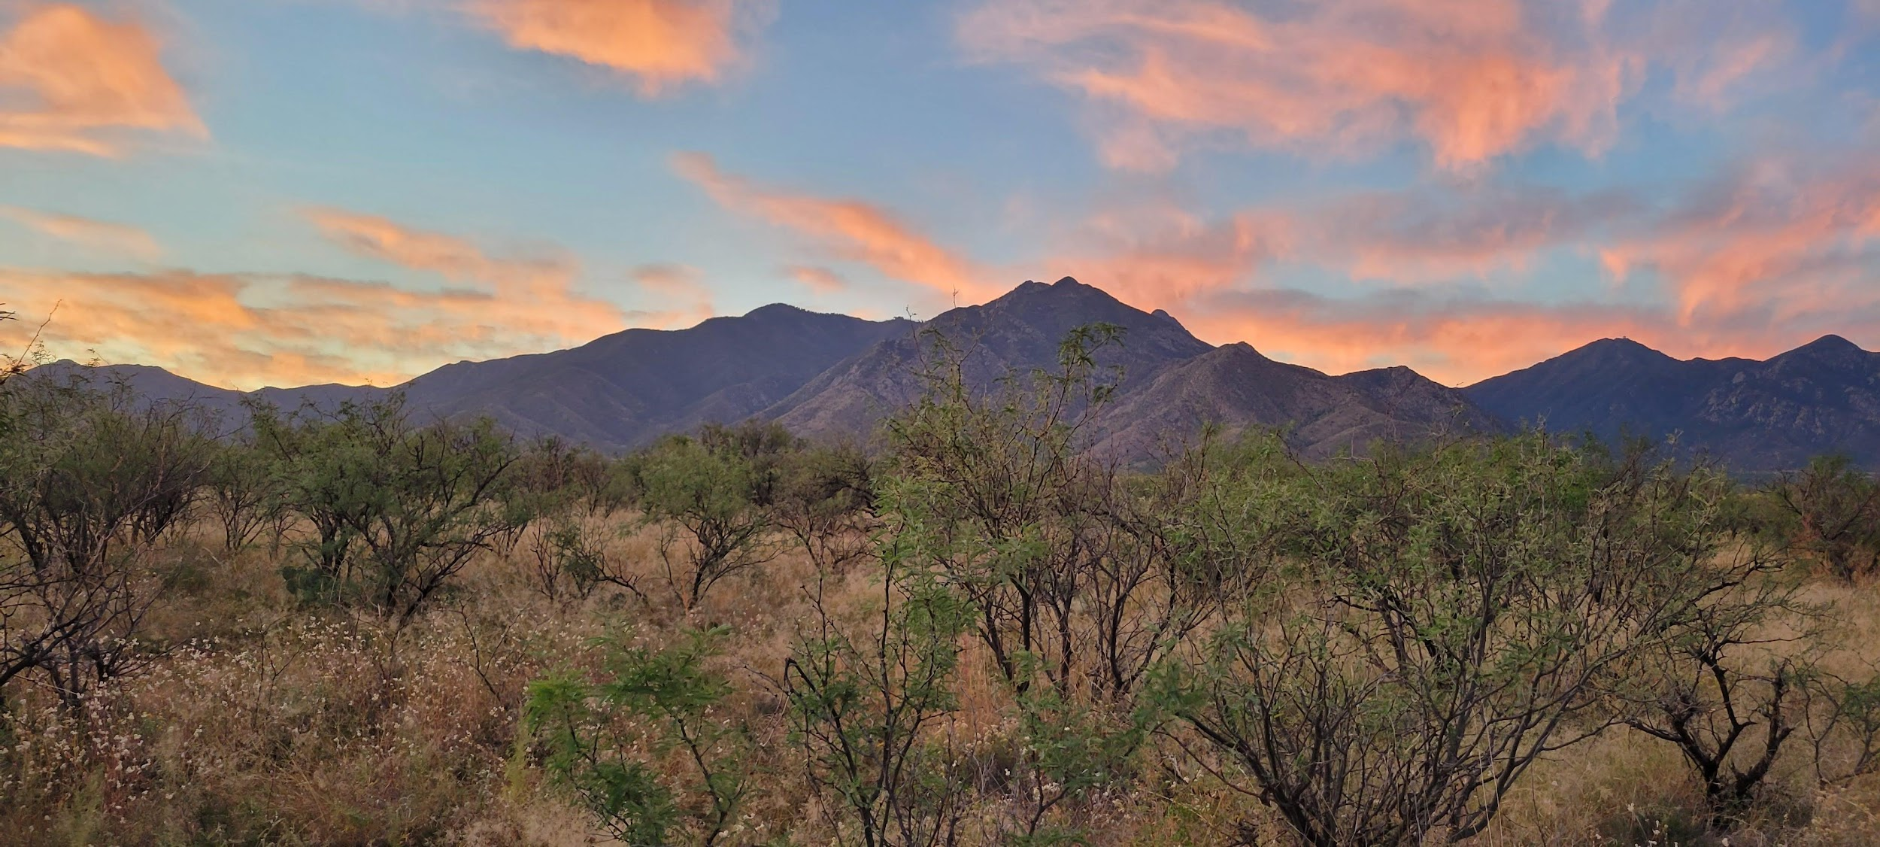


Tierra Seca Meeting 11/22/2022

Slide 2
Agenda
Steer Raffle Updates
Upcoming Events
SRM Updates
Volunteer / Job Opportunities

Slide 3
Meeting Schedule
August 30th
September 13th
September 27th
October 11th
October 25th
November 8th
November 22nd
December 6th
Every other Tuesday: @5:30-6:30 pm, ENR2 room N350

Slide 4

Steer Raffle
Let’s sell these tickets!
We have raffle tickets!!
  One Quarter (~125 LBS): $20 each or 5 for $100
Steer provided by Dennis and Debra Moroney (The 47 Ranch)
  Local beef producer from Bisbee AZ
  Sustainable production, Grass raised and finished!
Drawing on February 7th, 2023.
Information sheet will be attached to meeting minutes!
  Share with friends, family, and everyone else!

Slide 5

AZSRM Bar V Event
Who: Cooperative Extension + AZSRM
What: Producer oriented workshop
Where: Vail, AZ
When: November 30th, 2022 8:30 - 3:00 PM
You need to register in advance (see Dr. Gornish’s email from earlier this week). There is a $20 registration fee.

Slide 6
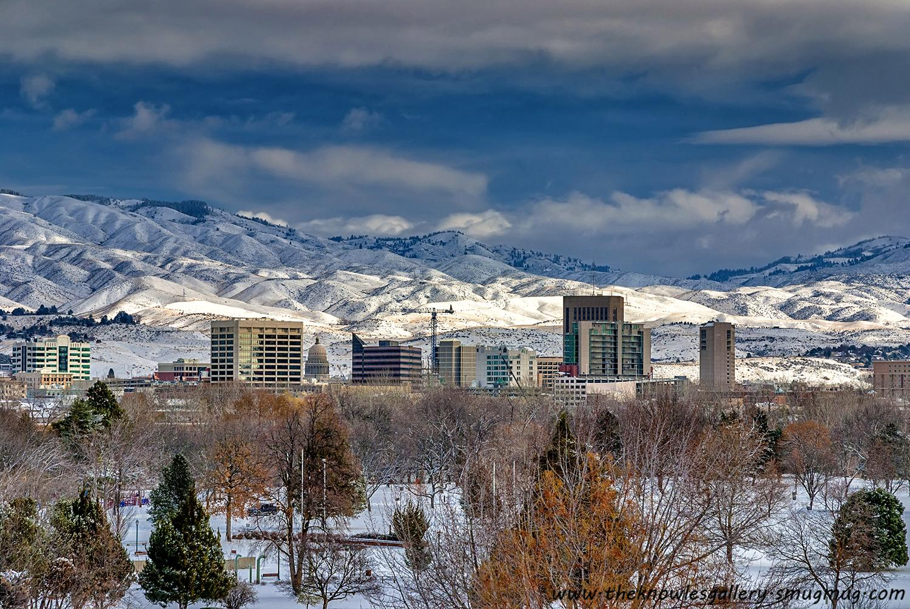
SRM Updates
We finalized Dean’s Excuses!
Working on securing funding
Booking hotel rooms + cars soon!

Slide 7
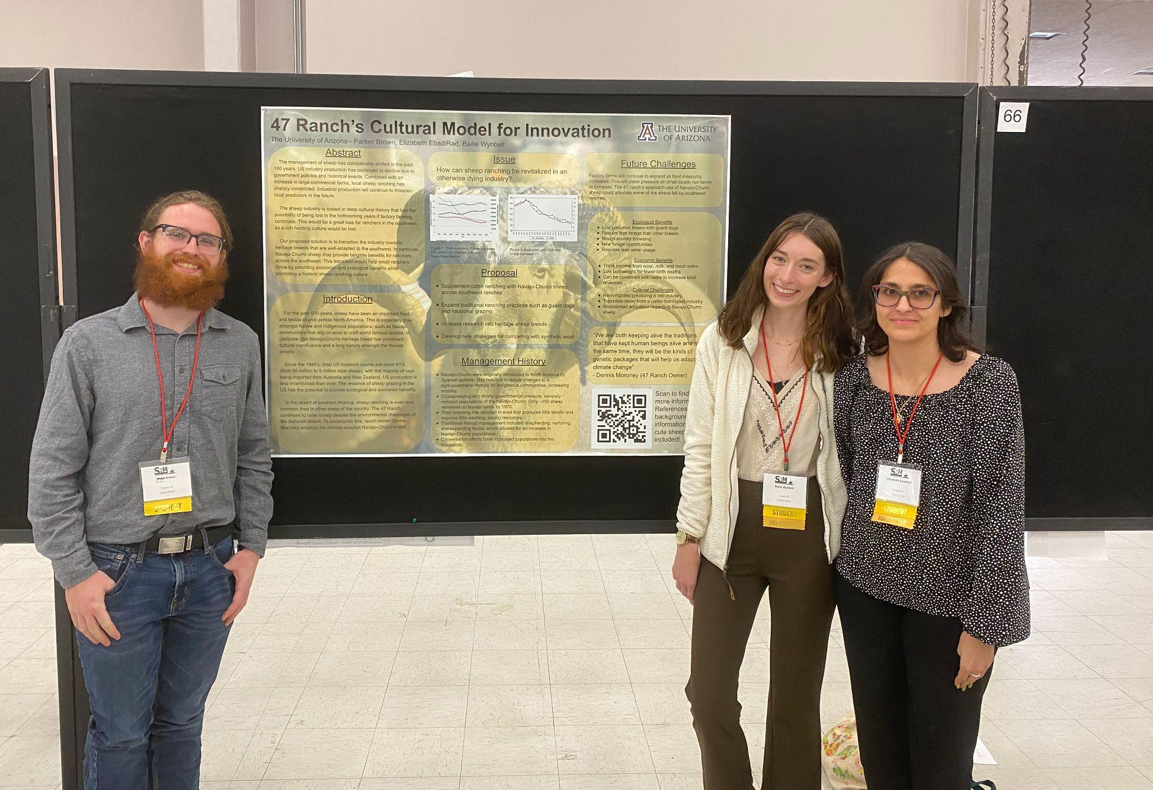
Topic Released for Range Cup
The topic this year is to identify a climate change issue affecting North American rangelands (can be region-specific) and then identify one or more solutions to this problem drawing on data from places outside of North America
Dr. Aaron Lien offered to coach again this year!
1st-3rd place wins a cash prize, and this looks great on a resume
Let us know if you are interested.
Last year’s team! Parker, Bailie, and Elizabeth won 3rd place in 2021.

Slide 8
Ogden Scholarship!
Professional travel scholarship for students to use for SRM
Fill out the application ( survey form) in email form Katie Hughes
Must be filled out by individuals
High likelihood of receiving money to support travel
Deadline is Dec 10th!

Slide 9
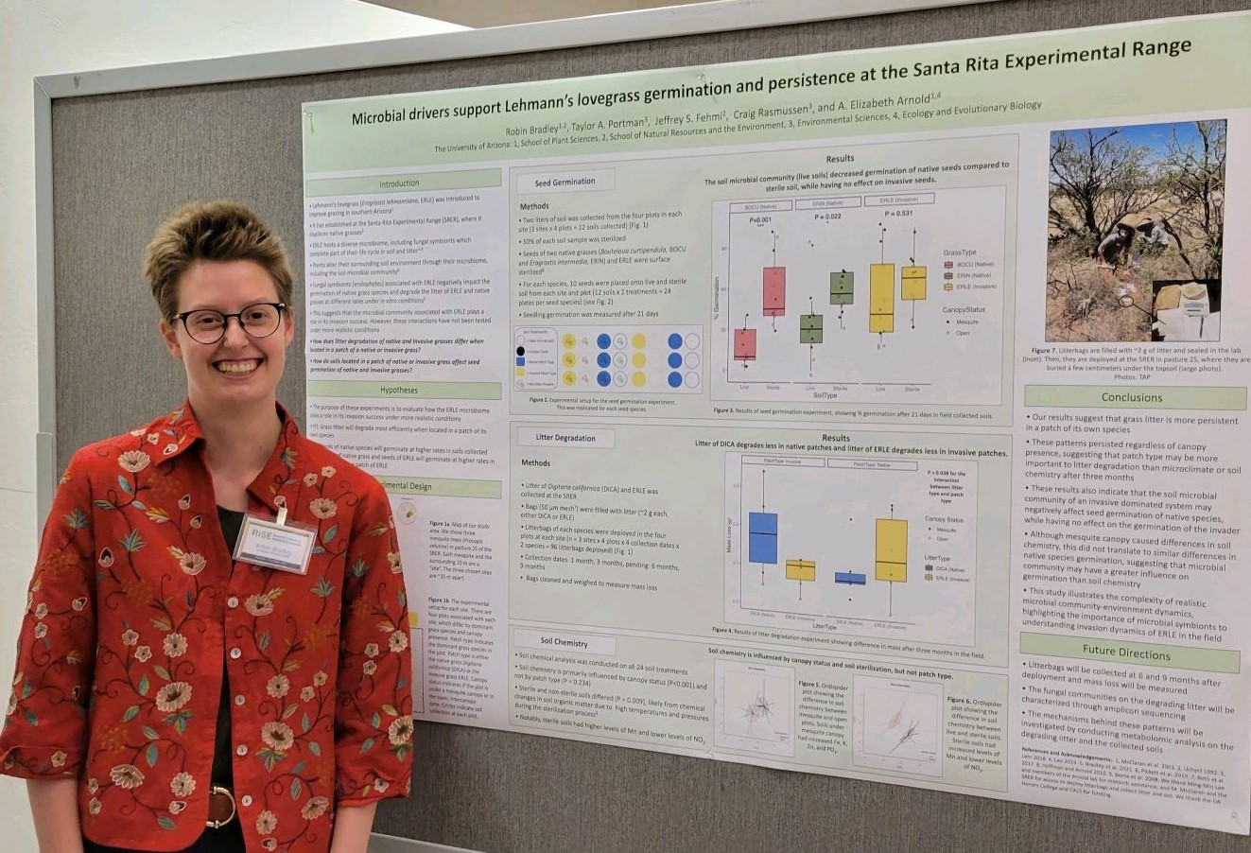
Another congratulation to Robin!
Robin won 1st place at the RISE symposium in the undergraduate poster competition!

Slide 10
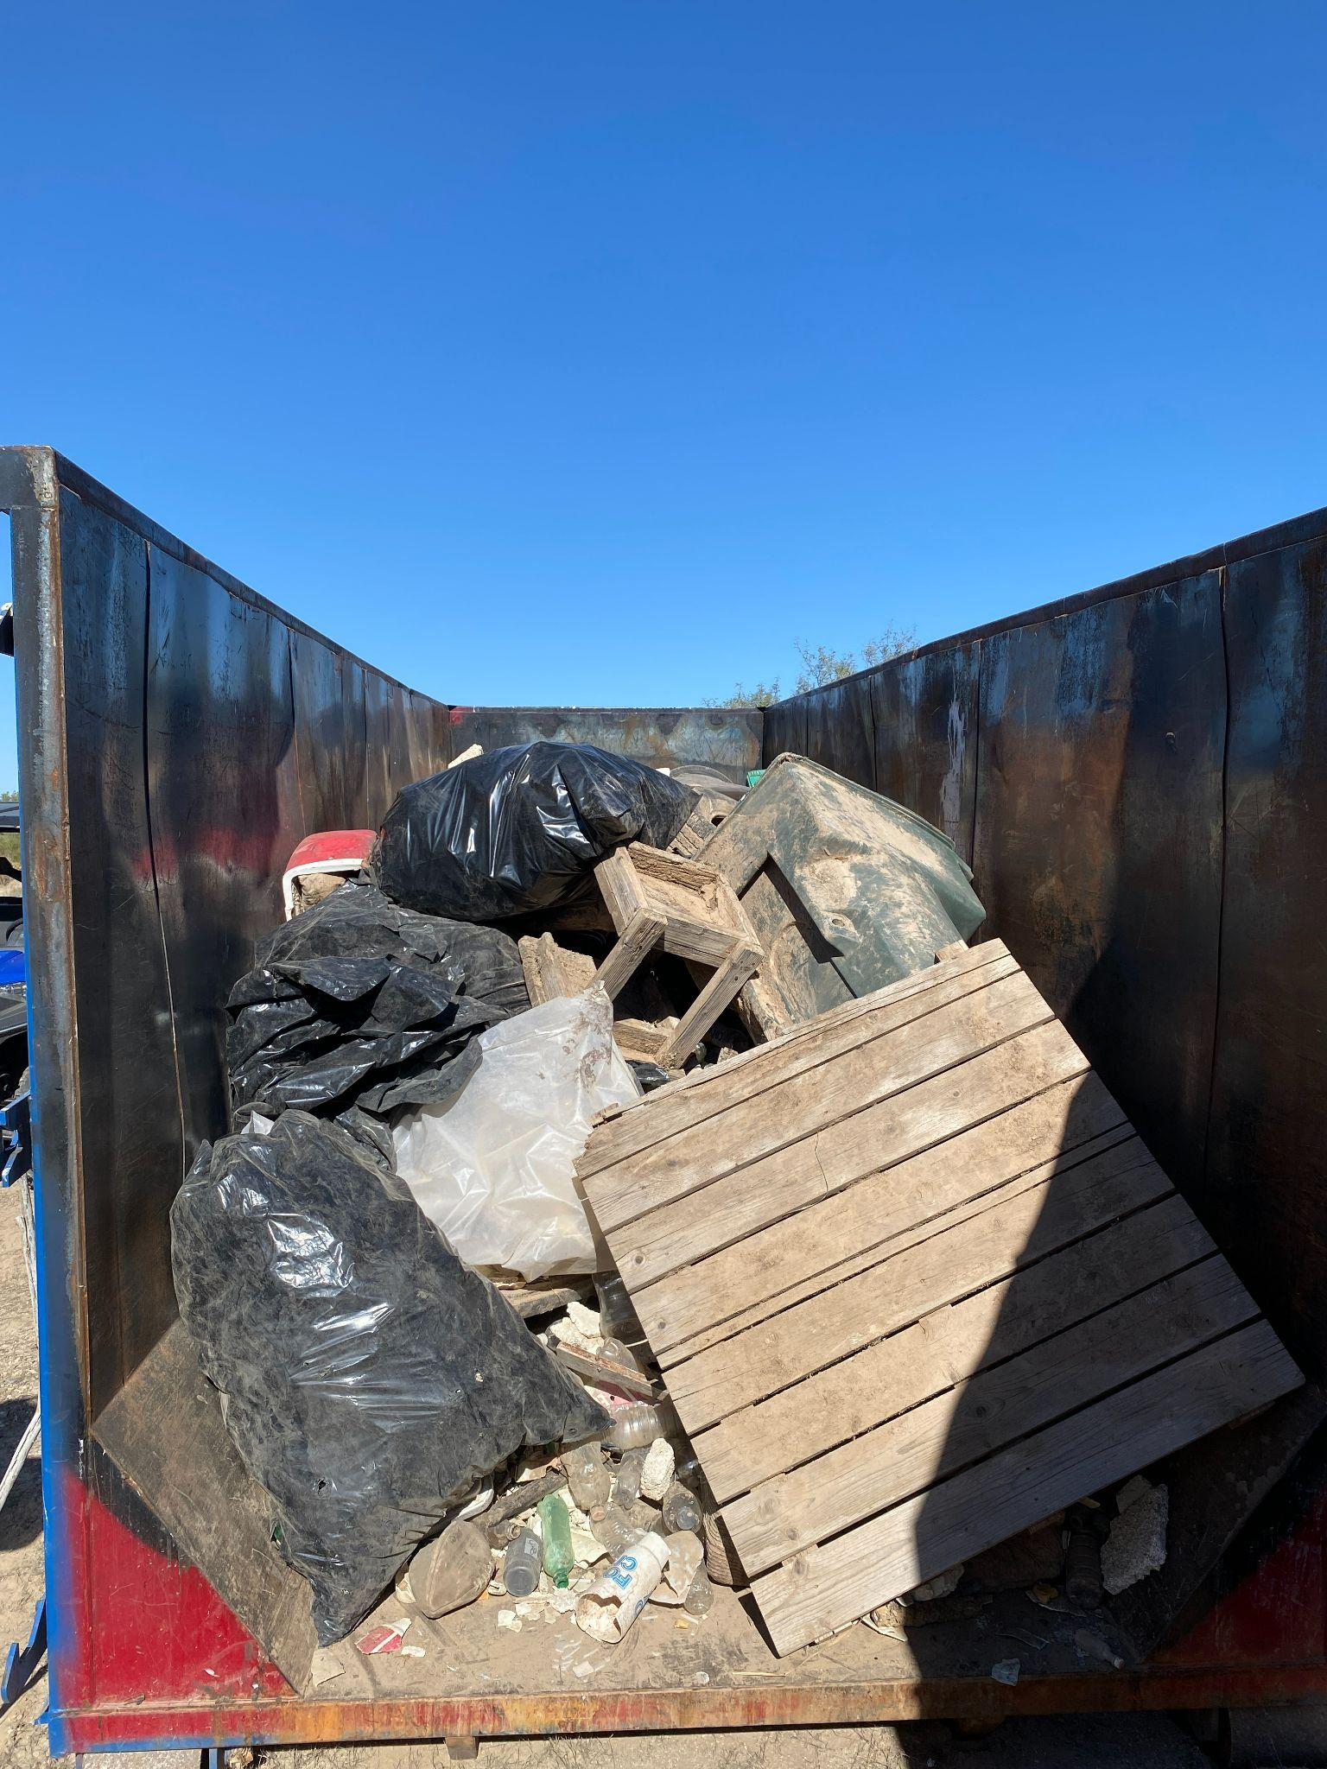
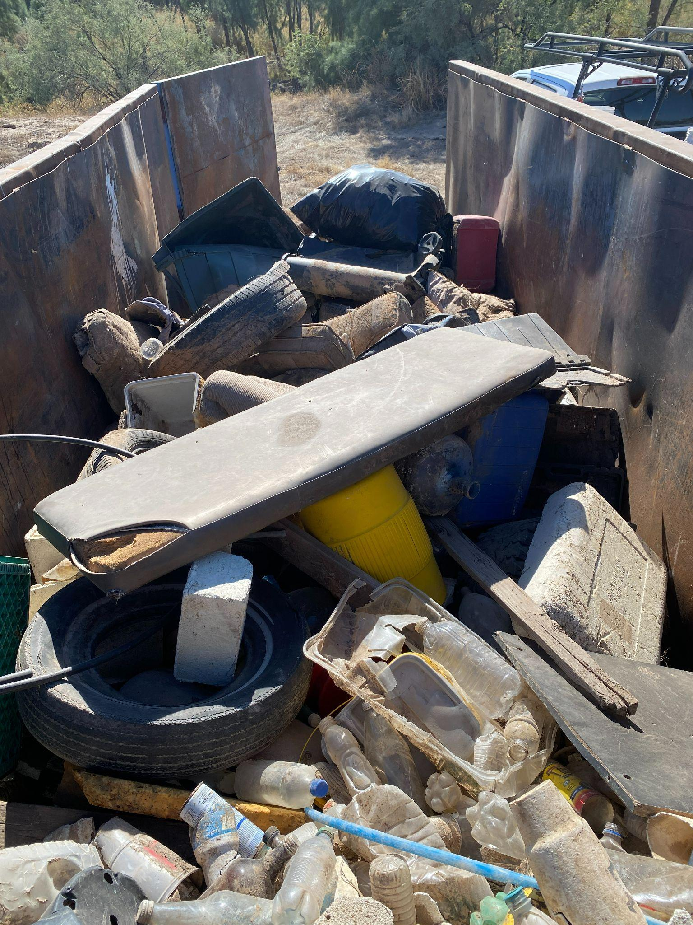
Corazon Trash Clean-up
44 volunteers + 155 volunteer hours !
240 32-gallon trash bags or 16 standard pickup truck loads

Slide 11
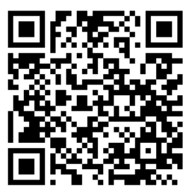
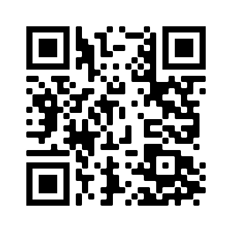

We’re active on Instagram!
@uatierraseca
Join our group me!
Notes:
Remember to pass out list serve form

Slide 12

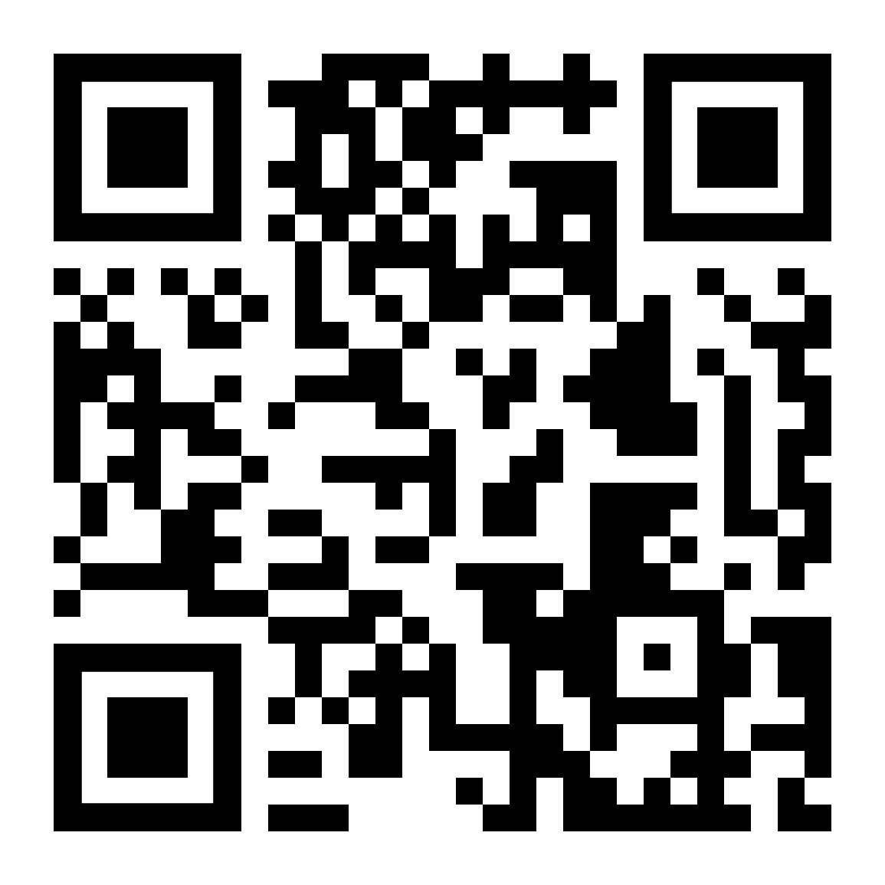
Budget
Venmo QR
Balance: $6,077.12
Club Dues: $15/semester or $30/year
  Cash, Venmo, PayPal, Check

Slide 13

Questions, comments, random thoughts?
Email: uofatierraseca@gmail.com
Have a good break!

