Slide 1
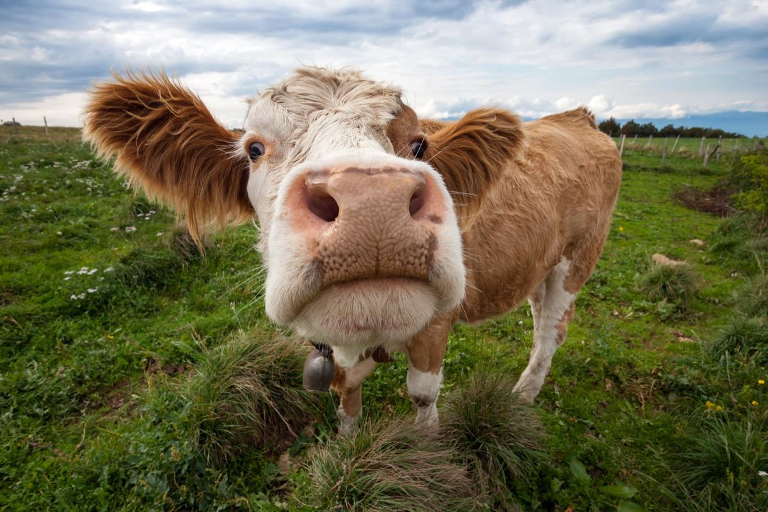


Tierra Seca Meeting 11/08/2022

Slide 2
Agenda
Rise Recap
Steer Raffle Updates
Upcoming Events
Volunteer / Job Opportunities

Slide 3
Meeting Schedule
August 30th
September 13th
September 27th
October 11th
October 25th
November 8th
November 22nd
December 6th
Every other Tuesday: @5:30-6:30 pm, ENR2 room N350

Slide 4

Steer Raffle Updates!
We have raffle tickets!!
One Quarter (~125 LBS): $20 each or 5 for $100
Steer provided by Dennis and Debra Moroney (The 47 Ranch)
Local beef producer from Bisbee AZ
Sustainable production, Grass raised and finished!
Drawing on February 7th, 2023.
Information sheet will be attached to meeting minutes!
Share with friends, family, and everyone else!

Slide 5

AZSRM Bar V Event
Who: Cooperative Extension + AZSRM
What: Producer oriented workshop
Where: Vail, AZ
When: November 30th, 2022 8:30 - 3:00 PM
Dean’s Excuse info due by Tuesday November 8th. Student ID + Full Name emailed to club.
Sign Up: https://docs.google.com/spreadsheets/d/1gO911fPmsCxOQNzQTR9UGNn7z9rOmoBqCiS7mk-P8Eo/edit?usp=sharing

Slide 6

Volunteering opportunities
Watershed clean-up! Corazón project
When: Saturday, November 19, 2022 from 8 am - 12 pm
Where: West of I-10 along N Silverbell Road
Additional information: There will be a 20’ long garbage rollout available and, depending on volunteer turn out, some parking space (although we strongly encourage carpooling).
Email: Wynbeltb@arizona.edu or Rhianyon@arizona.edu for more information and to be added
Scan QR code to sign up!! :)

Slide 7

Spring 2023 Classes
Plant Communities (RAM 384 Spring)
TuTh 11:00AM - 11:50AM
Grazing Ecology (RAM 436 Spring)
TuTh 10:00AM - 10:50AM
Wildland Restoration (RAM 446 Spring)
MoWeFr 10:00AM - 10:50AM
Rangeland Planning (RAM 487 Odd Spring)
We 2:00PM - 4:50PM
Calving Management (ACBS 397A Spring)
We 8:00AM - 10:00AM
Beef Resource Management (ACBS 477 Spring)
TuTh 8:00AM - 9:15AM
Course Checklist and OPM:
https://nature.arizona.edu/undergraduate/ecology-management-restoration-rangelands

Slide 8
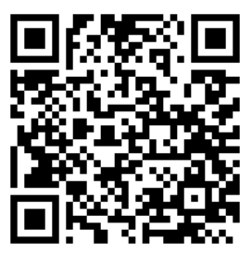
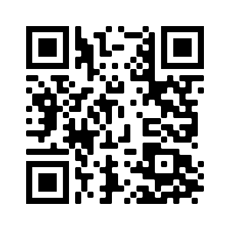

We’re active on Instagram!
@uatierraseca
Join our group me!
Notes:
Remember to pass out list serve form

Slide 9

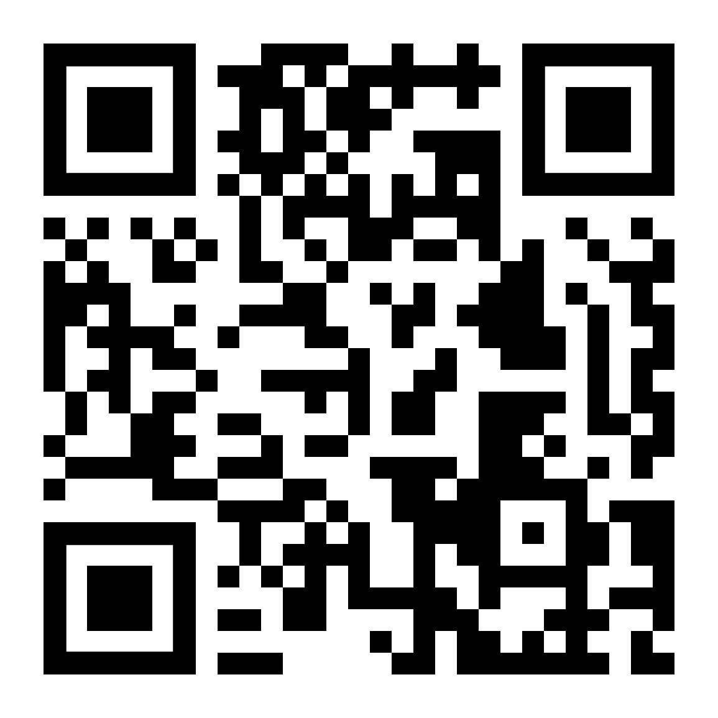
Budget
Venmo QR
Balance: $6,437.12
Club Dues: $15/semester or $30/year
Cash, Venmo, PayPal, Check

Slide 10
Questions?
Email: uofatierraseca@gmail.com

