Slide 1


Tierra Seca Meeting 10/11/22

Slide 2
Agenda
Santa Rita Recap
SRM Updates
Kickball Updates
Volunteer / Job Opportunities
KNOTS

Slide 3
Meeting Schedule: Half Way Through!
August 30th
September 13th
September 27th
October 11th
October 25th
November 8th
November 22nd
December 6th
Every other Tuesday: @5:30-6:30 pm, ENR2 room N350

Slide 4
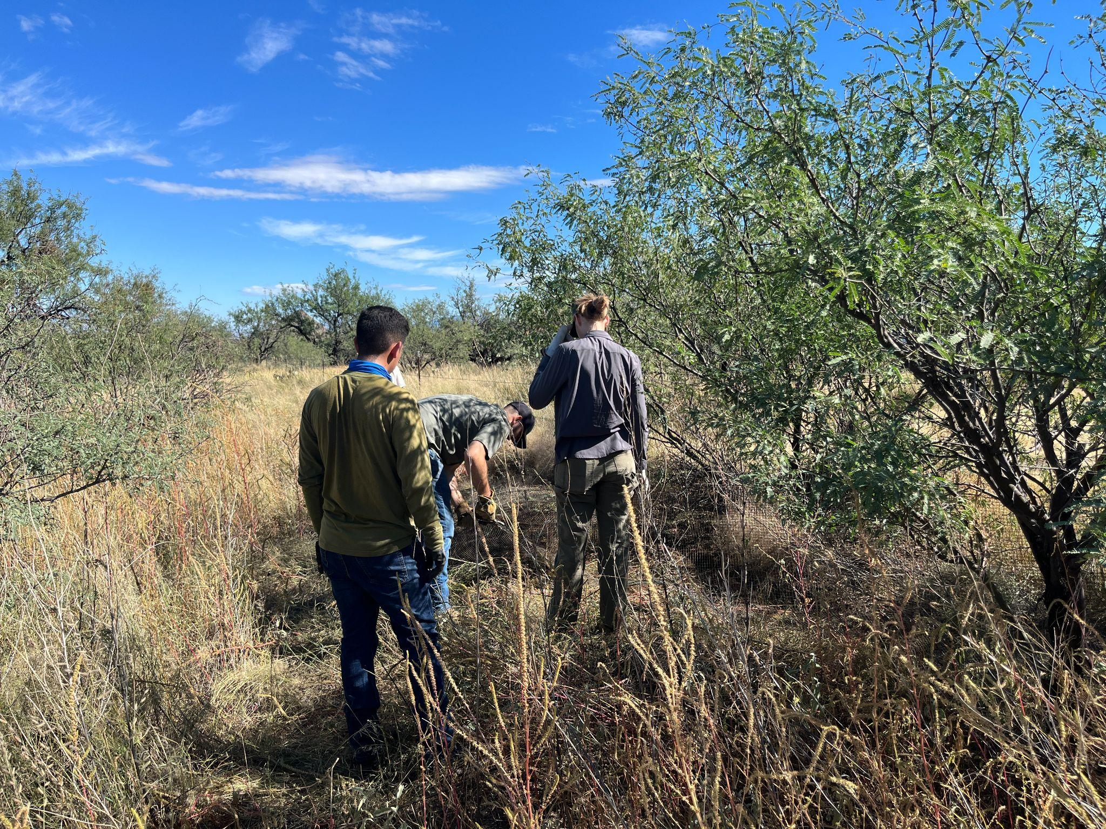
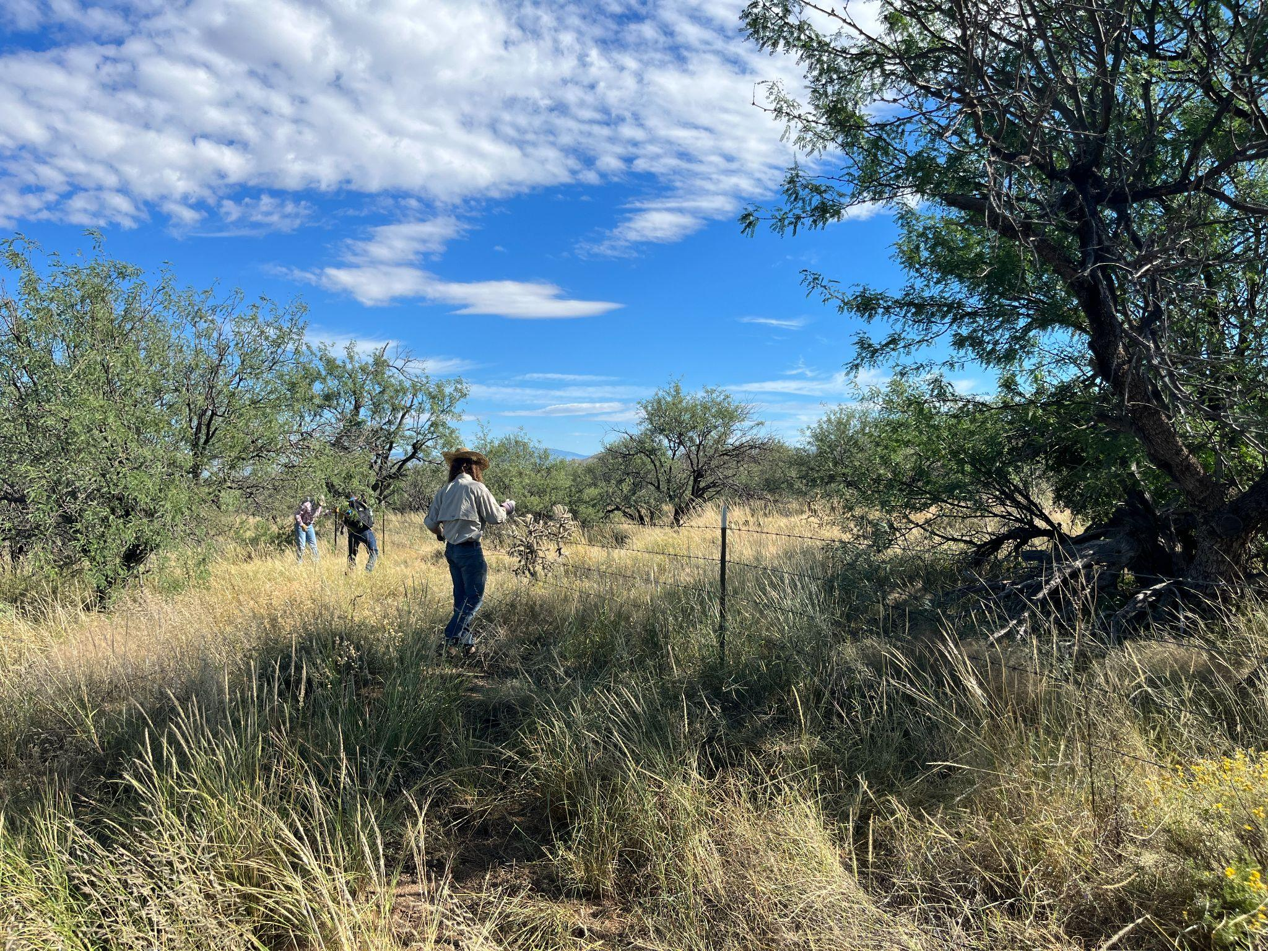
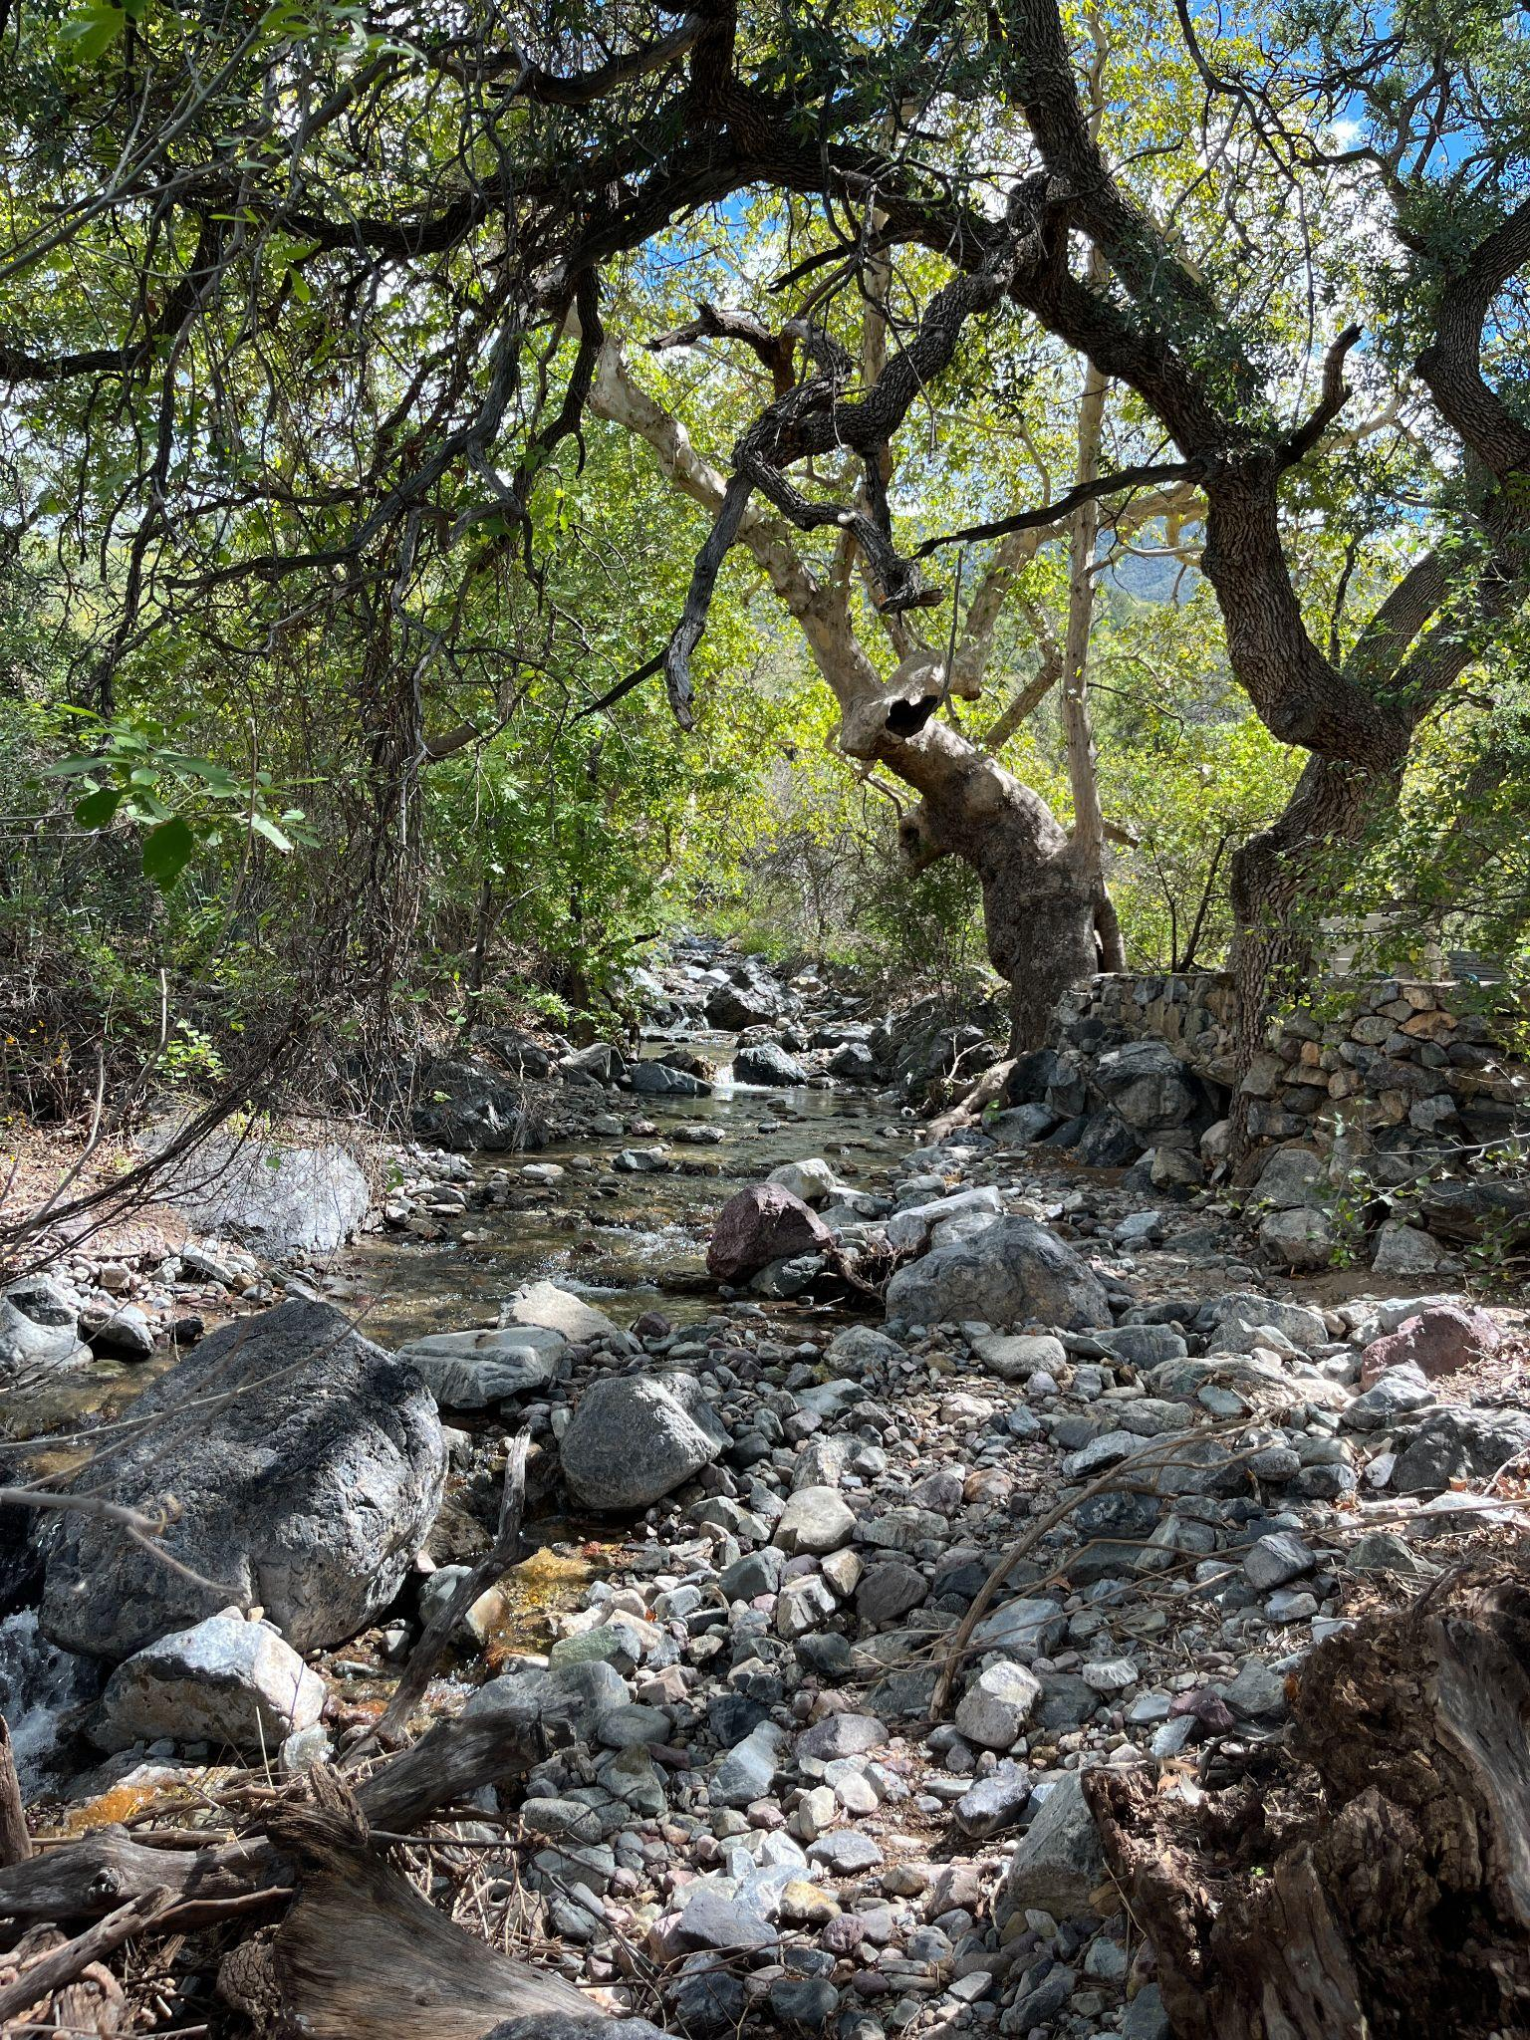
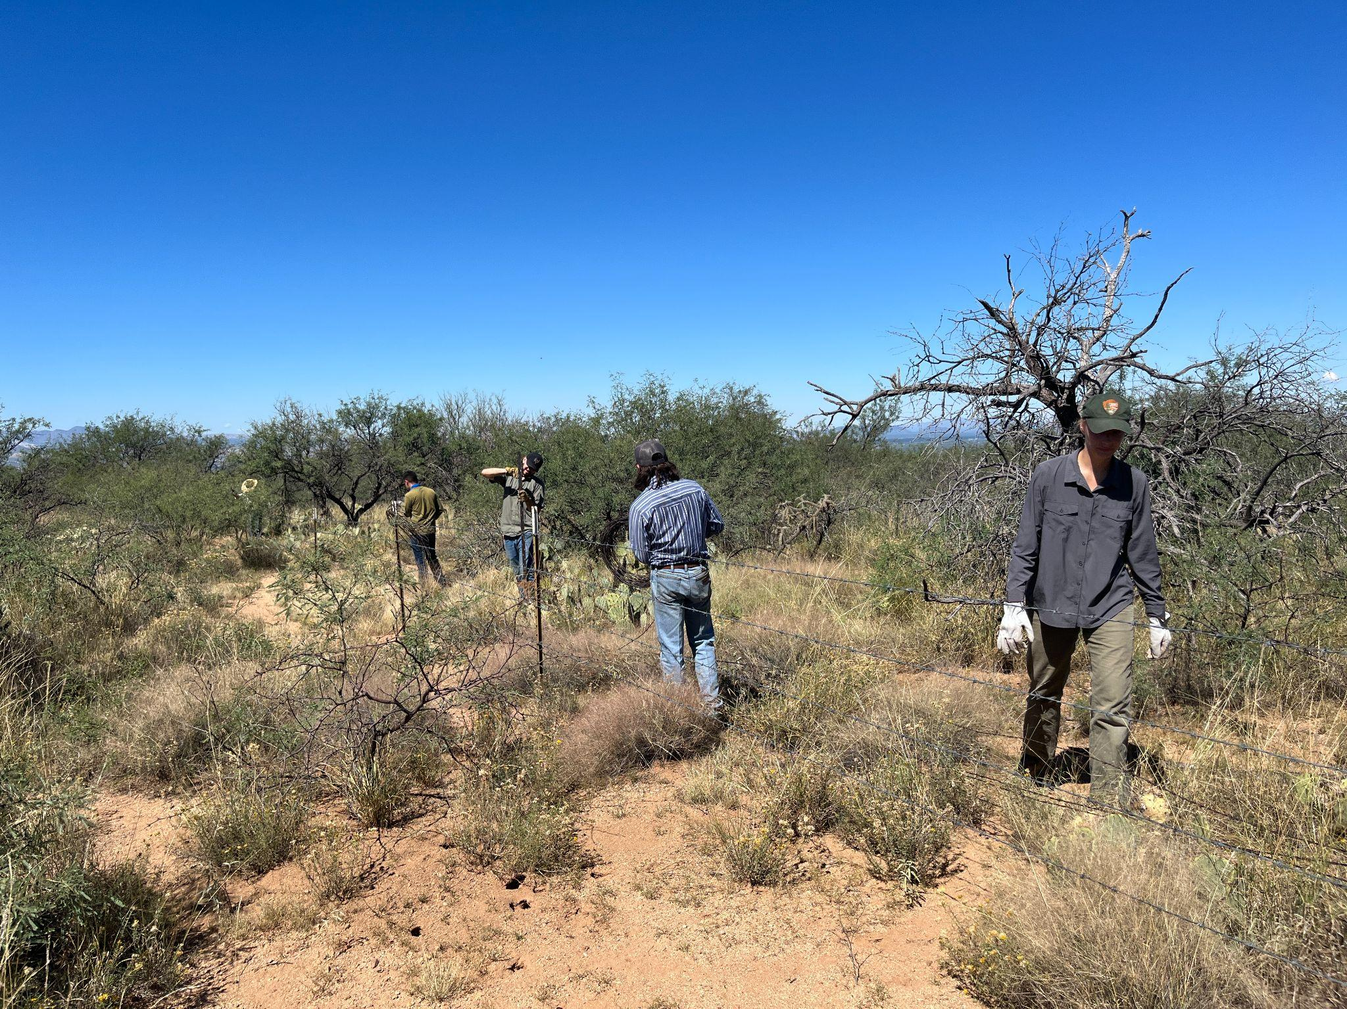
Santa Rita Recap

Slide 5
SRM Updates
URME Study Group!
Meets after Tierra Seca meetings, 6:30 - 7:30.
Via Zoom on Tuesdays without Tierra Seca meetings.
Call for Range Cup Team
Question TBD
SRM Contract
Due October 24th, but ASAP is appreciated!
https://docs.google.com/document/d/16SBmMxlwLC_I5xrUYhc94HW-NSg83Auhi0G_GJsQ7Fc/edit
Driving to Boise?!

Slide 6
Tierra Seca Versus Fish & Wildlife Kickball
Tierra Seca Versus Fish & Wildlife Kickball Event
Who: Club Showdown: Tierra Seca VS Fish and Wildlife
What: Kickball game
Where: Jacobs Park
3300 N Fairview Ave, Tucson, AZ 85705
When: Friday, October 14th. 6-8 PM
Sign Up Sheet:
https://docs.google.com/spreadsheets/d/1wQ-UqUC4HSuS8sXBDLIx-pXLMrz8JN2FQ1qnlfZnXCU/edit?usp=sharing

Slide 7
Volunteer Opportunities!
Elkhorn / Las Delicias Monitoring
Who: Altar Valley Conservation Alliance
Partnering with NRCS and others!
What: Photo monitoring of the vegetation and channel morphology!
Where: Elkhorn Ranch (Near Three Points, AZ)
When: Friday, October 21st (8:00 AM - 3:00 PM).
Sign Up Sheet: https://docs.google.com/spreadsheets/d/1xz7gWu0U30PkwxNdznyeQ8sfduvQ8PWkjsj74pdYxZk/edit?usp=sharing
Location: https://g.page/ElkhornRanchTucsonAZ?share

Slide 8
Arroyo Chico Wash Clean Up #2
Who: SNRE Clubs
What: Trash pickup for our adopted wash.
Where: Corner of S. Highland and E. 14th St.
When: Sunday Morning, October 23rd
Sign Up: https://docs.google.com/spreadsheets/d/1HJgqQl92SSpE91PxAim8e7xAR8jqXh7KW3ZBf9oMTq4/edit?usp=sharing
Meet Up Location: https://goo.gl/maps/UgFYppKQ2No482qA7

Slide 9
Volunteer Opportunities!
BLM monitoring event at Empire Ranch
Who: Bureau of Land Management, NRCS (Natural Resource Conservation Agency)
Other Professional groups will be attending.
What: Photo monitoring of the vegetation and channel morphology of Las Cienegas uplands!
Where: Sonoita, AZ (Empire Ranch)
When:
Tuesday, October 4th
Wednesday, October 5th
Tuesday, October 25th
Sign Up Sheet: https://docs.google.com/spreadsheets/d/1mhWhpGls_201PE4BA3uDWIu0UmBrmRk-NvBmh_HSgt4/edit?usp=sharing
Location: https://goo.gl/maps/a3mKY6U3bJzGDj82A

Slide 10
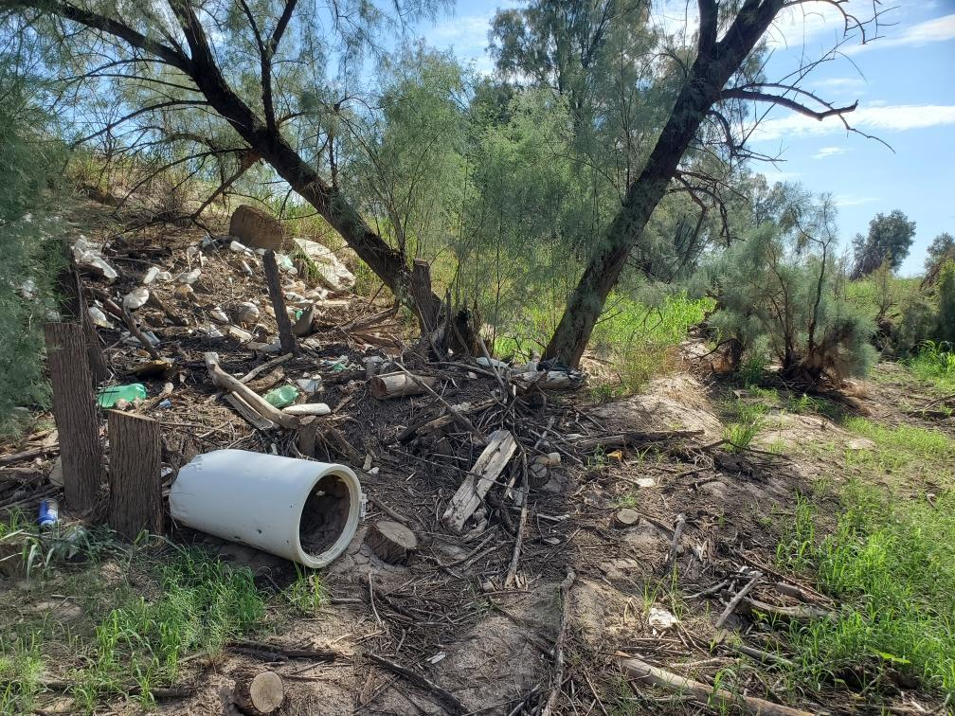
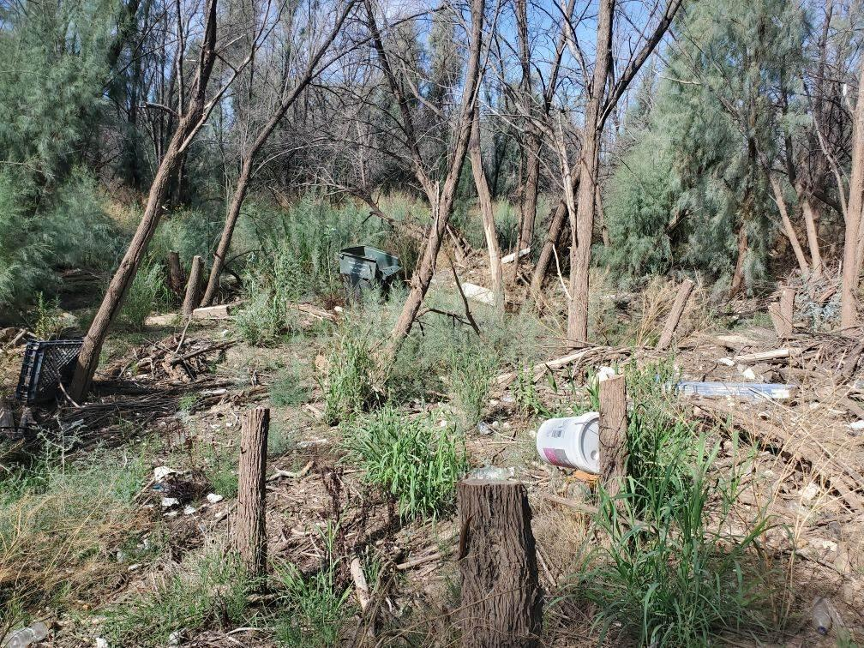
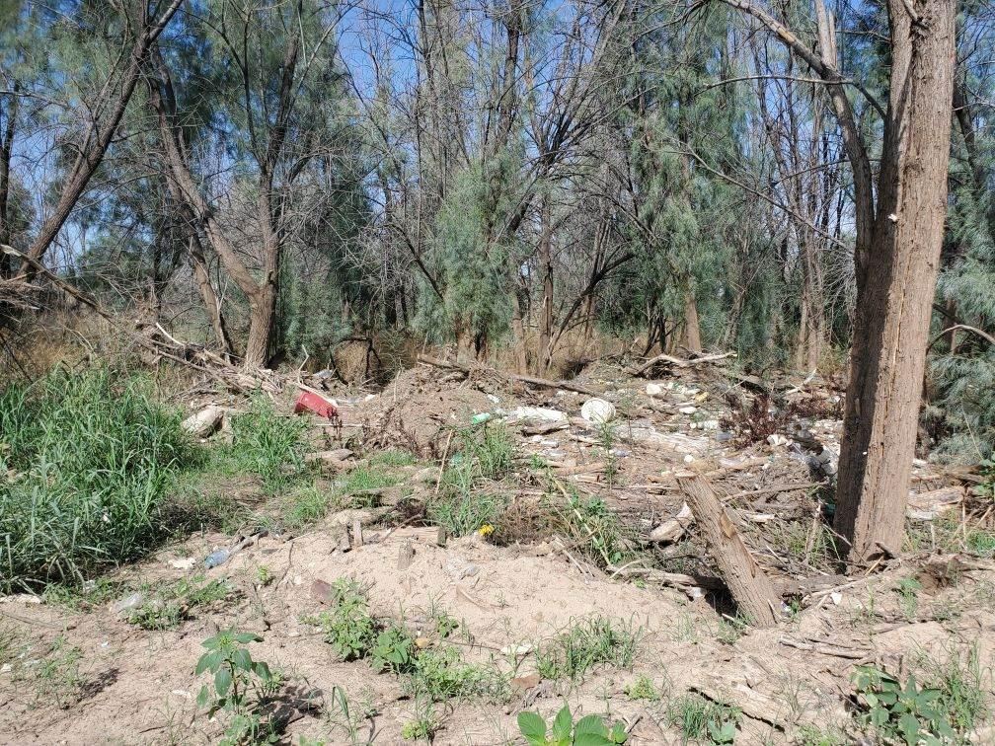
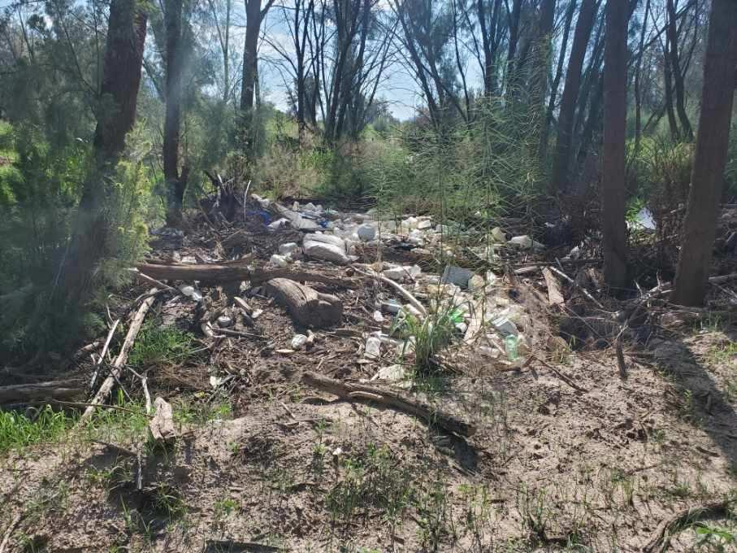
Volunteering opportunities
Watershed clean-up! Corazón project
When: Saturday, November 19, 2022 from 8 am - 12 pm
Where: West of I-10 along N Silverbell Road
Additional information: There will be a 20’ long garbage rollout available and, depending on volunteer turn out, some parking space (although we strongly encourage carpooling).
Email: Wynbeltb@arizona.edu or Rhianyon@arizona.edu for more information and to be added to the volunteer list!

Slide 11
Job Opportunities
The Resilience Internships and Student Experiences (RISE) Program is now recruiting student for 4 open internship opportunities starting in Spring 2023! There are 3 different opportunities with the Bureau of Land Management and 1 with the Pima County Department of Environmental Quality. Each opportunity will be compensated through UArizona and will pay students $18/hour.
To find out more about these internships, visit the RISE website. If you have any questions, please reach out to RISE Program Coordinator, Maria Johnson, at mariaaj13@arizona.edu.

Slide 12

Job Opportunities

Slide 13
Club Schwag!!!
Stay tuned for updates!
Can expect more swag before the end of the semester!!!!

Slide 14
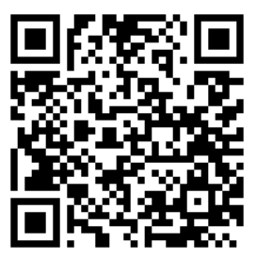
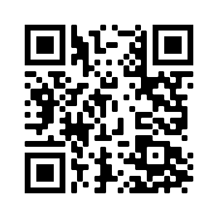

We’re active on Instagram!
@uatierraseca
Join our group me!
Notes:
Remember to pass out list serve form

Slide 15

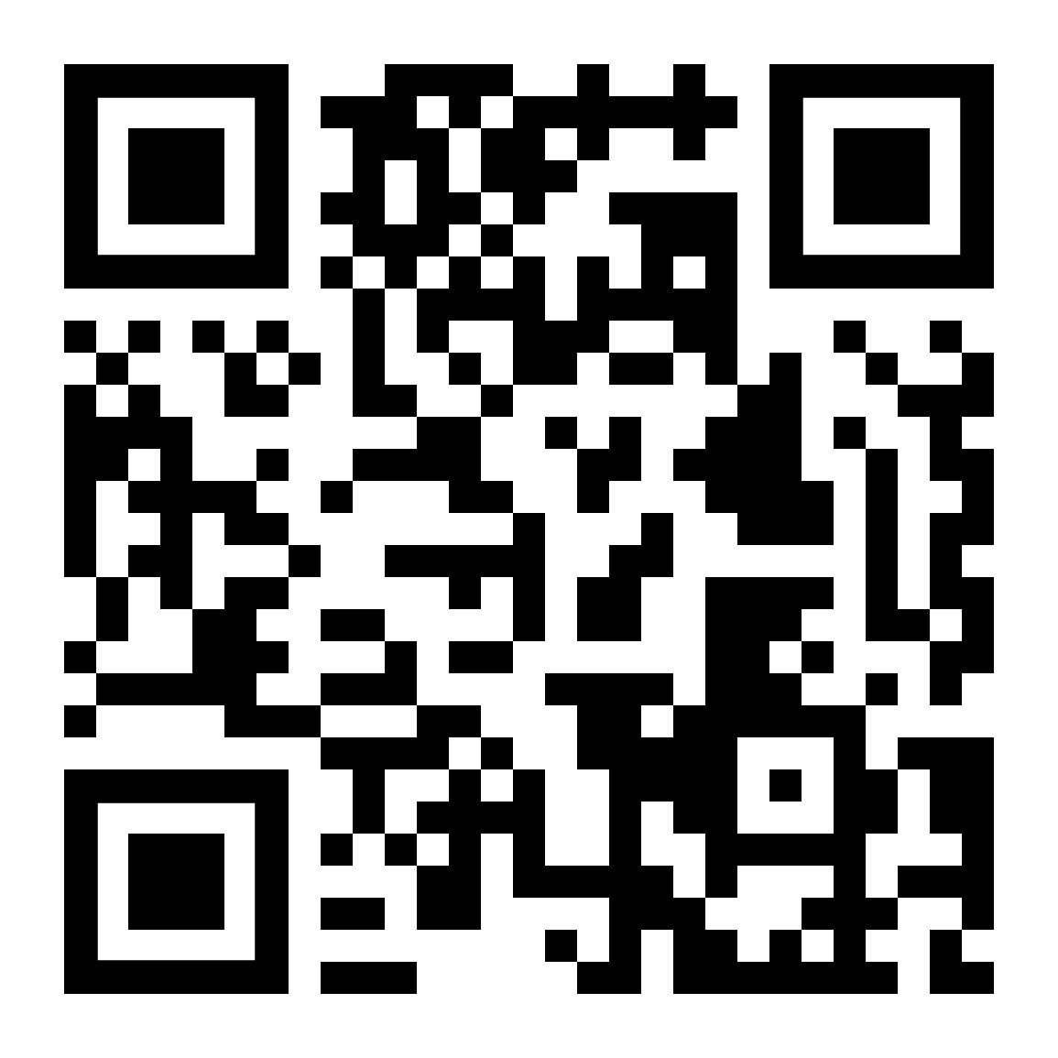
Budget
Venmo QR
Balance: $5196.09
Club Dues: $15/semester or $30/year
Cash, Venmo, PayPal, Check

Slide 16
Questions?
Email: uofatierraseca@gmail.com

