Slide 1


Tierra Seca Meeting 9/27/22

Slide 2
Agenda
Dr. Alessandra Gorlier Presentation
URME and Plant ID
Upcoming Speakers
Job and volunteer opportunities
Questions

Slide 3
Meeting Schedule
August 30th
September 13th
September 27th
October 11th
October 25th
November 8th
November 22nd
December 6th
Every other Tuesday: @5:30-6:30 pm, ENR2 room N350

Slide 4
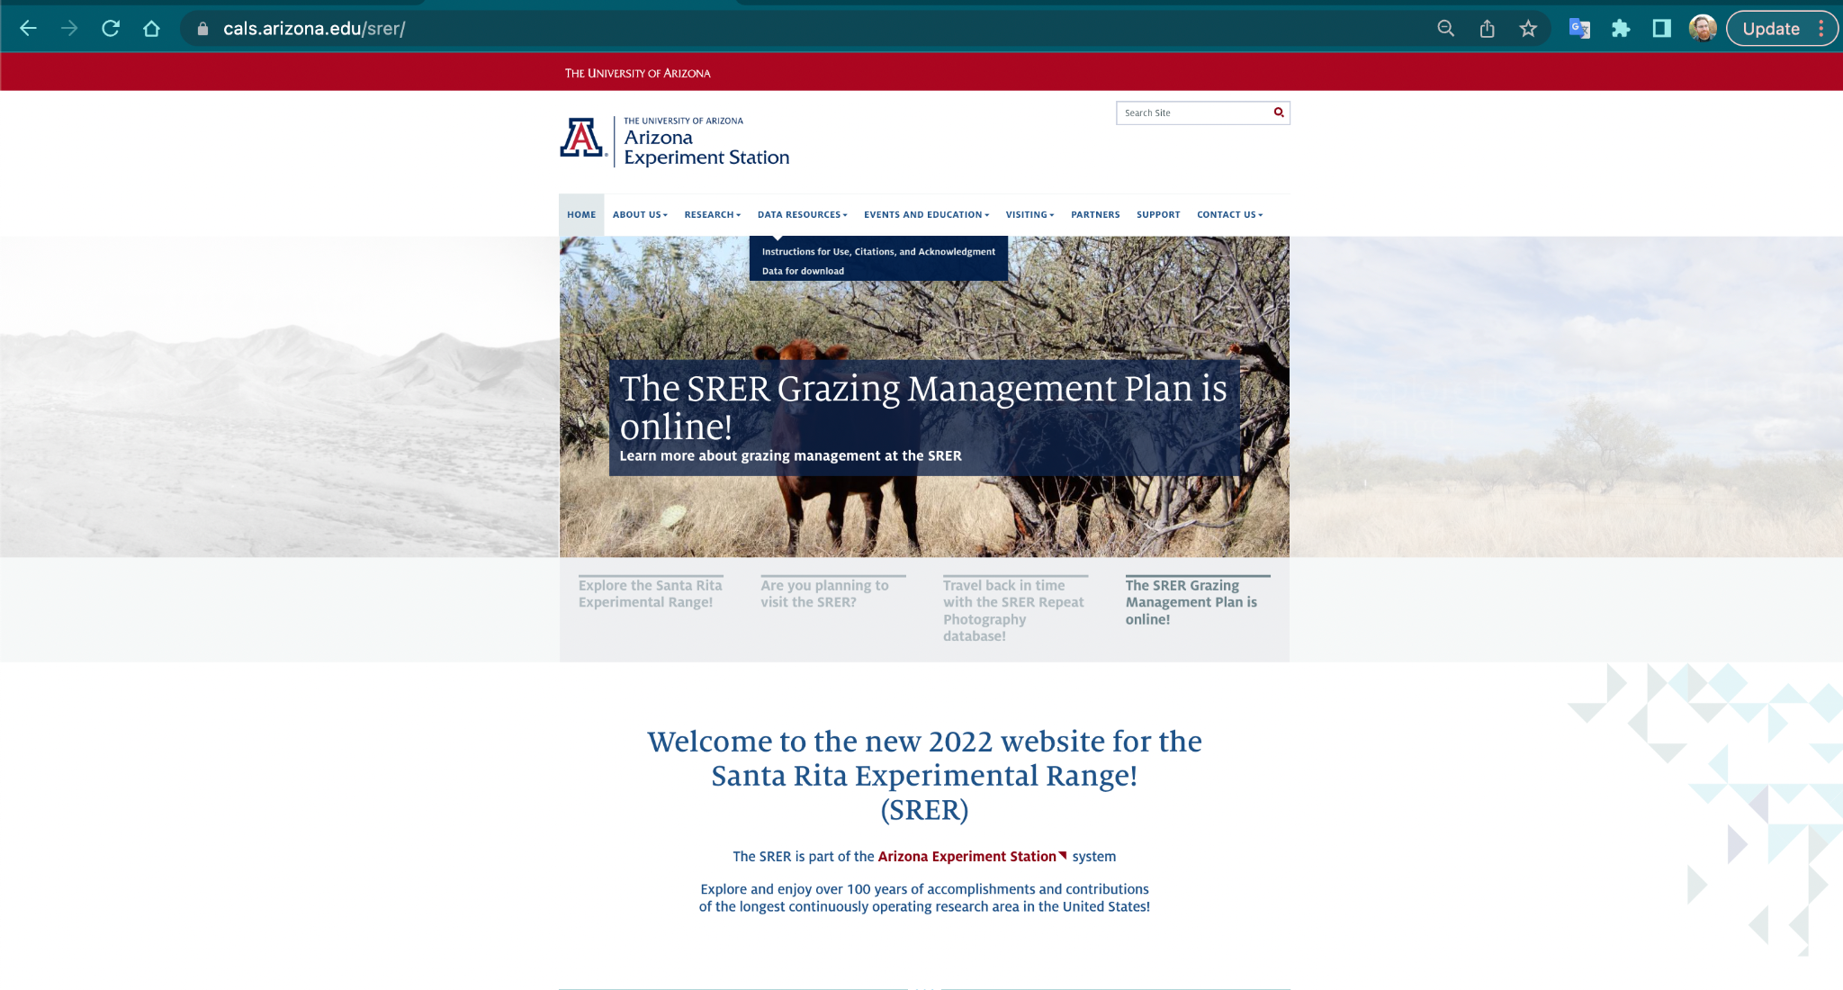
Guest Speaker Dr. Alessandra Gorlier

Slide 5

URME Updates!

Slide 6
Events to Look Forward To
Tierra Seca Versus Fish & Wildlife kickball event Date October 14th 6-8pm
Guest Speaker Appearances
Presentations < 30 minutes
Dr. Alessandra Gorlier Santa Rita Research
Iric Burden
October 11
Vanessa Prileson + Liz Delcamp (Pima County Range)
November 22nd
Volunteer Opportunities
Santa Rita Visit (October 2nd)
Elkhorn Monitoring Event (October 21st)
Empire Ranch Monitoring (October 4th, 5th, and 25th)

Slide 7
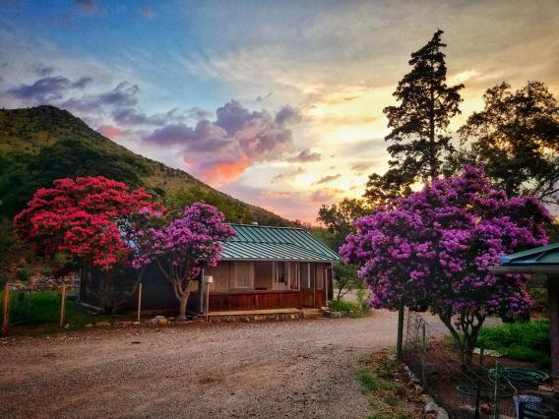
Santa Rita Experimental Station (SRER) Visit
Who: Tierra Seca + Hector Justiniani (SRER Manager)
What: Buffelgrass or Fencing work
Where: Florida Station, Santa Rita Experimental Range
When: Sunday, October 2nd. Meet at 8am.
Sign Up Sheet: https://docs.google.com/spreadsheets/d/1xcnhaasaUqjszyLNqrP1MF0cENze4XeucyOoXzwThiY/edit?usp=sharing

Slide 8
Fish and Wildlife Persuasive Letter Event
Who: Fish and Wildlife Club + Tierra Seca
What: Persuasive letter workshop to Pima County to alleviate dumping problems around areas such as Arroyo Chico
Where: ENR2 Room N350
When: Tuesday, October 4th @ 5:30 PM

Slide 9
Volunteer Opportunities!
BLM monitoring event at Empire Ranch
Who: Bureau of Land Management, NRCS (Natural Resource Conservation Agency)
Other Professional groups will be attending.
What: Photo monitoring of the vegetation and channel morphology of Las Cienegas uplands!
Where: Sonoita, AZ (Empire Ranch)
When:
Tuesday, October 4th
Wednesday, October 5th
Tuesday, October 25th
Sign Up Sheet: https://docs.google.com/spreadsheets/d/1mhWhpGls_201PE4BA3uDWIu0UmBrmRk-NvBmh_HSgt4/edit?usp=sharing
Location: https://goo.gl/maps/a3mKY6U3bJzGDj82A

Slide 10
Volunteer Opportunities!
Elkhorn / Las Delicias Monitoring
Who: Altar Valley Conservation Alliance
Partnering with NRCS and others!
What: Photo monitoring of the vegetation and channel morphology!
Where: Elkhorn Ranch (Near Three Points, AZ)
When: Friday, October 21st (8:00 AM - 3:00 PM).
Sign Up Sheet: https://docs.google.com/spreadsheets/d/1xz7gWu0U30PkwxNdznyeQ8sfduvQ8PWkjsj74pdYxZk/edit?usp=sharing
Location: https://g.page/ElkhornRanchTucsonAZ?share

Slide 11
Job Opportunities
The Resilience Internships and Student Experiences (RISE) Program is now recruiting student for 4 open internship opportunities starting in Spring 2023! There are 3 different opportunities with the Bureau of Land Management and 1 with the Pima County Department of Environmental Quality. Each opportunity will be compensated through UArizona and will pay students $18/hour.
To find out more about these internships, visit the RISE website. If you have any questions, please reach out to RISE Program Coordinator, Maria Johnson, at mariaaj13@arizona.edu.

Slide 12

Job Opportunities

Slide 13
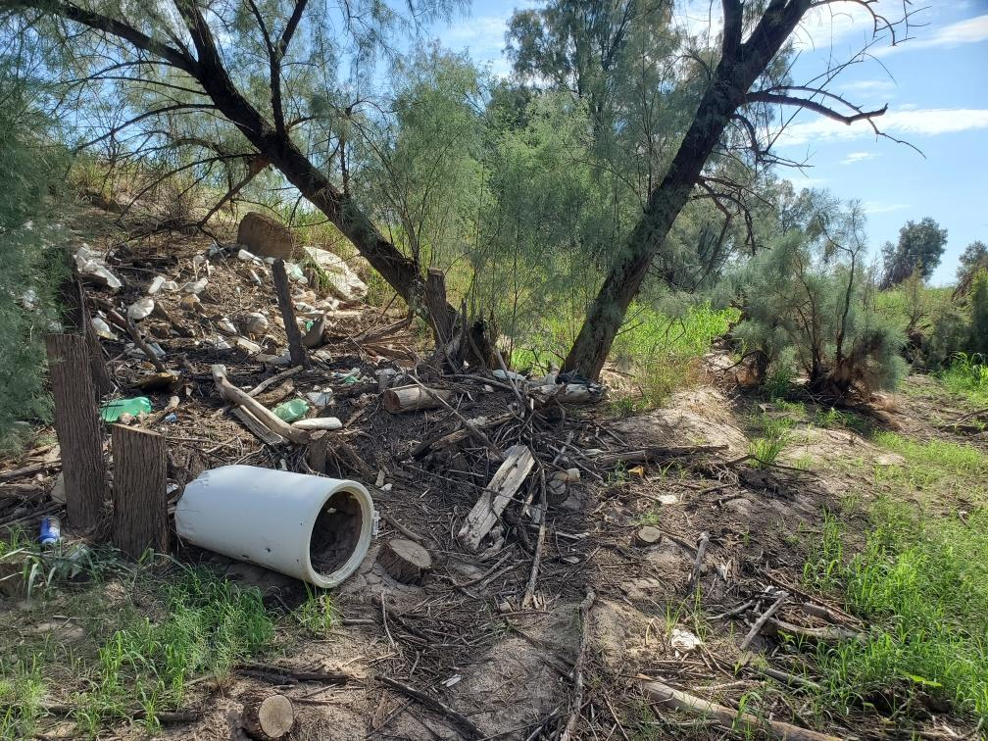
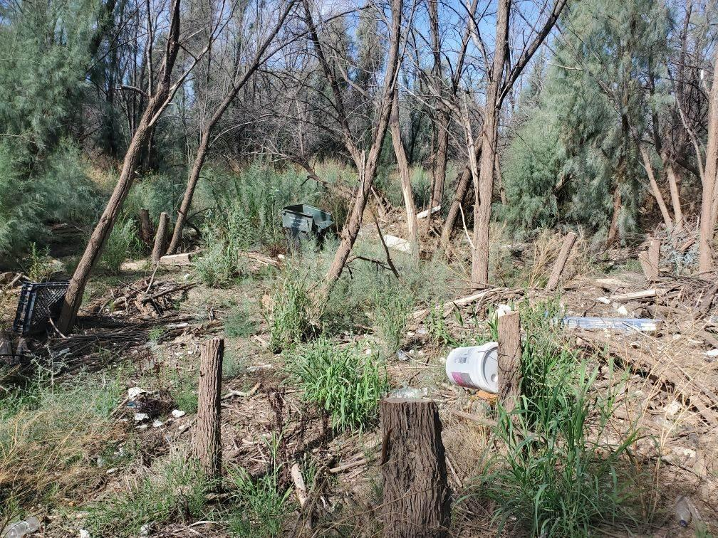
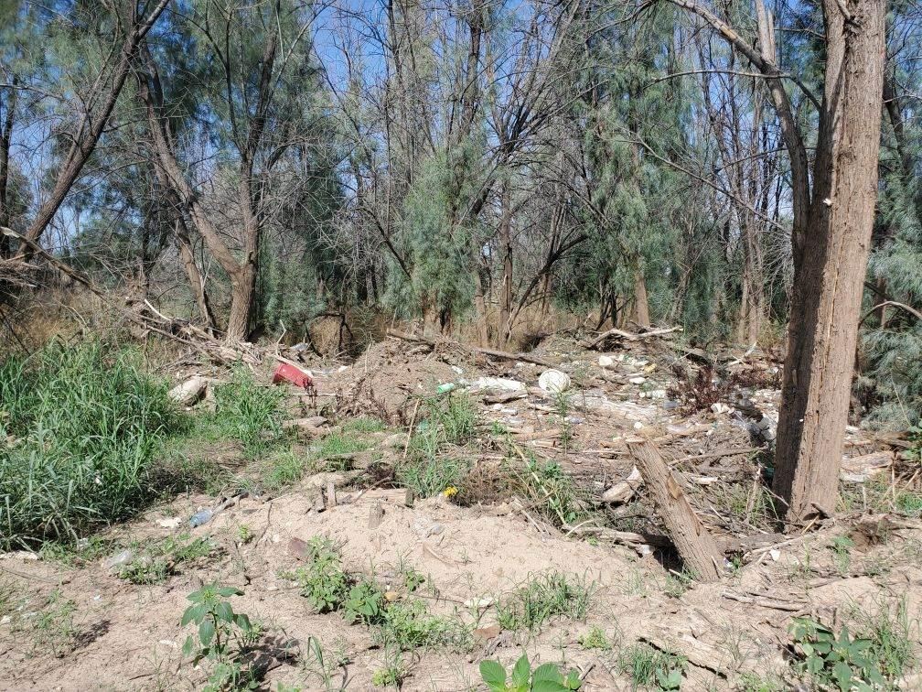
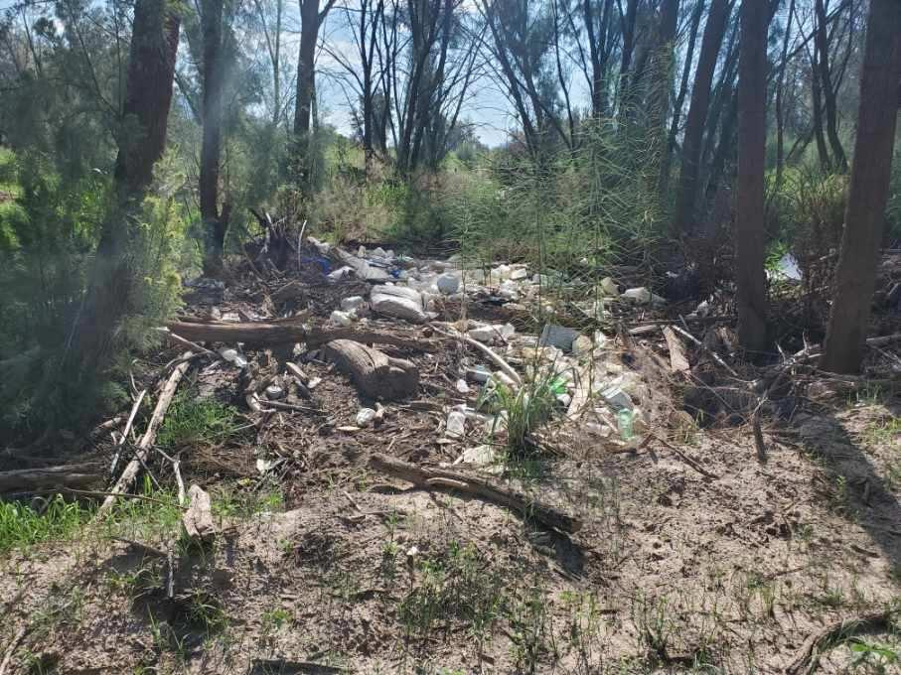
Volunteering opportunities
Watershed clean-up! Corazón project
When: Saturday, November 19, 2022 from 8 am - 12 pm
Where: West of I-10 along N Silverbell Road
Additional information: There will be a 20’ long garbage rollout available and, depending on volunteer turn out, some parking space (although we strongly encourage carpooling).
Email: Wynbeltb@arizona.edu or Rhianyon@arizona.edu for more information and to be added to the volunteer list!

Slide 14

Social Media / Historian Officer Position
We are looking for a social media officer!
Responsibilities
Maintain Instagram presence
Collaborate on website development
Obtain photos from club members
Take photos and videos at events
Organization and compilation of media in google drive.

Slide 15
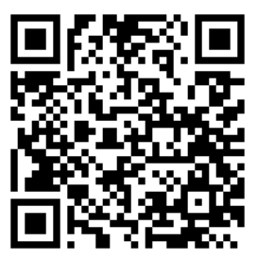
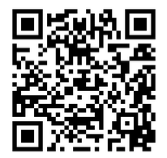


Join our groups!
Tierra Seca GroupMe:
Tierra Seca Campus Groups:
Notes:
Remember to pass out list serve form

Slide 16

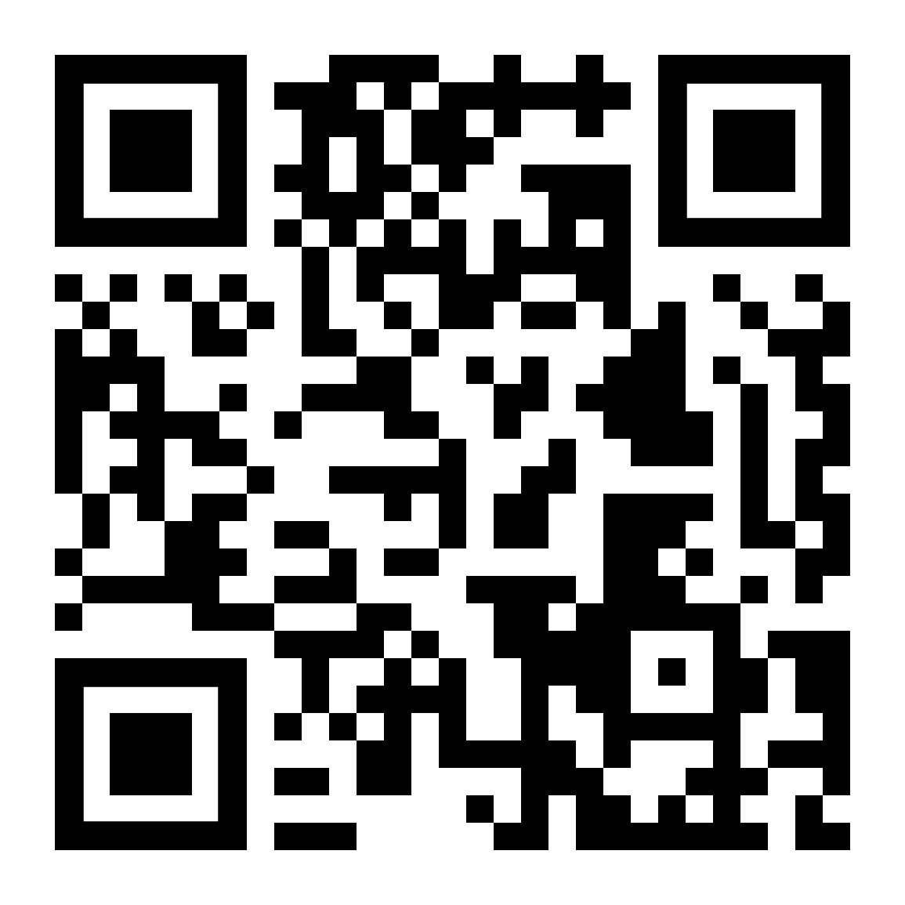
Budget
Venmo QR
Balance: $5,942.03
Club Dues: $15/semester or $30/year
Cash, Venmo, PayPal, Check

Slide 17
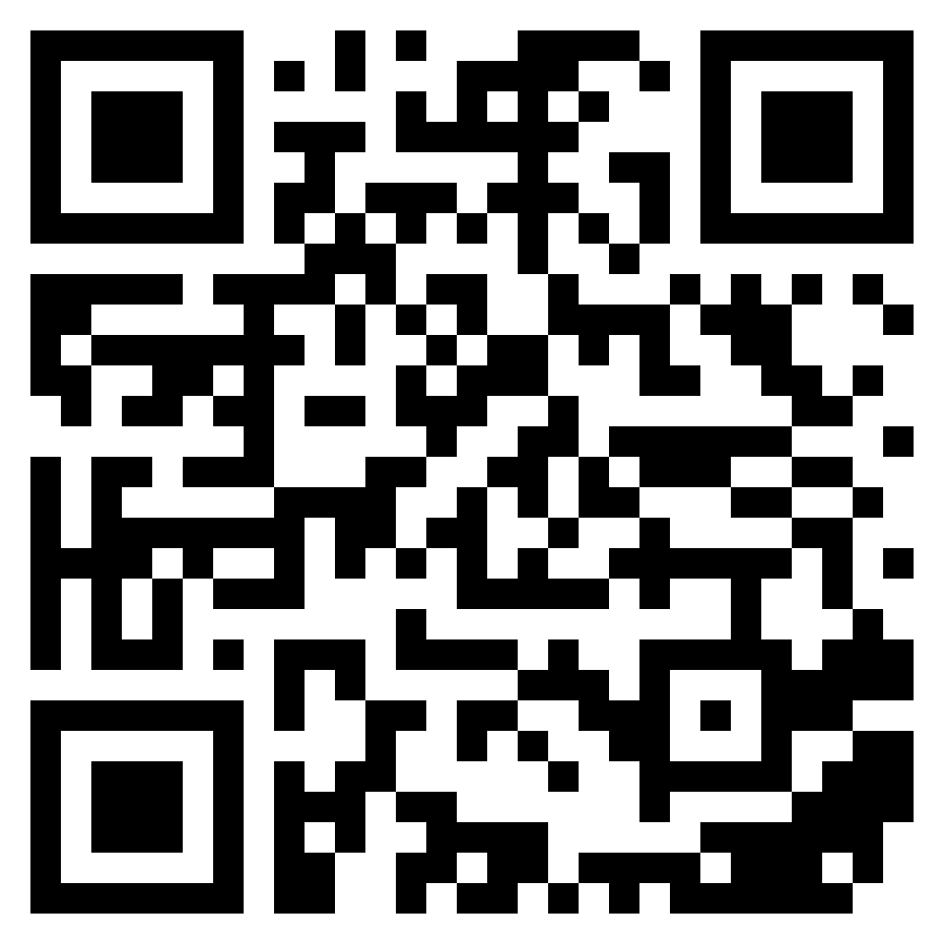
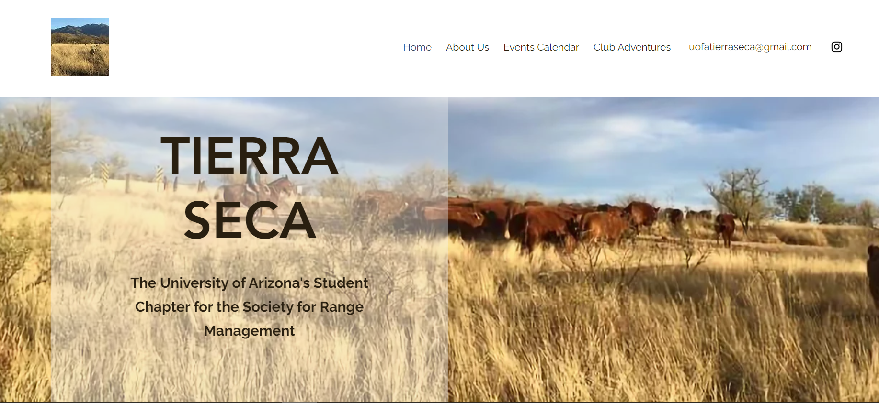
We have a new website!
https://uofatierraseca.wixsite.com/website

Slide 18
Questions?
Email: uofatierraseca@gmail.com

Slide 19
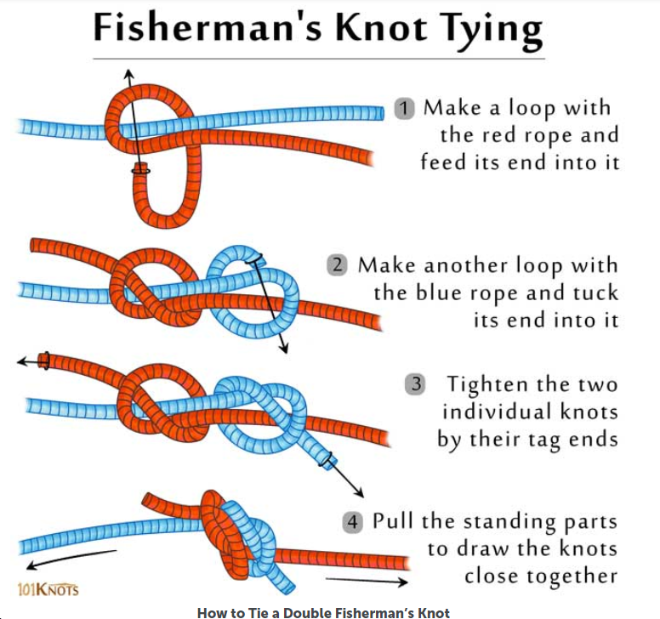

KNOTS!!!!!!

