Slide 1


Tierra Seca Meeting 8/30/22

Slide 2
Agenda
New Website!
URME and Plant ID
Club Fair Volunteering
AZSRM Recap
Job and volunteer opportunities
Questions

Slide 3
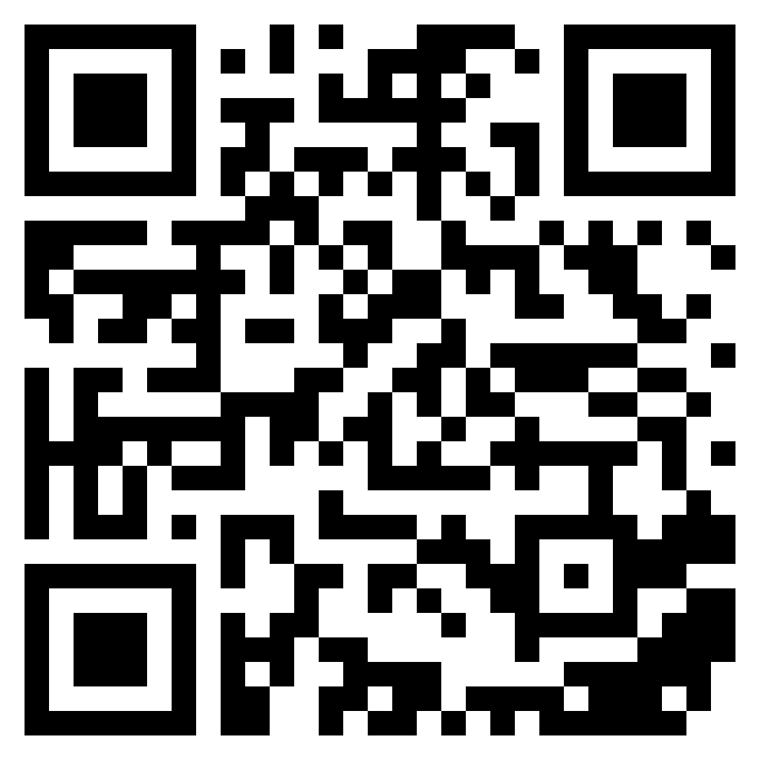
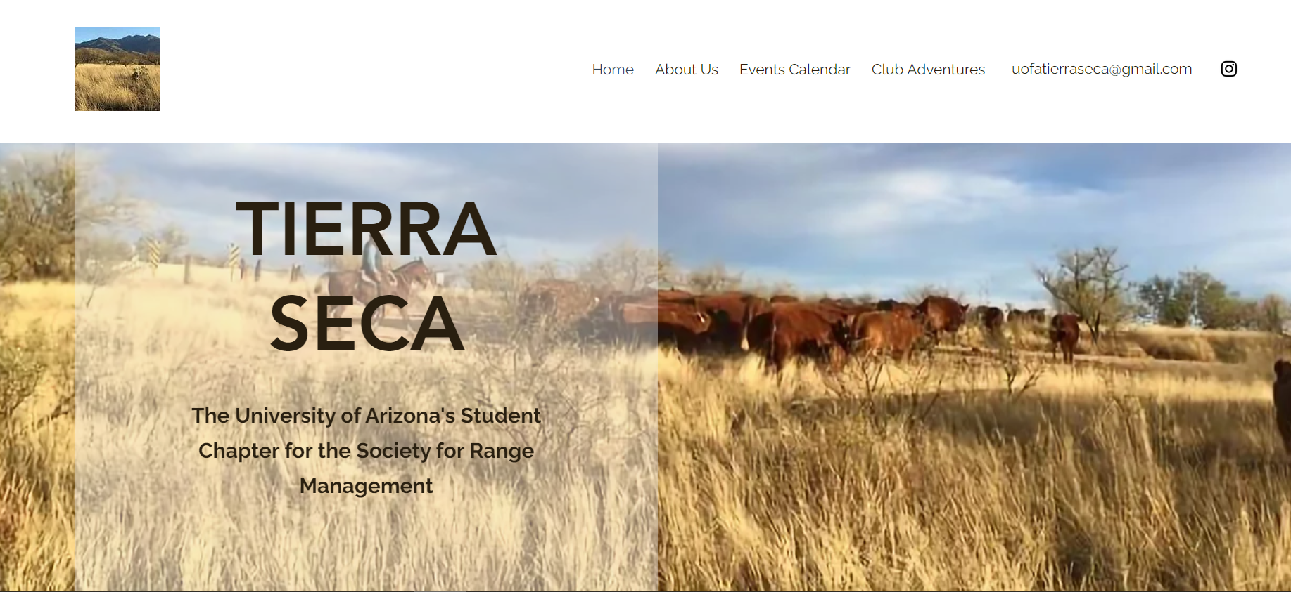
We have a new website!
https://uofatierraseca.wixsite.com/website

Slide 4
Meeting Schedule
August 30th
September 13th
September 27th
October 11th
October 25th
November 8th
November 22nd
December 6th
Every other Tuesday: @5:30-6:30 pm, ENR2 room N350

Slide 5
Events to Look Forward To
Tierra Seca Versus Fish & Wildlife kickball event
Tierra Seca + Fish and Wildlife wash clean up
Guest Speaker Appearances
  Presentations < 30 minutes
  Dr. Alessandra Gorlier Santa Rita Research (October)
  Volunteer Opportunities
    Elkhorn Monitoring Event
    Pima County Range Dept. Field Day
    Santa Rita Work
      Weekend of September 24th or October 1st
Dates TBD

Slide 6
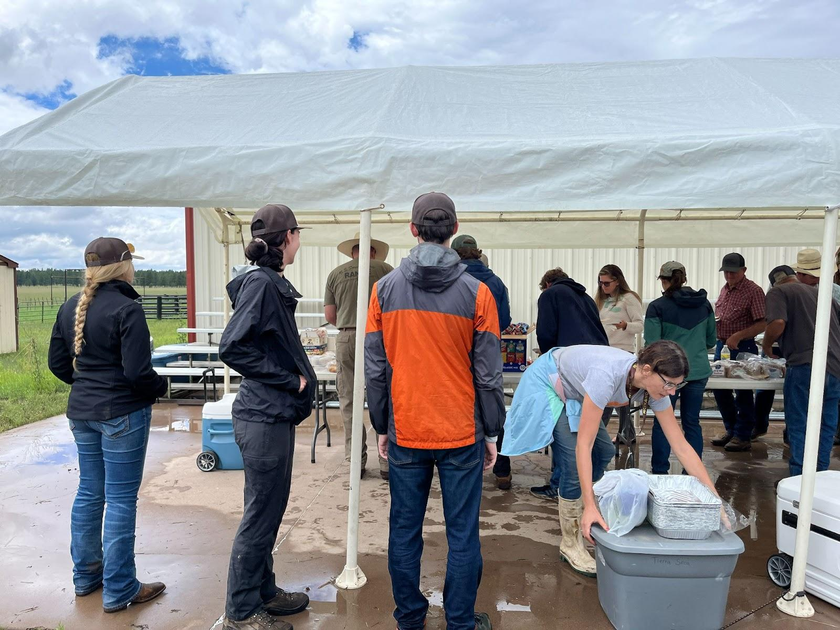
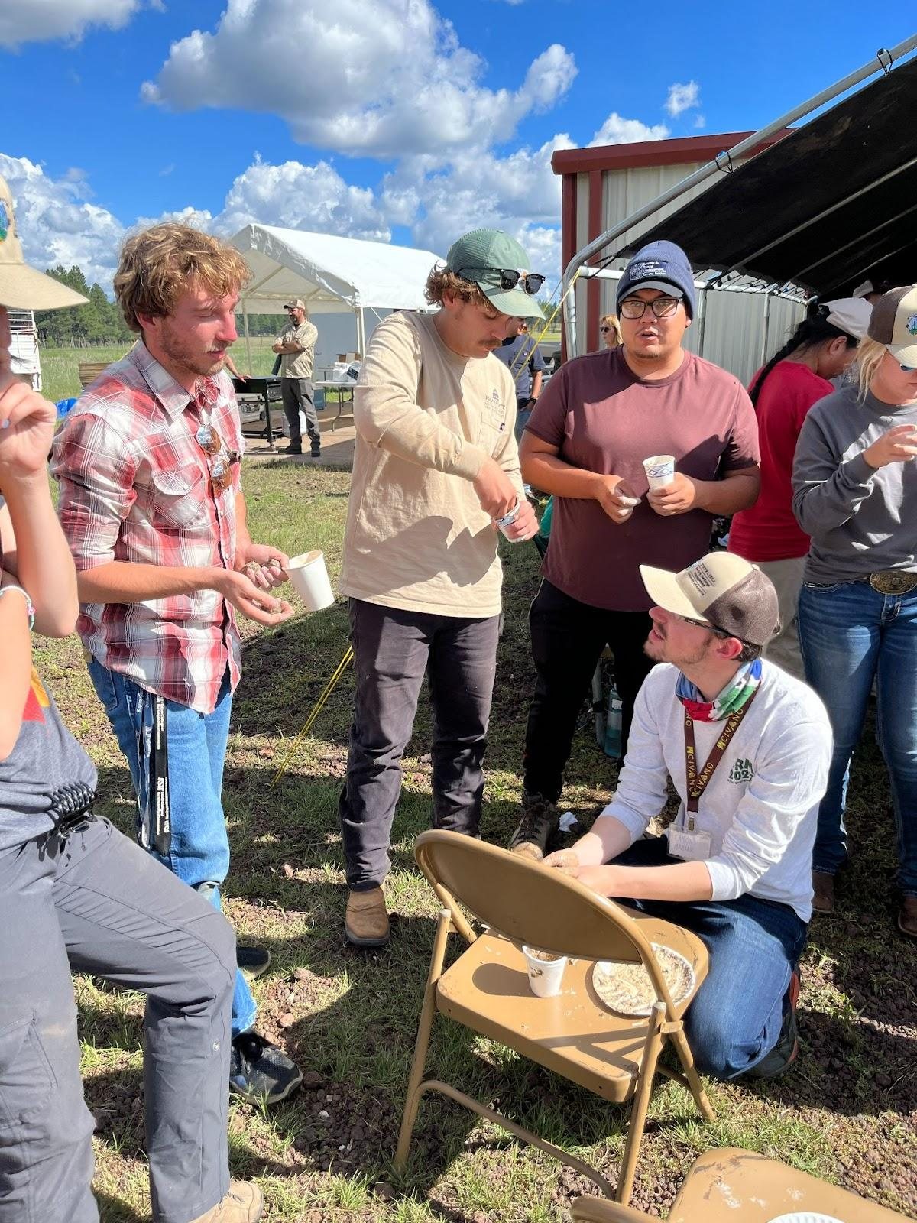
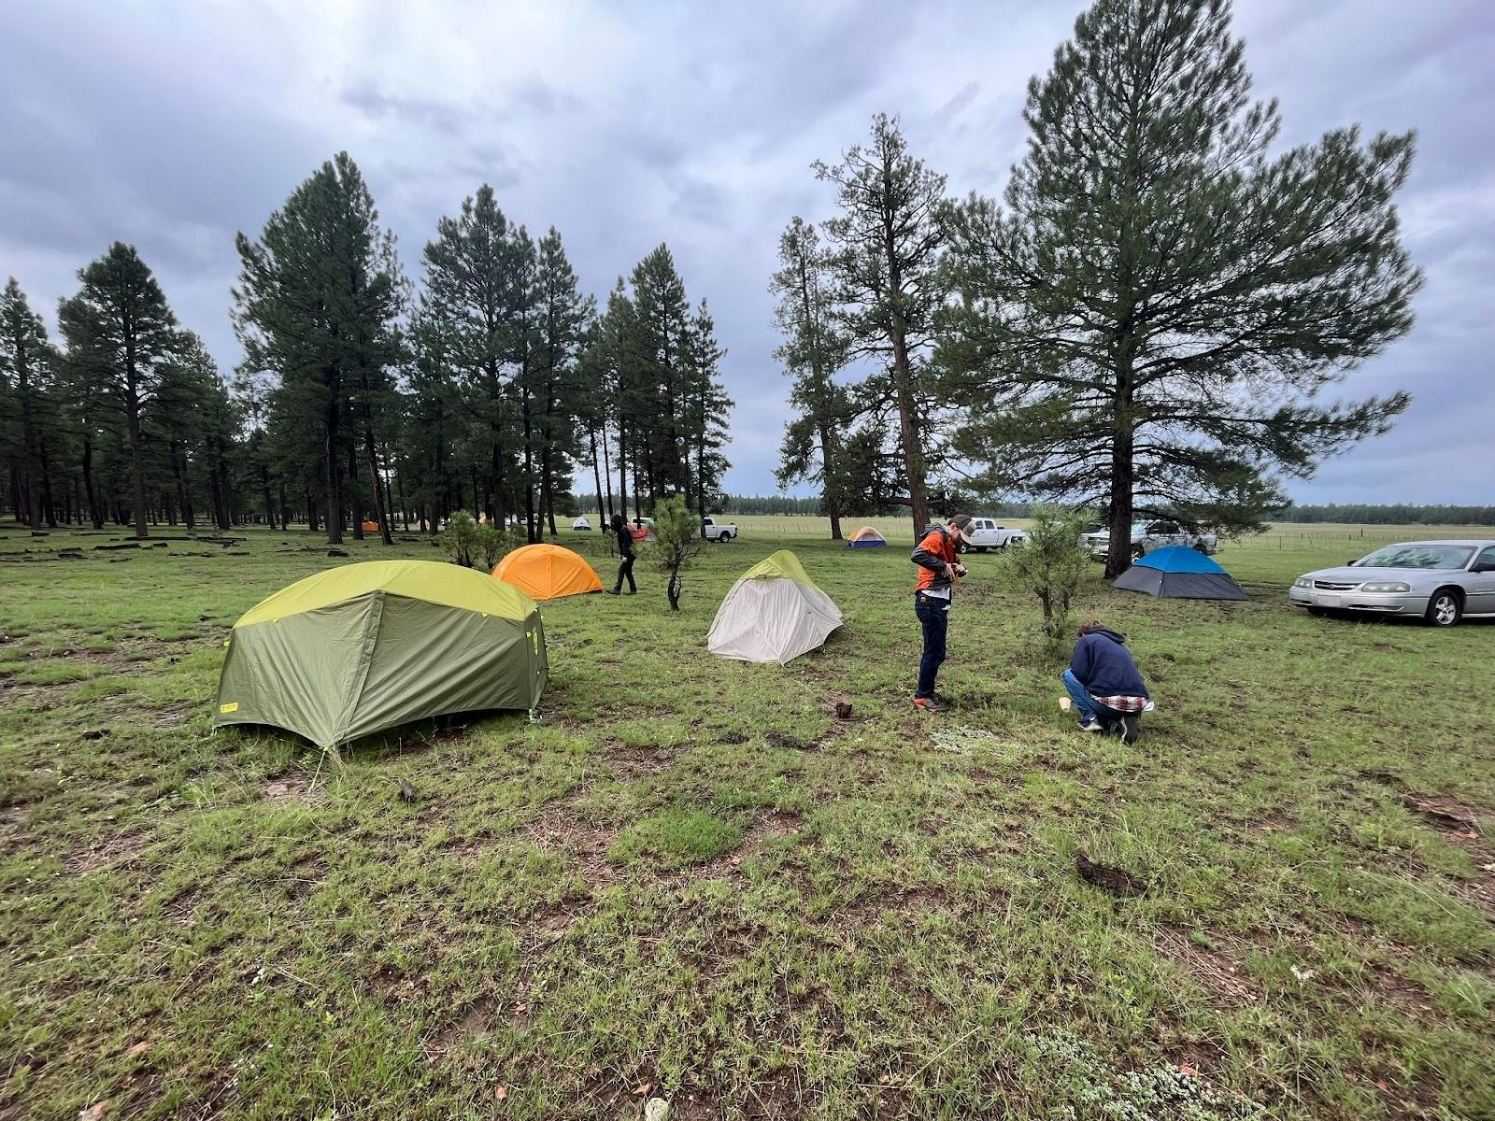
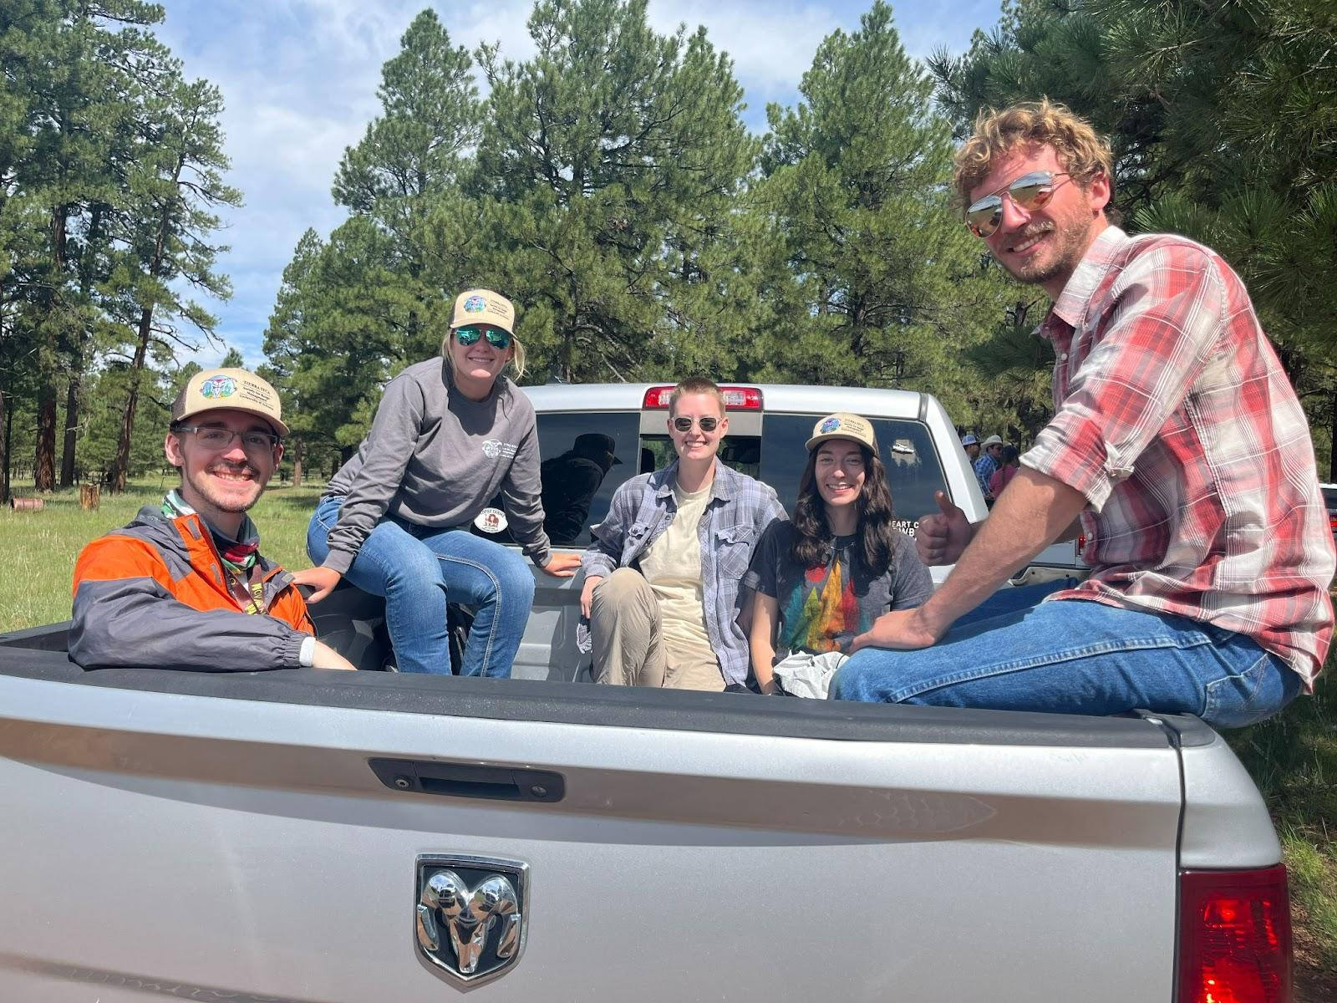
AZSRM Summer Meeting 2022 Recap
August 3rd-5th at V Bar V Ranch

Slide 7
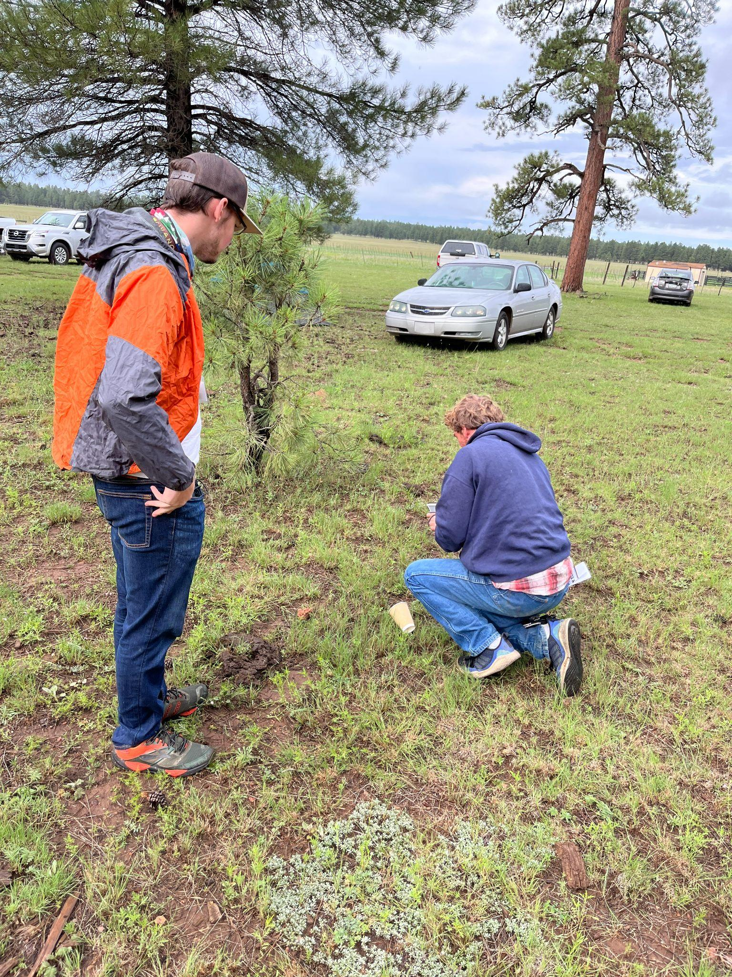
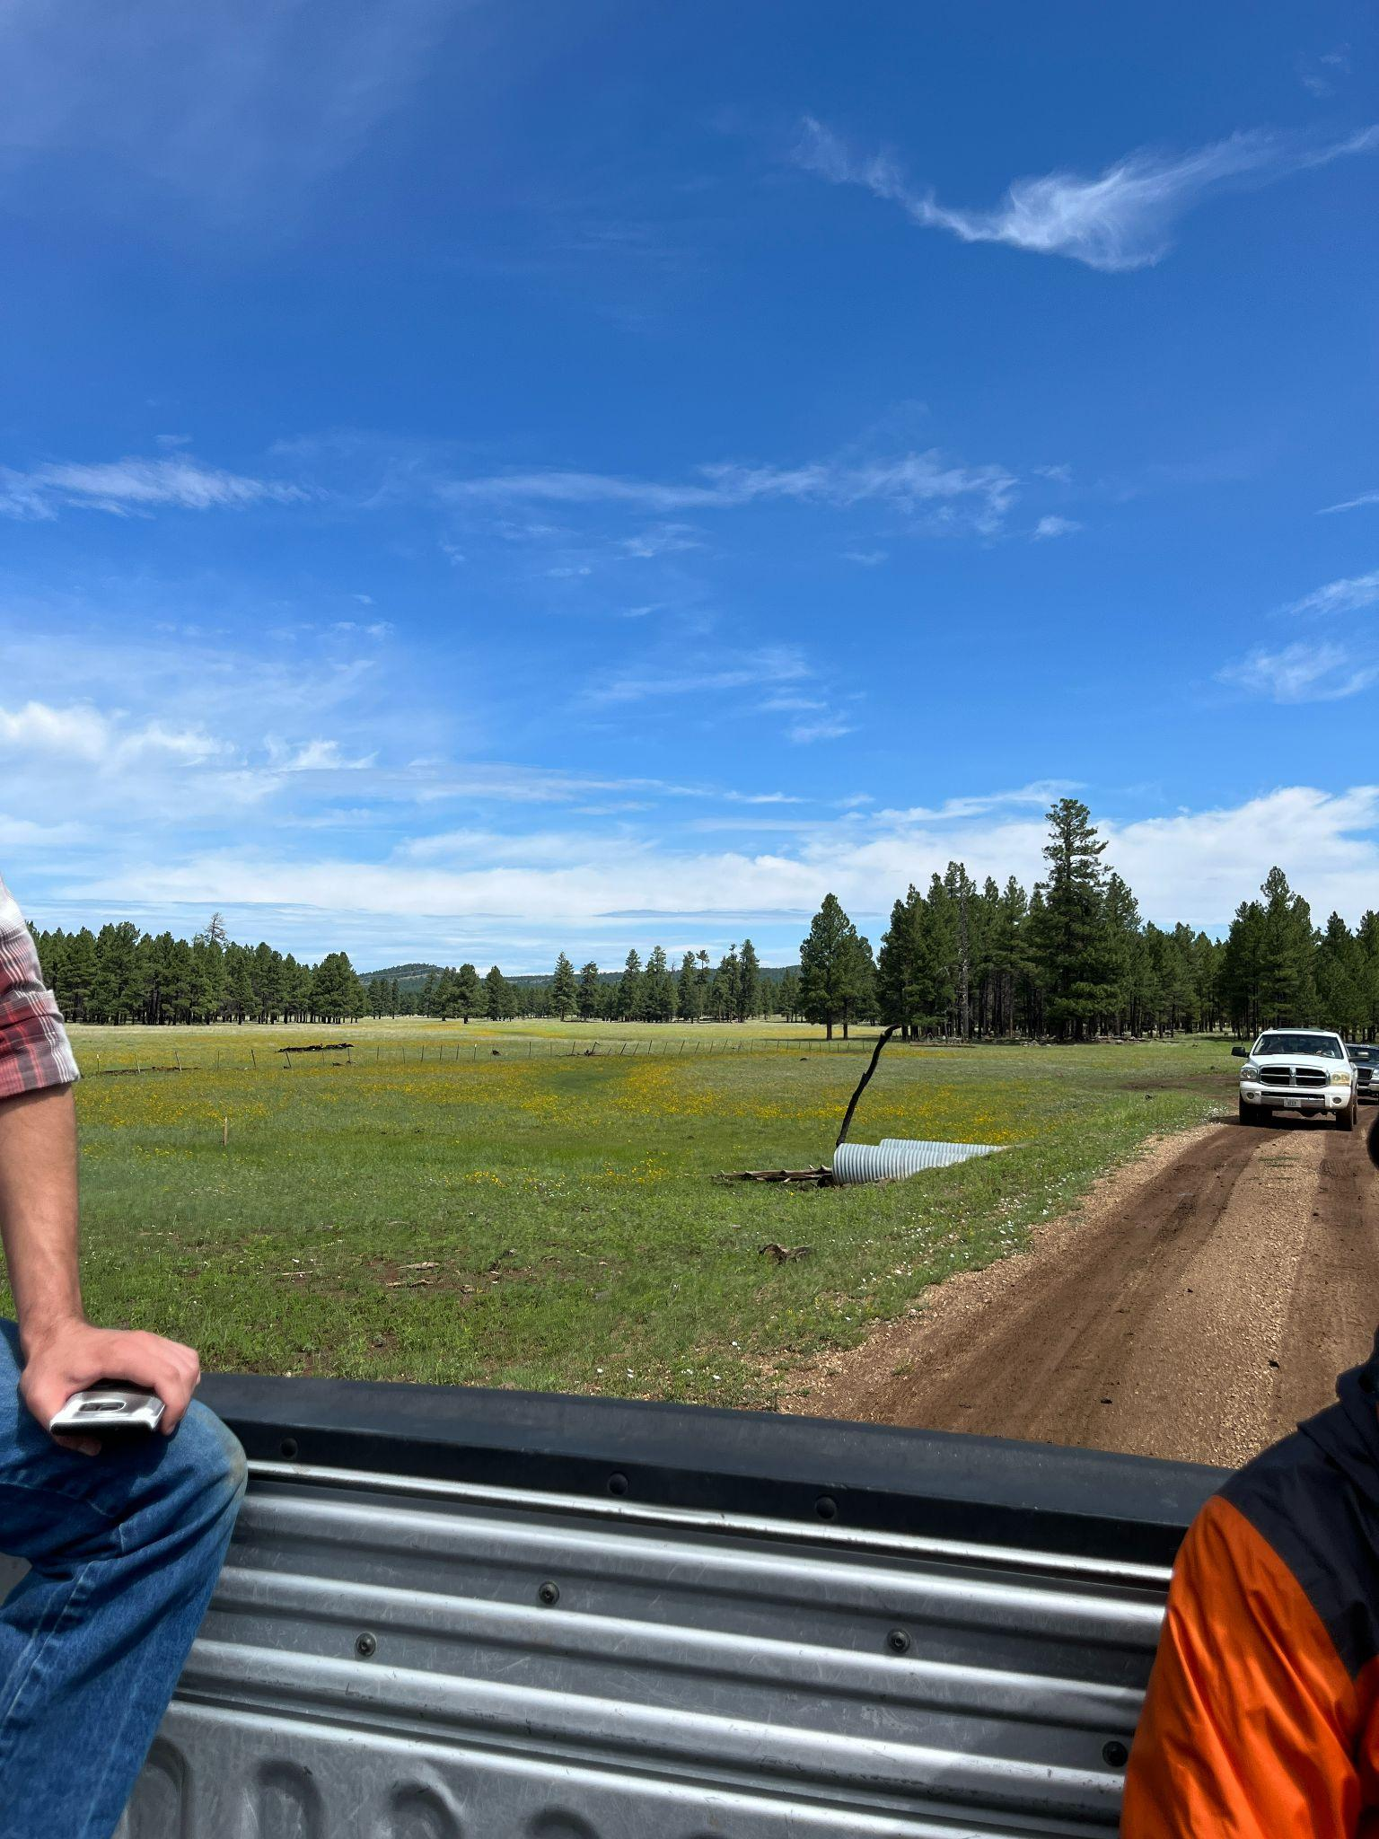
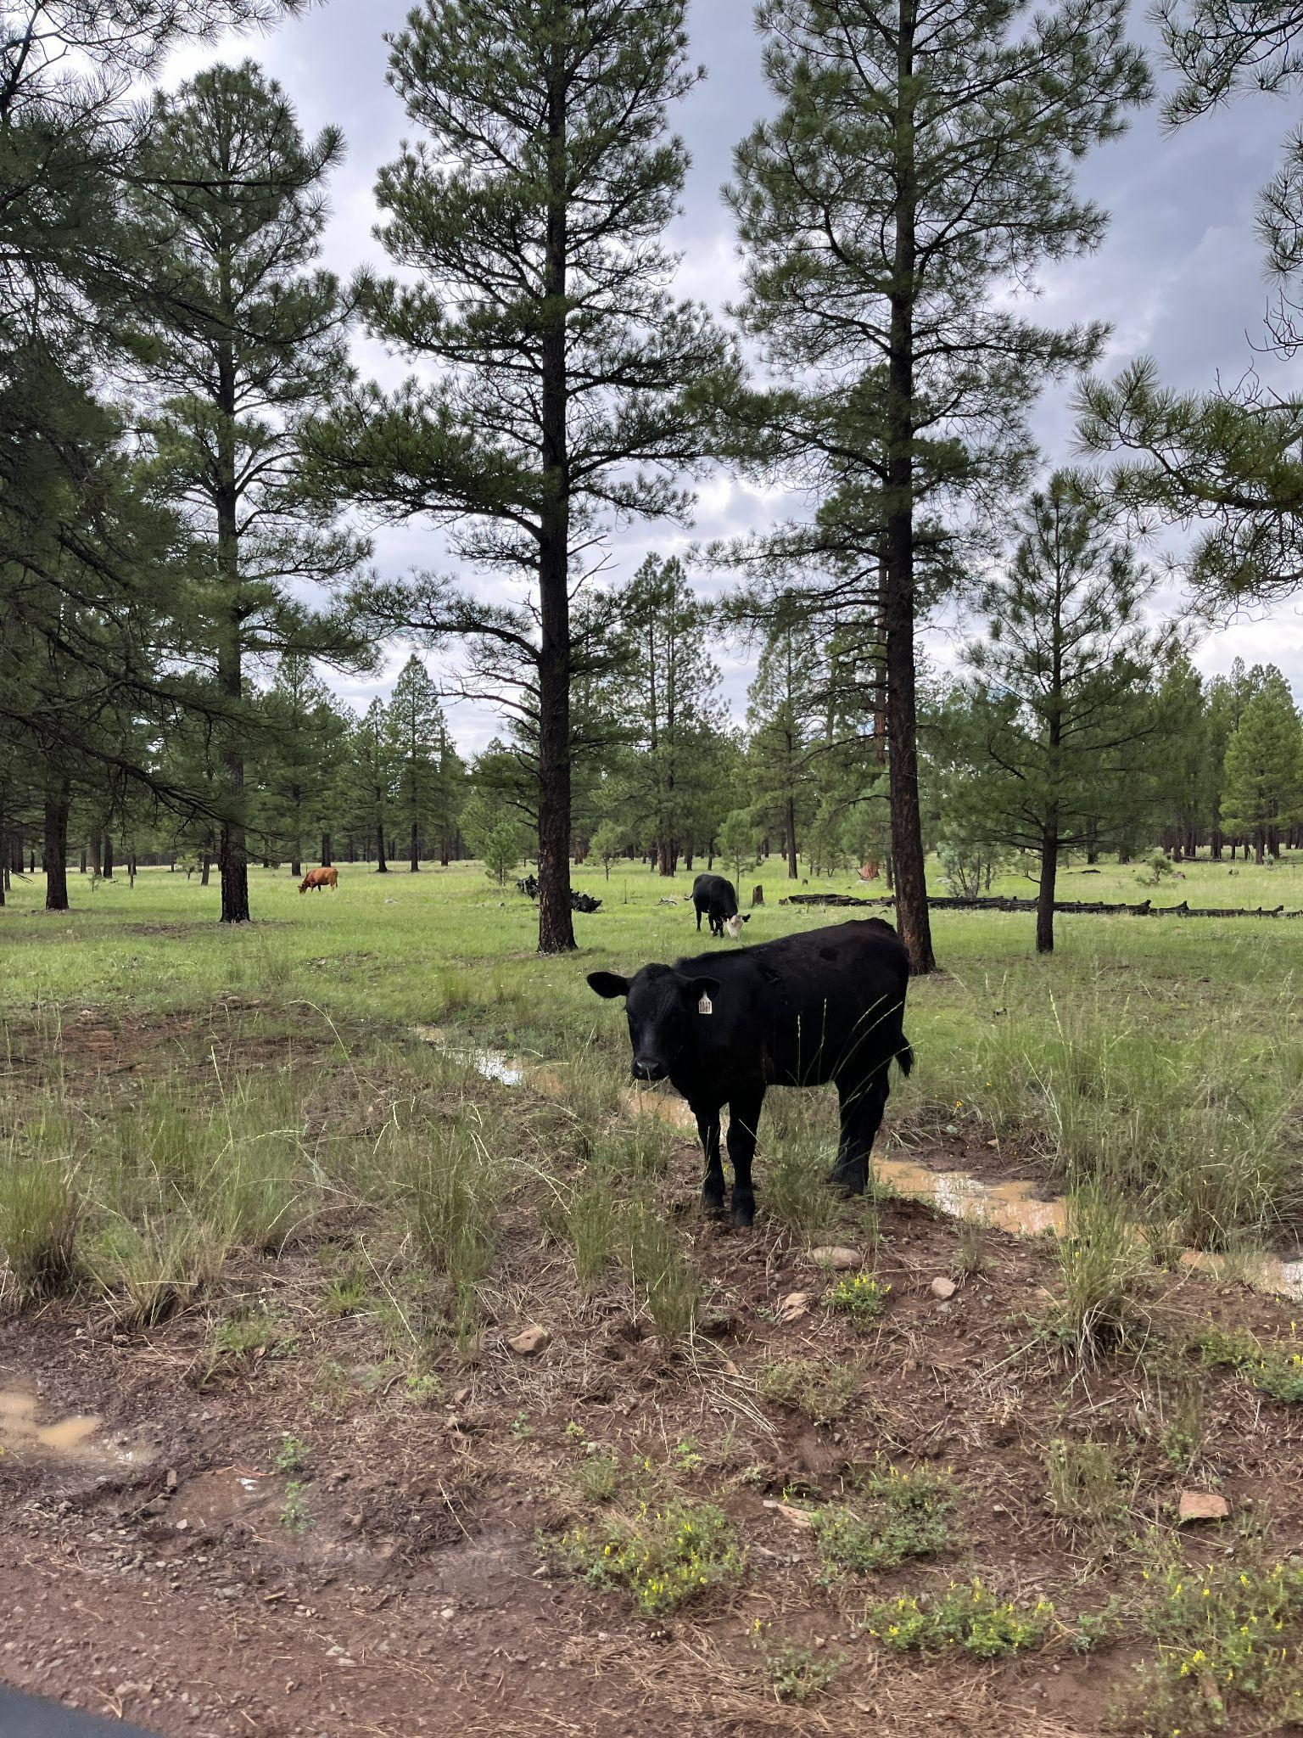
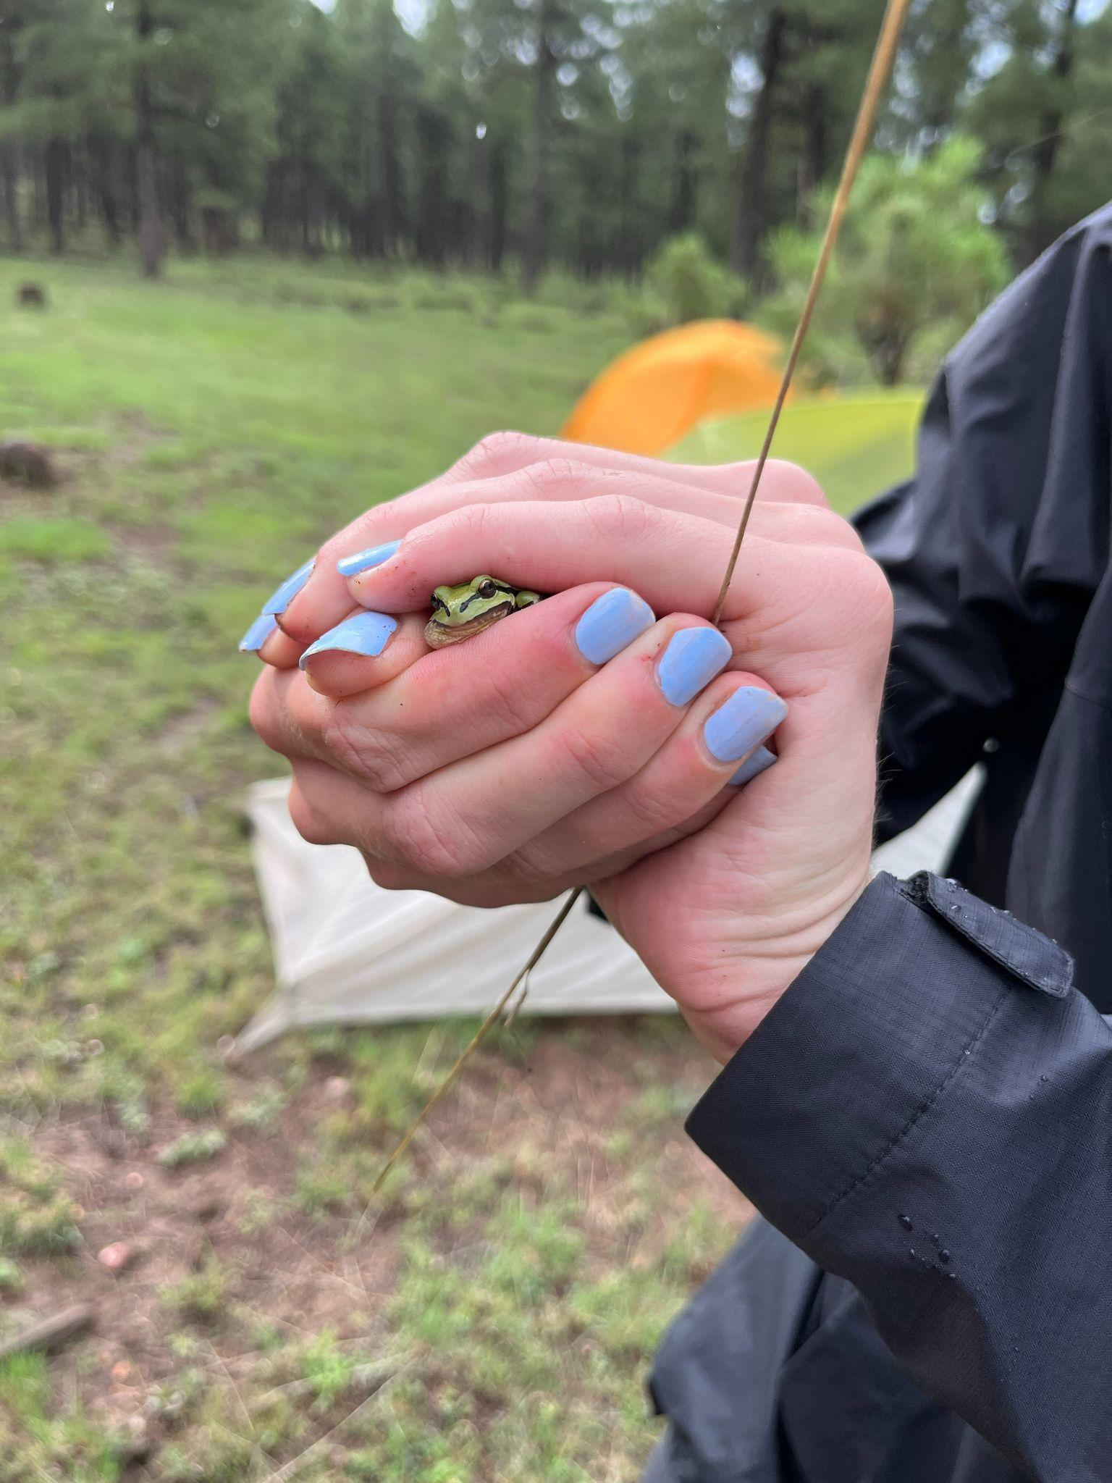
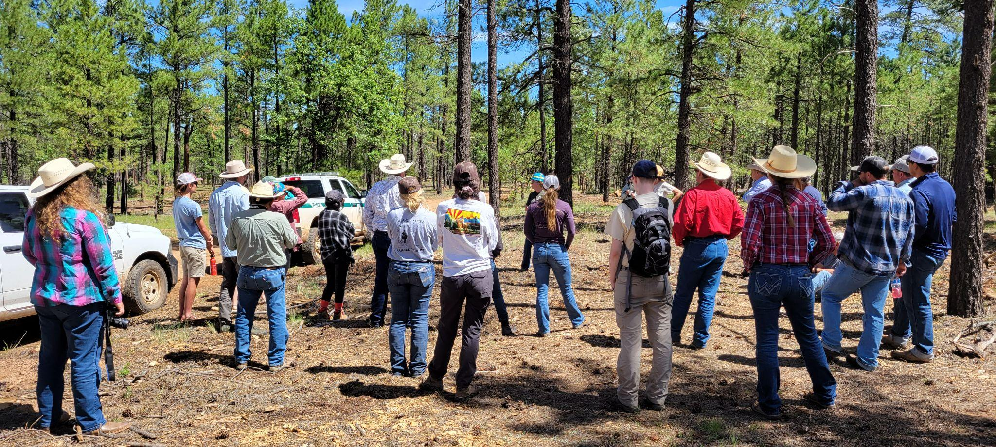
AZSRM Summer Meeting 2022

Slide 8
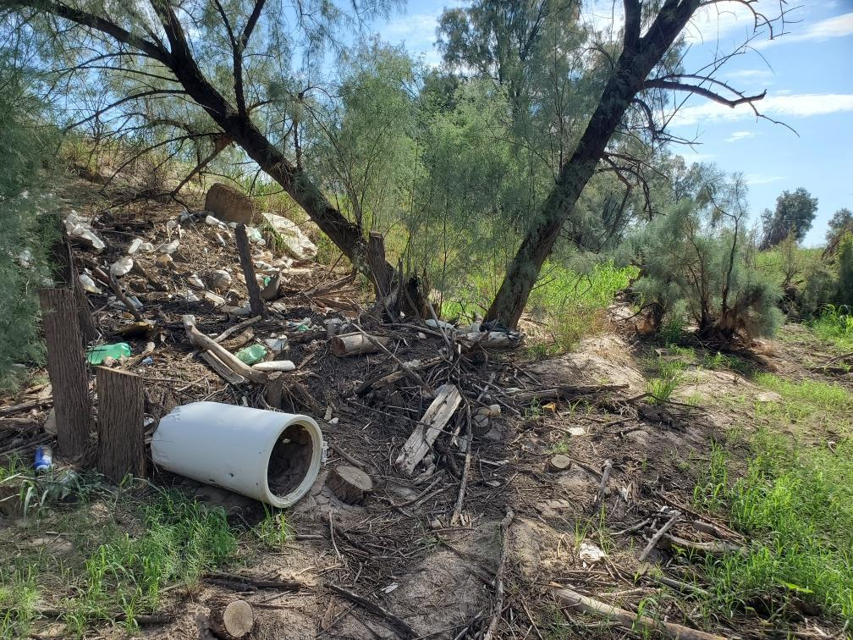
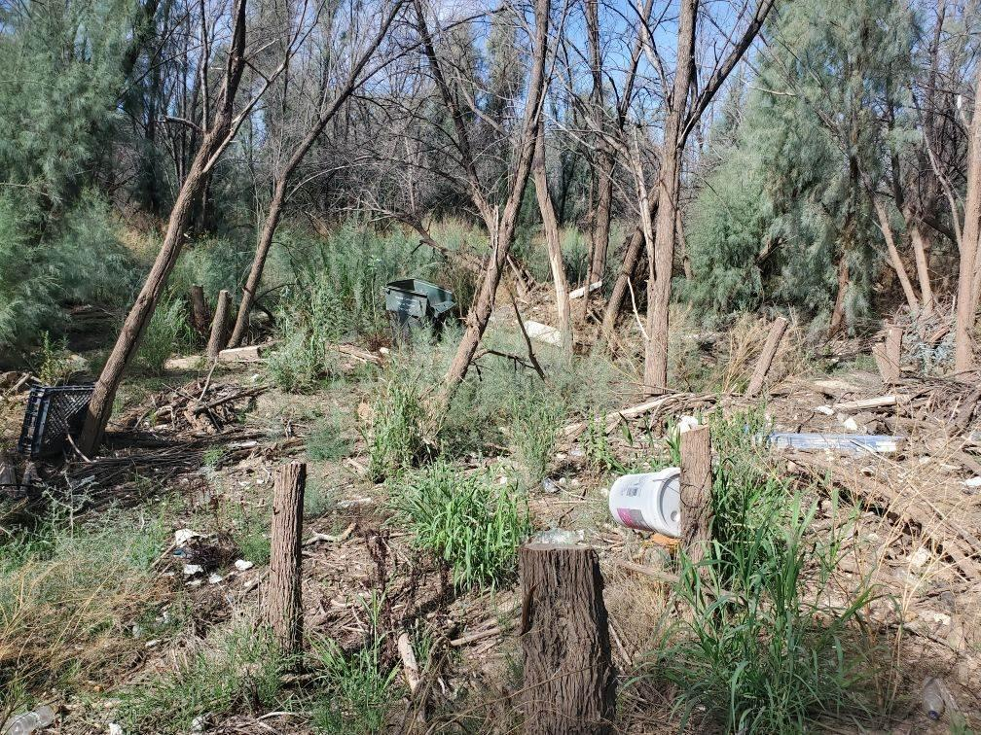
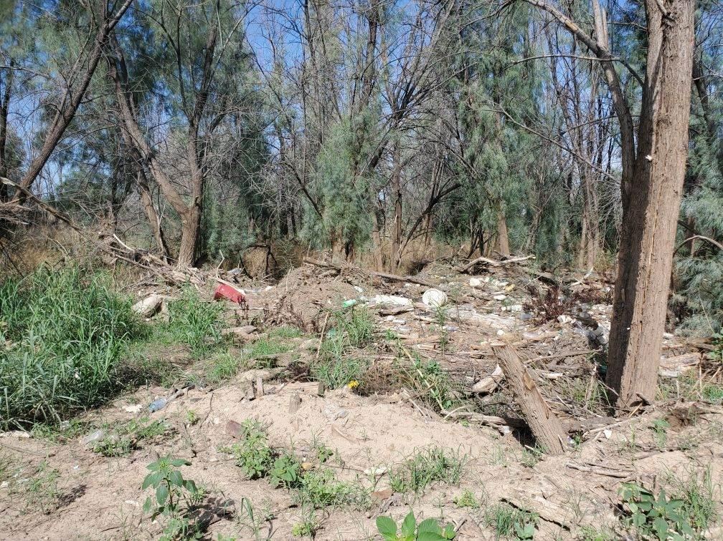
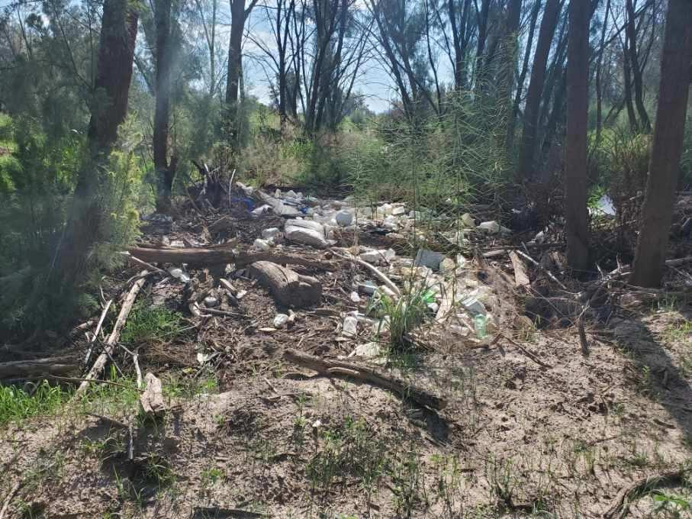
Volunteering opportunities
Watershed clean-up! Corazón project
  When: Saturday, November 19, 2022 from 8 am - 12 pm
  Where: West of I-10 along N Silverbell Road
  Additional information: There will be a 20’ long garbage rollout available and, depending on volunteer turn out, some parking space (although we strongly encourage carpooling).
  Email: Wynbeltb@arizona.edu or Rhianyon@arizona.edu for more information and to be added to the volunteer list!

Slide 9
Job Opportunities
The University of Arizona Office of Sustainability is currently hiring 3-4 new student employees as part of an expansion of our programs. The deadline for applications is September 18th at 11:55pm.
  Neither of these positions require prior experience or knowledge in composting or sustainability. All skills and required knowledge in this space will be provided by the Compost Cats Program and the Office of Sustainability
  https://app.joinhandshake.com/stu/jobs/6909402
    The Data & Administrative Assistant role involves collecting, organizing, analyzing, and reporting on sustainability data from multiple campus stakeholders. Data will capture impact, opportunity, inefficiencies, and other key measures that guide sustainability initiatives and investments and inform university decision-makers. Tracking metrics is critical to the long-term success of sustainability efforts on campus, providing context for storytelling, and is integral to shaping successful university operations and technology/resource investments.
  https://app.joinhandshake.com/stu/jobs/6909545
    Compost Cats Program seeks one highly qualified undergraduate or graduate student to assist with educational and outreach activities on and off campus. This includes, but is not limited to, K-12 and community-focused STEM programming/curricula, education and/or outreach events for a wide range of audiences at compost demonstration sites, trainings for commercial business employees, potential operation of small-scale equipment for maintenance of composting systems (please be prepared to get dirty), collection and reporting of metrics or data to the Compost Cats Program Manager and Compost Cats Coordinator; participation in zero-waste effort events, and more. The successful candidates will inform and inspire the Tucson community about food waste reduction, materials cycling, soil health, sustainable agriculture, and environmental stewardship.

Slide 10
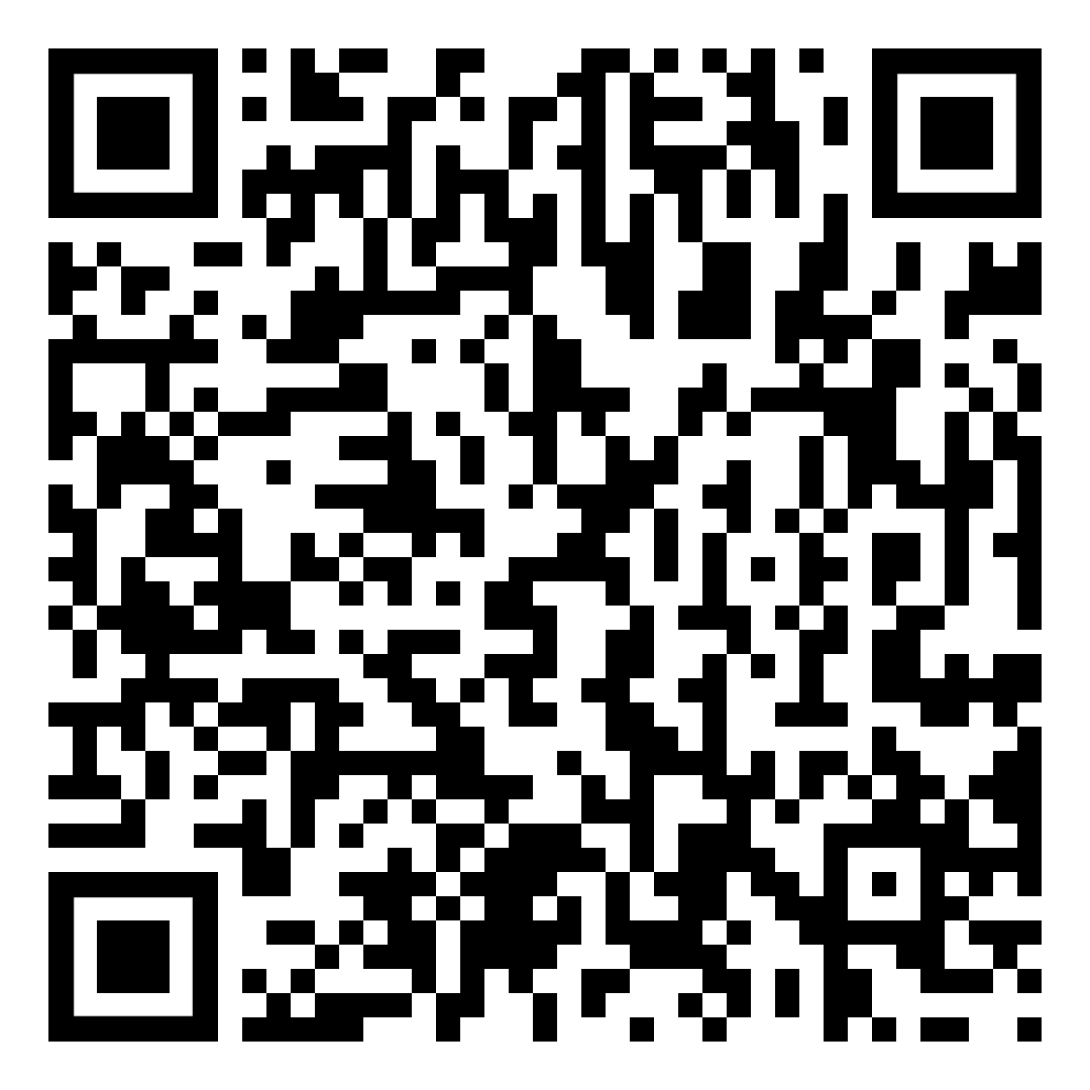
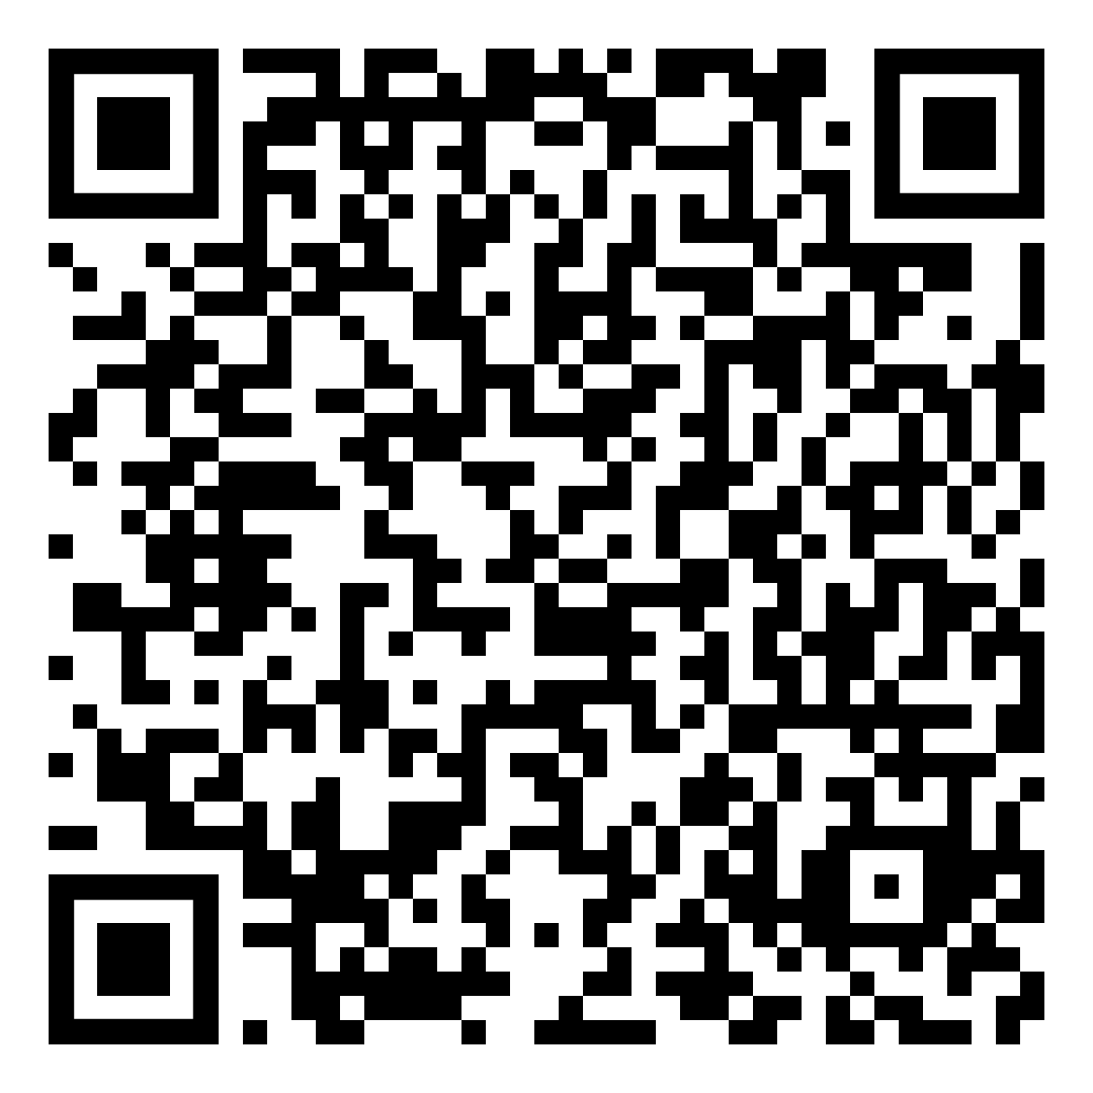
Volunteer Opportunities: Club Fairs!
ASUA Club Fair
CALS Club Fair
September 13th (8:30 - 2:00)
UA Mall
September 8th (3:30-6pm) ENR2 Courtyard
← !Sign Up Links! →
https://docs.google.com/spreadsheets/d/1SbYE46BmovOTG1lmXcDfe2PmkdWSN3JsIkRiHrIU860/edit#gid=0
https://docs.google.com/spreadsheets/d/1ayZy_qAxmIvgvF5SYD4QaQNvz3oamQzejE8bRHHLeoQ/edit#gid=0

Slide 11

Club Swag
If you ordered club swag, we have it!
Can pay using PayPal or cash
See an officer if you don’t remember what you owe or ordered.

Slide 12
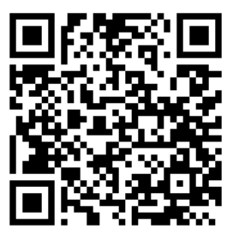
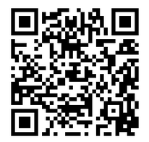


Join our groups!
Tierra Seca GroupMe:
Tierra Seca Campus Groups:
Notes:
Remember to pass out list serve form

Slide 13
Budget
Balance: $4,767.65
Club Dues: $15/semester or $30/year

Slide 14
Questions?
Email: uofatierraseca@gmail.com

Slide 15
KNOTS!!!!!!

