Slide 1
The School of Natural Resources and the Environment
Stuart E. Marsh
Director
2017

Slide 2

Overview
Cutting Edge Education and Research Programs Encompass:
Wildlife and Fisheries Conservation & Management
Human Dimensions and Policy
Geospatial Informatics: GIS – Remote Sensing
Climate Change and Phenology
Sustainable Rangeland Management and Restoration Ecology
Ecohydrology - Water Resource Management
Wildfire and Landscape Restoration
Natural Products Research
http://snre.arizona.edu/

Slide 3
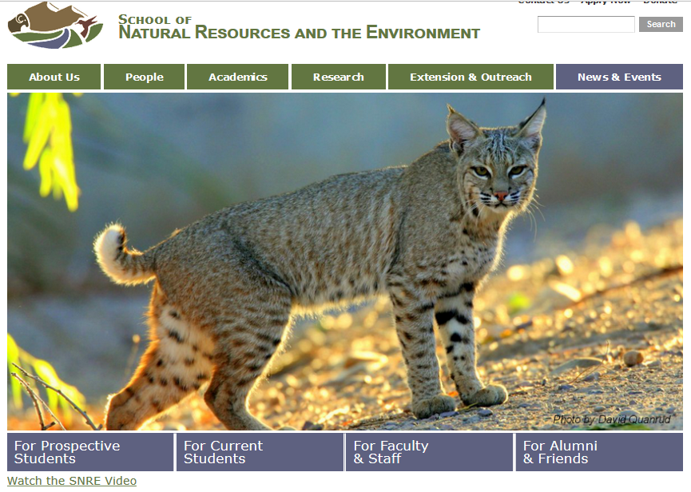
What Our Students Do
http://snre.arizona.edu/

Slide 4
Undergraduate Programs School of Natural Resources and the Environment

Slide 5
SNRE Educational Programs
Undergraduate Degrees and Students – 190 (Fall 2017)
BS in Natural Resources with Multiple Options:
Wildlife and Fisheries Conservation and Management
Ecology, Restoration and Management of Rangelands
Watershed Management and Ecohydrology
Conservation Biology
Global Change Ecology and Management
Graduate Degrees in Natural Resources
Masters and Ph.D. Students – 86 (Fall 2017)

Slide 6
Core curriculum
18 Semester Credits:
Introduction to Natural Resources (3 credits)
SNR - Field Botany (3 credits)
SNR – Ecology (3 credits)
SNR - Measurements (3 credits)
SNR - Management Practices (3 credits)
SNR – Policy & Administration (3 credits)

Slide 7
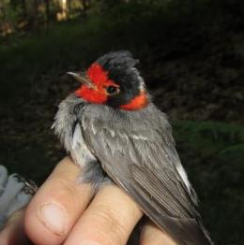
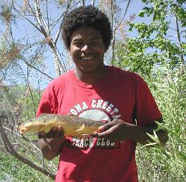
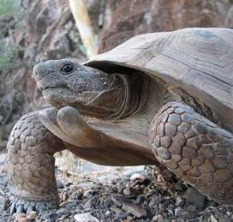
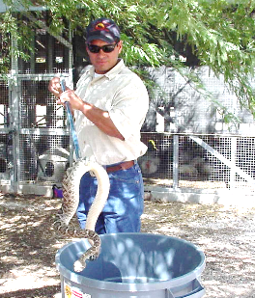
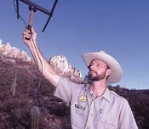
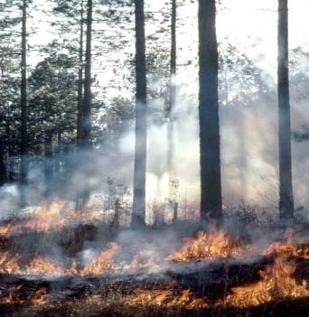
What is Work Like?

Slide 8
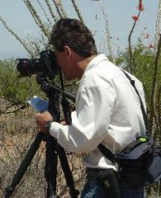
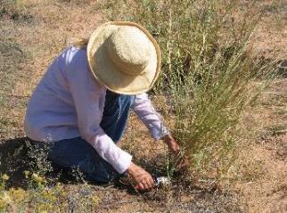
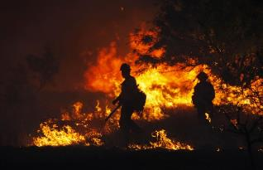
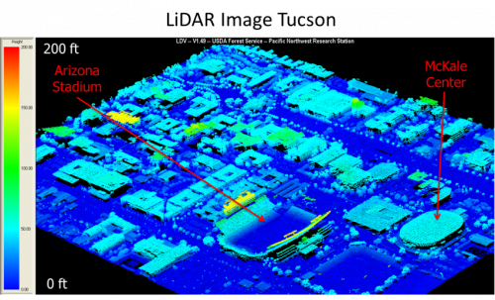
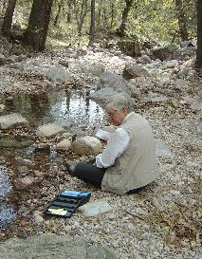
What is Work Like?

Slide 9
What is Work Like?
Problem Solving.
Field Work and Office Work.
US and International.
Working with People! Landowners, ranchers, government officials, special interest groups, the public.
High Tech – Remote Sensing, GIS, Computer Modeling.

Slide 10


Slide 11
Thank You
Please Feel Free to Contact Me at Anytime
smarsh@email.arizona.edu
520-621-8574

