Slide 1
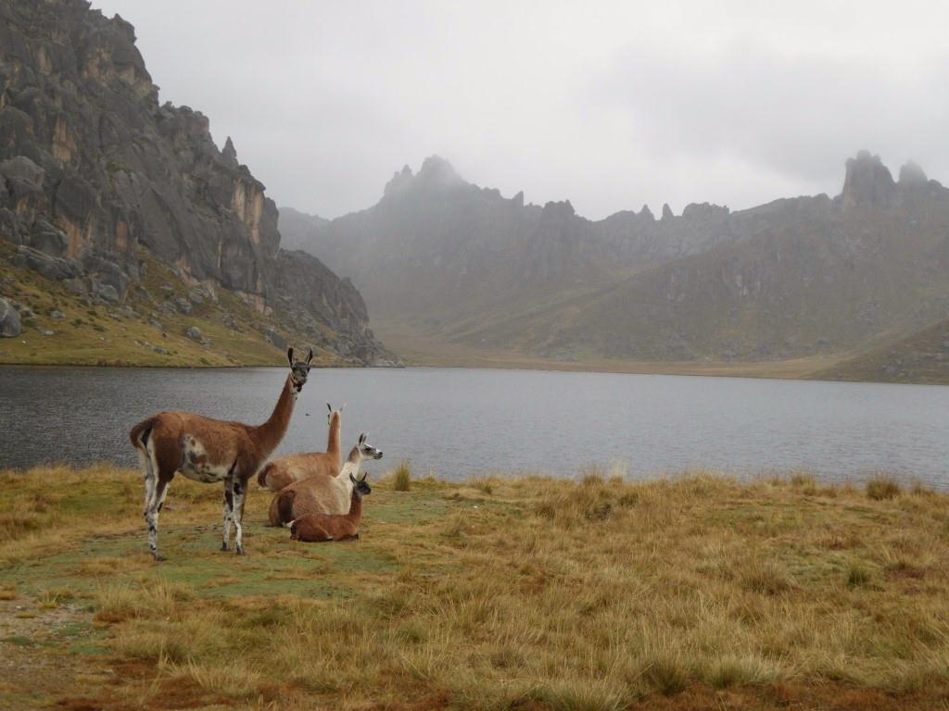



CALL FOR RESEARCHERS
The Rangeland Ecology and Utilization Laboratory (LEUP) of La Molina University (Lima - Peru) is seeking Adjunct and Postdoctoral Researchers to consolidate the research line “Ecology and Nutritional Management of Grazing Animals in Rangelands”.
Professional Profile:
Research experience and academic training in the following areas:
Nutrition of Domestic and Wild Ruminants
Nutritional Ecology of Herbivores
Plant – Animal Interactions and Modeling
Nutritional Behavior
Requirements:
PhD in Ecology, Animal Science, Rangeland Science, Biology, or related sciences
Leading/ Participating experience in research projects
Willingness to work on a full-time basis in Peru for 2 to 3 years
Information:
For detailed position description or more information, click here: http://www.lamolina.edu.pe/FACULTAD/Zootecnia/Leup/ficha_informativa.pdf
Interested applicants may send a mail to: efm@lamolina.edu.pe or lab_pastizales@lamolina.edu.pe
Universidad Nacional Agraria
La Molina

