Slide 1
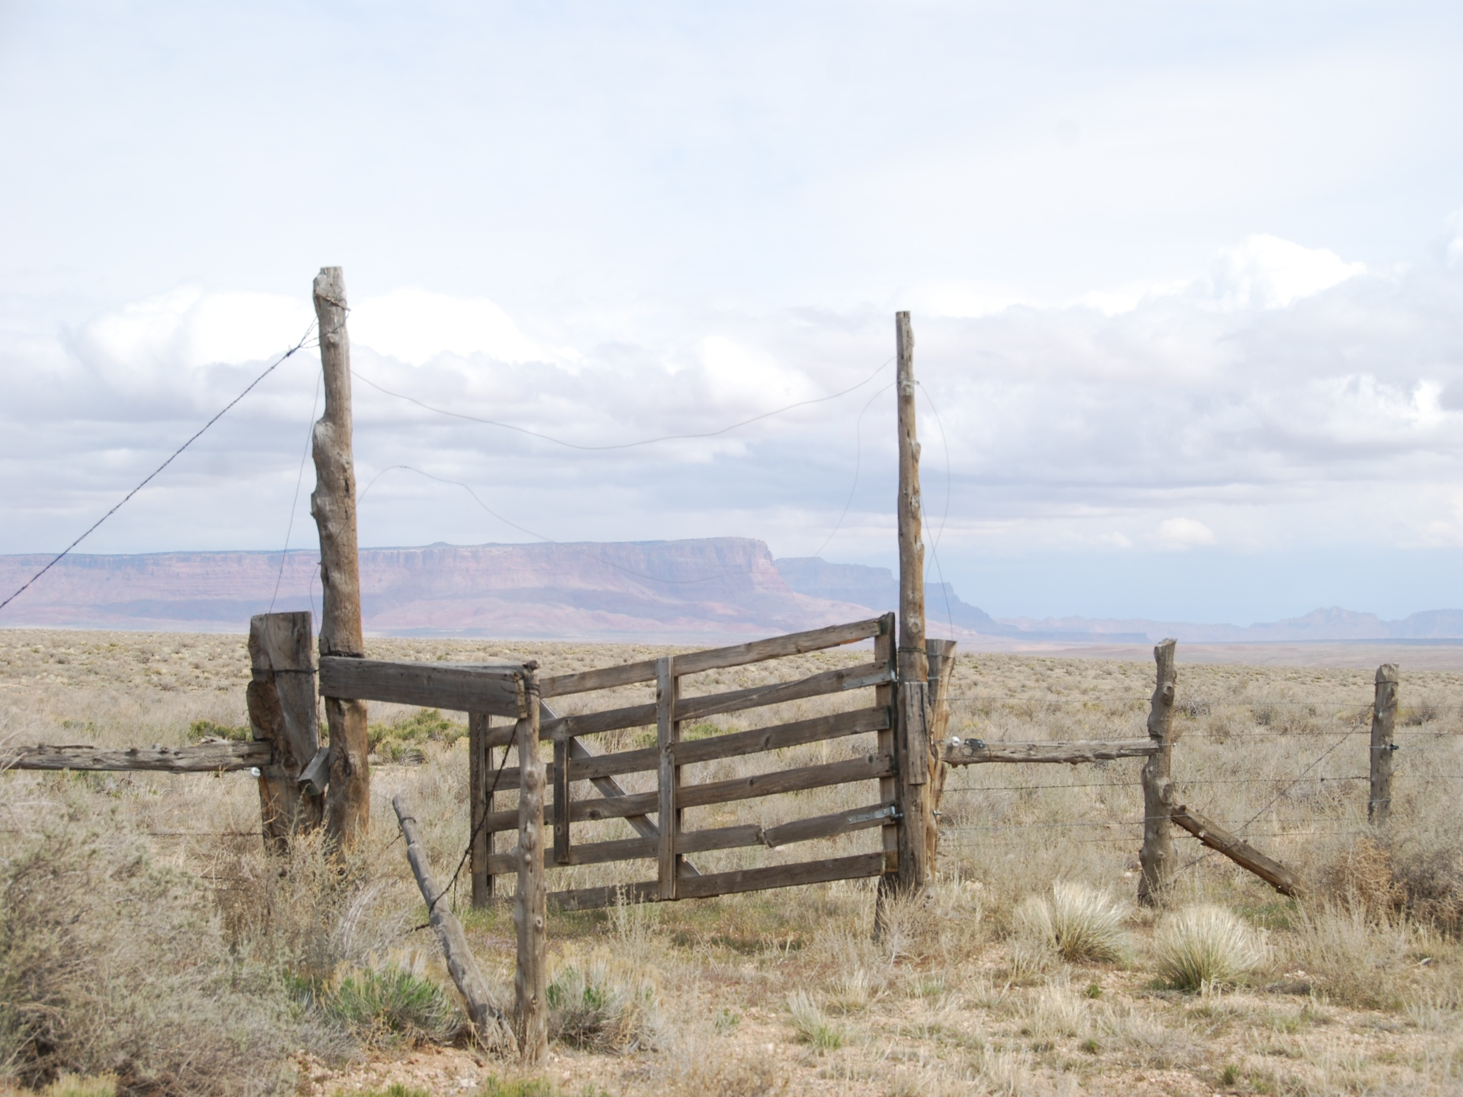
RAM 599: RANGELAND RESOURCE MANAGEMENT
A 3 hr graduate introductory class in rangeland
management designed for non-rangeland
majors or those students pursuing a
rangeland degree who come from a
non-rangeland background.
Material covered includes such topics as:
Ecological Principles and Ecological Sites
Nutritional Ecology of Rangeland Herbivores
Rangeland Management on Public Lands
Rangeland Management during Drought
Spring 2013 Distance Education
Class in Collaboration with
Texas A&M University
For more information contact:
Doug Tolleson
dougt@cals.arizona.edu

Slide 2
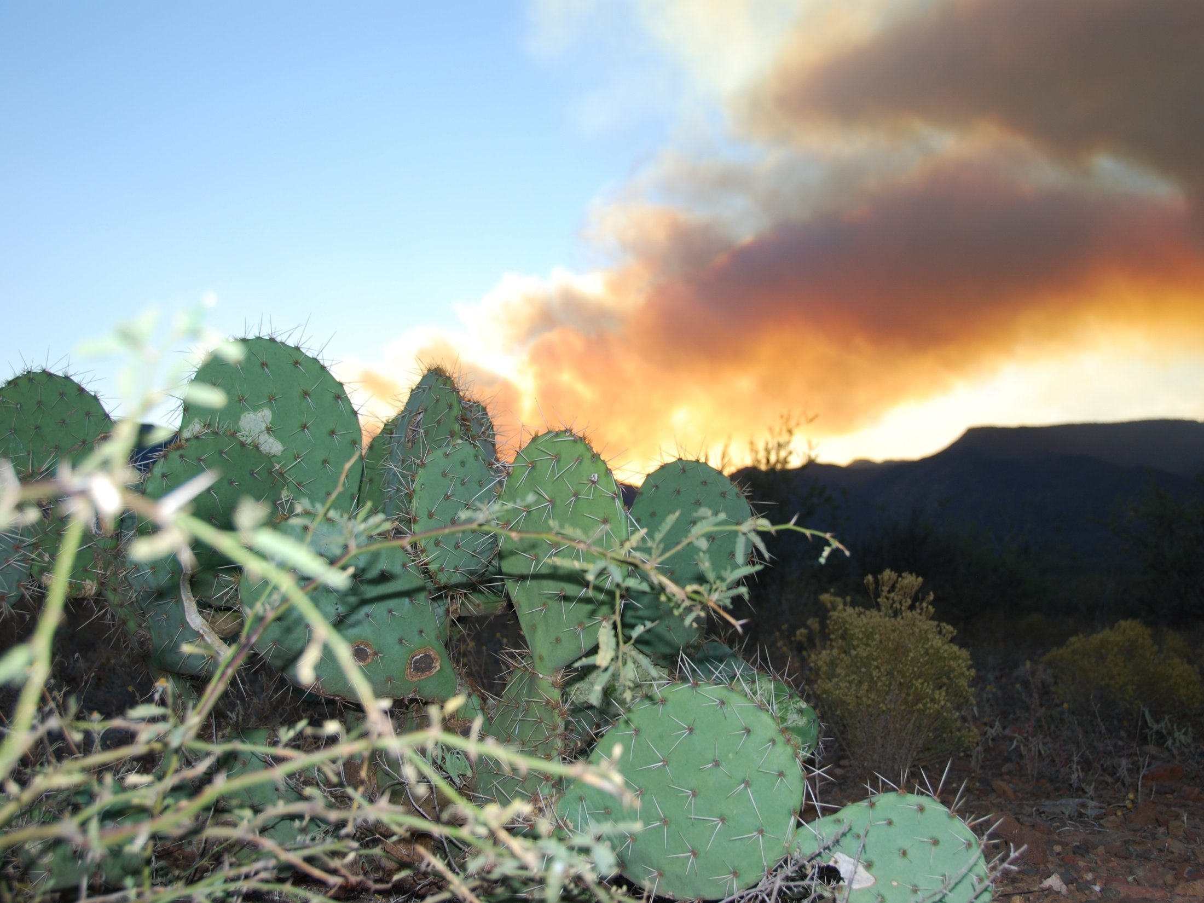
RAM 599: RANGELAND RESOURCE MANAGEMENT
A 3 hr graduate introductory class in rangeland
management designed for non-rangeland
majors or those students pursuing a
rangeland degree who come from a
non-rangeland background.
Material covered includes such topics as:
Ecological Principles and Ecological Sites
Nutritional Ecology of Rangeland Herbivores
Rangeland Management on Public Lands
Rangeland Management during Drought
Spring 2013 Distance Education
Class in Collaboration with
Texas A&M University
For more information contact:
Doug Tolleson
dougt@cals.arizona.edu

Slide 3
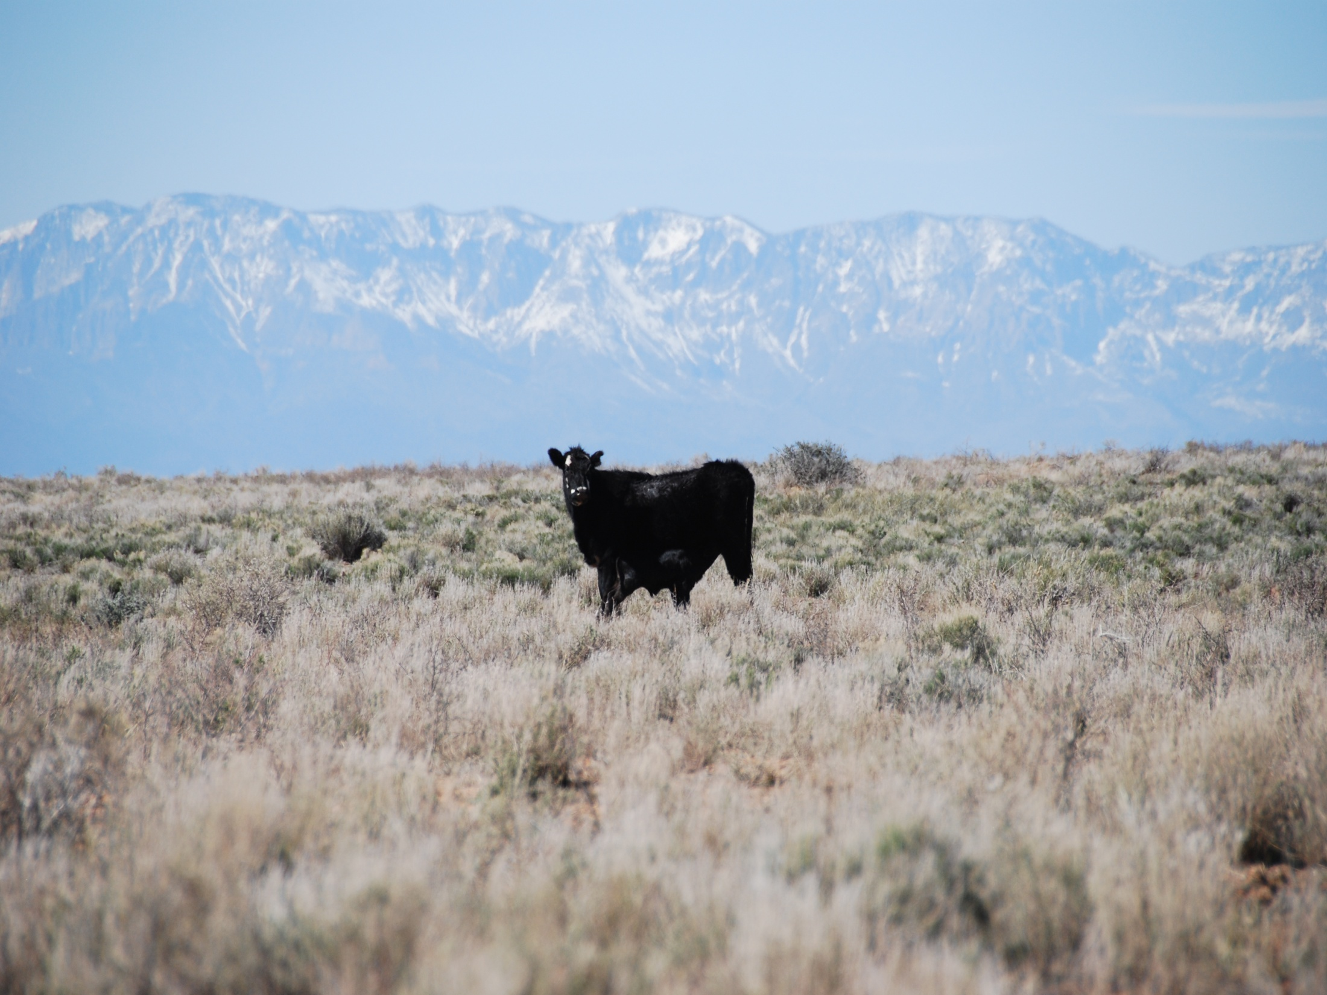
RAM 599: RANGELAND RESOURCE MANAGEMENT
A 3 hr graduate introductory class in rangeland
management designed for non-rangeland
majors or those students pursuing a
rangeland degree who come from a
non-rangeland background.
For more information contact:
Doug Tolleson
dougt@cals.arizona.edu
Material covered includes such topics as:
Ecological Principles and Ecological Sites
Nutritional Ecology of Rangeland Herbivores
Rangeland Management on Public Lands
Rangeland Management during Drought
Spring 2013
Distance Education Class in Collaboration with
Texas A&M University

Slide 4
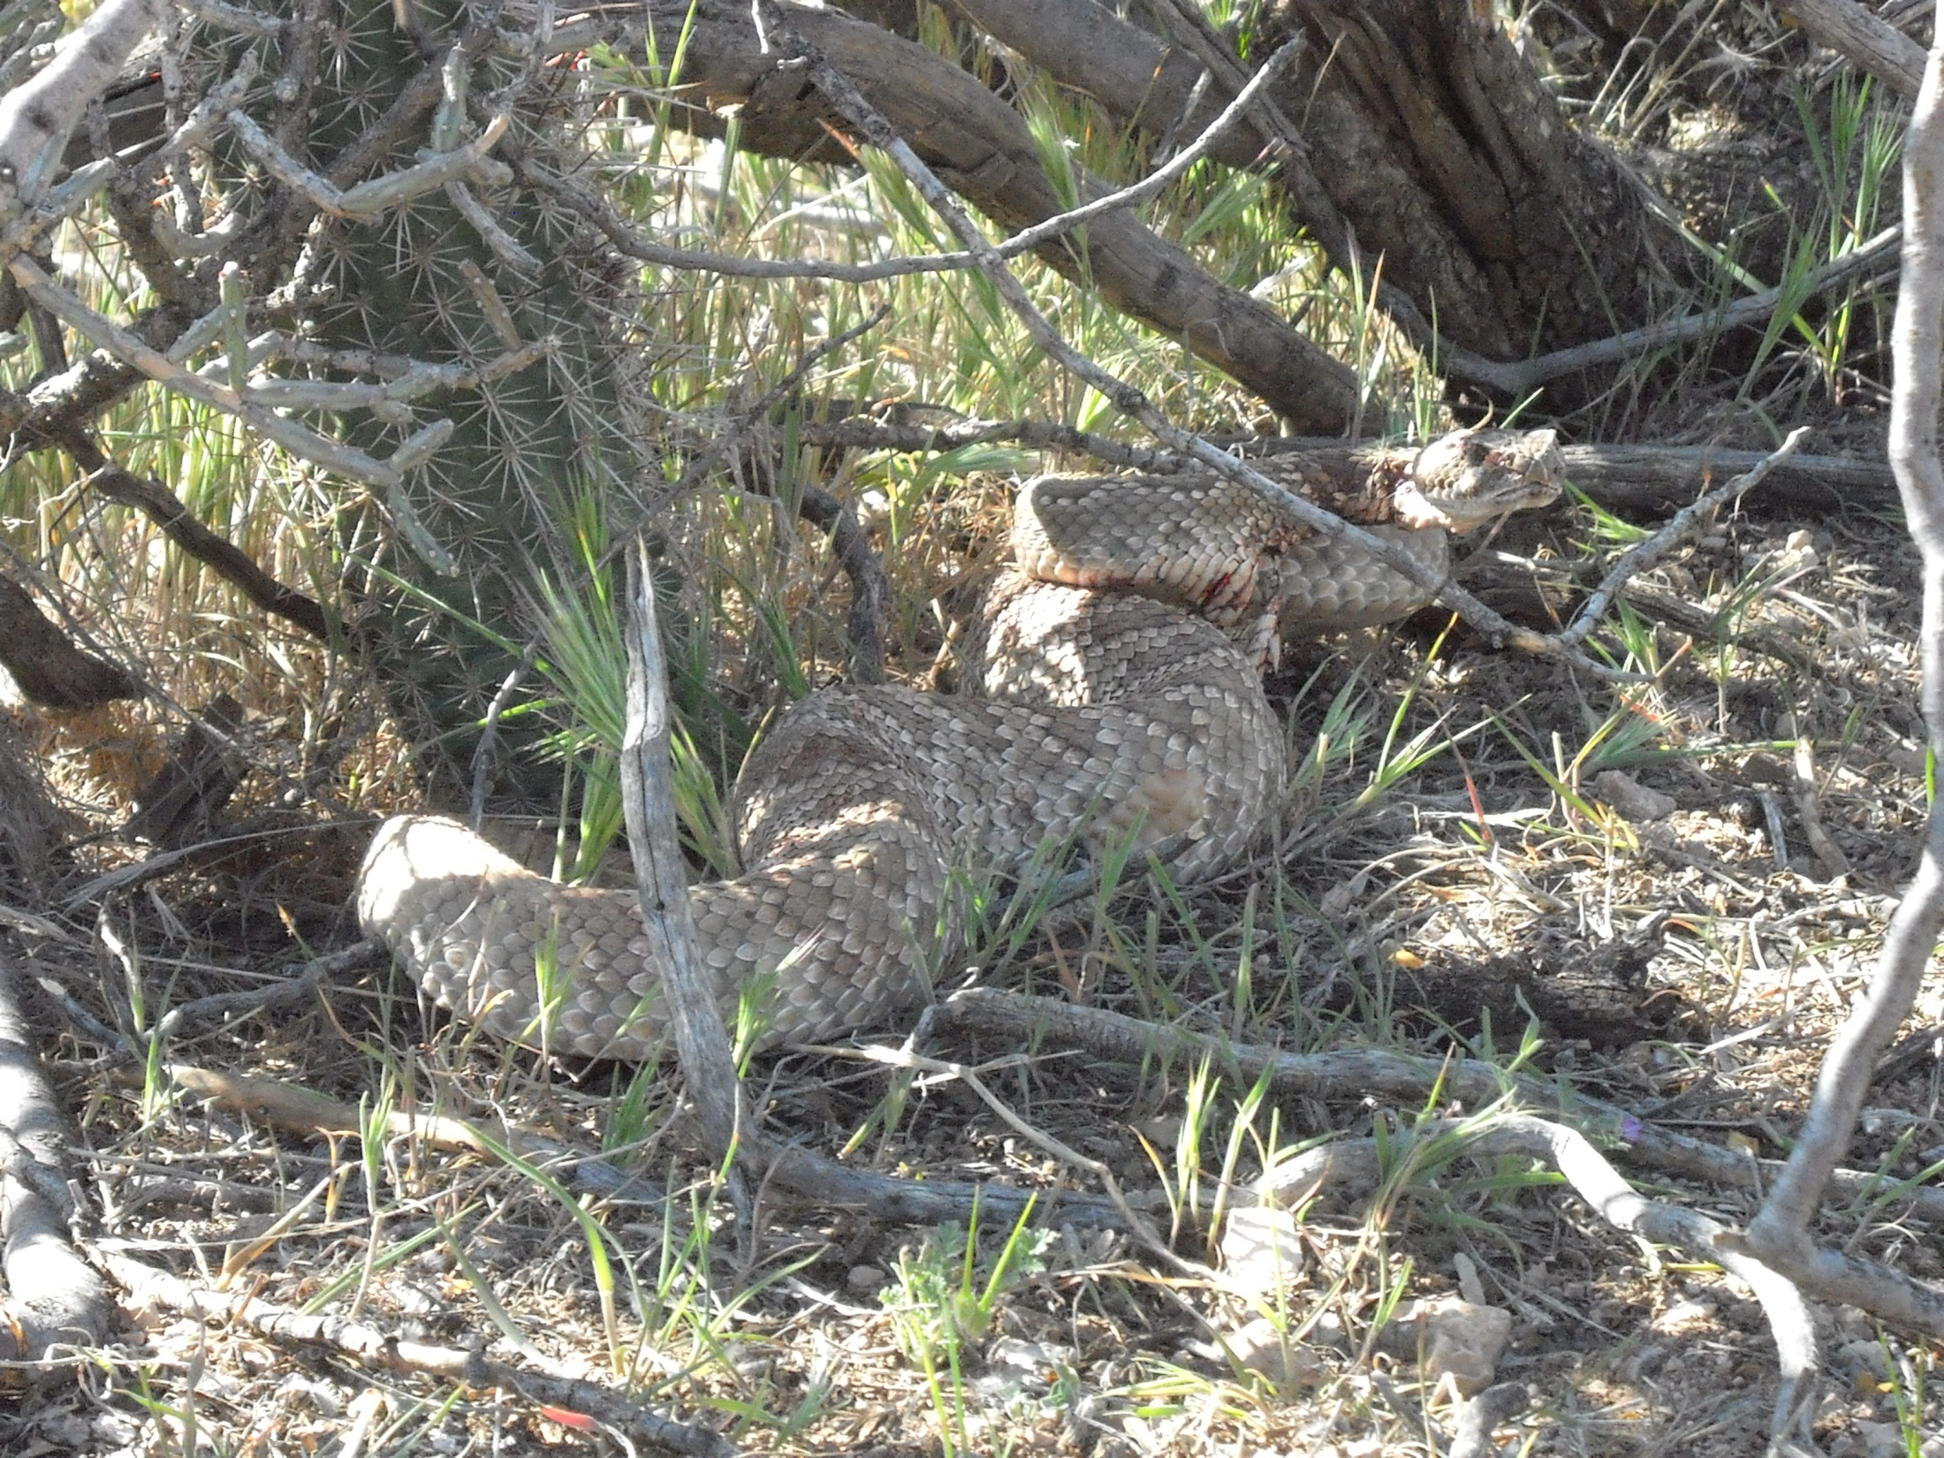
RAM 599: RANGELAND RESOURCE MANAGEMENT
A 3 hr graduate introductory class in rangeland
management designed for non-rangeland
majors or those students pursuing a
rangeland degree who come from a
non-rangeland background.
Spring 2013
Distance Education Class in Collaboration with
Texas A&M University
Material covered includes such topics as:
Ecological Principles and Ecological Sites
Nutritional Ecology of Rangeland Herbivores
Rangeland Management on Public Lands
Rangeland Management during Drought
For more information contact:
Doug Tolleson
dougt@cals.arizona.edu

Slide 5
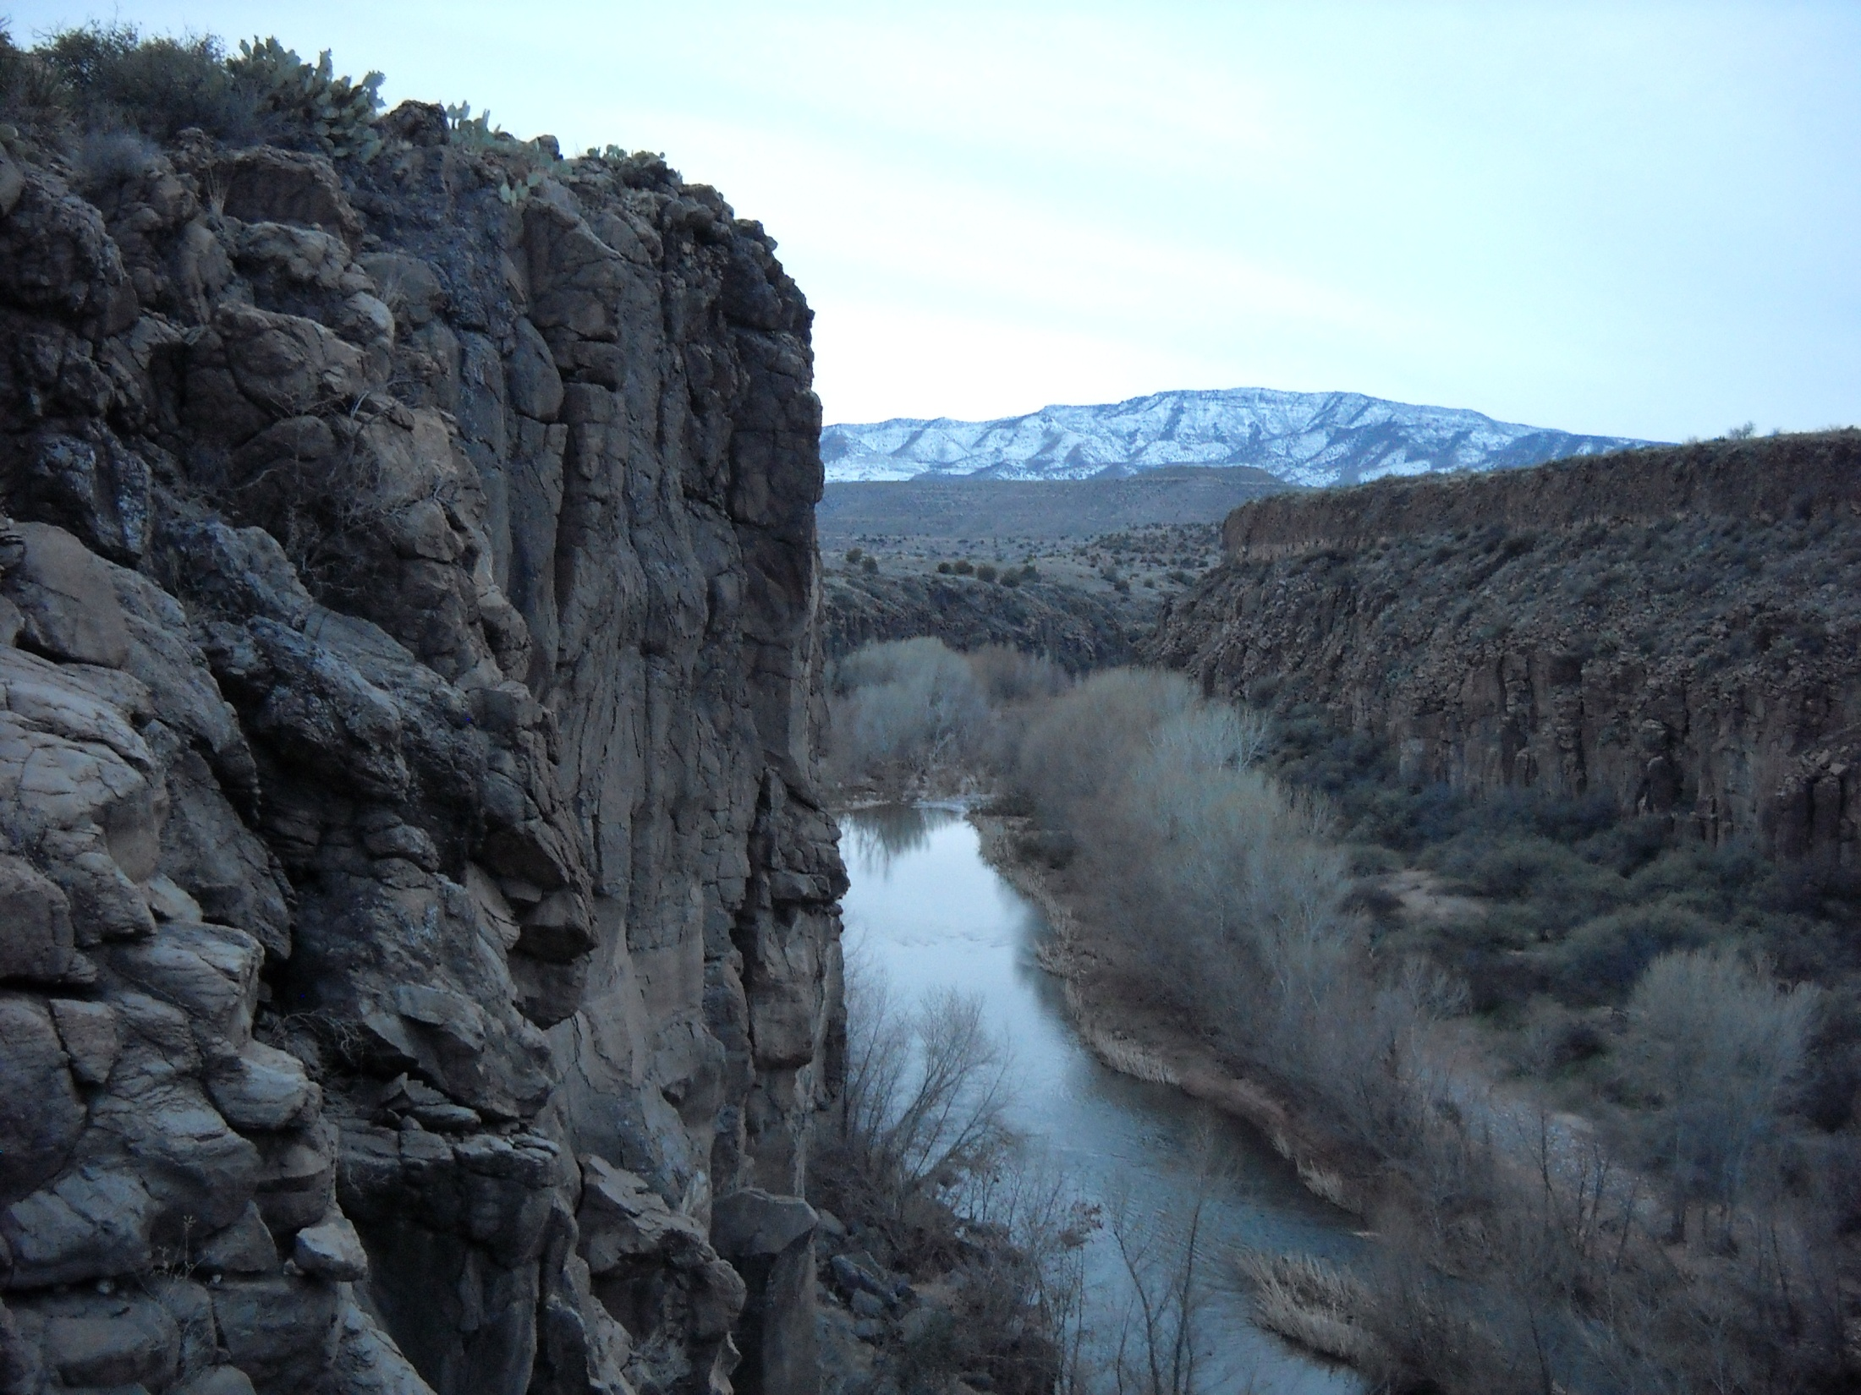
RAM 599: RANGELAND RESOURCE MANAGEMENT
A 3 hr graduate introductory class in
Rangeland management designed for
non-rangeland majors or those students
pursuing a rangeland degree who come
from a non-rangeland background.
For more information contact:
Doug Tolleson
dougt@cals.arizona.edu
Material covered includes such topics as:
Ecological Principles and Ecological Sites
Nutritional Ecology of Rangeland Herbivores
Rangeland Management on Public Lands
Rangeland Management during Drought
Spring 2013
Distance Education Class in Collaboration with
Texas A&M University

