Slide 1
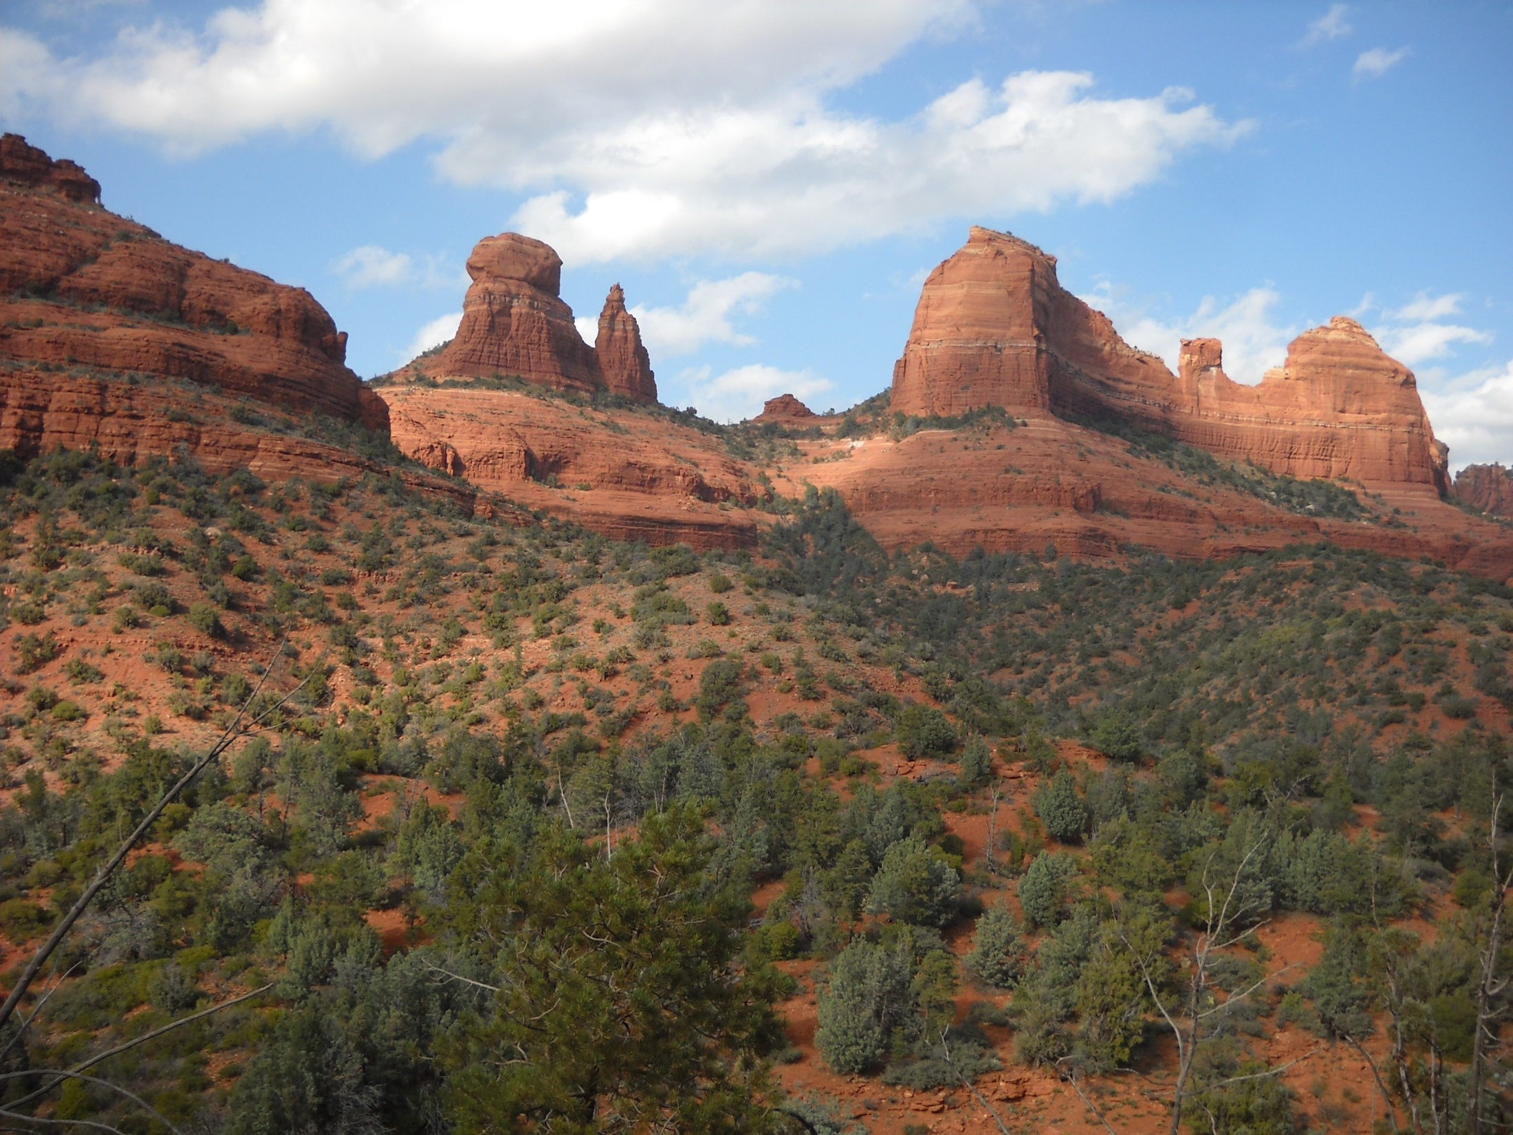

Top 10 Reasons You Should Major in Rangeland Ecology and Management at the University of Arizona
10. Land grant university tradition
9. Diverse and award winning faculty
8. Low student:teacher ratio
7. Tierra Seca, student chapter of the SRM
6. The V Bar V Ranch Experiment Station
5. The Santa Rita Experimental Range
4. One of only ten SRM accredited degree programs
3. University-wide focus on environmental studies
2. ?% employment rate for our graduates the past 5 years
And…
1. Because we are in Arizona!
School of Natural
Resources and the
Environment
College of
Agriculture and
Life Sciences

Slide 2

Rangeland Ecology and Management at the University of Arizona
The rangeland ecology
and management option
offers a flexible program
to prepare you for a
challenging and
rewarding career
managing, advocating
for, and conserving
natural ecosystems in a
changing world.
Career Opportunities Include:
Ranch / Rangeland Manager
Environmental Law / Policy
Conservation Planner
Ecological Restoration
Research Scientist
Extension Educator
International Development
College of Agriculture
and Life Sciences
School of Natural
Resources and the
Environment

