Slide 1
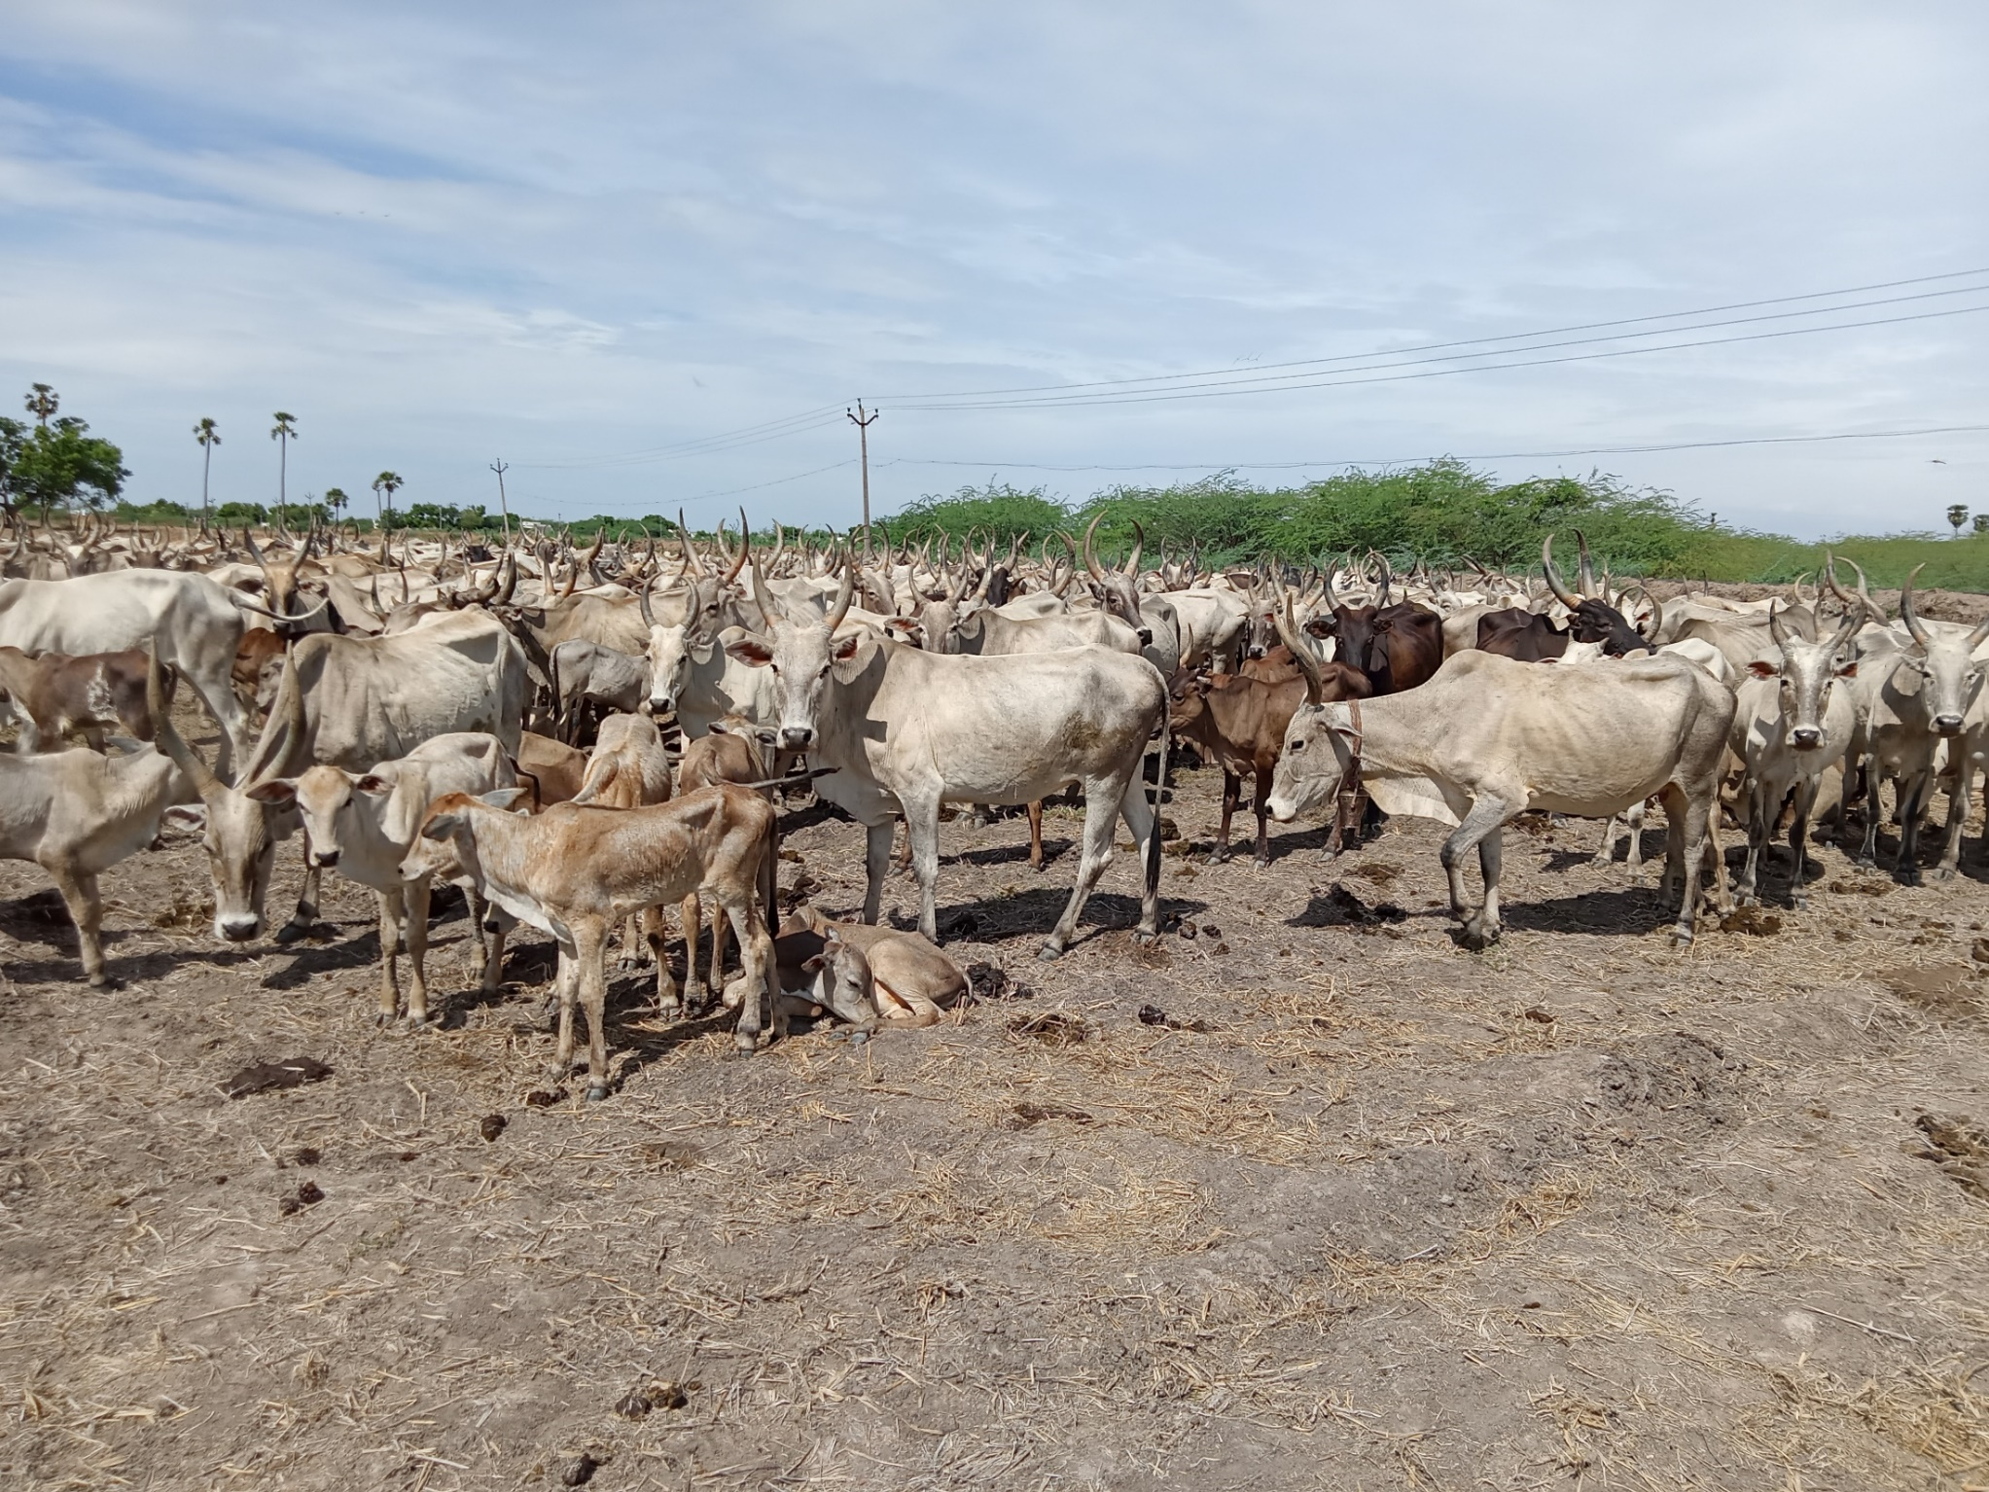

Update from RISG-South Asia
ISG Meeting
July 7, 2023
Tatsama Motilal
Communication team of the IYRP South Asia

Slide 2
Structure of the RISG
Chair: Dr. Arun M. Dixit
Co-chair: Mr. P. Vivekanandan
Communication team: Natasha Maru,
Tatsama Motilal, Rashmi Singh, Anita Sharma,
Sajal Kulkarni, Kishore Sheik Ahamed
Govt Nodal office/Contacts:
Dr. Amaresh Chandra, Range Management Society of India
ICAR-Indian Grassland and Fodder Research Institute, Jhansi
Dr. Anirban Guha, Assistant Commissioner, Pastoral Cell,
Ministry of Fisheries, Animal Husbandry & Dairying,
New Delhi
Membership
Afghanistan | 2
Bangladesh | 1
Bhutan | 1
India | 78
Nepal | 1
Pakistan | 2
Sri Lanka | 2
Others | 5

Slide 3
Updates on activities April-June 2023
# | Date | Event Name | Organised by / in Collaboration with
1 | April 11-12, 2023 | “South Asia-level Learning and Exchange Program to Sustain Pastoralism” at Ahmedabad | SAPA
2 | May 12, 2023 | Online Knowledge Sharing and Dialogue Session – “Towards Sustainability and Inclusion: Public Policy for Pastoralists in Jammu and Kashmir” with Dr. Shahid Iqbal Choudhary, Secy., Tribal Affairs, GoJK | RISG-SA
3 | 29 May to 1 June 2023 | Attended Regional Workshop on Managing Rangelands for Multiple Benefits | ICIMOD

Slide 4
Planned Activities
1 | Raising awareness within communities and other key stakeholders on the importance of pastoralism, rangeland management and IYRP 2026. Identify and map rangelands lands and initiate action for Preparation of Plan for regeneration in association with MGNREGA .
2 | Organizing 2 days National Workshops (13 to 14- Sep-2023) with key stakeholders including policy makers on Rangeland Policy and 10 regional workshops cum exhibition on pastoralist culture, knowledge systems, stories, local breeds, herbal plants for animal health etc. in 10 locations/states- Annually (10 states viz. Telangana, Tamil Nadu, Karnataka, Maharashtra, Gujarat, Rajasthan, Uttarkhand, Himachal Pradesh , Jammu & Kashmir, Ladakh, Arunachal Pradesh)
3 | Document, develop and disseminate communication materials on IYRP themes/papers in local languages 2023-2026.
5 | Recognizing pastoralists through awards for best practices related to pasture land and local breed conservation at South Asia level (10 awards annually at South Asia level) with 30 awards in 2023-26

Slide 5
Action Plans of the RISG- SA
Submission of Project proposal with ILRI, New Delhi office, ICIMOD, Nepal, FAO
Organizing National workshop on Rangeland Policy and Rural Employment Generation Program/MGNREGA for Pasture land development on 13-15 Sep-2023 in association with IGFRI, FES, ILRI, NIRDPR, etc.
Regional/state/cluster level workshop with stake holders on pasture land issues, migration, etc at 10 places during 2023
Documentation of 10 best practices at South Asia and Central Asia level

Slide 6
Challenges experienced by the RISG-SA
No Core funding for group coordination
No full time coordinator but volunteers are active when they are free
Unable to tap Government funds due to laborious procedure

Slide 7
IYRP Song
IYRP IYRP All the Region IYRP (2)
Contribution, Contribution, Collective Livestock Contribution
Country grazing Distribution, Community Contribution
Entry point, Entry point, Economy Country point
Equity only point, Eco-friendly Grazing point [IYRP]
Restore, Pasture Land, Regenerate, Pasture land
Custodian Common land, Customary Pasture land
Castewise Pastoralists, Caring Animal Diversity
Climate Uncertainty, Livestock moving Community [IYRP]
Bio---diversity, Participating Community
Pastoral Activity, for the Service Humanity
Pioneer Community, Passing knowledge nativity
Planet earth priority, climate carbon utility ( IYRP )
Thank you

