Slide 1
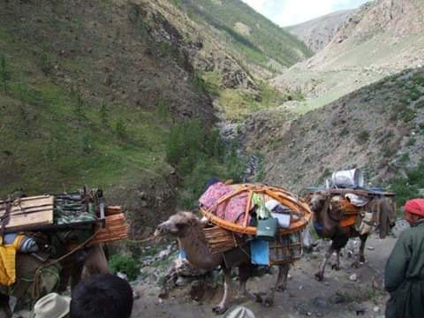

Update of activities
The "Central Asia and Mongolia" RISG, for the International Year of Rangelands and Pastoralists (IYRP)

Slide 2
Structure
CAM Members (2 Co-chairs, Hasrat, me and CG)
Members and partners from CA and Mongolia, other countries
CAPA ( Community land, Policy and Legislation, Agroforestry)
ICCA ToL - NEA
Mongolian Government- National Committee going to established -MoFALI

Slide 3
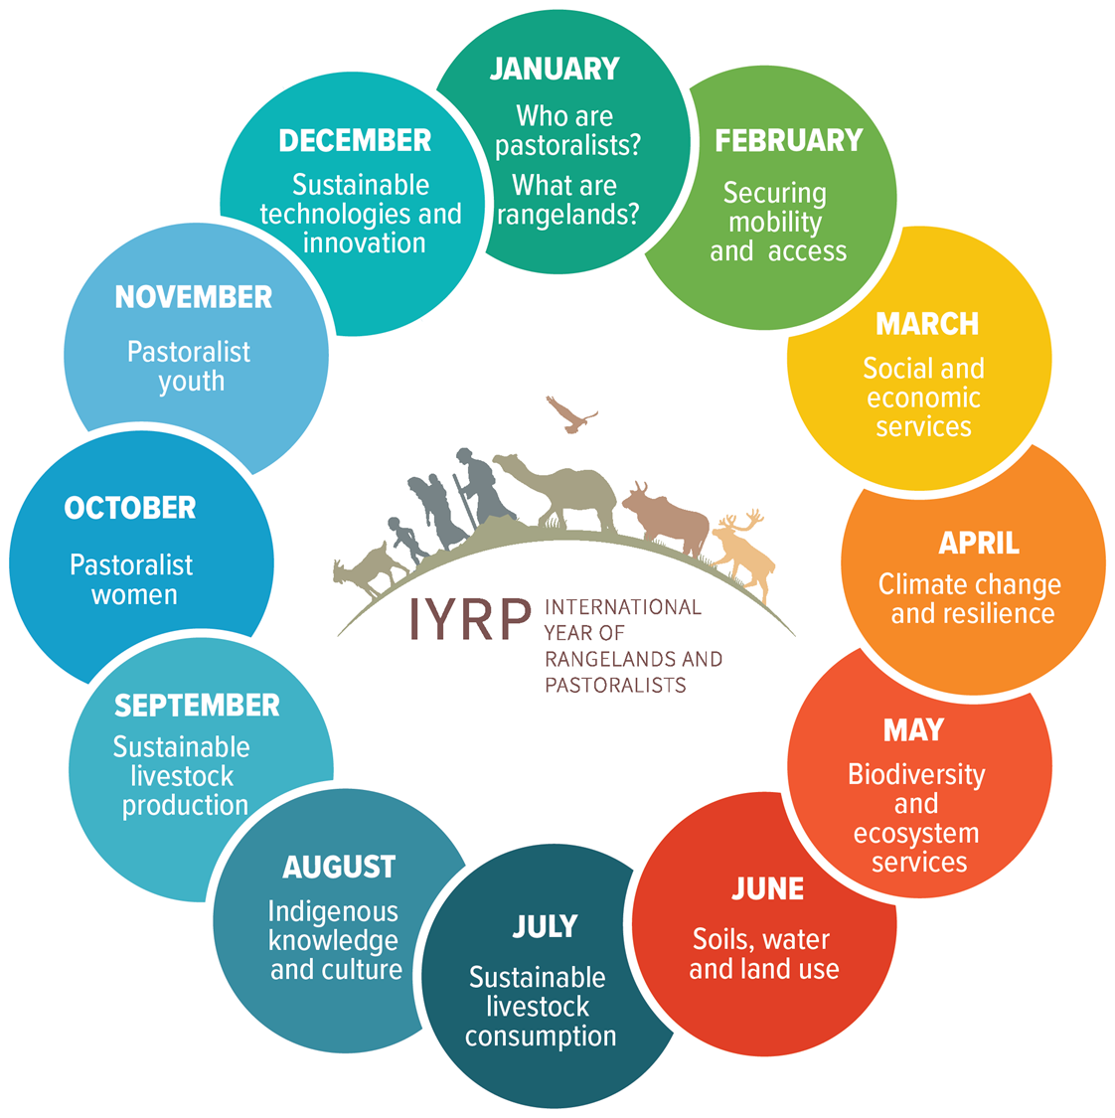
Regional action plan
Organization’s action plans developed by following members of CAM RISG so far: JASIL, Mongolia; TGI, Canada; KAFLU, RDF, Kyrgyzstan; NFPUG, Mongolia; KJ , Kyrgyzstan FOK, Kazakhstan; NADF, Tajikistan; DSST, China (Inner Mongolia)
Table of Action Plan

Slide 4
Events
Mongolian Rangeland Forum , was organized in June, 15 and discuss Monitoring Environmental services of Pastureland
Legislation of Pasture use by herder’s with use contract , but its stile discussing in MP (vs.common resources policy)

Slide 5
Events
Regional online meeting of CAPA , June,
Participants from Kazakhstan, Kyrgyzstan, Mongolia, Uzbekistan, and other countries organizations
- Action plan for 2023
Draft Strategy

Slide 6
Regional and Global level cooperation
CAM Co-Chair participated to the Global Gathering of WeCan Initiative of COFO FAO; Apr.,

Slide 7
Regional Data base
Draft of Data base for the Pastoral Communities in CAM Region
- FAO
- JASIL /CAPA

Slide 8
Plans for next mounts
Workshop “Women in Natural Ecosystems Conservation and Restoration” (Nov., RDF)
Regional Meeting of CAPA ( Oct., Bishkek )
Organize experience sharing retreats among the members and the partners in Mongolia ( Aug., JASIL)
Short Film? ( French moviemaker contacted us, but.)

Slide 9
Plans for next mounts
Certification for the “Responsible Nomads“ for livestock products (Sept., NFPUG)
Publication (issue) of the “AsylZher Press” newspaper on positive examples of pasture management of the State Forest Fund ( KAFLU, Kyrgyzstan)
Organization of Summer Field School on “Mountain Transhumance, Pastoralism and Rangeland Governance”,
(12-15 Sept, TGI, RDF, JASIL, others)

