Slide 1
IYRP.info Regional Editor Guide
September 2022

Slide 2
This Guide will Cover the Following Options for Maintaining Your Regional IYRP Web Pages
Your Account and Initial Login - First confirm your email address and set up your account.
View all content in your region - A place to keep track of all of your Region's content.
Add Content - Add Resources (documents), Friends (logos), Gallery Items (photos) to your regional page. Once saved, they will appear in your Region's landing page.

Slide 3
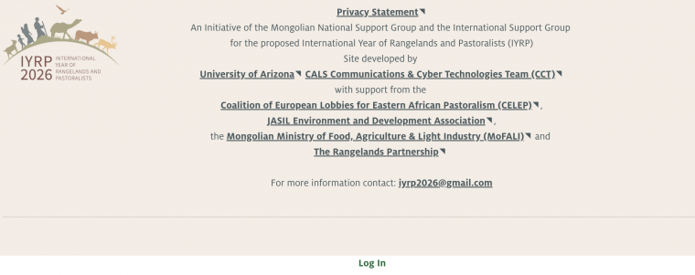
Your Account and Initial Login
1. From https://iyrp.info, scroll to the bottom of the page below the footer and click on the link "Log In“.
2. Click on the "Request New Password" tab. You can come back to this step and reset your password in the future if necessary.

Slide 4
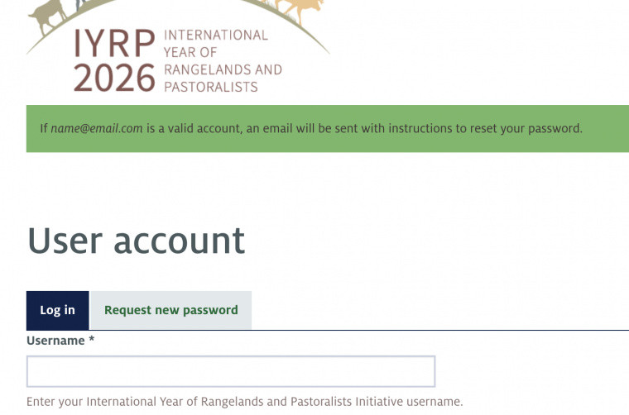
3. In the "Username or E-mail Address" field, enter your email address and click "E-mail New Password“.

Slide 5
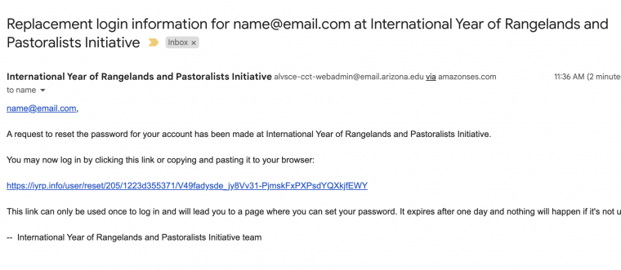
4. Check your inbox for an email from "International Year of Rangelands and Pastoralists Initiative". This may take a couple of minutes. Be sure to check spam and clutter folders. Click the link or copy and paste into your browser.

Slide 6
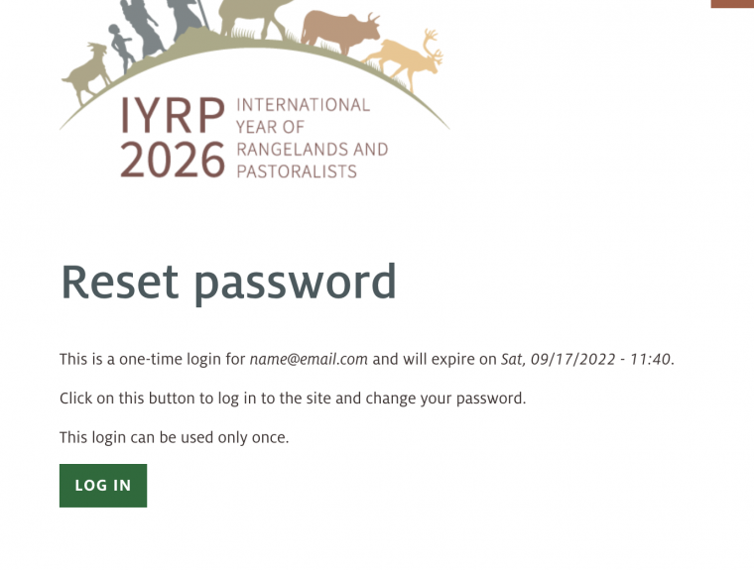
5. Click on the "Log In" button. This link will only be active for 24 hours.

Slide 7
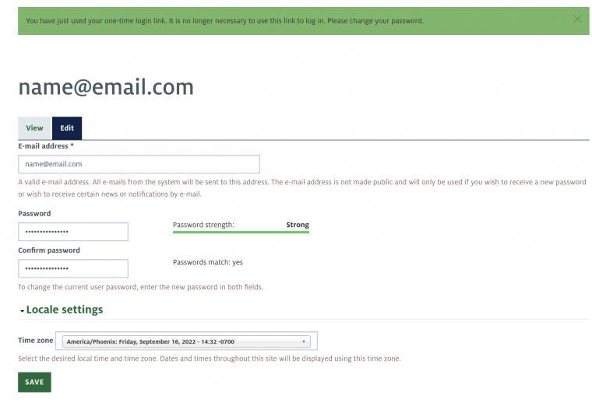
6. Enter a new password into the "Password" and "Confirm Password" fields. Set preferred time zone and click "Save”.
7. You’re now logged in. A "Log Out" link will appear on the bottom of the page if logged in.

Slide 8
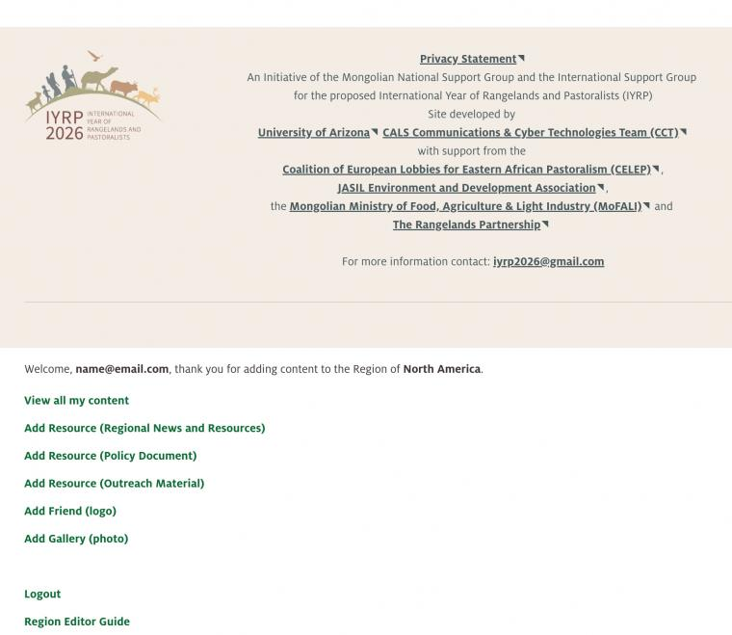
View all Content in Your Region
Once logged in, scroll to the bottom of the page. You should see "Welcome, [username/email address], thank you for adding content to the Region of [your Region].

Slide 9
2. Click on "View all my content" in the footer. This is a dashboard of all Resources (news & documents), Friends (logos), and Gallery Items (photos) created for the Region you are a part of. This is where you go to edit/update or delete existing content.
Add Content (Resource, Friend, Gallery) to Regional Page
1. To add Resources (Regional News and Resources, Policy Documents and Outreach Materials), click on "Add Resource (Regional News and Resources)" in the footer.

Slide 10
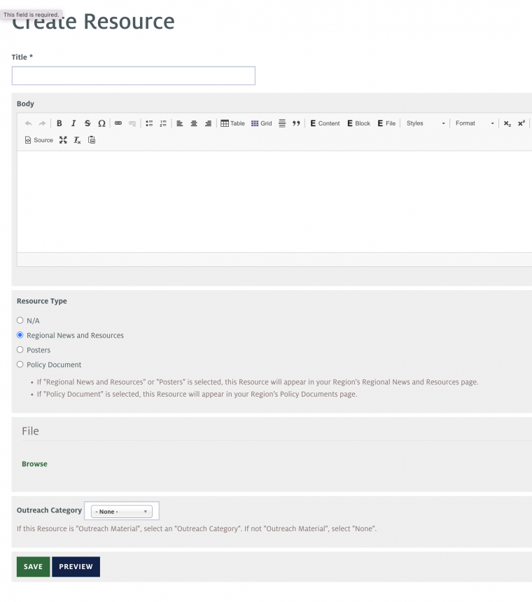

Slide 11
2. Add the following fields:
a. Title: name of the document
b. Body: a description of the document (not required)
c. Resource Type: If "Regional News and Resources" or "Posters" is selected, this Resource will appear in your Region's Regional News and Resources page. If "Policy Document" is selected, this Resource will appear in your Region's Policy Documents page (a Policy box is created on request). If this is an "Outreach Category" or Other, select "N/A".
d. File: Click the "Browse" link to upload a file.
Click "Add files"
Select the files on your computer
Click "Start Upload" button
When upload is finished, click "Next" button
Adjust file name and add description if necessary.
Click "Save" button
e. Outreach Category: If this Resource is "Outreach Material", select an "Outreach Category". If not "Outreach Material", select "None".

Slide 12
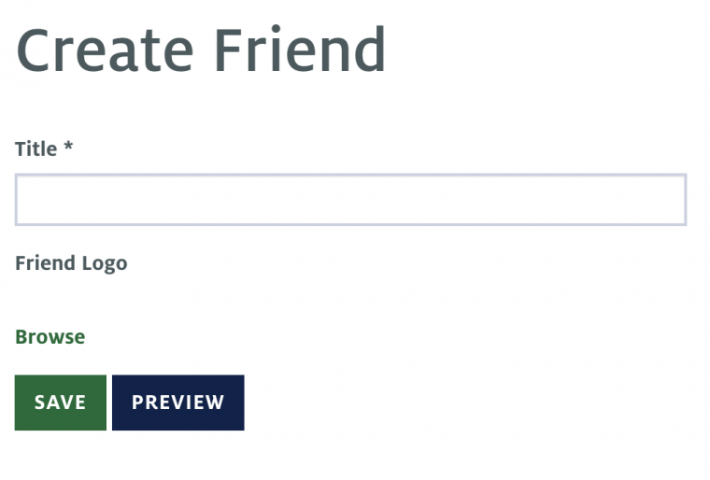
Add Friend (logo)
Click on "Add Friend" in the footer.

Slide 13
Add Friend, cont.
2. Title: Name of what the logo represents
3. Friend Logo:
Click the "Browse" link to upload a photo.
Click "Choose File" and select the file from your computer.
Click "Upload" and then "Next“.
Add any alt text, Title text, image credit or caption as needed. Please only upload images you are allowed and have permission to use.
Click "Save" button.
4. Click "Save" to publish.

Slide 14
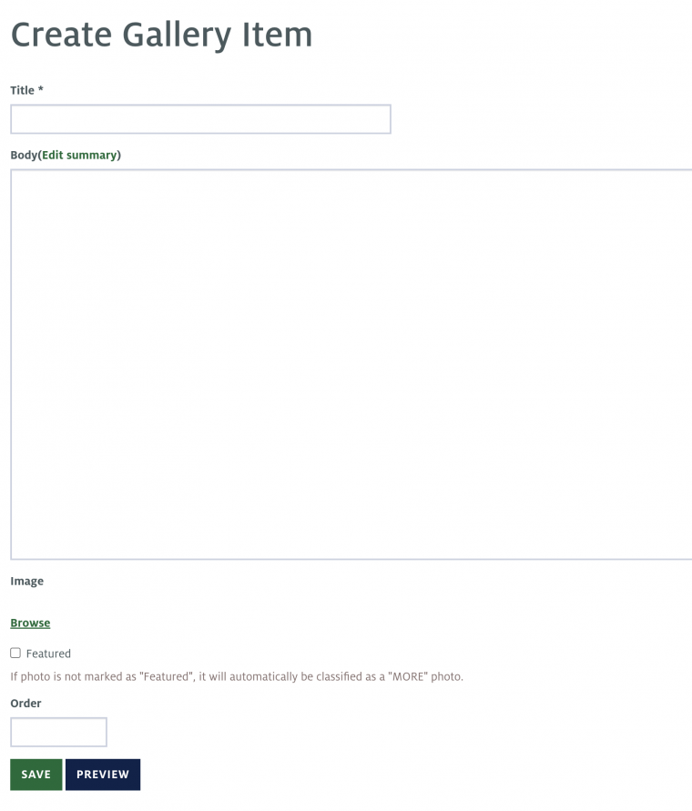
Add Gallery (photo)
Click on "Add Gallery Item" in the footer

Slide 15
Gallery Item, cont.
2. Title: Name of the photo
3. Body: Description of the photo
4. Image:
Click the "Browse" link to upload a photo.
Click "Choose File" and select the file from your computer.
Click "Upload" and then "Next"
Add any alt text, Title text, image credit or caption. Please only upload images you are allowed and have permission to use
Click "Save" button
5. Featured: If the "Featured" checkbox is checked, it will be placed in the "Featured" section of your Region’s landing page Gallery. If this box is not checked, the image will appear in the Region’s "More" photo section.
6. Order: The order of the image will appear in relation to other images. For instance, images with an Order of 1 or 2 will appear before images with an order of 7 or 8.
7. Click "Save" to publish.

Slide 16
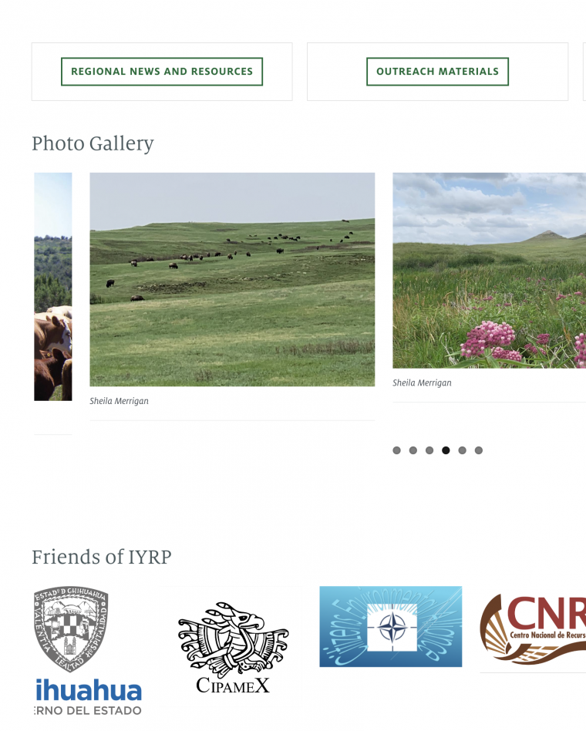
Check your content
To review your content, first go to “View all my Content". A link to this page is in the footer if you’re logged in. Your new content should be displayed on this page.
Then go to your Region’s landing page and look for your content in the correct section. For example: https://iyrp.info/north-america:

Slide 17
Questions?
Contact:
Barbara Hutchinson (barbarah@cals.Arizona.edu)
Ann Waters-Bayer (waters-bayer@web.de)
Craig Boesewetter (craigboes@cals.arizona.edu)

