Slide 1

Title
Subtitle
www.iyrp.info

Slide 3


Slide 6
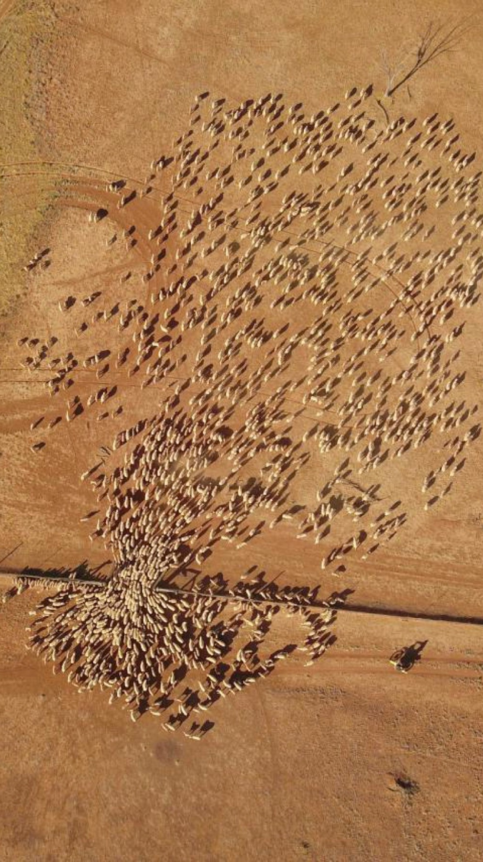

Slide 7

Thank you

