Slide 1


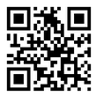
You might be a Range Nerd If
You might be a #RangeNerd if
Something creative in this box
Personal Logo Here

Slide 2
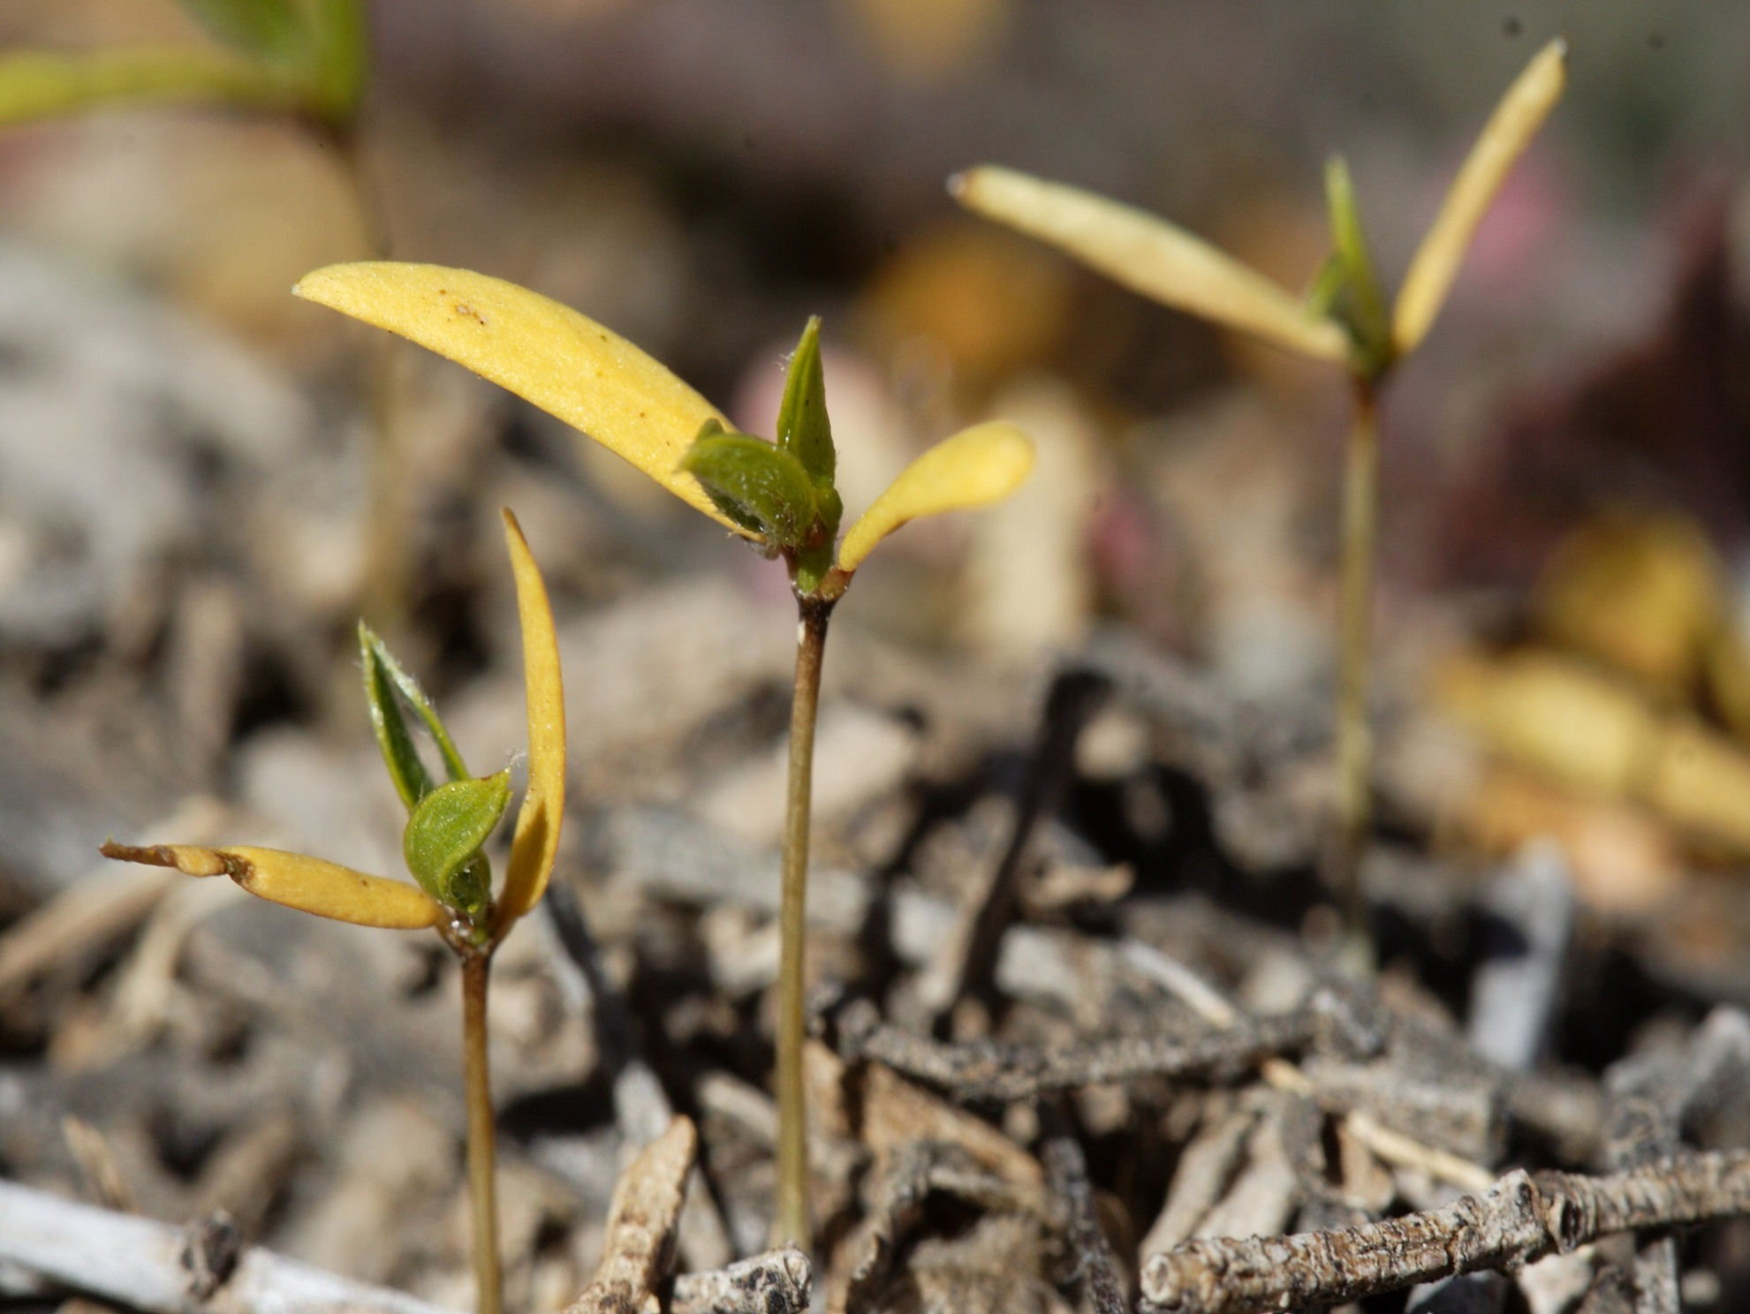



You might be a #RangeNerd if
EXAMPLE:
Add a picture (Recommended size: 6.75” height and 9” width)
Add creative text (Readjust font size as needed)
Add personal logos in bottom right corner
“Cute as a Cotyledon” is a term of endearment
Notes:
This is an Example of a #RangeNerd Meme

Slide 3
We Are Rangelands
Location of image or creative text in this box
Personal Logo Here
Notes:
This is an Example of a #RangeNerd Meme

Slide 4
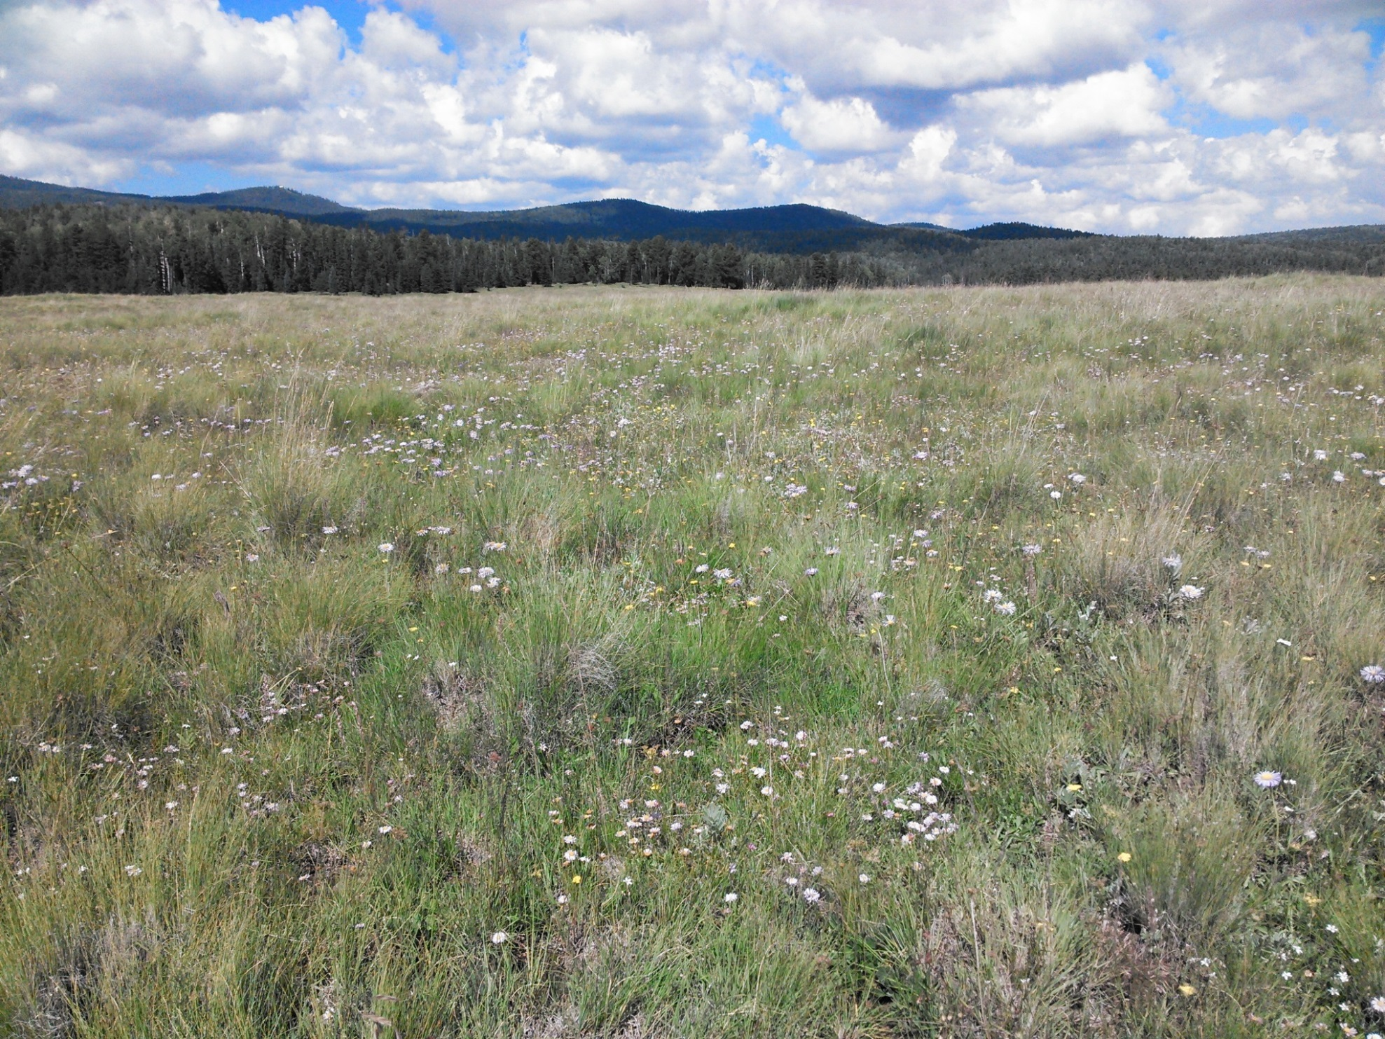
We Are Rangelands
EXAMPLE:
Add a picture (Recommended size: 6.75” height and 9” width)
Add the location (including state) or creative text (Readjust font size as needed)
Add personal logos in bottom right corner
White Mountains
Arizona
Notes:
This is an Example of a #RangeNerd Meme

