Slide 1
Global Rangelands Data Entry
Cheat Sheet

Slide 2
How to add content
Click “Login” from the menu
This will bring up a login page (not shown). Enter your username and password.
Click “Dashboard” from the menu
Notice recently searched and suggested content on the home screen.
Click “Add Content” link.
This takes you to the data entry page.

Slide 3
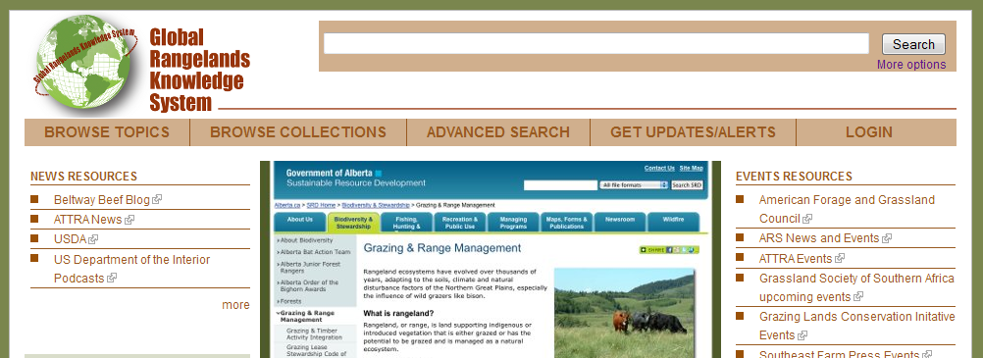
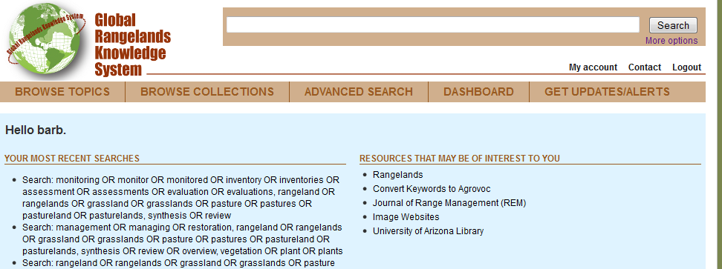
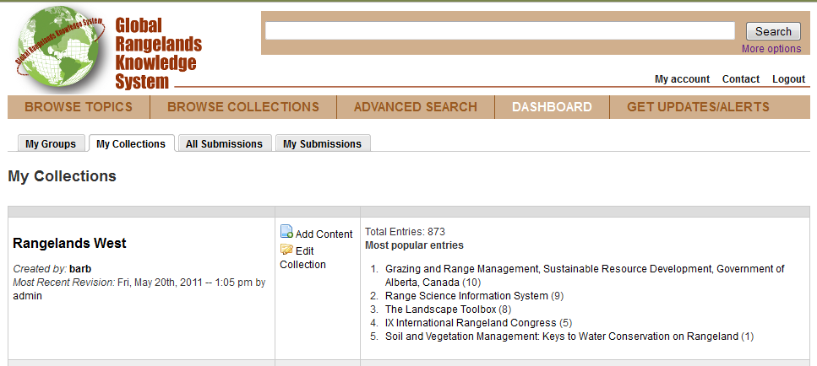
1
2
3

Slide 4
Data Entry Page
Enter the Title of the content
Select the Collection where you wish the content to get added
If checked, the content will be added to the Front Page slideshow
Enter the name of the Author (First name Last name. example John Smith. Add middle initial, if needed).
As you type, the system will try to suggest similarly-spelled authors
If you need to add more than two authors, click the “Add another author” button
Enter the name of the Publisher
As you type, the system will try to suggest similarly-spelled publishers
Is there a Publication Date? Websites often do not have a publication date
If so, click “Yes”. An additional field for the Year will appear
Enter the Language
Enter a Description. This is analogous to an abstract
If the content of the resource is online, enter the URL
If the content is a file that needs to be uploaded to the database, check the box
An additional box will appear which allows you to browse to the file on your computer
Enter the Document Object Identifier (DOI), if available, of the resource
Select the Resource Type from the pull-down menu
Select the Document Type from the pull-down menu
Additional fields will be added for certain document types (see last page)
Enter a Keyword. If the keyword exists in AGROVOC, it will appear below the box. Select it.
If the keyword does not exist in AGROVOC, add a Non-AGROVOC Keyword here.
Press “Add” button after each keyword
Enter a Geographic Keyword.
Press “Add” button after each geographic keyword
If you want your state site to include this resource, add the State name.
If a Citation exists, enter it here. This field is totally optional, and is used to catch metadata that is not previously entered.
Click the Save button to add the content to the database. Otherwise your entry will be lost.

Slide 5
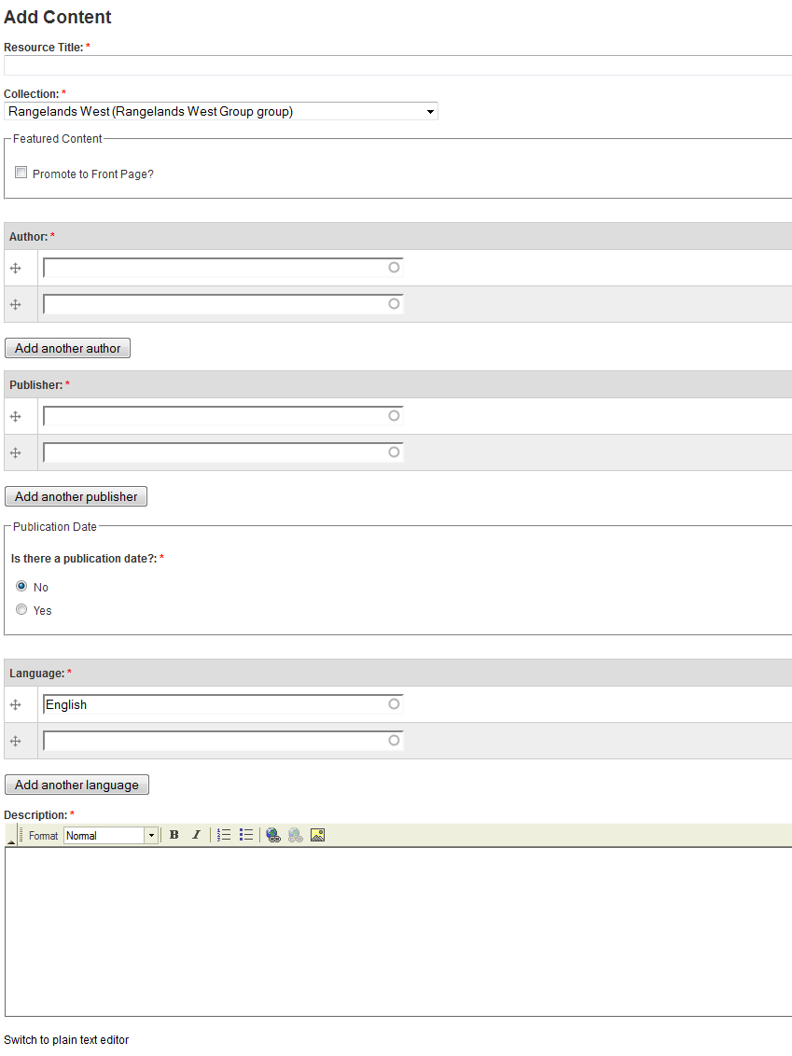
1
2
3
4
5
6
7
8

Slide 6
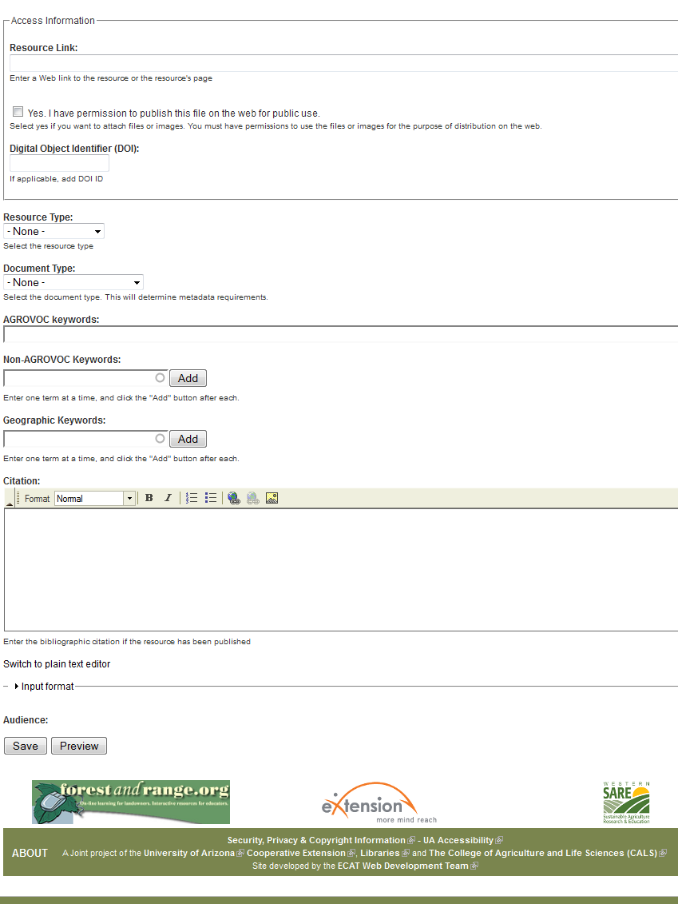
9
10
11
12
13
14
15
16
17
18

Slide 7
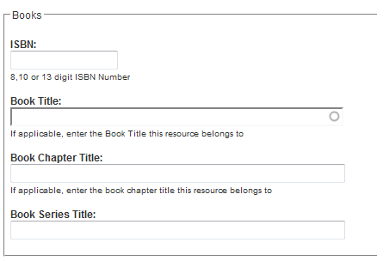
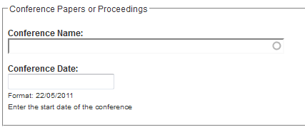
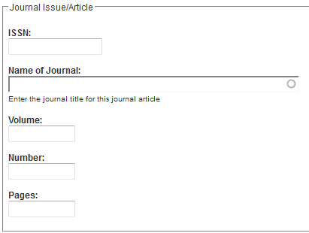
Additional Fields
Books
Conference Paper or Proceeding
Journal Issue or Article

