Slide 1
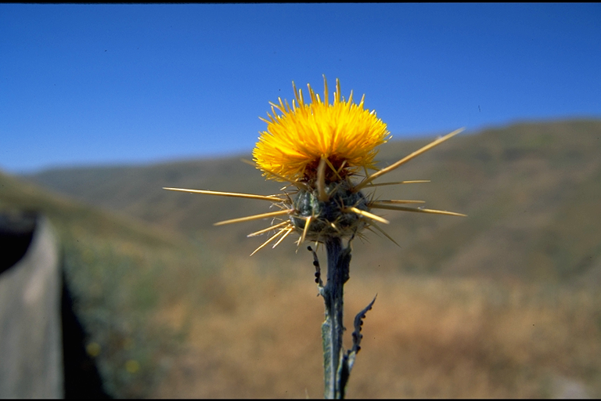
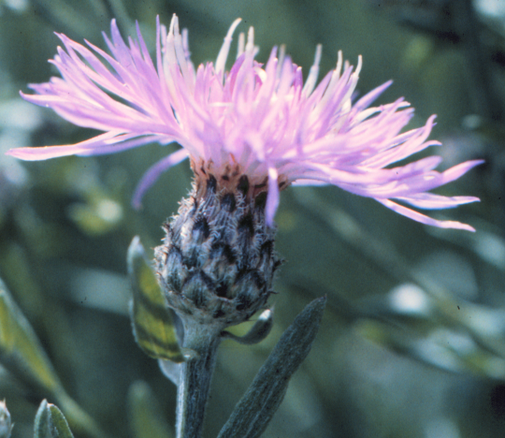
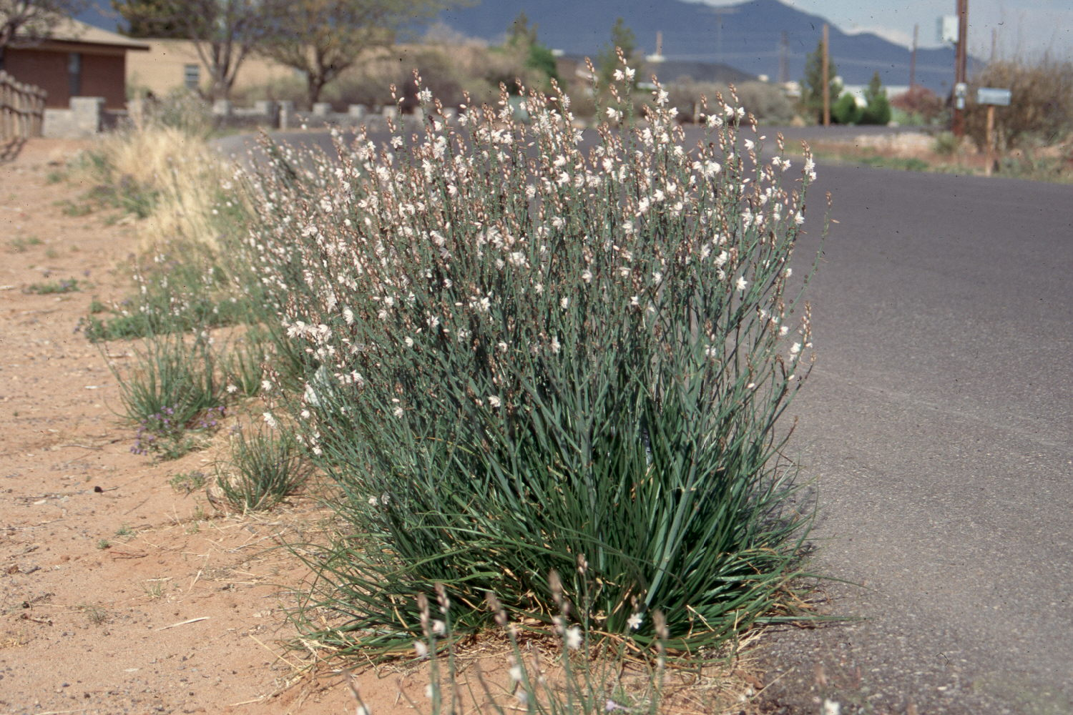
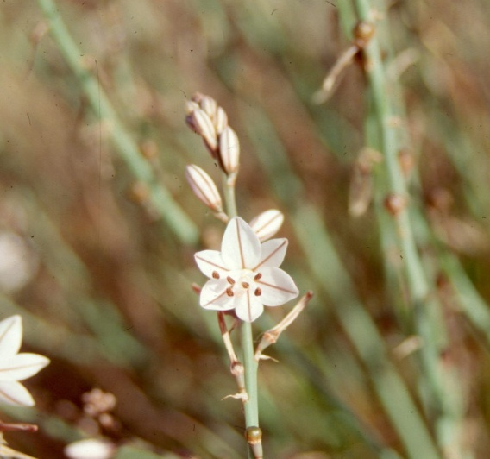
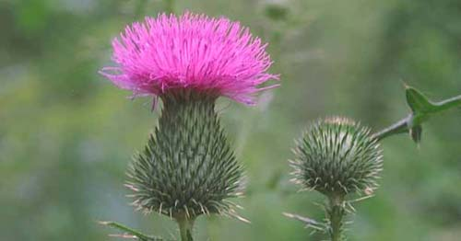
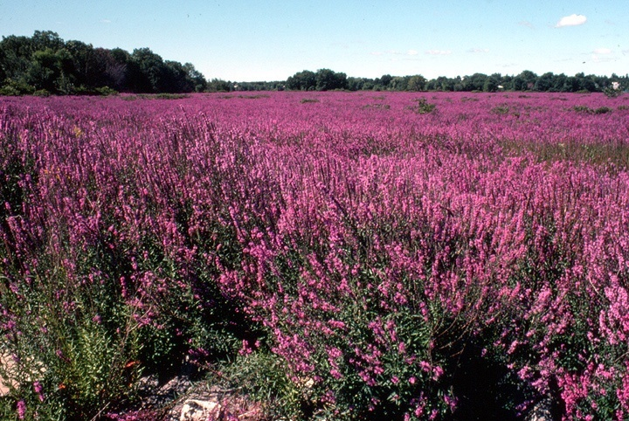
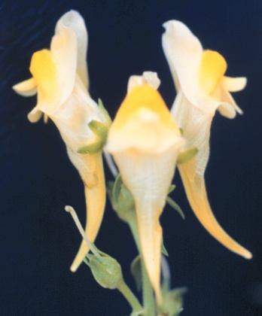
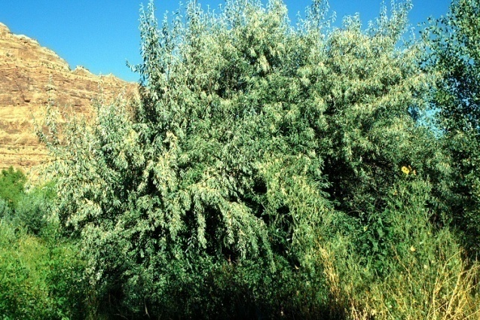
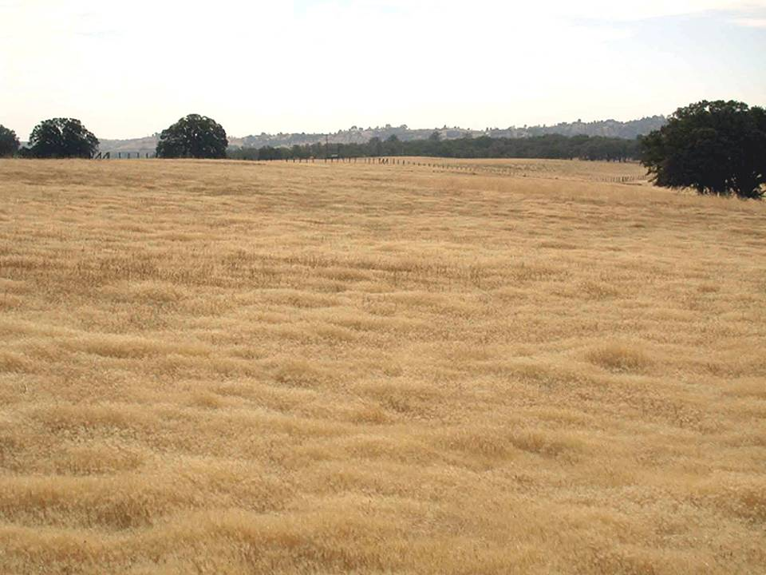
NOXIOUS, INVASIVE PLANTS OF ARIZONA (RNR/PLS 400)
Five Week, Summer Session I, 2021; 3 credits
Dr. Larry D. Howery (lhowery@ag.arizona.edu; 309-5412)
Fully On-line (D2L) Course
Course Synopsis: This fully on-line (mostly asynchronous) 3-credit course will “meet” June 7-July 8, 2021 and will provide an overview of the biology, ecology, impacts, and management options for noxious, invasive plants in Arizona and the western U.S. The course’s primary focus is on Arizona and the western U.S., however, it will also provide an overview of the ecological and economic effects of invasive plants across North America.
Background: Noxious, invasive plant problems in the western U.S. have been described as “a slow-moving biological fire.” When small weed infestations are left unchecked, they may grow exponentially. However, land impacted by fire usually recovers and may be more diverse and productive than before the fire occurred. On the other hand, land infested by invasive plants may be irreversibly changed. Invasive plants also cause economic problems by negatively impacting human and animal health, disrupting the structure and function of natural ecosystems, and decreasing land values. Many weed scientists compare small infestations to biological time bombs, primed to expand exponentially when the right combination of environmental conditions come along. The risk of ignoring these infestations is great. In Arizona and throughout the western U.S., there are opportunities to control smaller infestations before they expand their range into previously uninfested areas.
Course Objectives and Expected Learning Outcomes: The primary objective of this course is to help you develop a deeper understanding of noxious and invasive plants that are currently established in Arizona or that threaten the state. By the end of this course, you will have achieved the following learning outcomes: 1) ability to describe various ecologic and economic impacts of noxious, invasive plants, 2) ability to site-identify ~ 30 invasive plant species presently in the southwestern U.S., 3) increased understanding of the biology and ecology of invasive species, and, 4) increased understanding of various integrated vegetation management strategies and tactics available to manage noxious, invasive plants.
Course Methodology and Teaching Format: Time management will be critical in this 5-week course which “meets” online (mostly asynchronously) 5 days/week for ~ 5 consecutive weeks (June 7 – July 8, 2021). Each class day, there will be a Learning Module that you will be required to read, and, an on-line Discussion Assignment that you will be required to complete by the end of the day (unless the day has been devoted to a quiz). There will be 4 quizzes given weekly throughout the session, and you will be required to develop a PowerPoint® presentation on a noxious or invasive plant topic that is approved by me. Questions? Call or email Dr. Howery (see contact information, above.)

