Slide 1

American Society for Horticultural Science • ashs.org • @ashs_hort • 703-836-4606
Join ASHS!
ASHS is a network of researchers, scientists, students, industry professionals, and government employees from around the world – all interested in discussing and promoting all areas of horticulture and plant sciences.
ASHS shares your interests and is a key asset in the growth and development of your future.
Connect with others through interest groups, the ASHS E-News, the ASHS Annual Conference, and our social media. Members are recognized each year through society awards, published works, competitions, student scholarships and travel grants.
Members receive discounted publishing fees in any of the three peer-reviewed journals – HortTechnology, HortScience, and the Journal of the American Society for Horticultural Science.
Students receive FREE membership during undergraduate years (and graduate students receive one year FREE).

Slide 2
American Society for Horticultural Science • ashs.org • @ashs_hort • 703-836-4606
Member Benefits
• Professional Interest Groups – Join more than 50 specialized groups; network and collaborate with ASHS members from around the world
• ASHS Mentoring Program – One-on-one mentoring with experienced ASHS professional members
• ASHS Career Center – post and search for jobs, get resume and interview tips, set up job alerts
• Access Webinars presented by experts in their field of horticulture - get your questions answered in real time or review archived webinars
• Twice monthly ASHS E-News
• ASHS Annual Conference – present your work; participate in workshops, tours, and competitions; meet peers and experts in academia and industry; discounted registration for members
• Reduced Publication fees in the open-access publications of ASHS
• Leadership opportunities on our Committees or Professional Interest Groups

Slide 3

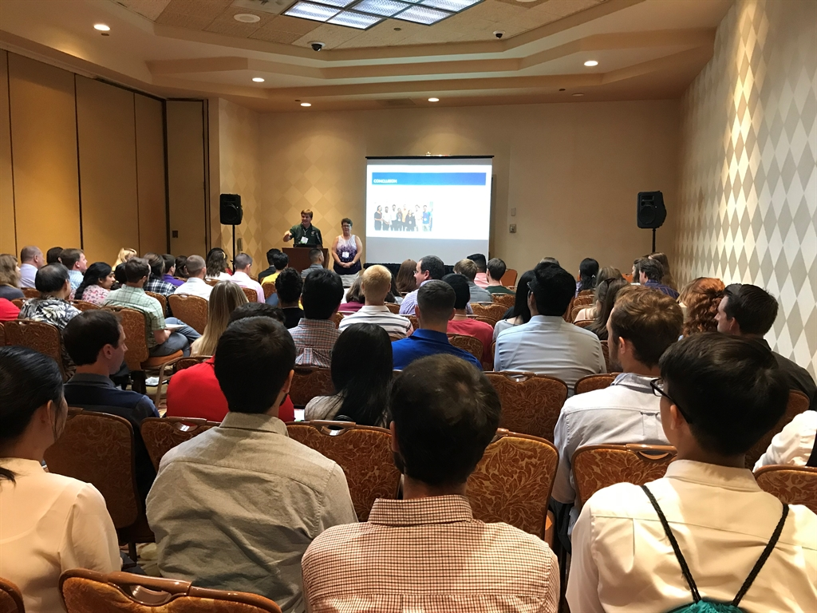
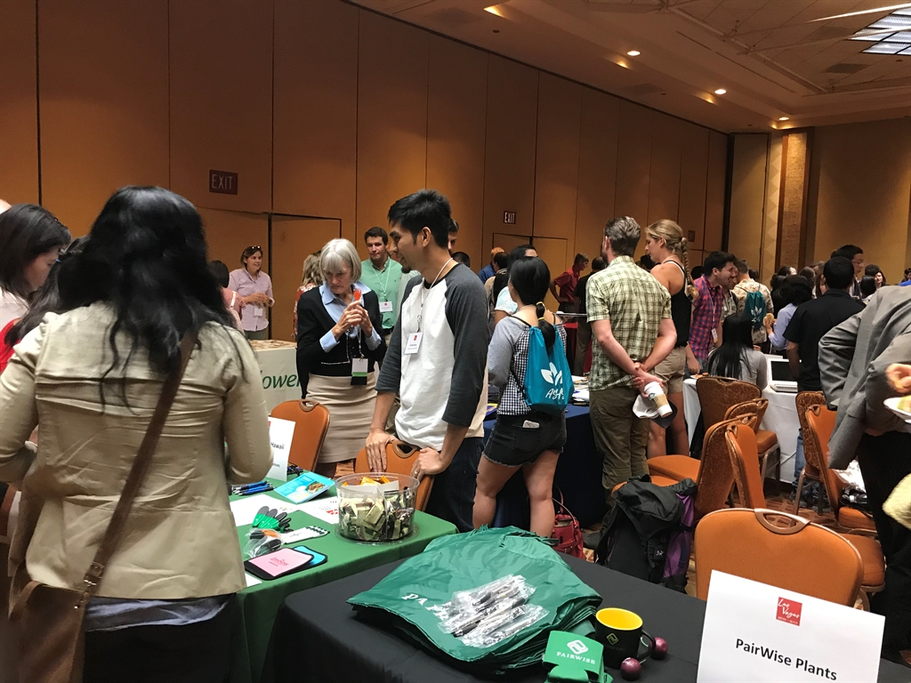
ASHS Annual Conference
August 5th - Student Education and Career Day
Attend career planning sessions run by experts from academia, industry, and extension
Career Fair and Networking Reception
Meet representatives from industry, academia, and government and get your questions answered in person

Slide 4
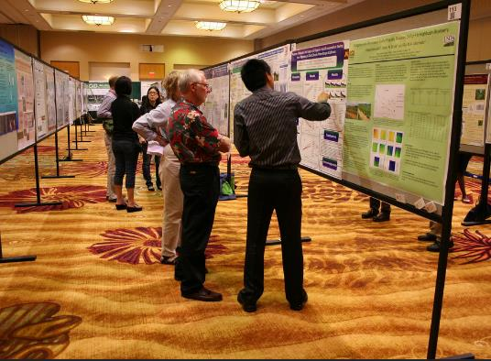
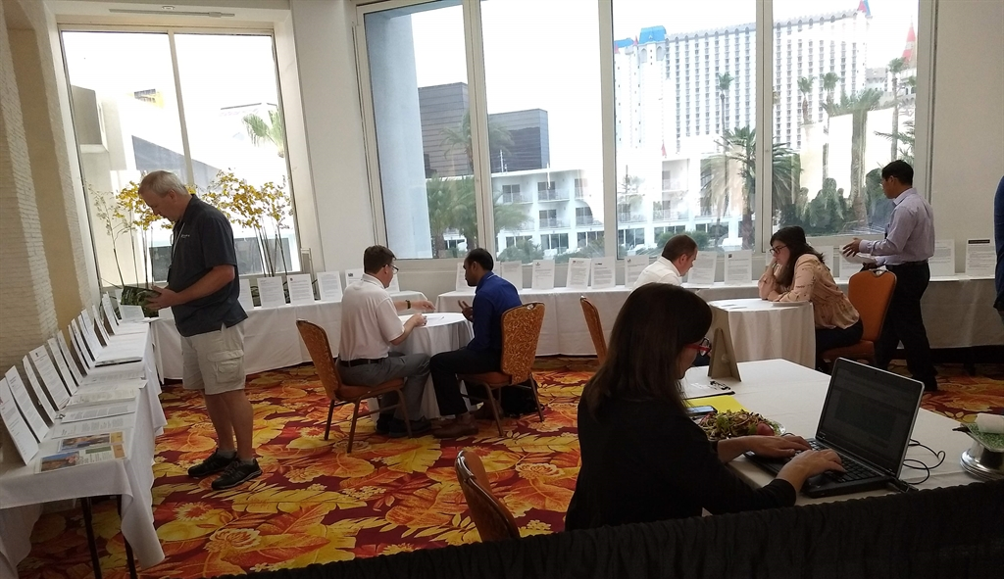
ASHS Annual Conference
Present your research and receive feedback on your presentation; Q&A chat box allows for questions to be posted and sent to you post-conference
E-Posters are published to ASHS website and available permanently
Attend sessions outside of your field to gain perspective on other specialties
Visit the Career Center and sign up for resume reviews and advanced education advising
Visit Exhibitors - many of them are potential employers and travel sponsors!

Slide 5
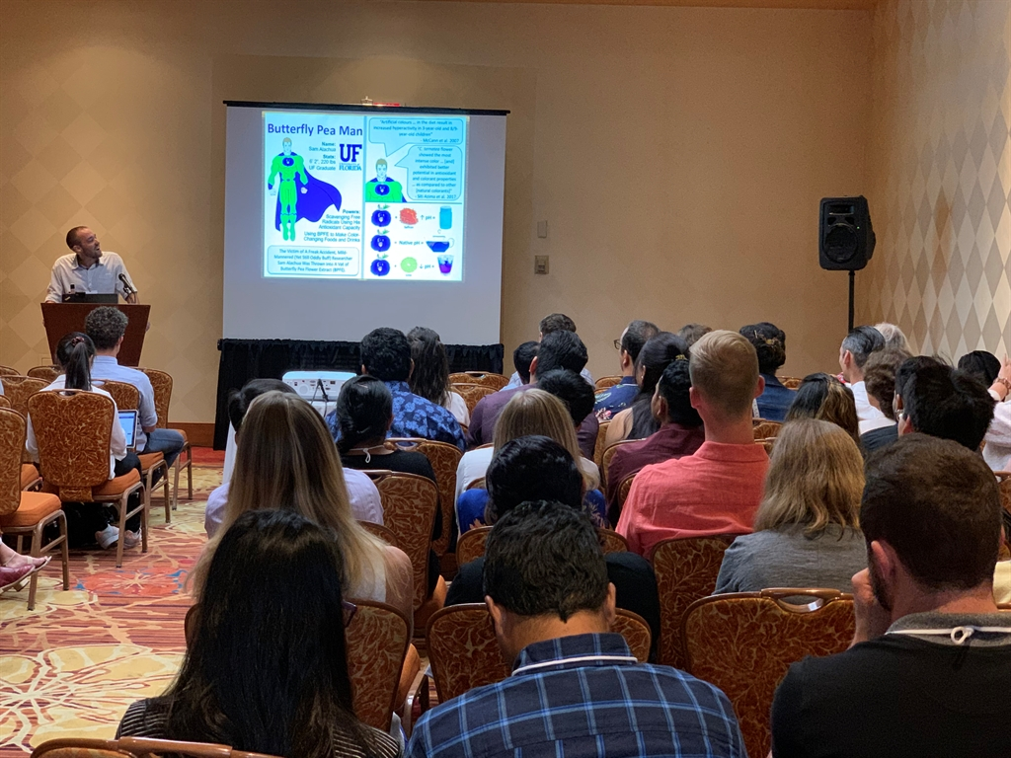
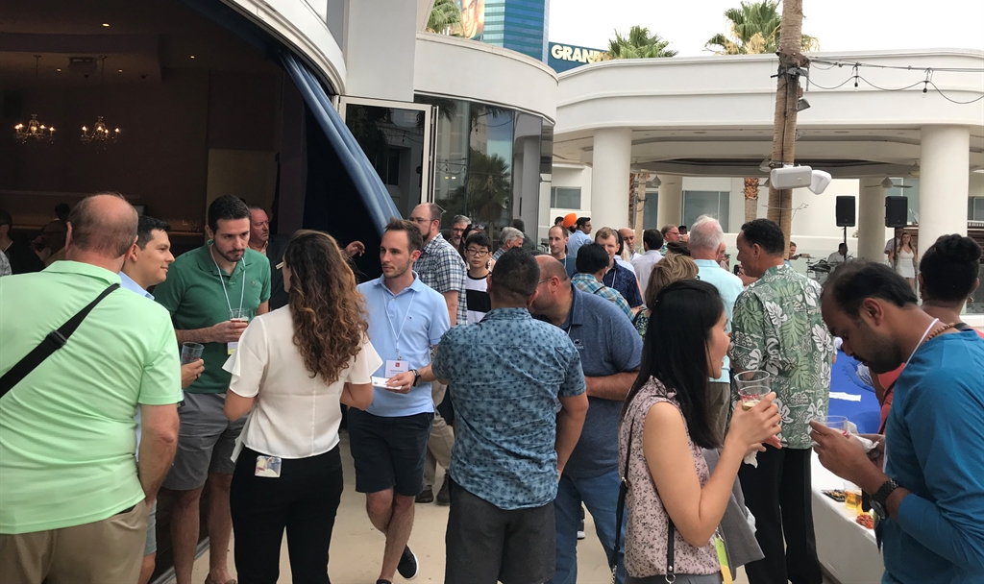
ASHS Annual Conference
Participate in student competitions:
Undergraduate Oral and Poster Competitions
Graduate Student Poster Competition
Scholar’s Ignite
Controlled Environment Oral
Floricultural Oral
Plant Growth Regulation Oral
Network:
Meet like minded peers from other institutions and experts in academia and industry
Opportunity for small group dinner with faculty and industry member

Slide 6
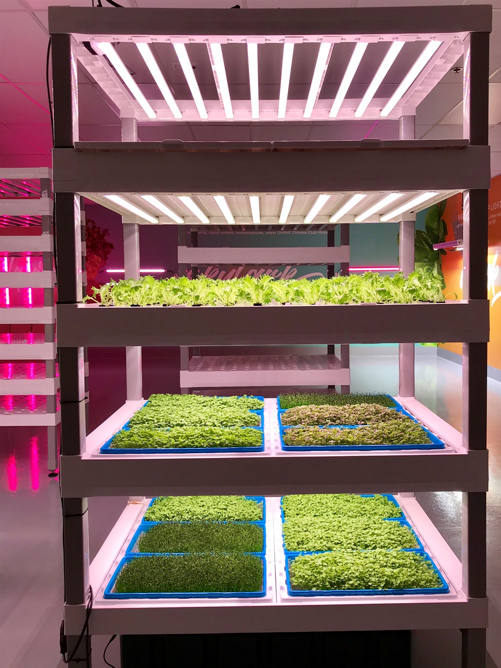
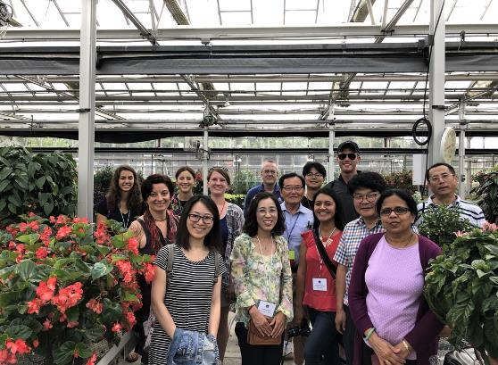
ASHS Annual Conference
Attend professional tours
Behind-the-scenes horticultural tours of local gardens and industry operations

Slide 7
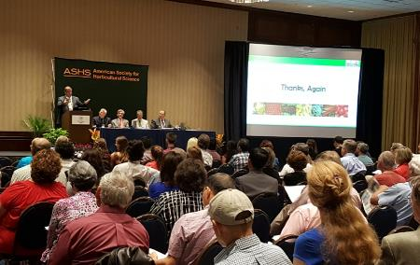
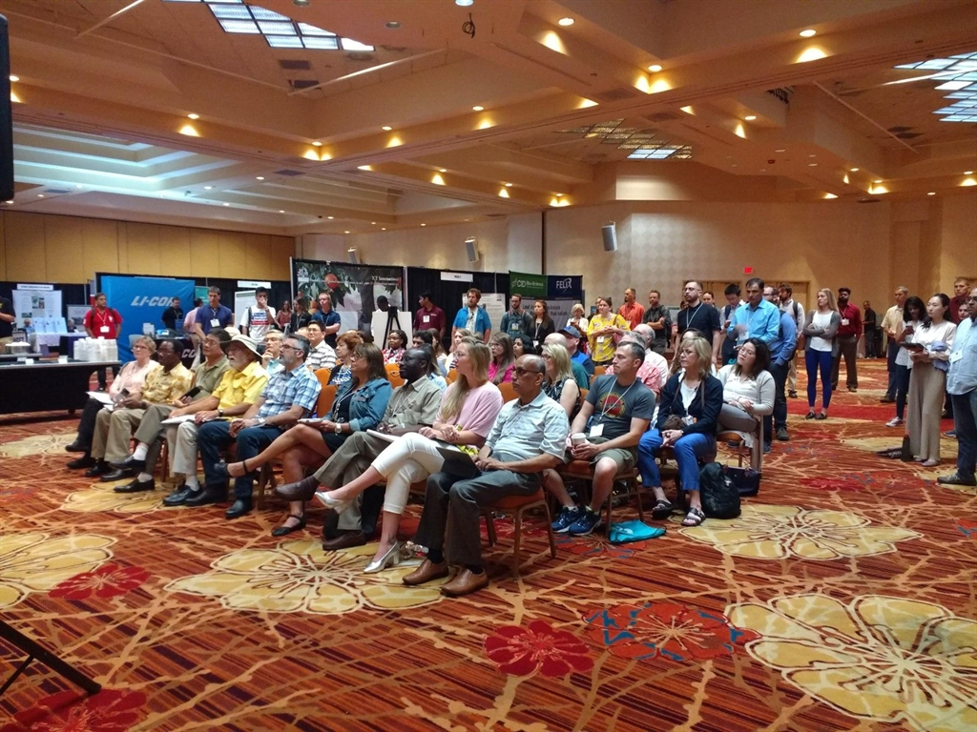
ASHS Annual Conference
Attend workshops, demonstrations, poster and oral sessions of any of more than 50 Professional Interest Groups
And more!...
Pi Alpha Xi Photo Contest
Closing Evening Dinner
Student Awards Night
Travel Grant and Scholarship opportunities

Slide 8
ASHS Annual Conference
January 15th – Registration opens. Many horticultural tours have limited space available. Register Early!
March 15th – Deadline for Oral and E-Poster Abstract Submissions.
April 1st – Early Career Competition Applications are due.
April 4th – Travel Grant Applications Deadline. Must be ASHS members and be presenting a paper at the Annual Conference.
June 30th – Pi Alpha Xi Photography Competition Deadline.
July 1st – Scholars Ignite Slides are due.
July 23rd – Deadline to upload E-Posters.
August 5th – Student Education and Career Day with career planning seminars and career fair

