Slide 1
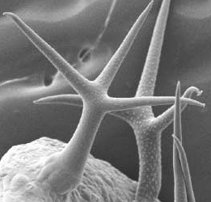
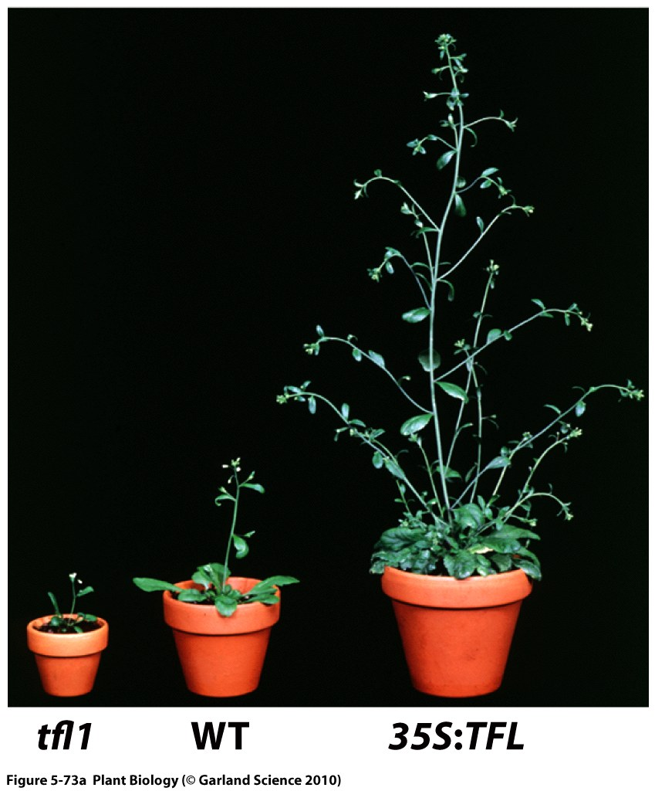
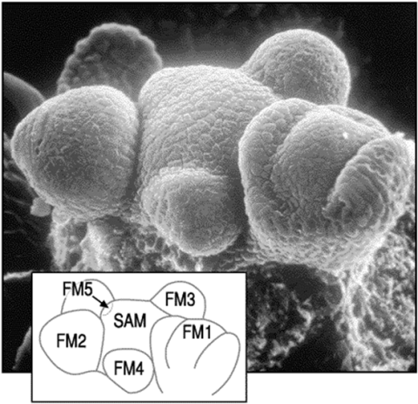
PLS/MCB/ECOL 440/540 MECHANISMS IN PLANT DEVELOPMENT Dr. Ramin Yadegari Fall 2018 Lecture: Tu, Th 9:30-10:45am
Understanding how plants change in form and function (development) can inform the selection and breeding of plants with enhanced capacity to adapt to their environment. This course will explore the molecular genetic mechanisms that underlie plant development. Students will learn current approaches used to understand cell differentiation, morphogenesis, growth, and reproduction.
Pre-requisites: PLS 312 or ECOL 320. / Recommended: BIOC 384, PLS 360, and MCB 304.

