Slide 1
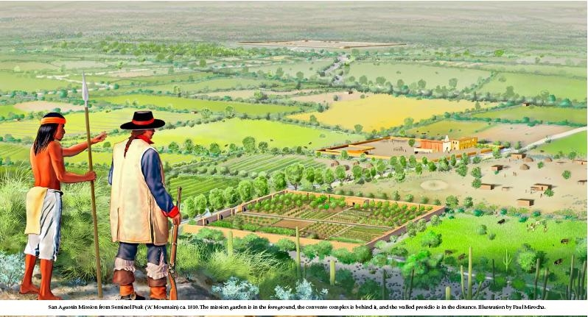
Mission Garden
Friends of Tucson’s Birthplace
2018-19 Internships Available
For more information contact Kendall Kroesen
520-971-2385 / kkroesen@cox.net
Mission Garden is a living agricultural museum of Sonoran Desert-adapted heritage fruit-trees, traditional local heirloom crops and edible native plants. We are a non-profit volunteer-based educational organization. Our primary mission is to preserve, transmit and revive the region’s rich agricultural heritage by growing garden plots representative of more than 4000 years of continuous cultivation in the Tucson Basin.

