Slide 1
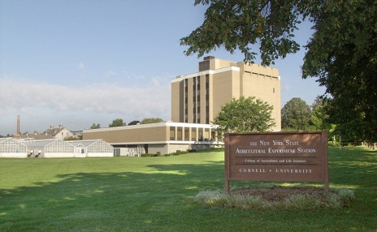
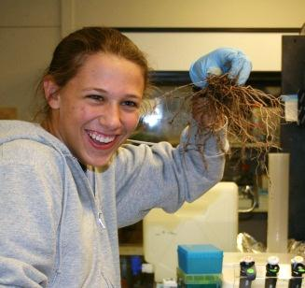
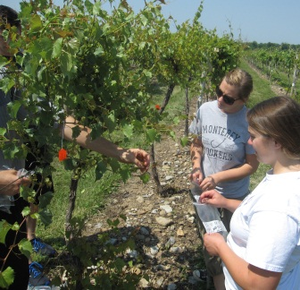
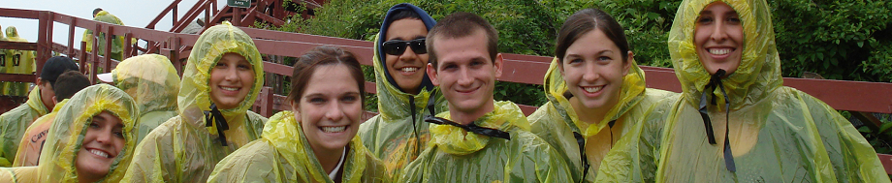
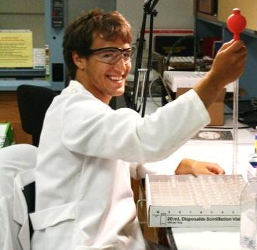
2015 Summer Research Scholars Program
Cornell University
Geneva Campus
Cornell University’s New York State Agricultural Experiment Station in Geneva, New York offers a Summer Research Scholars Program where undergraduate students can participate in exciting research projects in one of four disciplines including; Entomology, Food Science, Horticulture, and Plant Pathology & Plant-Microbe Biology.
The student interns will have the opportunity to work with faculty, their graduate students and postdocs on research projects that can be laboratory or field-based.
Apply online at:
http://www.scholars.pppmb.cals.cornell.edu/
Applications due: 13 February 2015
Applicants notified of acceptance by mid-March 2015
Specifics
Nine week internships in conducting research in a faculty program at the Experiment Station
Gain research experience and learn about the research conducted at Cornell’s Geneva campus
Additional programs and trips will be offered
Benefits include housing, assistance with transportation costs, and a $4,000 stipend
Starts on June 1, 2015 (June 1 for travel) and runs through July 31, 2015
Eligibility
Must be a U.S. citizen or permanent resident
Must have completed two, and preferably three, years of college level study in one of the life sciences by June 2015

