Slide 1
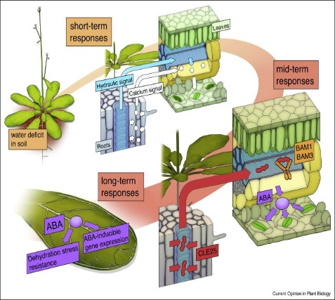
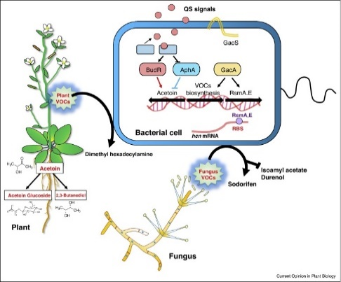
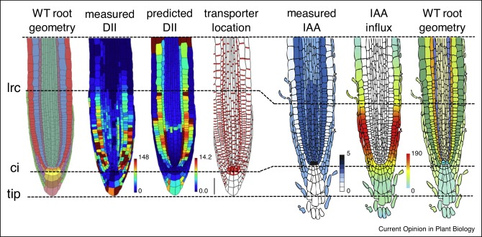
PLS/PLP/MCB/ECOL 560 - Advanced Plant Biology Dr. Karen Schumaker
Fall 2019 Lecture: Tu, Th 8-9:15 am; W 9-9:50 am
The course will cover basic principles fundamental to the study of plant development, physiology and metabolism, responses to environmental signals and stress, and interactions with other organisms.

