Slide 1
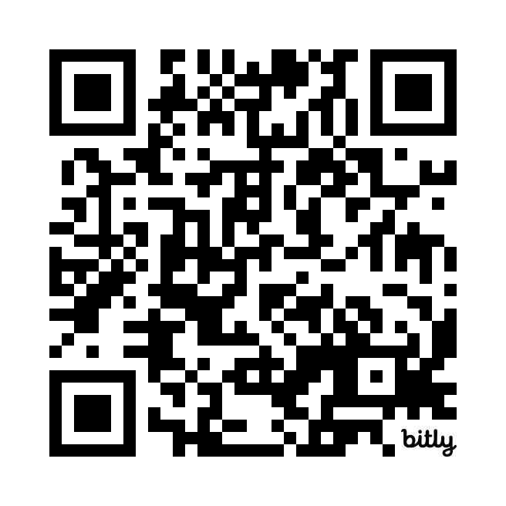
WE WANT
TO HEAR
FROM YOU!
Your voice matters!
Share your honest (and anonymous) feedback about your CALES experience this year.
Complete the survey for a chance to win UA & CALES swag prize packs! A separate form will collect your raffle info to keep responses anonymous.
Take the CALES Annual Student Survey today!
Deadline: May 15, 2025
Visit uazcales.com/survey or scan the QR code to participate.

