Slide 1

Academic Units & CES
Agricultural and Resource Economics
Agricultural Education, Technology and Innovation
Animal and Comparative Biomedical Sciences
Biosystems Engineering
Entomology
Environmental Science
Human Ecology
Natural Resources and the Environment
Nutritional Sciences and Wellness
Plant Sciences
Cooperative Extension System

Slide 2

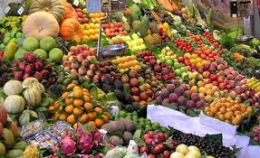
Food security under climate change
“Exploring the Climate Adaptation Potential of Nature-Based Solutions to Strengthen Food System Resilience and Benefiting One Health in Arizona”
Synopsis: Exploring and mapping the innovative strategies for enhancing community and environmental sustainability and justice via local food producer and entrepreneur practices.
Funding: UAz RRI One Health Research Initiative Pilot Grant
PI: Dr. Yevheniia Varyvoda, College of Public Health
Co-PI: Dr. Matthew Mars, College of Agriculture and Life and Environmental Sciences

Slide 3

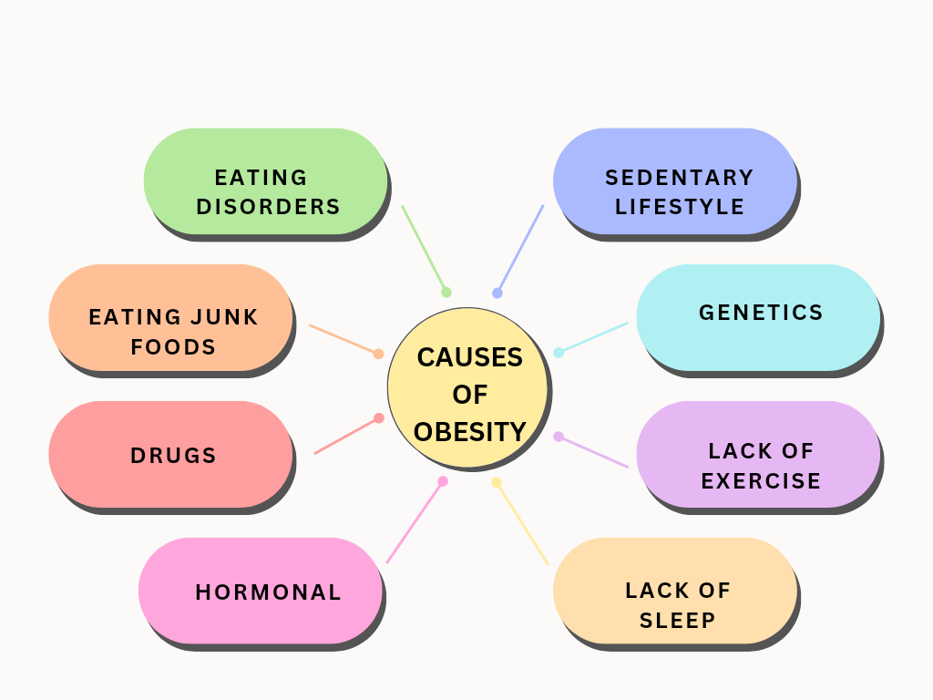
One Health Foci
Time Spent Eating, Sleeping, & Exercising: Impacts on BMI
  Econometric evidence from the American Time Use Survey, Eating & Health Module

Slide 4

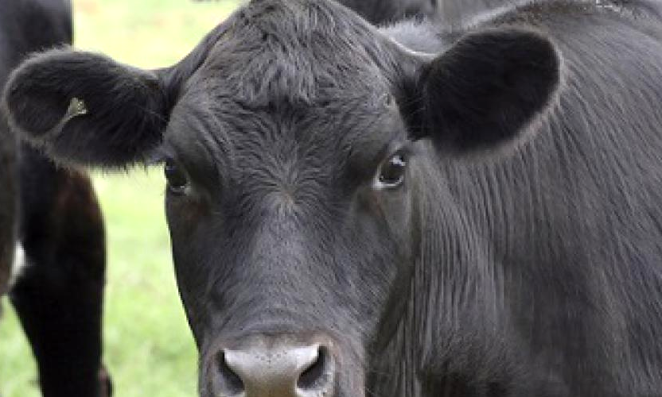
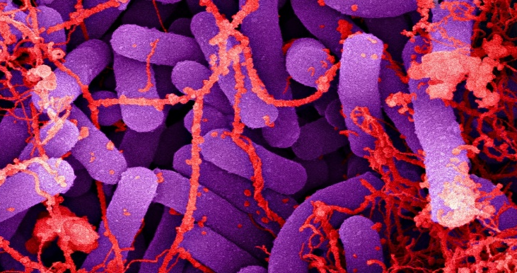
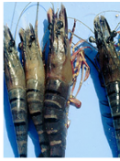
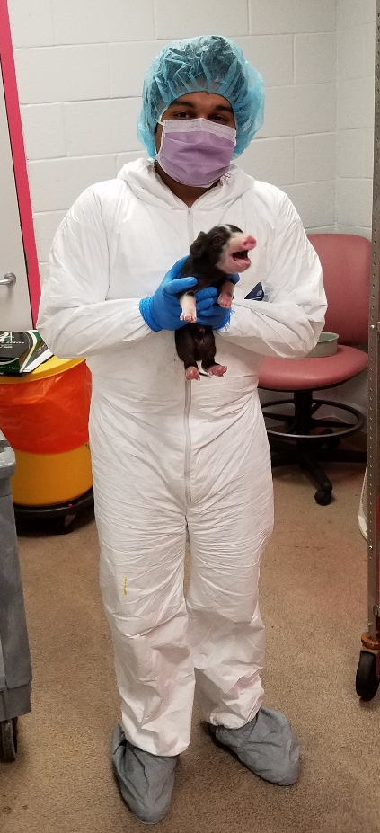
Multiple One Health Foci
Animal-Human Disease Identification, Vaccines, Therapeutics
K. Cooper, L. Salvador, V.K. Viswanathan, M. Riggs, G. Lopez, G. Vedantam
Food Animal Production and Management
D. Wolf, S. Limesand, D. Diaz, J. Beard
Food Safety, Diagnostics
S. Ravishankar, A. Dhar
Animal/Human Health
Z. Craig, B. Renquist F. Duca, F. McCarthy, E. Greene, E. Norton, Z. Chu
Current Funding: US Federal, State, Local, University, Industry, Private Foundation

Slide 5

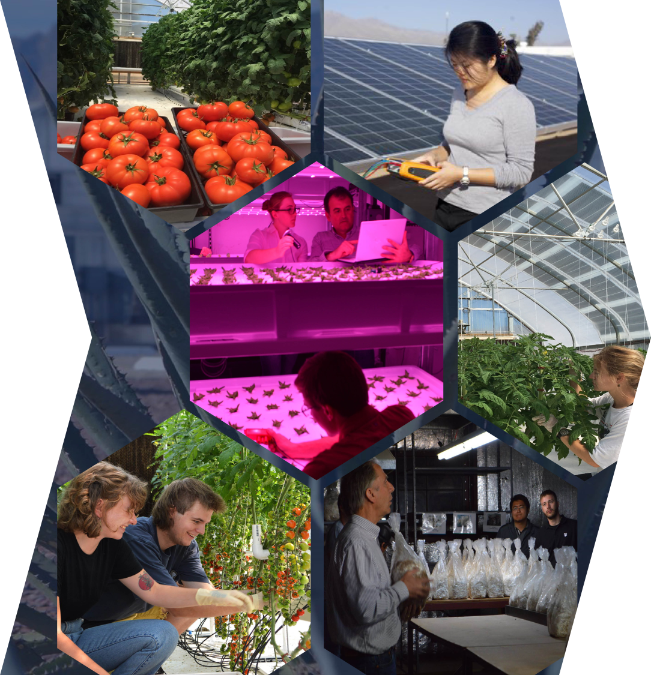
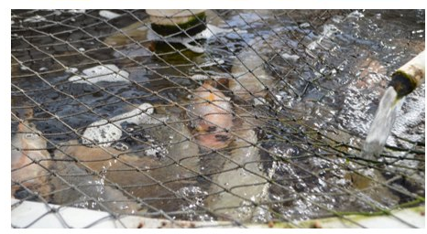
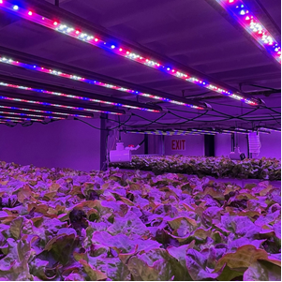
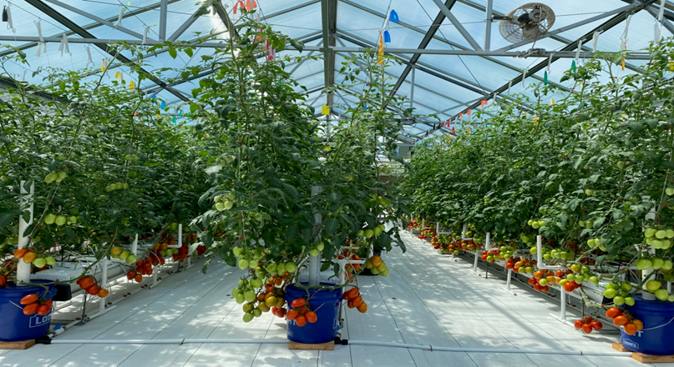
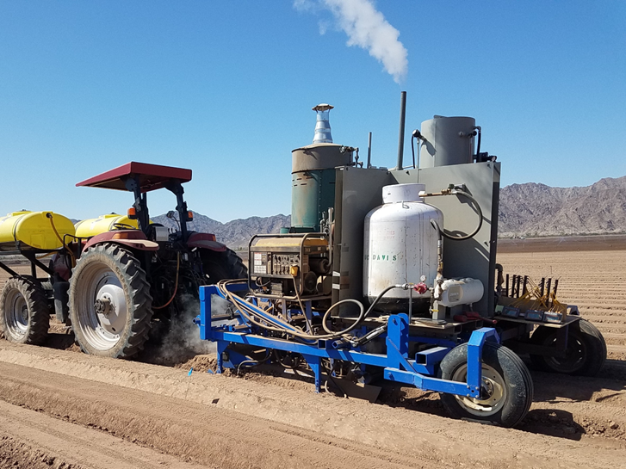
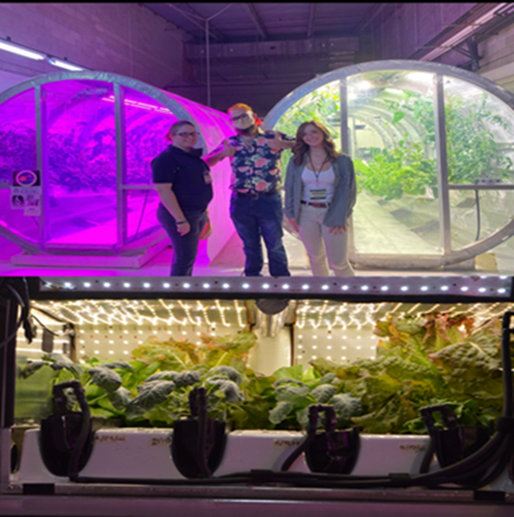
Engineering food production
Controlled environment agriculture (center)
Wavelength selective greenhouse coverings [M. Kacira, G. Giacomelli]
Insects as a nutrient source for fish (aquaculture) and plants (hydroponics) [M. Recsetar, K. Fitzsimmons]
Development of a novel machine for disinfecting soil using steam [M. Siemens]
Optimizing indoor agriculture/vertical farming for leafy green production [M. Kacira]
Sustaining astronauts in space: Space horticulture and bioregenerative life support [M. Kacira, G. Giacomelli]

Slide 6

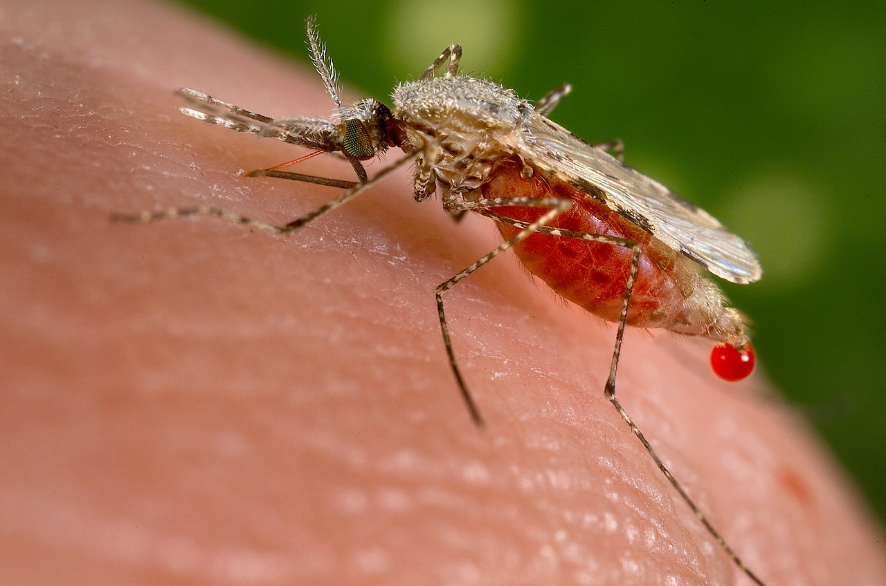
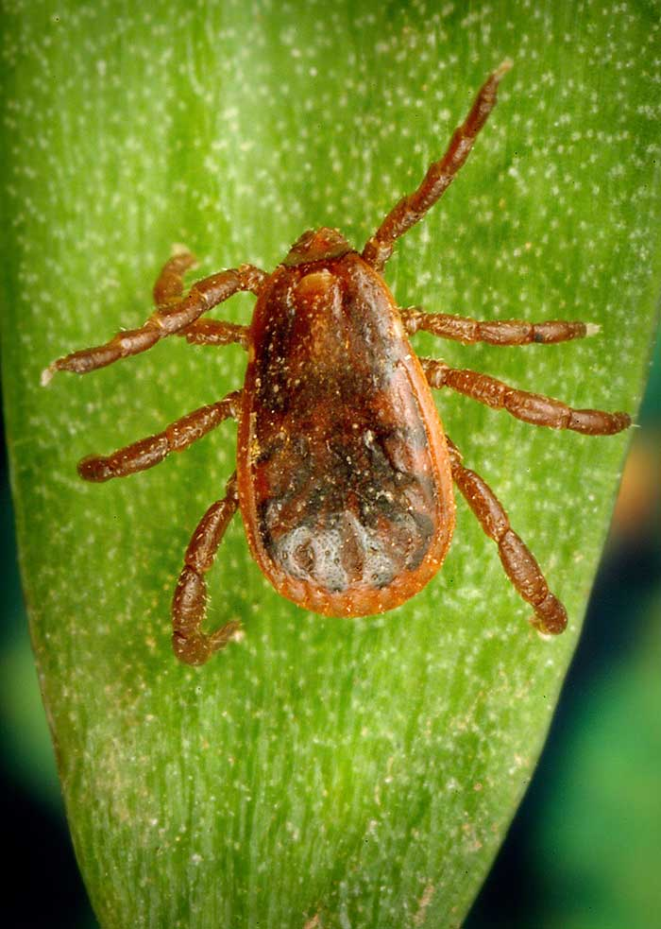
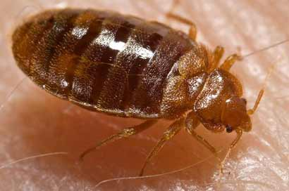
Insect vectors of disease
Mosquitoes: Manipulating vitamin B5 levels in mosquitoes to starve the malaria parasite of this essential nutrient.
Ticks: Collaborating with Arizona tribal public health, veterinary health and animal control agencies to improve surveillance and control of the brown dog tick, a principal vector of Rocky Mountain spotted fever.
Cockroaches and Bedbugs: Training and technical support to tribal health agencies to control pest infestations that contribute to poor indoor air quality and other health risks.

Slide 7

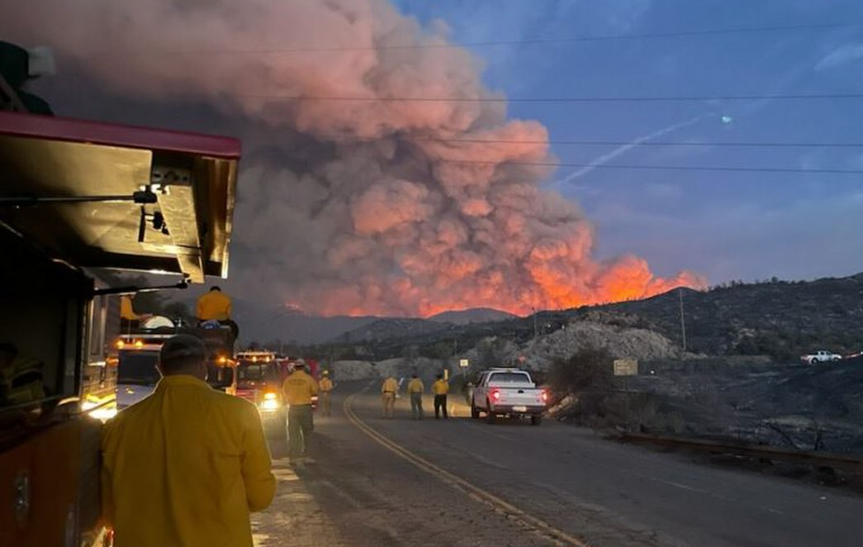
Increased exposure risk under climate change
Dust generation and contaminant exposures from the release and remobilization of contaminants during wildfire [PI Mónica Ramírez-Andreotta, Funded by NIEHS, OHI]
Bridging the gap: Understanding the nexus of animal agriculture, fresh produce, and food safety in the One Health Paradigm [PI Channah Rock, Funded by USDA, FDA, EPA, and Center for Produce Safety]
The use of coliphage MS-2 in an aquaculture system as indicator of ultraviolet filter efficiency [PI Charles Gerba, Funded by AZDA, NIH, EPA].
Bioaccessibility of toxic metal(loid)s in mine tailings dust [PI Jon Chorover, funded by NIEHS]

Slide 8



Environmental Causation of Multimorbidities
Americans born between 1948 and 1965 are more likely than the generations that preceded them to have multiple chronic conditions¹
Diabetes and depression are common elements of multimorbidity associated with cognitive decline in older adults²
¹ Bishop, Haas, Quiñones. (2022). Cohort Trends in the Burden of Multiple Chronic Conditions Among Aging U.S. Adults, The Journals of Gerontology: Series B, 77(10):1867–1879. https://doi.org/10.1093/geronb/gbac070; https://www.usnews.com/news/health-news/articles/2022-06-16/boomers-sicker-than-their-parents-were-at-same-age)
² Bishop, Botoseneanu, Markwardt, Zambrano, Walker, Quiñones; Abstract submitted to Gerontological Society of America annual meeting)

Slide 9

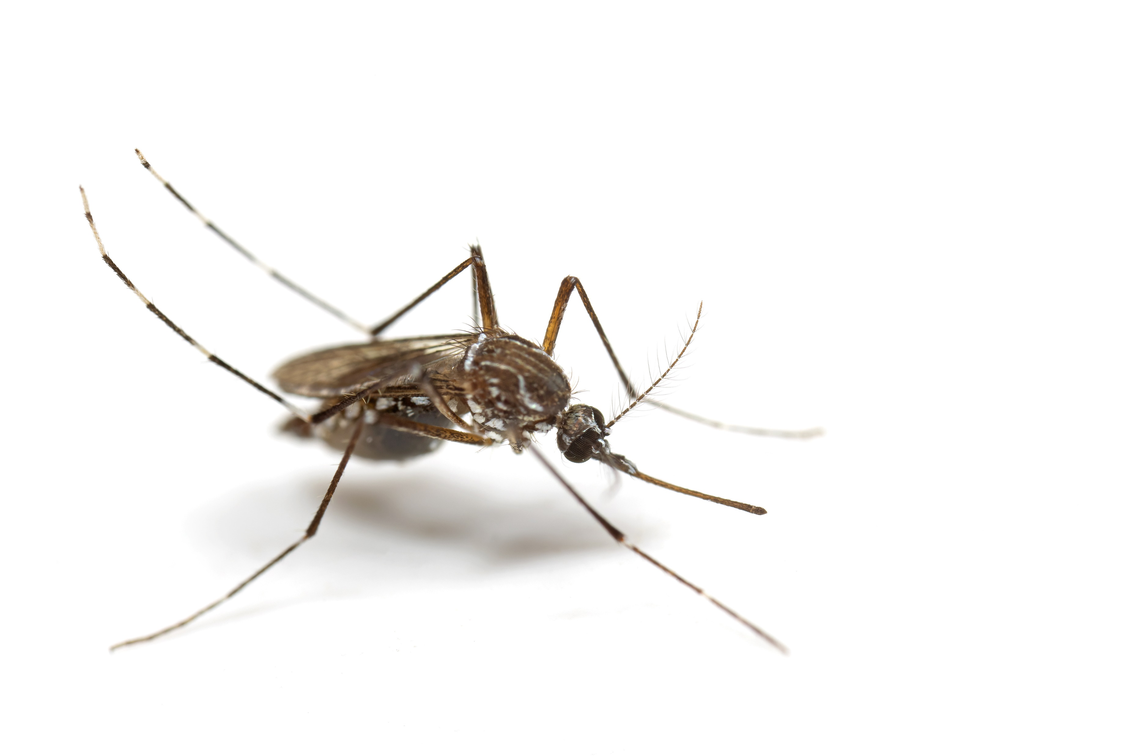
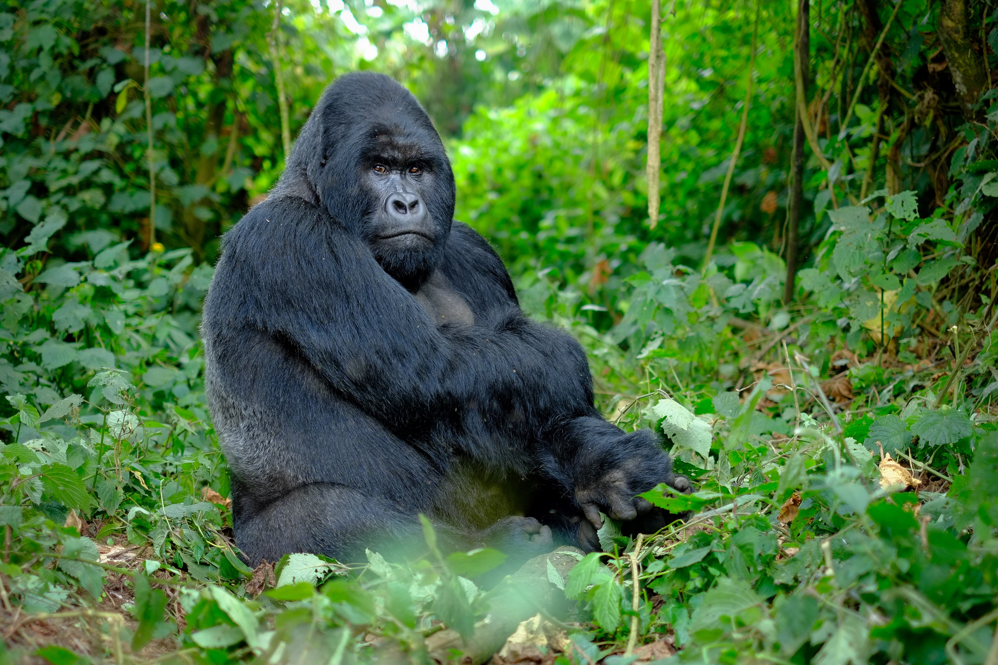
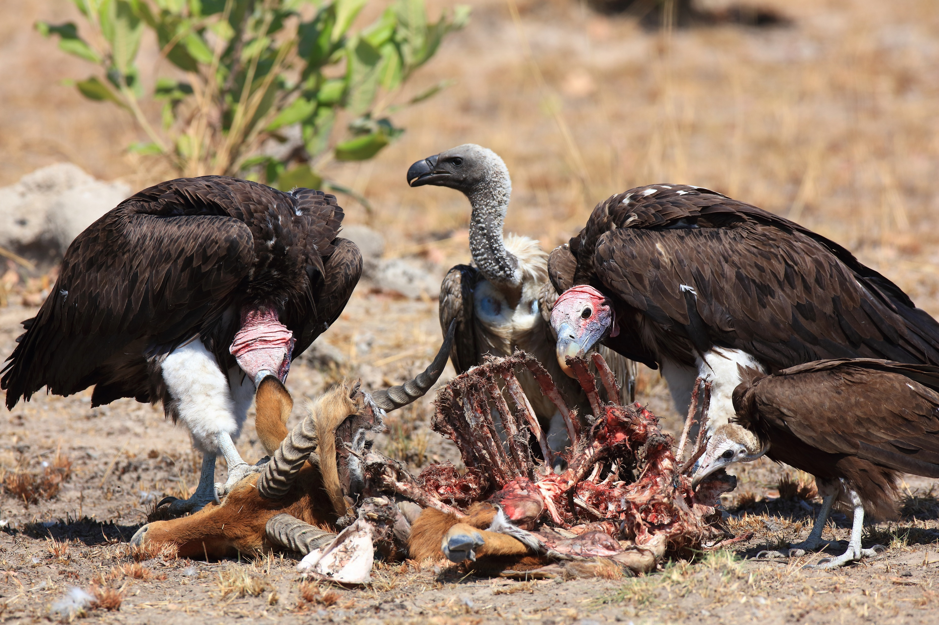
Animal-Human Connections in Disease
Predictions of Vector-borne and Zoonotic Disease Spread – a collaborative response network (SNRE-CoPH collaboration) USEPA & Coconino County AZ, Health and Human Services. How climate-induced changes will impact human health through modeling the spread of infectious diseases within AZ
Infectious disease transmission between humans and mountain gorillas (Bwindi Impenetrable Forest National Park, Uganda - Characterize the gut microbiome, gut parasite and viromes of mountain gorillas having differing levels of contact with human settlements in the BIFNP ecosystem)
TRASH: Trans-omic Research for Avian Scavenger Health (KwaZulu-Natal, South Africa - Understanding the role of large avian scavengers at the human-wildlife-livestock-disease interface)

Slide 10

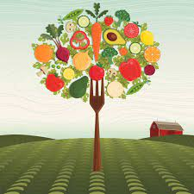
Food-Environment-Health and Nutrition
Effects of pasture finishing on the omega-3 fatty acid profile of beef
Effect of organic vs. conventional treatment of soil on nutritional composition of Hopi corn grown using indigenous dry farming methods
Microbe-associated phenotypic flexibility of healthy lettuce cultivars for optimizing human retinal and gut function
Interactions between social and genetic determinants of health contributing to cardiometabolic disease
Effects of environmental noise on human health
Novel and damaging sphingolipid metabolite produced in human tissue by recluse spider venom

Slide 11

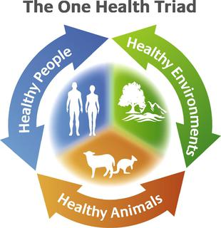
Plant-microbe-human interactions
A comprehensive whole-genome inventory of Arizona biomes.
Exploring the interactions of different lifeforms in Arizona, from cells to fields.
Valley Fever vaccine – a true One Health success story
  Virulence mutant in a maize pathogen led to creation of ∆cps1 avirulent VF strain
  ∆cps1 is a live-attenuated canine vaccine. USDA application for approval to be followed by human vaccine development

Slide 12

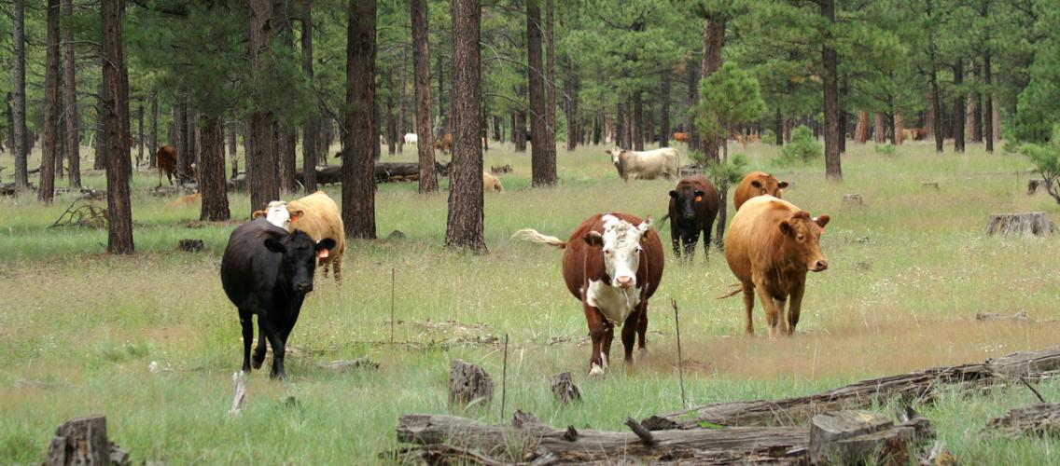
Bringing science to bear on practical problems faced by stakeholders
Veterinarian Program – diseases that cross over to humans from domestic and wild animal populations
Culinary Medicine Program – Learning how your choice of food can affect your daily health
Rangeland Management Program - Healthy grazing maintains domestic and wildlife food sources while reducing wildfires

Slide 13
One Health Initiative Awards in CALES
Climate, Vectors and Infectious Disease
Community Engaged Vector Management - Mosquitoes
Human and Veterinary Clostridium Difficile Infections
Growing Food for Better Health
Valley Fever Vaccines Safety
Lettuce Cultivars for Optimizing Retinal & Gut Function
Climate Effects on Human/Mosquito Interactions
Social Determinants of Health & Metabolic Disease
Environmental Pollutants:
Exposures & Health Outcomes
Detection/remediation/sequestration of Per- and Polyfluoroalkyl substances (PFAS)
Human Exposure Pathways Following Wildfires
Animal Models for Wildfire Exposure in Humans
Exposures to Airborne Particulate-Bound Arsenic from Mine Tailings
Notes:
Foci represented by the different areas covered by awarded pilots and graduate fellowships.

Slide 14



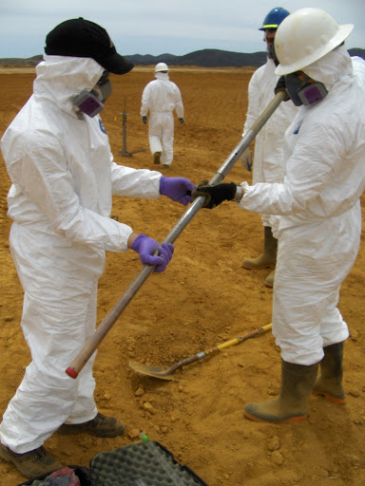
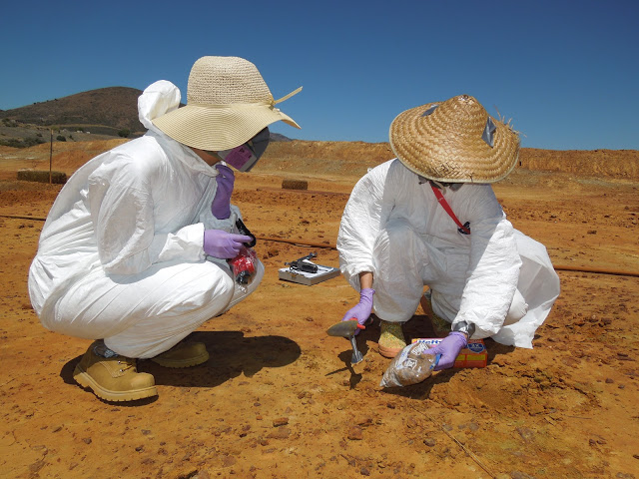

Inter-college centers relevant to One Health

