Slide 1
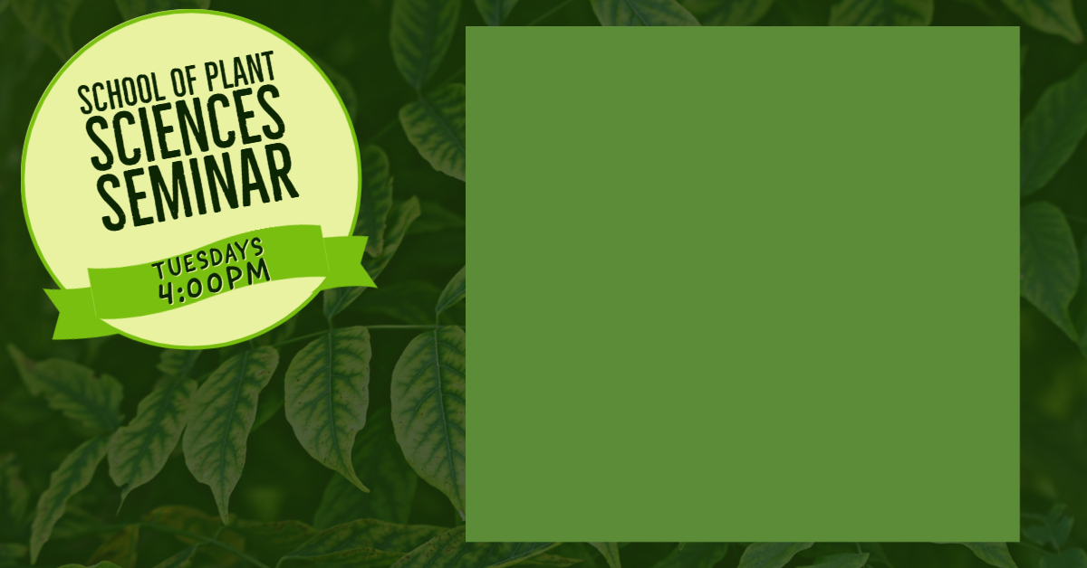

Tuesday, September 5, 2023
“Using natural genetic variation to improve and extend aflatoxin biocontrol”
Dr. Kenneth Callicott
USDA-ARS Aflatoxin Lab
Biological control using non-aflatoxigenic A. flavus isolates has been one of the great successes in managing aflatoxin contamination of crops. While largely successful, aflatoxin biocontrol sometimes fails due to application errors or environmental conditions. The technology imposes application costs on the grower even when it fails to reduce aflatoxins below regulatory limits, and many countries at high risk for aflatoxin contamination risks lack a registered biocontrol product. In conjunction with targeted field and laboratory experiments, studies of natural genetic variation can help address these problems, whether by finding new potential biocontrol isolates or by helping to design long-term application schemes that reduce the need to re-apply the product every growing season.
Dr. Callicott will be presenting in Marley 230 Live broadcast available in Zoom: https://arizona.zoom.us/j/83044711714
Password: spls23
Host: Hillary Mehl
Refreshments will be provided from 3:30pm – 4:00pm in the Marley Lobby

