Slide 1
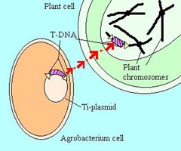
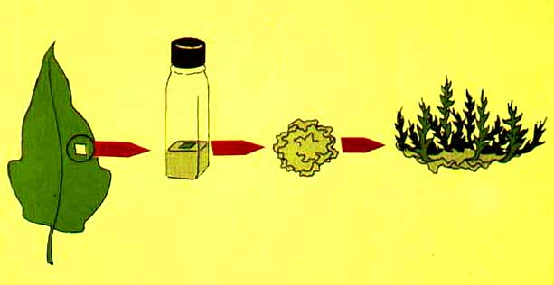
New Course Listing
Introduction to Biotechnology (PLS/MIC/MCB 340)
Fall Semester, 2010
MWF 1:00-1:50, Chavez 303
Instructor: KA Feldmann. Over the past 25 years, Dr. Feldmann has worked at 3 different biotech companies. He is currently the Director of the School of Plant Sciences. Prerequisites: PLS 240 or MCB 181 or MIC 205A. Contact KAF @ 621-1977
The average US citizen would find it very difficult to exclude biotech products from their daily diet. We will look at what constitutes a biotech product and explore the opportunities for these products in combating global warming and environmental degradation, feeding a growing population, providing feedstocks for the biofuels industry and making less expensive pharmaceuticals from microbes and/or plants.
Breeding
DNA is a strand of genes, much like a strand of pearls. Traditional breeding combines many genes at once.
Traditional donor
Commercial variety
New variety
(many genes are transferred)
X
=
Desired Gene
(crosses)
Desired gene
Biotechnology
Using biotechnology, a single gene may be added to the strand.
Desired gene
Commercial variety
New variety
(only desired gene is transferred)
=
(transfers)
Desired gene

