Slide 1
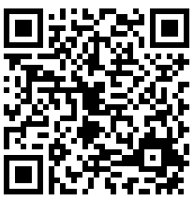
We Want to Hear From You
SCAN THE CODE TO LAUNCH THE SURVEY
COMPLETE THE UNIVERSITY SAFETY SURVEY BY APRIL 12
Learn more about the survey at safety.Arizona.edu
We have launched a survey to better understand the experiences of faculty, staff, designated campus colleagues and students related to safety and security.
The survey takes approximately 10-15 minutes.

