Slide 1
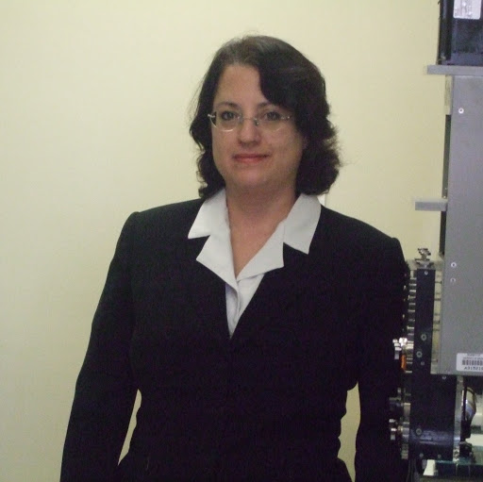

Molecular and Cellular Biology Special Seminar
“Run-on Oligomerization: A Novel Strategy to Control Enzyme Activity and Specificity”
Nancy Horton, PhD
Associate Professor, CBC
The University of Arizona
Tuesday, May 15th, 2018 – 2:00PM
ENR2 Room S107
To see all upcoming seminars, please visit mcb.arizona.edu/events or join the MCB Seminar Listserv (listname: mcbjointseminar) at list.arizona.edu.

