Slide 1
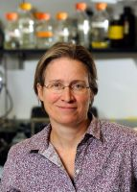
The Biological and Biomedical Joint Seminar Series
(Hosted by the departments of Molecular & Cellular Biology, Chemistry & Biochemistry, Cellular & Molecular Medicine, and Plant Sciences)
“Translational distress revealed by ribosome profiling”
Rachel Green, PhD
Bloomberg Distinguished Professor
HHMI, Johns Hopkins University, Medicine
Tuesday, April 10, 2018
11AM, ENR2 Room S107
Hosted By: Ross Buchan
To see all upcoming seminars, please visit mcb.arizona.edu/events or join the MCB Seminar Listserv (listname: mcbjointseminar) at list.arizona.edu.

