Slide 1
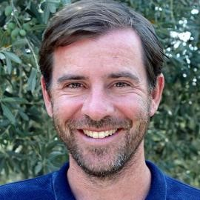

The Biological and Biomedical Joint Seminar Series
(Hosted by the departments of Molecular & Cellular Biology, Chemistry & Biochemistry, Cellular & Molecular Medicine, and Plant Sciences)
“On the biosynthetic mechanism coupling cell growth and division”
Jan Skotheim, PhD
Associate Professor, Biology
Stanford University
Tuesday, April 3, 2018
11AM, ENR2 Room S225
Hosted By: Guang Yao
To see all upcoming seminars, please visit mcb.arizona.edu/events or join the MCB Seminar Listserv (listname: mcbjointseminar) at list.arizona.edu.

