Slide 1
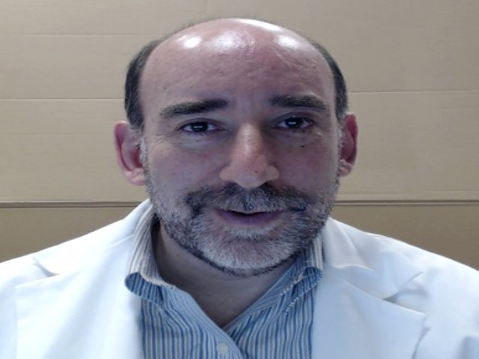
The Biological and Biomedical Joint Seminar Series
(Hosted by the departments of Molecular & Cellular Biology, Chemistry & Biochemistry, Cellular & Molecular Medicine, and Plant Sciences)
“The role of gene fusions and other molecular changes in cancer of the skeletal muscle lineage”
Frederic Barr, M.D., Ph.D.
Adjunct Professor, Dept of Pathology and Laboratory Medicine
University of Pennsylvania School of Medicine
Medical Director, Laboratory of Pathology, NCI, Bethesda, MC.
Tuesday, February 27, 2018
ENR2 Room S107
Hosted By: Justina McEvoy
To see all upcoming seminars, please visit mcb.arizona.edu/events or join the MCB Seminar Listserv (listname: mcbjointseminar) at list.arizona.edu.

