Slide 1
CONSIDER COURSES IN PLANT SCIENCES THIS FALL 2012 http://cals.arizona.edu/spls/undergraduate/courselist
The School of Plant Sciences
Plants are fundamental to all aspects of our existence. Given the growth of the human population and the effects of this growth on the environment, research and training
in the Plant Sciences has never been more critical.
Courses prepare students for careers in research,
medicine, pharmacy, biotechnology,
horticulture, agriculture or microbiology.

Slide 2
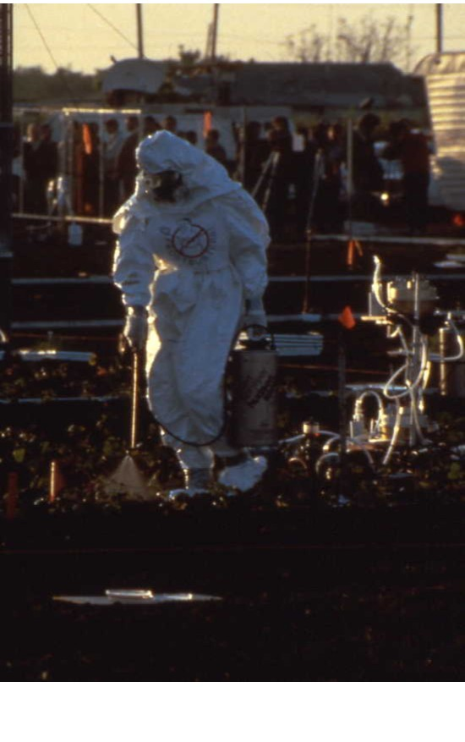
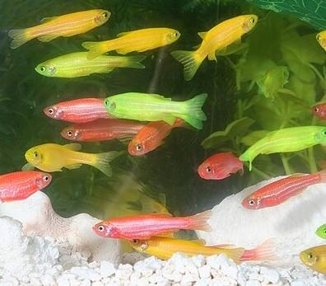
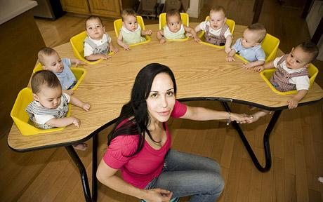
PLS 170
Introductory Biotechnology
Dr. Ken Feldmann
Fall Semester
Lecture: TTh 12:30-1:45
Prerequisites: None
Transgenic plants
Human Cloning
Transgenic animals
In Vitro Fertilization
Bioterrorism
Biotechnology is a field of applied biology that involves the modification of living organisms to create products directed at improving human health and minimizing environmental impacts. An increasing number of product we use including the food we eat and the therapeutics we use are created using biotechnology. This course explores the methods, applications and ethics associated with these emerging technologies.
http://cals.arizona.edu/spls

Slide 3
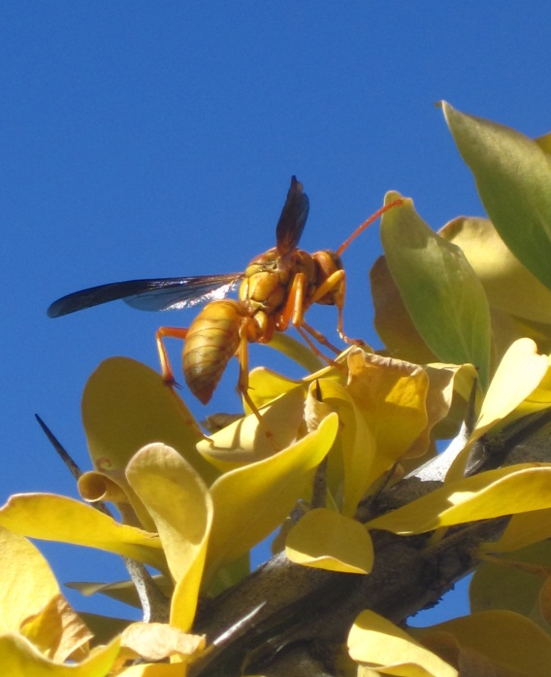
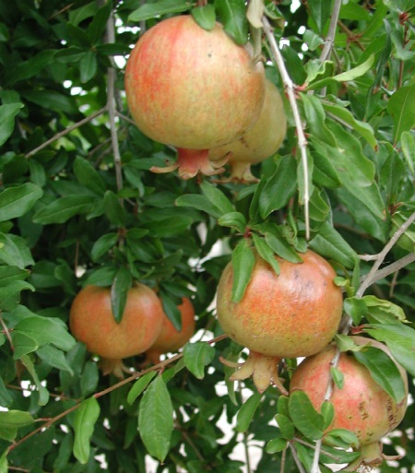
PLS 170 C1 Plants and Our World Dr. Tanya Quist Fall semester
What makes plants uniquely interesting, different from other organisms, and central to human life and society?
Discover the principles of plant growth, development and reproduction working at the cellular and whole plant level.
Explore how plants are affected by their environment,
and their ecology and evolution.

Slide 5
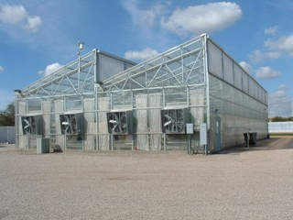
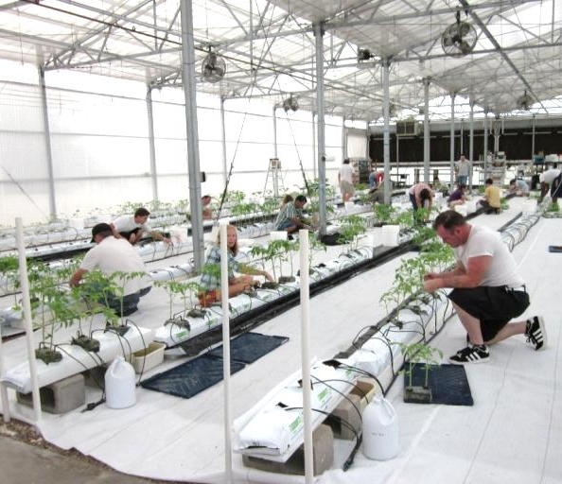
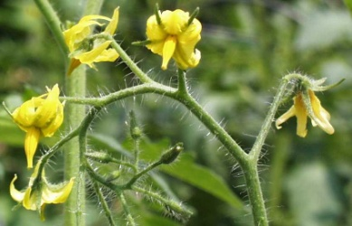
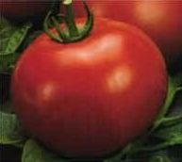
PLS 217
Introduction to Hydroponics & Controlled Environment Agriculture.
Dr. Patricia Rorabaugh
Fall Semester
Tu/Th 3:00-5:30pm
CEAC: 1951 E. Roger Road
4 mi. north of main campus
Learn the history of hydroponics and controlled environment agriculture. Gain understanding of plant physiology and anatomy and how cultural practices affect plant protection, transplanting, pollination and plant nutrition. Further your knowledge of practical concerns affecting greenhouse site selection, greenhouse structures, controls, and strategies to “green” the greenhouse and excel in business through better understanding of marketing, economics & business plans.
http://cals.arizona.edu/spls

Slide 6
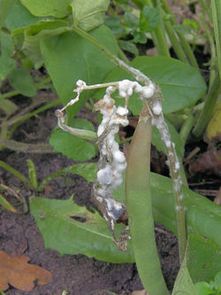
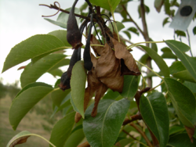
PLP 305 Plant Pathology Dr. Barry Pryor Fall Semester Tu, Th 12:30-1:45pm
Plants are fundamental to all aspects of life on earth.
This course explores the critical need to understand the bacteria, viruses, fungi, nematodes and other organisms that act as plant pathogens; their role in disease development, mechanisms of invasion and the natural plant defense responses and cultural
disease management strategies employed
to control infection and pathogenesis.

Slide 7
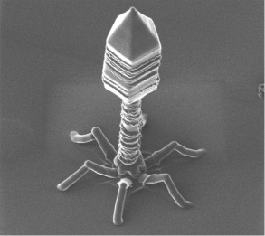
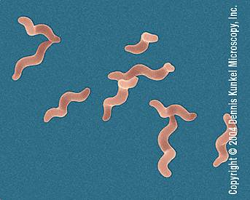
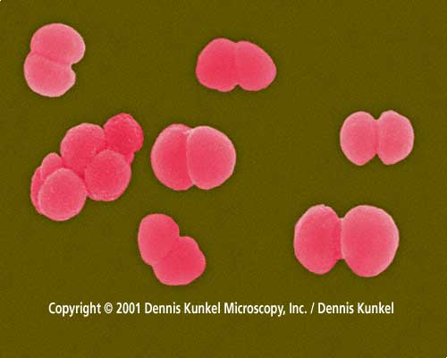
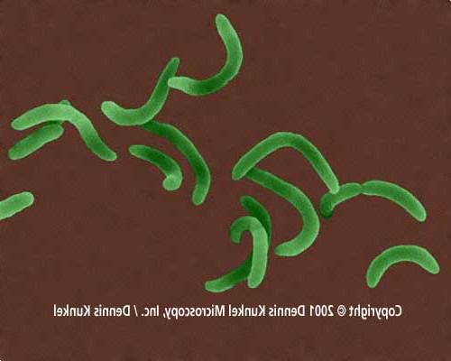
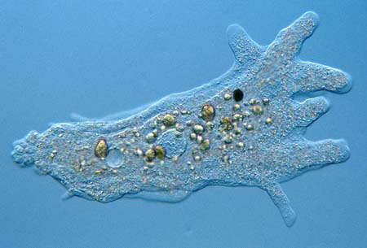
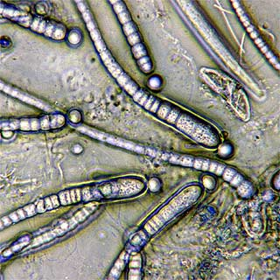
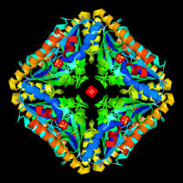
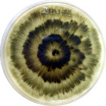
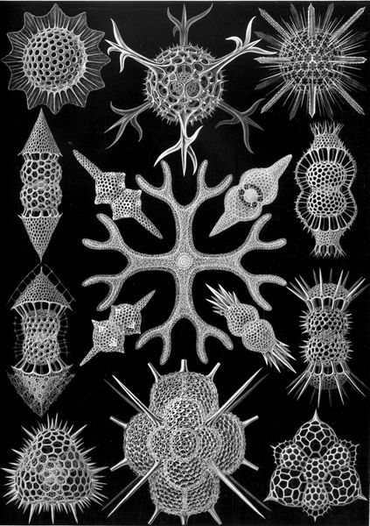
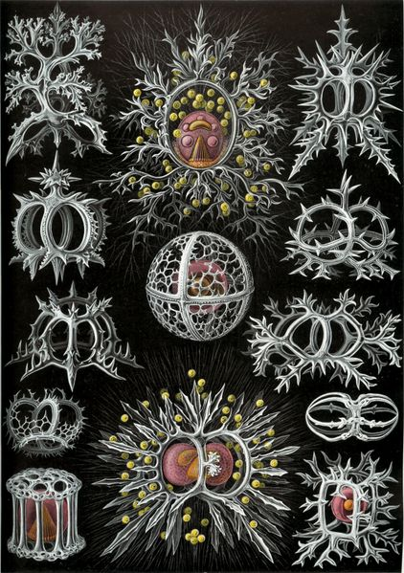
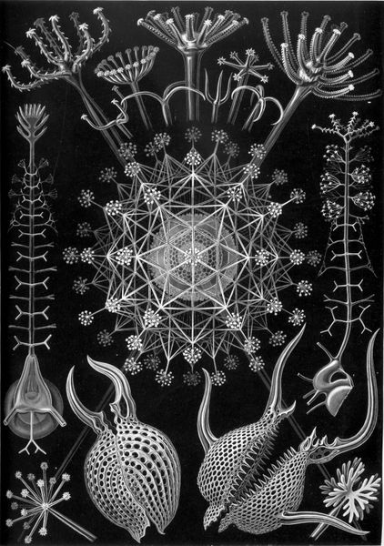
Microbial Diversity PLP/MIC/ECOL/VSC 329A
Fall Semester • M/W •5:00–6:15pm_
Diversity, ecology, evolution, and importance of acellular, prokaryotic, and eukaryotic microbes…and their genes
Dr. A. Elizabeth Arnold_

Slide 8
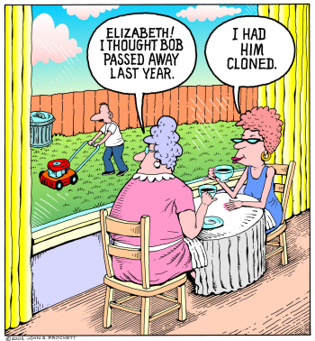
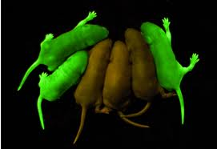
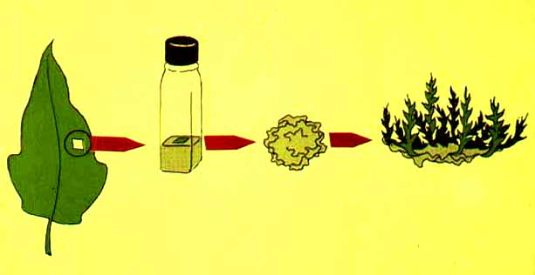
PLS 340
Introduction to Biotechnology
Dr. Ken Feldmann
Fall Semester
Lecture: MWF 1:00-1:50
Prerequisites: PLS 240 or MCB 181 or MIC 205A.
Many Americans are blind to the prevalence of biotech products in the food consumed in the US. In this course, we will look at what constitutes a biotech product and explore the opportunities for these products in combating global warming, environmental degradation, feeding a growing population, providing feedstocks for the biofuels industry and making less expensive pharmaceuticals in vivo.
http://cals.arizona.edu/spls

Slide 9
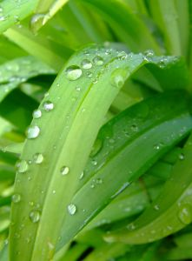
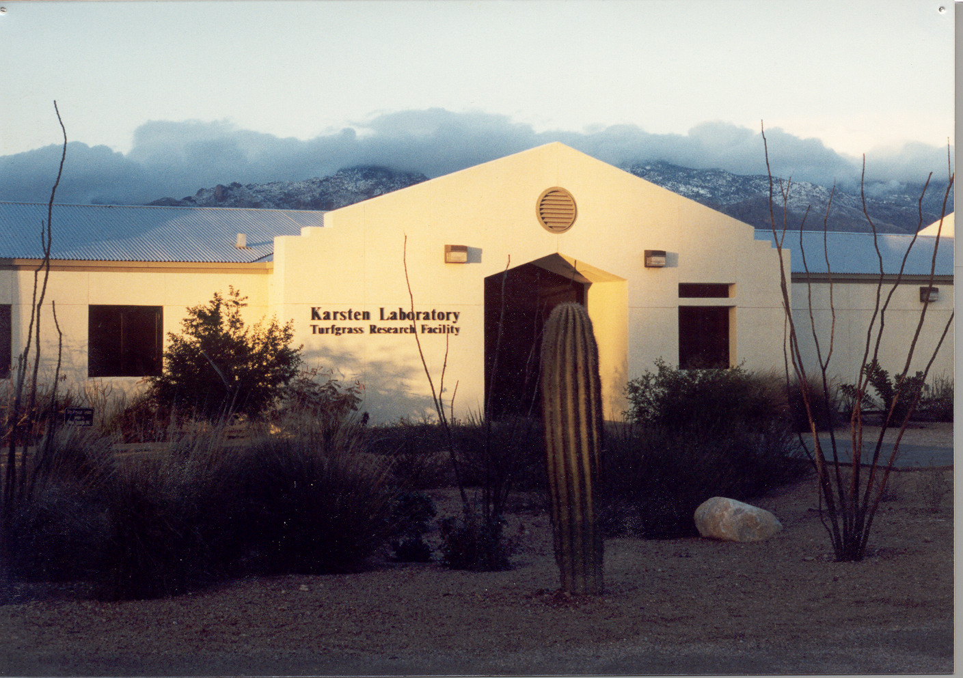
PLS 355
Turfgrass Science and Culture
FALL MWF 10:00 AM – 10:50 AM
Introduction to turfgrass management, identification, environmental adaptation, establishment techniques, management practices of low & high input turfgrasses, & pest control.
Dr. Mohammad Pessarakli,
Pre-requisite: PLS 240
Karsten Turfgrass Research Facility

Slide 10
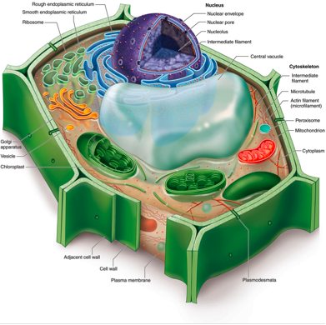
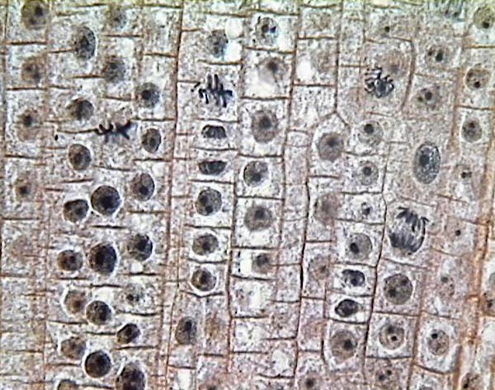
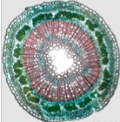
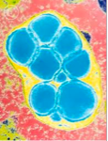
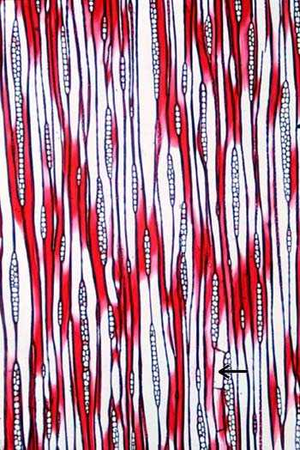
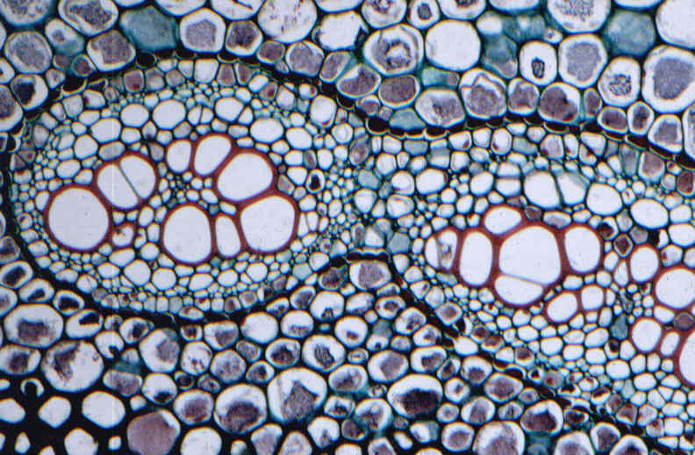
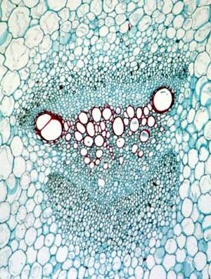
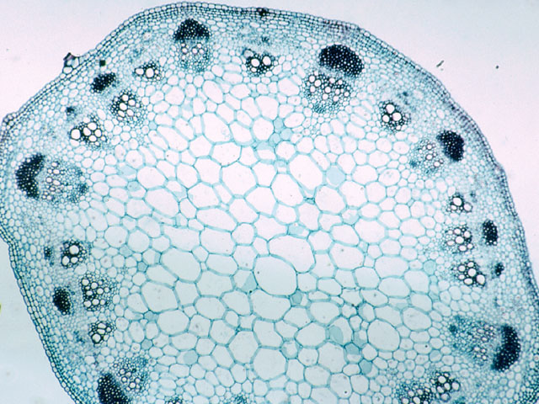
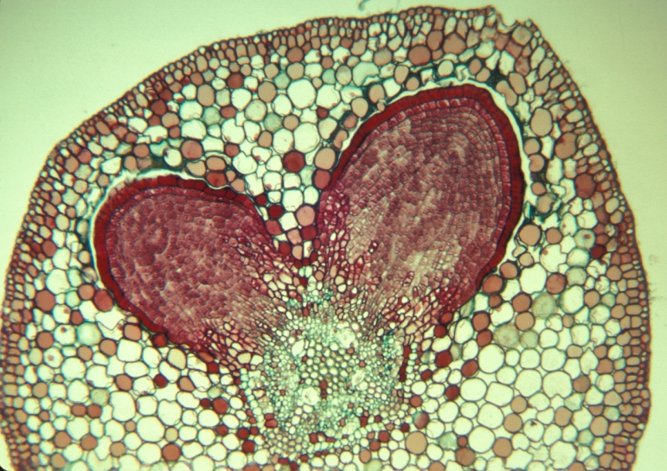
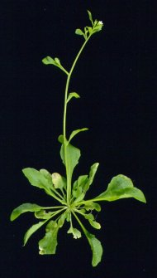
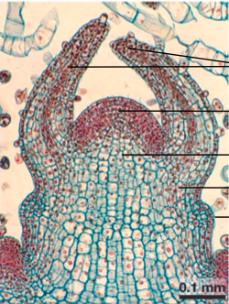
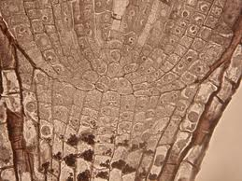
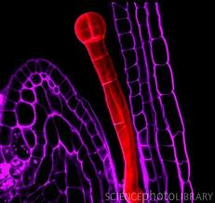
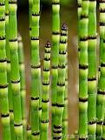
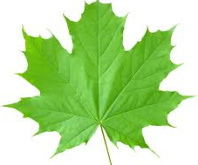
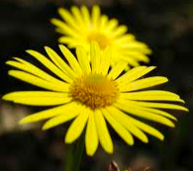
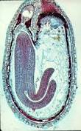
PLS 359 – Plant Cell Structure and Function
PLS 359L – Plant Cell Structure and Function Lab
LECTURE: 3 credits, T&Th, 3:30 - 4:45 LAB: 1 credit, W, 2:00 - 4:50
Comprehensive discussion on structure and function of cells, tissues and organs in higher plants. Dr. Ravi Palanivelu

Slide 11
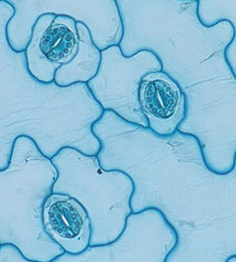
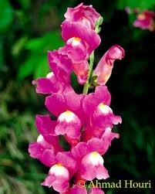
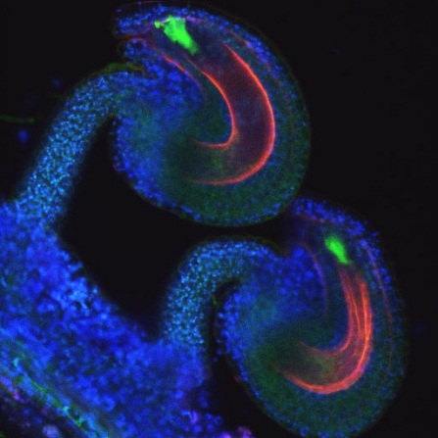
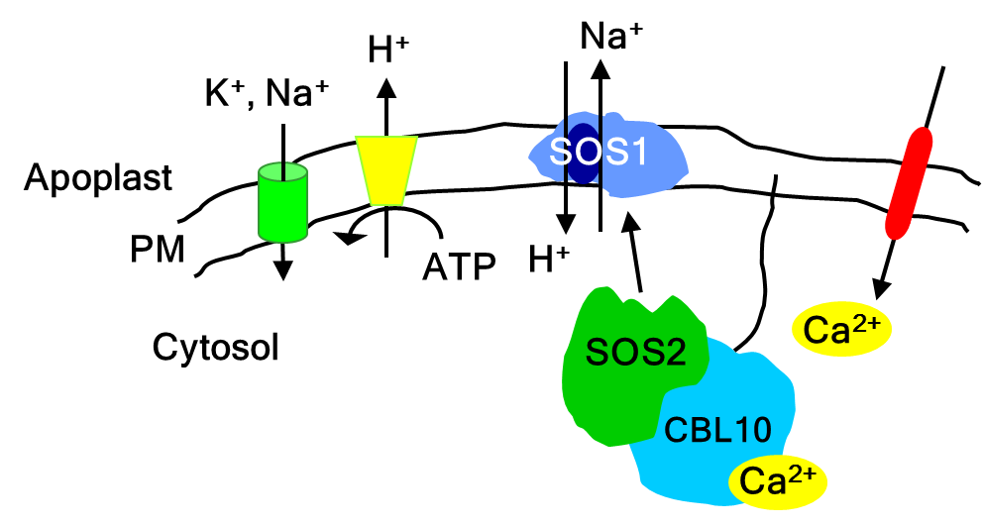
PLS/MCB/ECOL 440/540 MECHANISMS IN PLANT DEVELOPMENT
Dr. Karen Schumaker
Fall 2012
Tu, Th 9:30-10:45 AM
This course provides a fundamental knowledge of the molecular mechanisms that underlie plant development. We will study central processes in development and explore their genetic and genomic control. We will learn how experiments are performed, how the data is analyzed and how the results form concepts in plant developmental biology.
Pre-requisites: PLS 312 or ECOL 320. / Recommended: BIOC 384, PLS 360, and MCB 304.

Slide 12
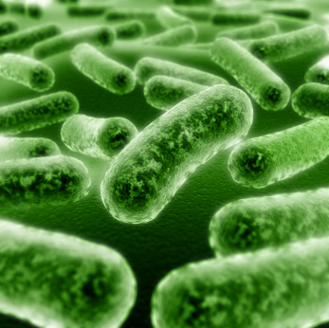
PLP452/552 Antibiotics – A Biological Perspective. Dr. István Molnár Fall Tu, Th 6:00pm-7:15pm
This course provides an introduction to the major classes of antibiotics, their discovery, mechanisms of actions, biosynthesis, microbiological role, and industrial production. The development of resistance leading to the threat and the reality of antibiotic-resistant “superbugs”, and the context of use and mis-use of antibiotics in our society will also be addressed.

