Slide 1
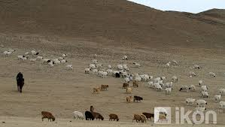
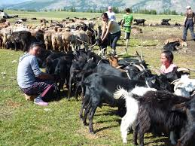
IYRP
Update from Mongolia on Process Towards COAG 2020 & Next Steps

Slide 2
Why IYRP
More than half of the Earth’s land surface is classified as rangeland
these lands are directly critical to the livelihoods and cultures of more than 500 million pastoralists around the world.
But Rangelands are faced with increasingly erratic climates, rapidly increasing human populations, and a fast pace of unsustainable land-use change.

Slide 3
Why IYRP
Pastoral agriculture is a way of life for many communities in many countries
pasture land can contribute for livelihood of herder’s and local communities
Pastoral Agriculture’s share in the GDP in many countries is substantial
Pastoral agriculture supports ecological green development
Climate change have contributed to the degradation of rangeland and rangelands and grass species are being lost its traditional natural condition
Traditional knowledge and methods of rangeland use are depredating

Slide 4
Support for IYRP /mobilization
First our support for IYRP was discussed also at the WG Meeting of Central Asia RLI, held in Apr., 2018, in Bishkek
We understand that the Governments of many CA countries willing to support the IYRP
We has several meetings and discussions with Mongolian stakeholders in last 2 years
In June 2018 at GASL Meeting representatives of GRLI and CA RLI initiate it with the Ministry of Food and Agriculture of Mongolia for IYRP

Slide 5
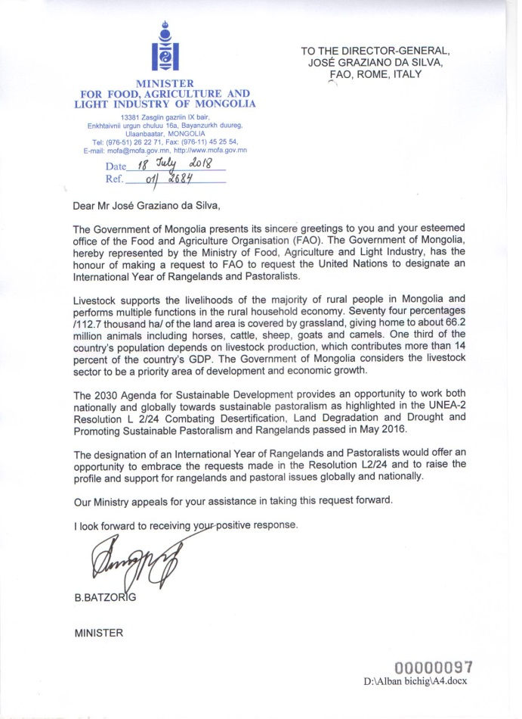
Mongolian Initiative
the Minister for Food , Agriculture and Light Industry of Mongolia Mr,Batzorig B, deliver Offical support letter of Mongolian Government to UN FAO on the support for IYRP

Slide 6
COAG :Mongolian Initiative
in 11 Nov., 2018, Mongolian request for the support on IYRP was discussed at the COAG -11 ( Committee on Agriculture) of UN FAO
Government of Mongolia proposes to establish an International Year of Rangelands and Pastoralists
.
Mongolian Government will officially develop proposal for IYRP until next COAG Meeting to be held in 2020

Slide 7
After COAG : What next
Mongolian IYRP proposal
National support group
Inter-sectoral understanding
Government proposal
Working with MNET
Working with MoFALI and MFA

Slide 8
Working on proposal
Draft of proposal doc. was translated into Mongolian and delivered to MoFALI and MNET
Dr.G.Batmunkh, Director of Livestock Department of MoFALI lead the proposal development
General discussions on the structure and timing of proposal was agreed
Proposal will done May-June, 2019

Slide 9
Structure of proposal
Summary
Importance of rangelands and pastoralism
  Food security in pastoralism
  Pastoralism , as sustainable agriculture and its resilience to CC
  Nature Conservation, Green development and Pastoralism
  Innovations/initiatives on integrating Rangelands and Pastoralism in global, regional and national development
  Tourism in Rangelands and Pastoralism
  Poverty eradication and Pastoralism

Slide 10
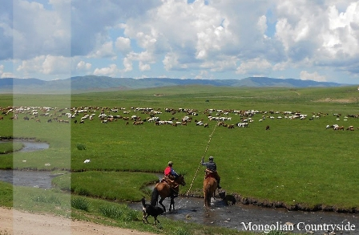
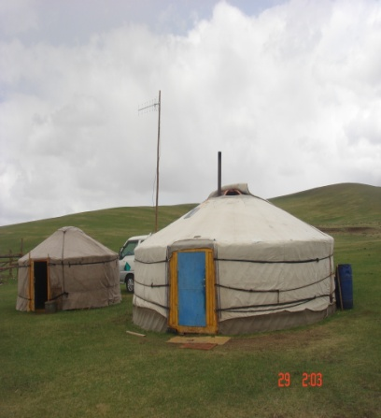
Objectives of the International Year of Rangelands and Pastoralists
  Awareness raising
  Growing recognition
  Partnership
  National and international actions

Slide 11

Mongolian Initiative update
National support group
National support group will established by FAO Mongolia and Ministry of Agriculture in later Feb., which will include representatives of all reacted stakeholders in Mongolia
The Chair and co-chair of the National support group was proposed as: Dr.Batmunkh, Director of Livestok Departemnt, Mr.Batjargal, Director of CC and IC Department
Secretary and Communication Office for Mongolian National Support Group will Dr.Munkhnasan, Specialist, Livestok Departemnt
Endorsement of National Support Group by National level stakeholders meeting in early March, 2019
National Support Group will finalize Mongolian Proposal for IYRP

Slide 12
Mongolian Initiative update
Working with MNET
Mongolian Environment Ministry will jointly organize the site event (breakfast) at the UNEA-4 in Nairobi, Kenya, in 11-12 March, 2019
In UNEA-4 Mongolian Environmental Minister will make presentation about the proposal and importance of IYRP in its side event in 11 March, 2019 in Nairobi
Mongolian resolution from UNEA-4 on Sustainable infrastructure will include some additional article on IYRP and Gap Analysis on RP

Slide 13
Mongolian Initiative update
Working with MoFALI and MFA
Ministry of Agriculture and Ministry of Foreign Affairs will conduct contract on mutual cooperation, which will include support for IYRP
New Agriculture Minister will updated by Livestock Department after this Lunar New Year
We are expecting meeting of Agriculture and Environment Ministers in early March before/during the National support group meeting on IYRP
Working with public
. Working Group will handle

Slide 14




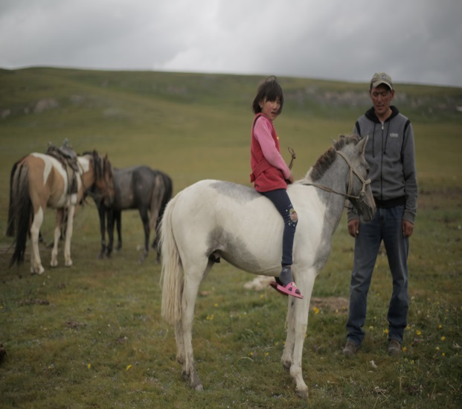
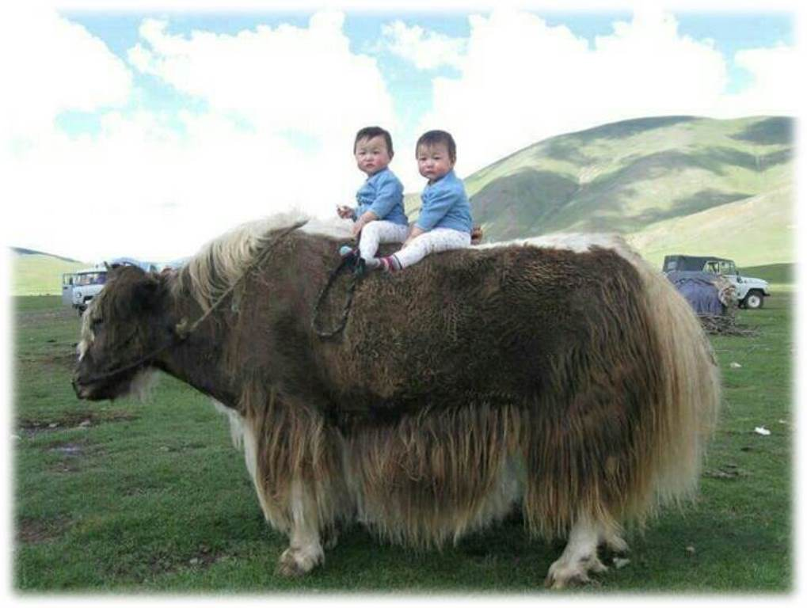
THANK YOU

