Slide 1
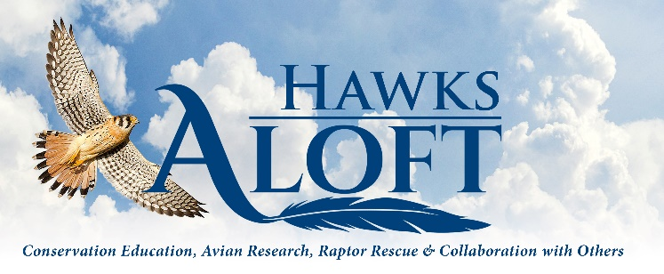
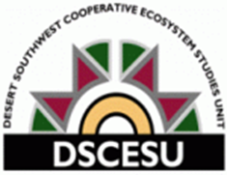
Avian Monitoring as Part of the Southwest Jemez Collaborative Forest Landscape Restoration Project
Project Goal
Evaluate avian use within eight habitat types located in the Valles Caldera National Preserve and the Santa Fe National Forest, New Mexico
Major Findings
Avian use was highest in mixed conifer forest (2.51 birds/ha) and burned mixed conifer forest (2.28 birds/ha)
Avian richness was highest in riparian habitat (115 species) and ponderosa pine forest (89 species)
In a comparison of untreated and treated ponderosa pine forest plots, cumulative avian density was significantly higher in burned and thinned points (2.41 birds/ha) than points that were only thinned (1.97 birds/ha) and untreated points (1.68 birds/ha)
Management Implications
The use of thinning and prescribed fire can benefit avian forest communities. But avian response to thinning and fire varies among species. Thus, careful consideration needs to be given to the needs of all species, especially species of concern. A combination of treatments, including prescribed fire, thinning, and areas of no treatment, conducted in patchy arrangements over time and area are likely to provide the greatest benefit to overall avian diversity and the greatest number of species.
Partner and Sponsor List
Valles Caldera National Preserve (National Park Service)
Santa Fe National Forest (USFS)
ADD ORGANIZATION LOGO HERE
http://cales.arizona.edu/dscesu/

Slide 2
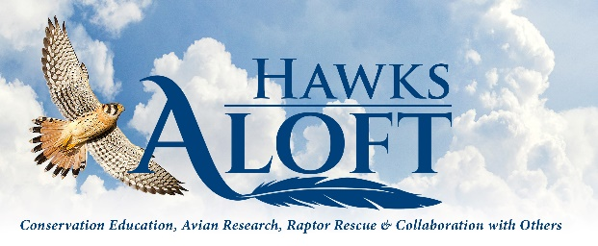
Avian Monitoring as Part of the Southwest Jemez Collaborative Forest Landscape Restoration Project
As part of the Southwest Jemez Collaborative Forest Landscape Restoration Project, Hawks Aloft, Inc. was subcontracted to conduct avian point count surveys from 2012-2024 to evaluate avian use within eight habitat types located in the Valles Caldera National Preserve and the Santa Fe National Forest. Cumulatively, over 13 years of surveys, avian density was highest in mixed conifer forest (2.51 birds/ha) and burned mixed conifer forest (2.28 birds/ha). Avian richness was highest in riparian habitat (115 species) and ponderosa pine (Pinus ponderosa) forest (89 species). We documented a total of 141 bird species. In a comparison of unthinned and thinned ponderosa pine forest plots, cumulative (2012-2024) avian density was significantly higher at treated points (2.27 birds/ha) than untreated (1.68 birds/ha); however, the difference was largely driven by data collected after the thinned points were subjected to prescribed fire. Density was significantly higher at thinned and burned points (2.41 birds/ha) than points that were only thinned (1.97 birds/ha). Avian richness was higher at thinned points (59 species) than unthinned points (58 species). We documented 57 avian species of conservation concern, including two species listed as threatened by the State of New Mexico: Peregrine Falcon (Falco peregrinus) and Gray Vireo (Vireo vicinior). The response of relatively common species of concern was variable among unburned and burned habitats of like type and between untreated and treated ponderosa pine forest. Among 15 relatively common species of concern, nine were more abundant in unburned forest and six were more abundant in burned forest, while eight were more abundant in unthinned forest and seven were more abundant in thinned forest. Our results suggest that the use of a combination of treatments, including prescribed fire, thinning, and areas of no treatment, conducted in patchy arrangements over time and area could improve overall avian diversity and benefit the greatest number of species.
ADD ORGANIZATION LOGO HERE
http://cales.arizona.edu/dscesu/

