Slide 1
EXCITE
Extension Collaborative on Immunization Teaching & Engagement
H5N1 for Dairy Farmers
Dr. Michelle Rodgers
Project Director, EXCITE

Slide 2
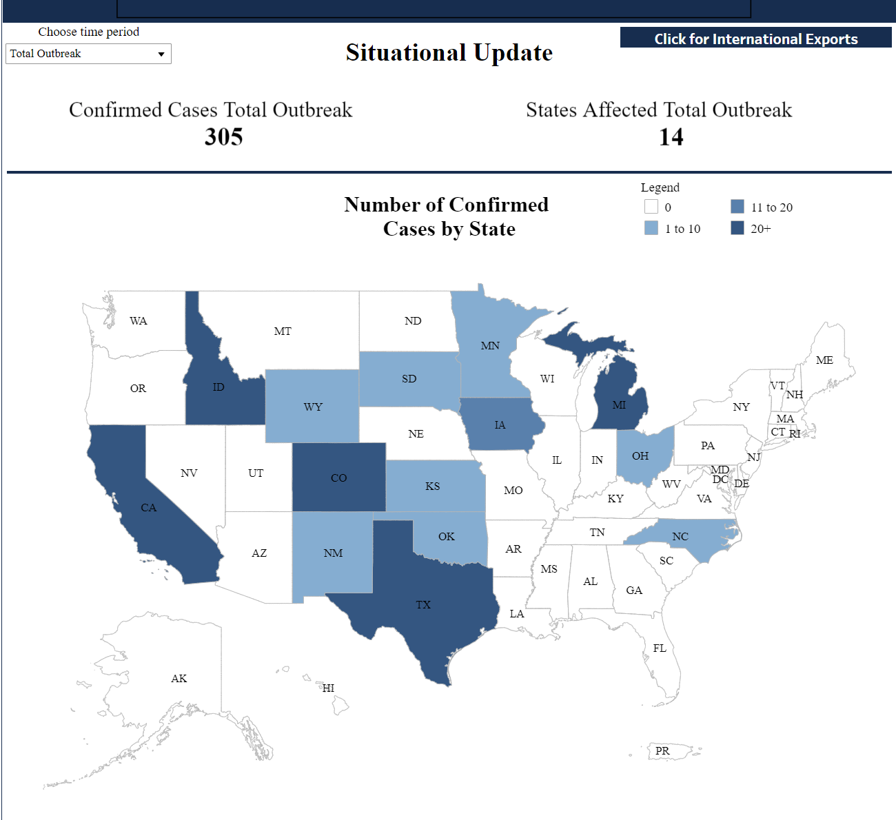
Notes:
299 dairy herds in 14 US states
CA Oct 3 had 56 herds and had 100 by Oct 11

Slide 3
Priority States
California Minnesota
Idaho South Dakota
Colorado Wyoming
Texas Kansas
Michigan Oklahoma
Indiana New Mexico
North Carolina
Ohio

Slide 4
Human Health Update-as of Oct 11
20 human cases of avian influenza A since April 2024
  10 from poultry, 9 from dairy cattle
    6 in first two weeks of Oct in CA
  Epidemiology continues to suggest sporadic spread from animals to human
  Illness is mild, including conjunctivitis
  Risk to general public is low, people exposed to infected animals are at higher risk

Slide 5
Objectives
1. Cooperative Extension Dairy Agents will increase their knowledge and understanding of H5N1 and gain knowledge and enhance skills in behavior change communication as it relates to human health.
2. Dairy producers will have an increased knowledge and understanding of H5N1 and the potential transference and impact on human health.
3. Dairy producers will adopt prevention practices on farm to reduce animal and human health risk of H5N1.

Slide 6
H5N1 Program Leadership Team
1 “One Health” Dairy Specialist - overall leadership to Extension efforts, national advisory
committee representation, liaison to National Center Farmworker Health efforts, training NCFH partners about Extension – 1 FTE
Offer in process
  2 Dairy Specialists - Science Based Information on Animal and Human Health
    Jason Hartschuh - Dairy Specialist - The Ohio State University - .25 FTE
    Dr. Diego Manriquez Alverez - Dairy Vet Specialist - Colorado State University - .25 FTE
  Washington State University Murrow College of of Communications - Contract
  Message content and delivery, professional development for agents
    Dr. Erica Austin - Director of Murrow Center for Research and Health Promotion
    Dr. Paul Bolls - Director Research Labs, Co-Director Murrow Media Mind Lab
    Dr. Yen-I Lee - Co-Director of Murrow Media Mind Lab
    Dr. Nicole O’Donnell - Media psychology and health promotion
Notes:
Media lab-brain friendly content Neurotesting content that will increase opportunity for changing behavior

Slide 7

Training Components:
Science Media Literacy
Motivational Interviewing
Neuromarketing
Notes:
Address Internal Organization Hesitancy: Our organization representative of the country
Washington State University Murrow College of Communications–study us
Recommendations
Tailor professional development based on the roles of the individuals (Ag-vet projects) -Current projects each have 1 aspect of their project on educating their LGU Extension
Prioritize preserving community trust and professional credibility-political aspects challenged some view of politically biased instead of unbiased research based.--Whole Health
Use whole health approach-Integrate in existing education and not stand alone immunization education as primary
EX: EFNEP and integrate aspects of immunization into nutrition education
Strengthen Communication Skills
Tool Kit

Slide 8
Funding Available now through September 2025
$500,000 Reallocation of EXCITE funding - IAA between CDC and NIFA through Extension Foundation
$180,000 Subcontract to EXCITE from National Center for Farmworker Health for Lead Dairy Specialist & Neurotesting of materials
$ 75,000 Seqirus (Pharmaceutical Co) for Professional Development
  ~$300,000 of the above to come directly to states to support delivery of educational programming. (Discussion with APHIS for additional.) Public Health Jurisdiction funding to consider

Slide 9
CDC has awarded approximately $2 million in funding to support the operational costs of the various activities jurisdictions are implementing to encourage and facilitate the uptake of seasonal flu vaccination among farmworkers.
  Examples:
  mobile vaccine clinics
  promotion via virtual town halls
  vaccine education workshops
  partnering with local public health agencies and community-based organizations to organize mass vaccination events.

Slide 10
Rationale:
Seasonal flu vaccine does not protect against H5 bird flu
Expanding access to flu vaccines among farmers does
  prevent severe illness
  help reduce strain of flu season on rural health care
  Reduce prevalence of seasonal flu
  help public health agencies better detect cases of H5 bird flu
  Fewer people infected with seasonal flu = fewer possibility of co-infection with human seasonal virus and H5 bird flu.

Slide 11
Discussion Questions
How Should we connect with dairy agents in your states?
How do you want to be informed of what is happening in this area?
  Directors? Program Leaders? Direct list of dairy agents? Other?

Slide 12
Deliverables
Listening Sessions with Dairy Agents - Directors invite your Agents to Participate
      October 24 1 – 2 p.m. EST
      https://extension.zoom.us/meeting/register/tZAtc-ispzMrHdYX1PEarDRUoZyhExcnHF6O
      October 25 12 – 1 p.m. EST
      https://extension.zoom.us/meeting/register/tZIvceqsqz0qHNbmYByZ9dsQfWztwUj9f2DO
Communication Tools to meet Agents needs for winter meetings
  Approved by CDC, APHIS, National Center for Farmworker Health
Professional Development for Dairy Agents across Extension System - Directors inform agents of date
  December 12 from 2 – 4 p.m. EST

Slide 13
Deliverables Continued
Educational Efforts
Neurotesting of educational materials, redesign as needed
Ongoing updates / professional development by One Health Dairy
Partnerships / Collaboration at local level
Evaluation / Documentation of Reach / Output - one national reporting tool and data collection by EXCITE; data available to states

Slide 14
Contact
MichelleRodgers@extension.org

