Slide 1
ALVSCE Research Team - Update
Key Activities
Unit Assignments
New Workflow System
Proposal Submission Timeline
Late Proposal Policy for ALVSCE

Slide 2
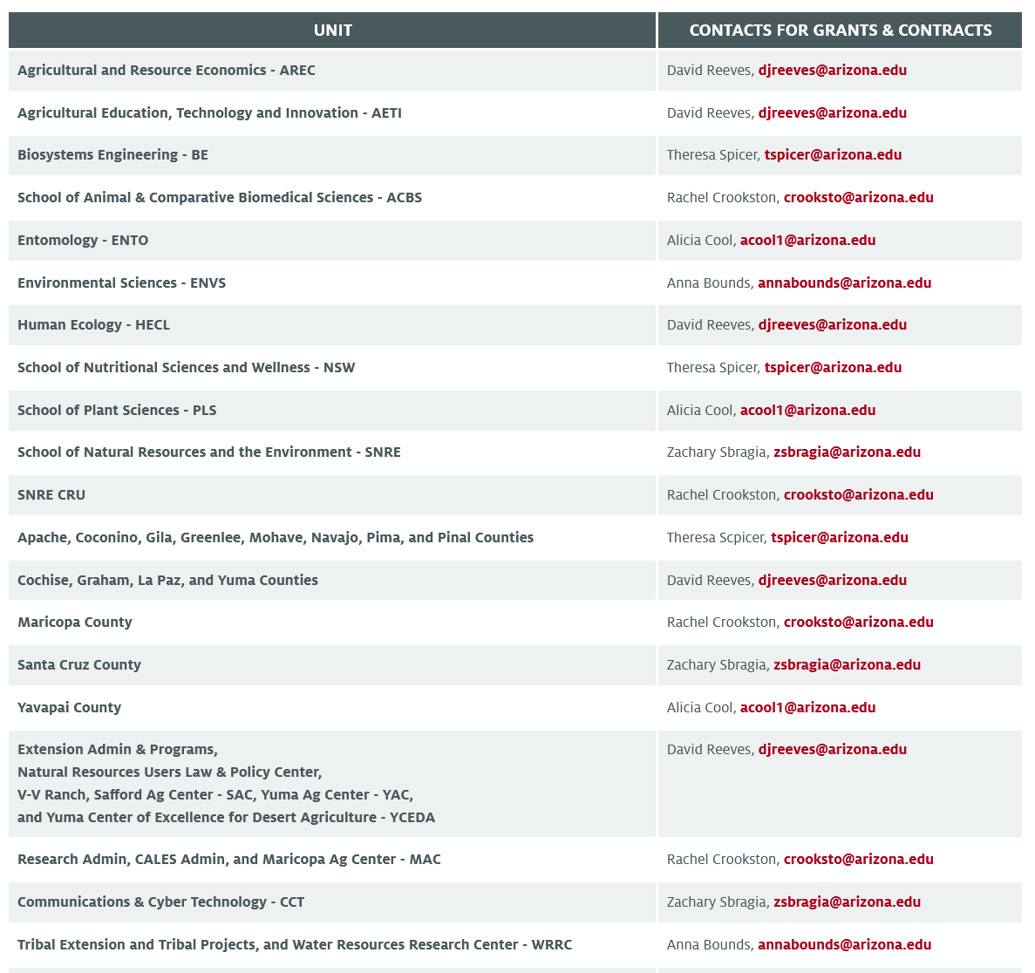
Unit Assignments

Slide 3
New Workflow System
The team have been developing a single ALVSCE PreAward Workflow system in Smartsheet.
Introduces dedicated forms, such as Proposal Intake forms to more effectively collect the information required to initiate a request.
Utilizes automated emails and processes for more streamlined and consistent Research Administrative support.
Will allow the team to plan work more effectively by being able to view the entire team workload in one place and allow for flexibility in task assignment based on current bandwidth.
Improved data collection covering data points currently not collected anywhere, which can direct future team developments
The workflow has been fully operational since 03/01/24 for the RAs and we will be work towards more forward facing reports for the all of ALVSCE.

Slide 4
Updated Submission Timetable
The Workflow system has been constructed around a slightly updated submission timetable.
The submission timetable was updated to make it more streamlined and to identify key deadlines for required documentation.
Designed to accommodate key Compliance deadlines, including Office Research Contracts (7-10 business days) and Sponsored Projects (Three-day Deadline.)
Key changes
  Asking for notification of intent to submit a proposal 20 business days for all projects
  Formalizing the documentation deadlines
    Subawards – 10 business days prior to submission deadline
    Documents for internal routing – 8 business days prior to submission deadline

Slide 5
ALVSCE Proposal Submission Timeline
PLAN - Ongoing
Explore research opportunities – send any opportunities that interest you to your Research Administrator (RA) to review for eligibility and limited submission requirements. You can find your RA here
Identify your research team, subawards and other collaborators.
Consider contacting Research Development Services (RDS) for project narrative support or identifying departmental colleagues who can act as internal reviewers.
NOTIFY - 20 business days prior to Sponsor Deadline
Notify your RA of your intent to submit. You will need to provide your RA with a copy of the funding opportunity, a budget outline and the contact details for any subawards.
Complete the Proposal Intake Form
Your RA will help you prepare the full budget/budget justification and other non science related documents in the sponsor’s requested format.
SUBAWARDS DUE - 10 business days prior to Sponsor Deadline
All subaward documents due.
This should include budget, budget justification, scope of work and subrecipient commitment form.
FINALIZE ROUTING DOCS - 8 business days prior to Sponsor Deadline
All documents for internal routing are due.
Provide your RA with the following documents so they can initiate routing: Project Title, Project start & end dates, project abstract/summary, budget, budget justification, PI/Co-I distribution of credit & F&A.
Proposal documents received after this date will be subject to the Late Proposal Policy
Continue to work on science sections of the proposal and send final documents to RA as completed.
FINALIZE PROPOSAL - 3 business days prior to Sponsor Deadline
Completed grant proposal package with all approvals due at Sponsored Projects Services by 8am.
NO SUBSEQUENT CHANGES TO DOCUMENTS ARE ALLOWED
Be on call and ready to make edits and troubleshoot any submission issues.

Slide 6
Late Proposal Policy
What is a late proposal?
A late proposal is any proposal where the documents needed for internal routing have not been provided to your RA by the ALVSCE submission deadline of 8 business days prior to the Sponsor deadline.
This could be for a number of reasons, including short notice from the sponsor, unresponsive collaborators, illness, or you only found about the funding opportunity and it’s due next week!
However, the impact of a late proposal is the same regardless of the reason for lateness
What is the impact of a late proposals?
.
For the Investigator | For the RA
reduced amount of time to edit and refine the proposal. preferred research team members unable to join due to shortened deadline. missing key compliance deadlines so the proposal may not be submitted to the sponsor | late proposals require stopping work on other on-time proposals to generate and route documentation. significant negative impact on RA workload and working hours

Slide 7
Late Proposal Policy - Overview
Will apply to all new, competing renewal, continuation and re-submission proposals where there is a sponsor deadline.
Any proposal where key documentation for internal routing is not provided by the 8 business day deadline identified in the ALVSCE timeline will be considered late and will require Unit Head approval for the proposal to proceed.
For proposals where the RA is first notified of the proposal, or has not received any documentation from the Investigator by 5 business days prior to the sponsor deadline, this will require the approval of both the Investigator’s Unit Head and the Associate Dean of Research for the proposal to proceed
Approvals will be obtained through the Late Proposal Request Process integrated into our ALVSCE Preaward Workflow. This process is also aligned with SPS late proposal processes.
For non-competing proposals, or proposals where the sponsor has requested a short turnaround, investigators will be asked to contact their RA as soon as they are notified as these proposals may require additional steps to ensure timely submission by Sponsored Project Services.

Slide 8
Late Proposal Policy - Process
Investigator completes a proposal intake form or emails their RA about a proposal.
Workflow system automatically calculates dates based on the submission deadline provided, and will identify those proposals that are subject to the late proposal policy.
Information is reviewed against the RFP to make sure the dates are correct, before a late proposal request is initiated.
Investigator will receive an email advising them that their request falls under the late proposal policy and asking them to complete a late proposal form.
Investigator submits completed form providing an explanation and documentation for the late request.

Slide 9
Late Proposal Policy - Process
Once an investigator has submitted the late proposal form, an email is sent to the Unit Head requesting approval. The Unit Head will be able to access all the original documentation provided by the PI and is asked to provide comments to support their decision
For proposals received within 5 business days of the submission deadline, after Unit Head approval, an email is then sent to the ADR for approval
Once a late proposal request has completed its approval path and a decision has been made, the Investigator will receive an email advising them of the outcome and the next steps

Slide 10
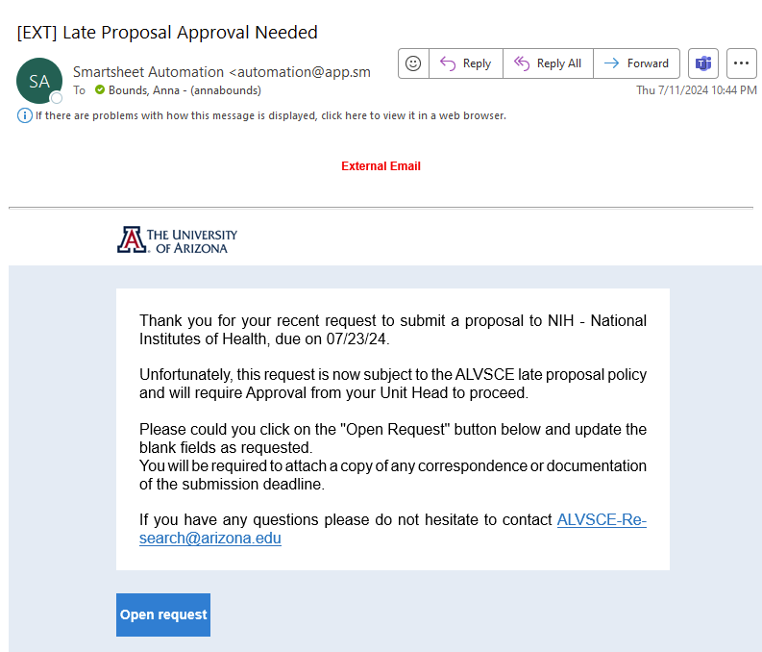
Late Proposal Policy - Examples

Slide 11
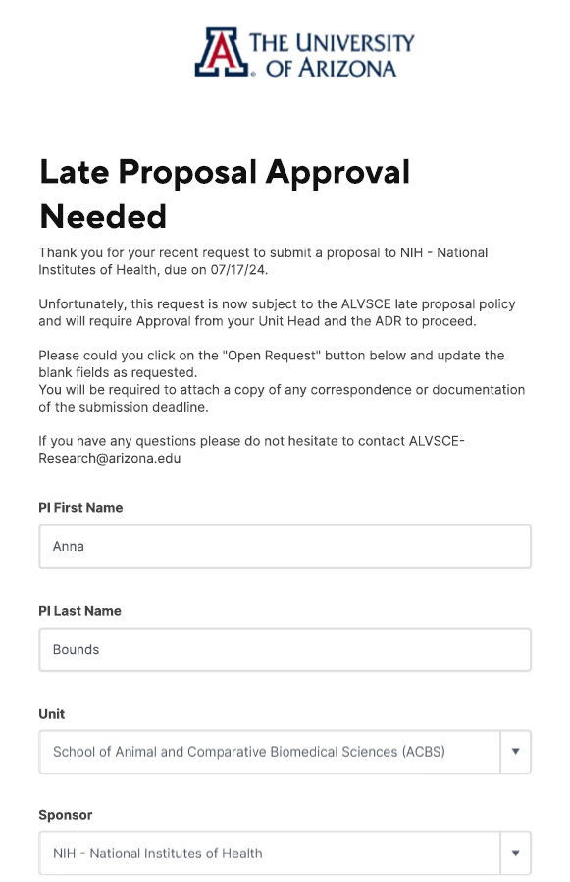
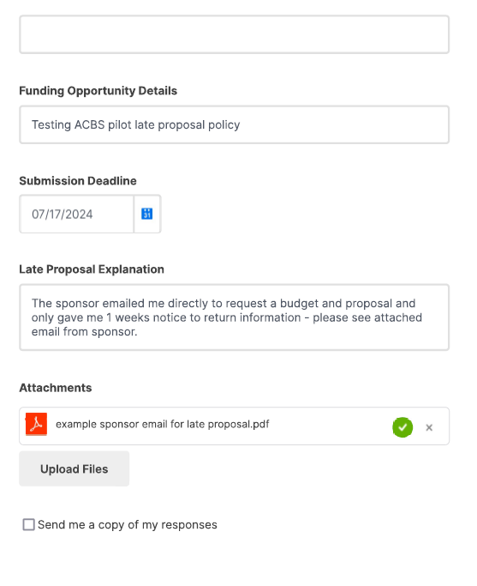
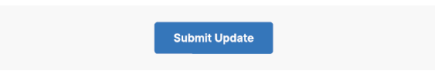

Slide 12
Late Proposal Policy - Guidance
More detailed guidance on the Late Proposal Policy can be found here.
This includes a comprehensive set of FAQs which we are regularly updating.
It is anticipated that the Late Proposal policy will come into effect from 08/19/2024, and is currently being piloted in ACBS.
We are available to answer any questions you may have, and we would also be happy to attend any Extension Office meetings to present this policy as needed.
You can email the team at any time at:
ALVSCE-Research@arizona.edu

