Slide 1
Prevention of Workplace Violence from a Threat Assessment and Management Perspective
Jessie Semmann, Ph.D.
Director of Threat Assessment and Management
University of Arizona

Slide 2
LEARNING OBJECTIVES
Identify relevant UA policies
Discuss inappropriate workplace behavior
Understand options for de-escalation and conflict resolution techniques
Examine how these topics relate to the Threat Assessment and Management Team (TAMT) and review basic information about the function of TAMT

Slide 3
Relevant UA policies
University Staff Standards of Conduct Policy:
https://policy.arizona.edu/employment-human-resources/university-staff-standards-conduct policy#:~:text=We%20do%20not%20tolerate%20discrimination,promptly%20report%20issues%20of%20concern.
Workplace Violence Policy:
https://policy.arizona.edu/human-resources/workplace-violence
Nondiscrimination and Anti-Harassment Policy
https://policy.arizona.edu/human-resources/nondiscrimination-and-anti-harassment-policy

Slide 4
Inappropriate workplace behavior
Gossiping
Bullying
Violating boundaries and other intrusive behaviors
Harassment (sexual or otherwise)
Intimidating others with words or gestures
Shouting, yelling, and demeaning
Discussion of inappropriate workplace topics (e.g., sexual, violence, weapons)
Unwanted physical contact
Discrimination
Alcohol and other drugs at work

Slide 5
Workplace Violence
Direct, implied, and vague threats
Property damage
Stalking
Brining weapons to work (or implying that you might)
Physical aggression/assault

Slide 6
Tips to avoid inappropriate workplace behavior
Know the policies
Think before speaking and acting
Consider the consequences
Try empathy
Utilize conflict resolution skills and de-escalation skills
Talk to your supervisor
Ask questions if you do not understand policies

Slide 7
Conflict in the workplace
Workplace disagreements will happen, and we all experience emotions
Sometimes we will notice heightened emotions in ourselves and sometimes we will notice it in our coworkers, supervisors, or customers
Conflicts may come on quickly or may be something that has been building overtime

Slide 8
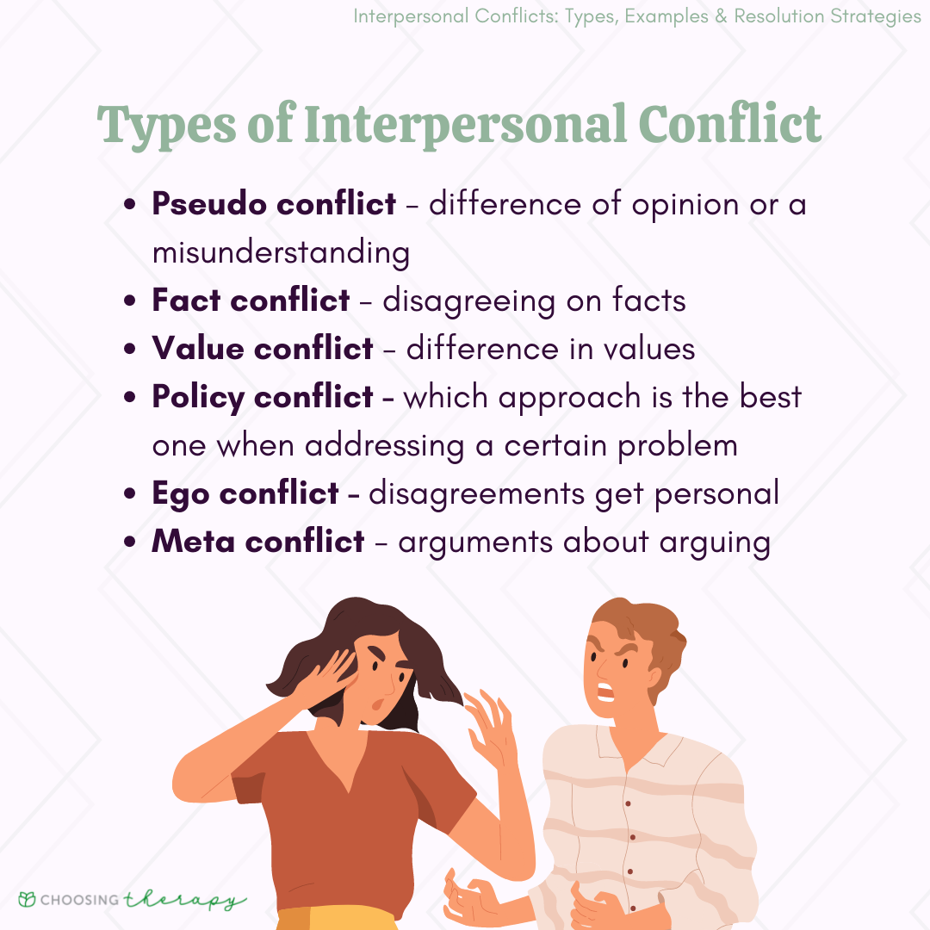
Workplace conflict examples
Personality differences and differences in work style
Misunderstanding and miscommunication
Power struggles

Slide 9
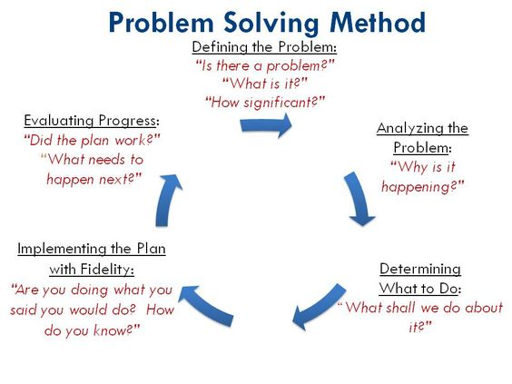

Slide 10
Conflict resolution tips
Address problems sooner rather than later
Notice your own emotions and use coping skills appropriately
Walk away if you are becoming too angry or the conversation is becoming unproductive
Be an active listener
Use “I” statements to avoid sounding accusatory
Speak calmly
Respect each other’s differences and show empathy
Be open-minded and recognize constructive criticism
Take ownership of your part and apologize if needed

Slide 11
Coping Skills and Regulating Your Own Emotions
Plan and prepare- consider practicing beforehand!
Deep breathing before, during, and after the conflict
Show yourself (and the other person) grace- no one is perfect
Look for common ground
Physical self-care before and after
Remember you don’t have to solve it all in one conversation
Have a mediator such as a supervisor be part of the conversation
Utilize resources such as Life & Work Connections

Slide 12
De-escalation
Safety is the number one priority- obtain help as needed
Watch your tone, your facial expressions, and your body language
Maintain space and do not touch the other person
Be polite, respectful, and courteous (even if what they are saying does not make sense or if they are being unnecessarily accusatory)
Stay as calm and composed as possible- do not mirror their appearance
Do not argue or interrupt- do try to understand

Slide 13
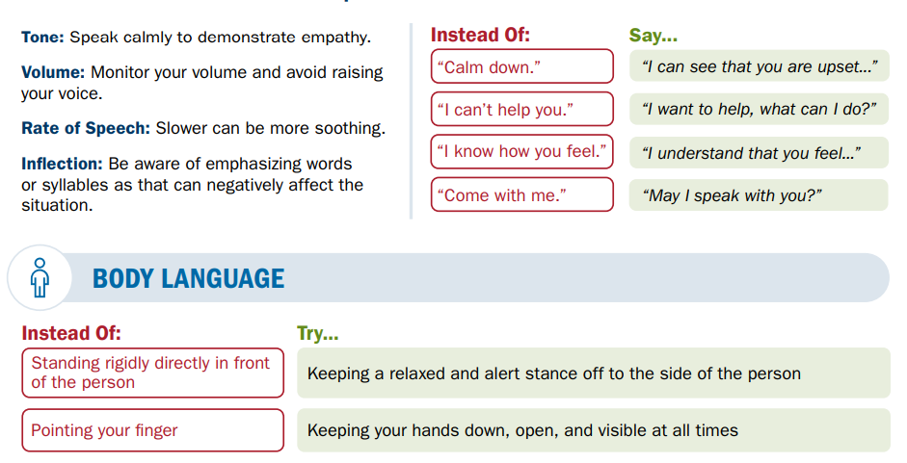

Slide 14
Final de-escalation tips
Simplicity
When setting limits, use clear and simple language
Choices
Offer choices
Flexibility
Be flexible when possible
Silence
Tolerate silence in the conversation when necessary to give time
Control
Don’t take the bait (e.g., if the person is challenging your authority or saying something insulting)

Slide 15
Threat Assessment and Management Team (TAMT)
https://tamt.arizona.edu/

Slide 16
Questions?

Slide 17
References
https://www.cisa.gov/sites/default/files/2022-11/De-Escalation_Final%20508%20%2809.21.21%29.pdf
https://www.hr.admin.cam.ac.uk/policies-procedures/dignity-work-policy/guidance-managers-and-staff/guidance-managers/acceptable-and
https://pollackpeacebuilding.com/blog/4-examples-of-conflict-situations-in-the-workplace/
https://www.businessnewsdaily.com/8766-resolving-workplace-conflicts.html
https://www.mindtools.com/ahcpfn4/conflict-resolution

