Slide 1
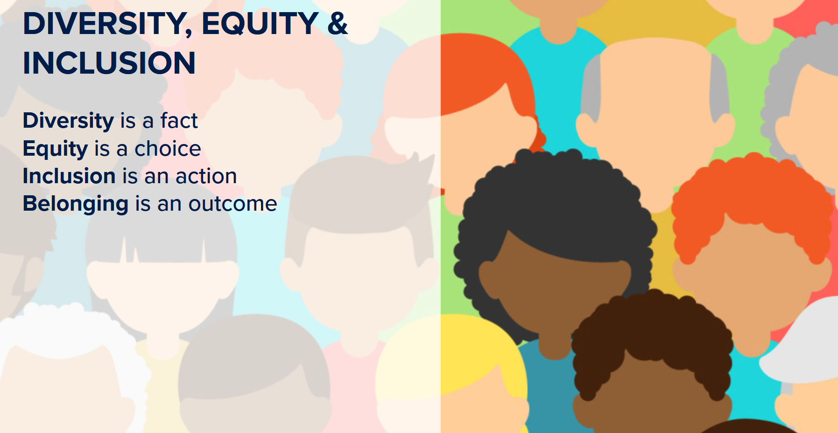
Jeff Ratje
jmratje@arizona.edu
March 23, 2023

Slide 2
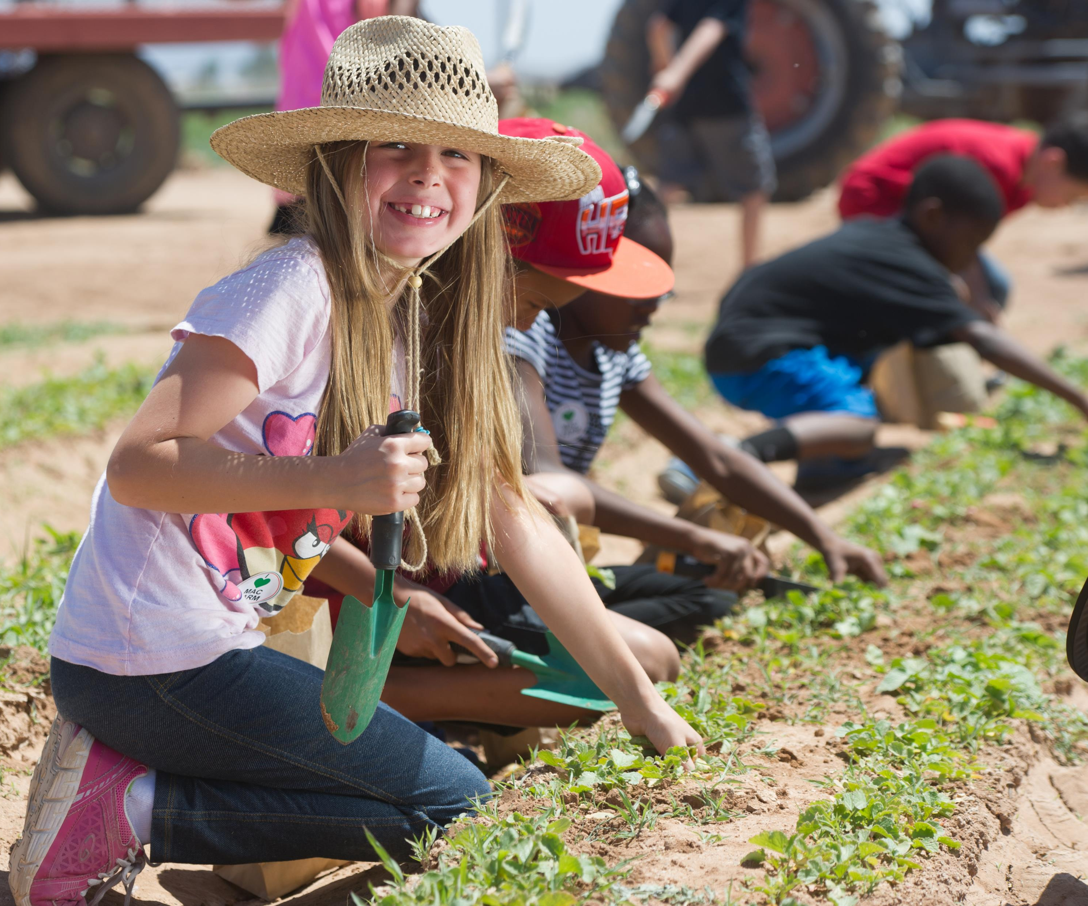
UArizona Values: Inclusion
At the University of Arizona, our diversity makes us stronger. Inclusion infuses our classrooms, our research labs and our outreach within the community because we believe the most significant learning takes place when we are working with others who are different from ourselves. We also prioritize culturally enriching experiences and student support through our cultural living communities and resources.

Slide 3
DEI: More Than Meets the Eye
Languages spoken
Lived experiences
Veteran status
Different physical abilities
Neurodivergence
Religion
Personality diversity
Sexual orientation
Experiences in countries and with cultures
Socio-economic diversity
General worldview
Education
Parental status
Marital status
And much more…

Slide 4
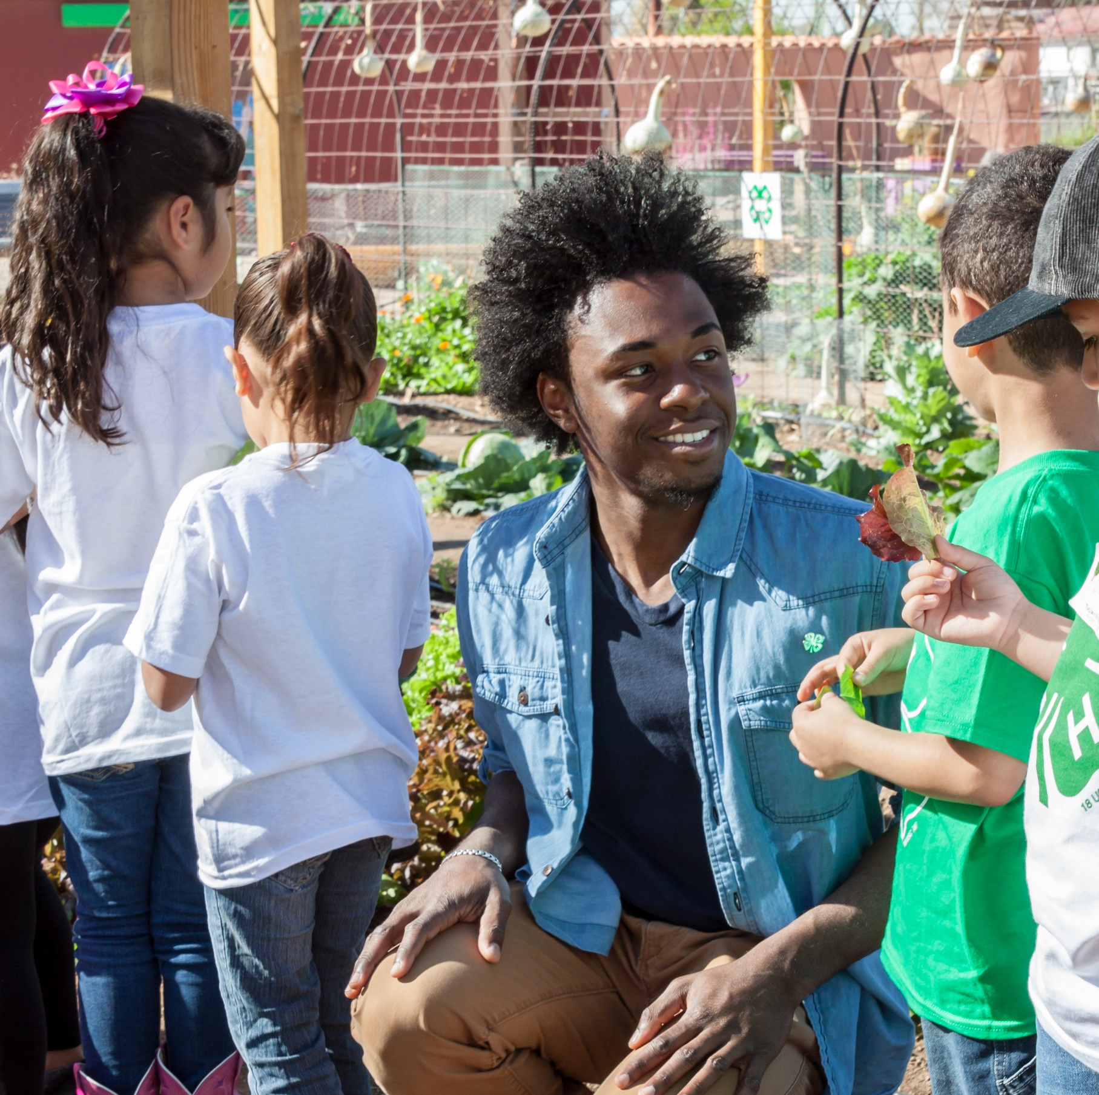
Extension Is Doing DEI
Program materials in Spanish and English
4-H programs tailored to Indigenous youth
Lactation spaces for faculty, staff, and participants
Providing safe work environment to express alternate viewpoints
And much more…

Slide 5
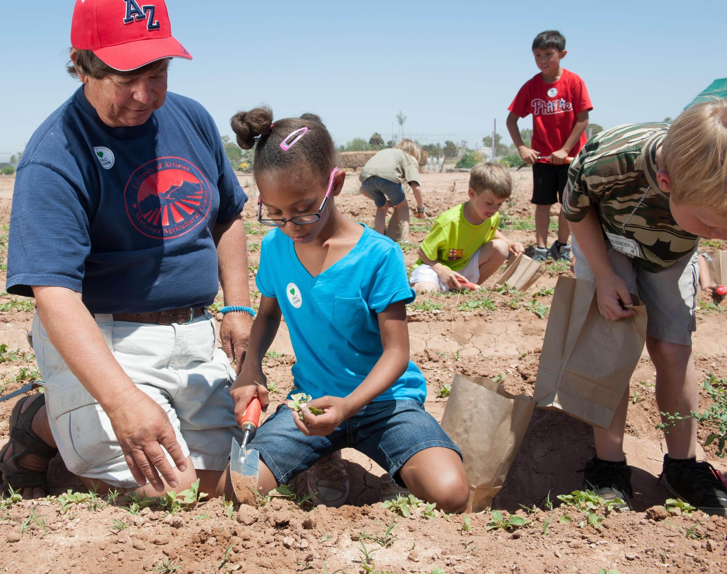
Before deciding, ask “Did we think about DEI?”

Slide 6
Were We Intentional?
Can we improve the onboarding so that new faculty and staff feel welcome?
Are we saying or doing things that make others uncomfortable? Did we ask?
Did we seek out the voices of individuals who don’t often speak up?
Are we mentoring future leaders who represent the diversity in our organization?
Are we reviewing for salary equity among the same job titles?
How actively are we recruiting faculty and staff from under-represented groups?

Slide 7
We will make mistakes with DEI. Be open, listen, learn, and improve.

Slide 8
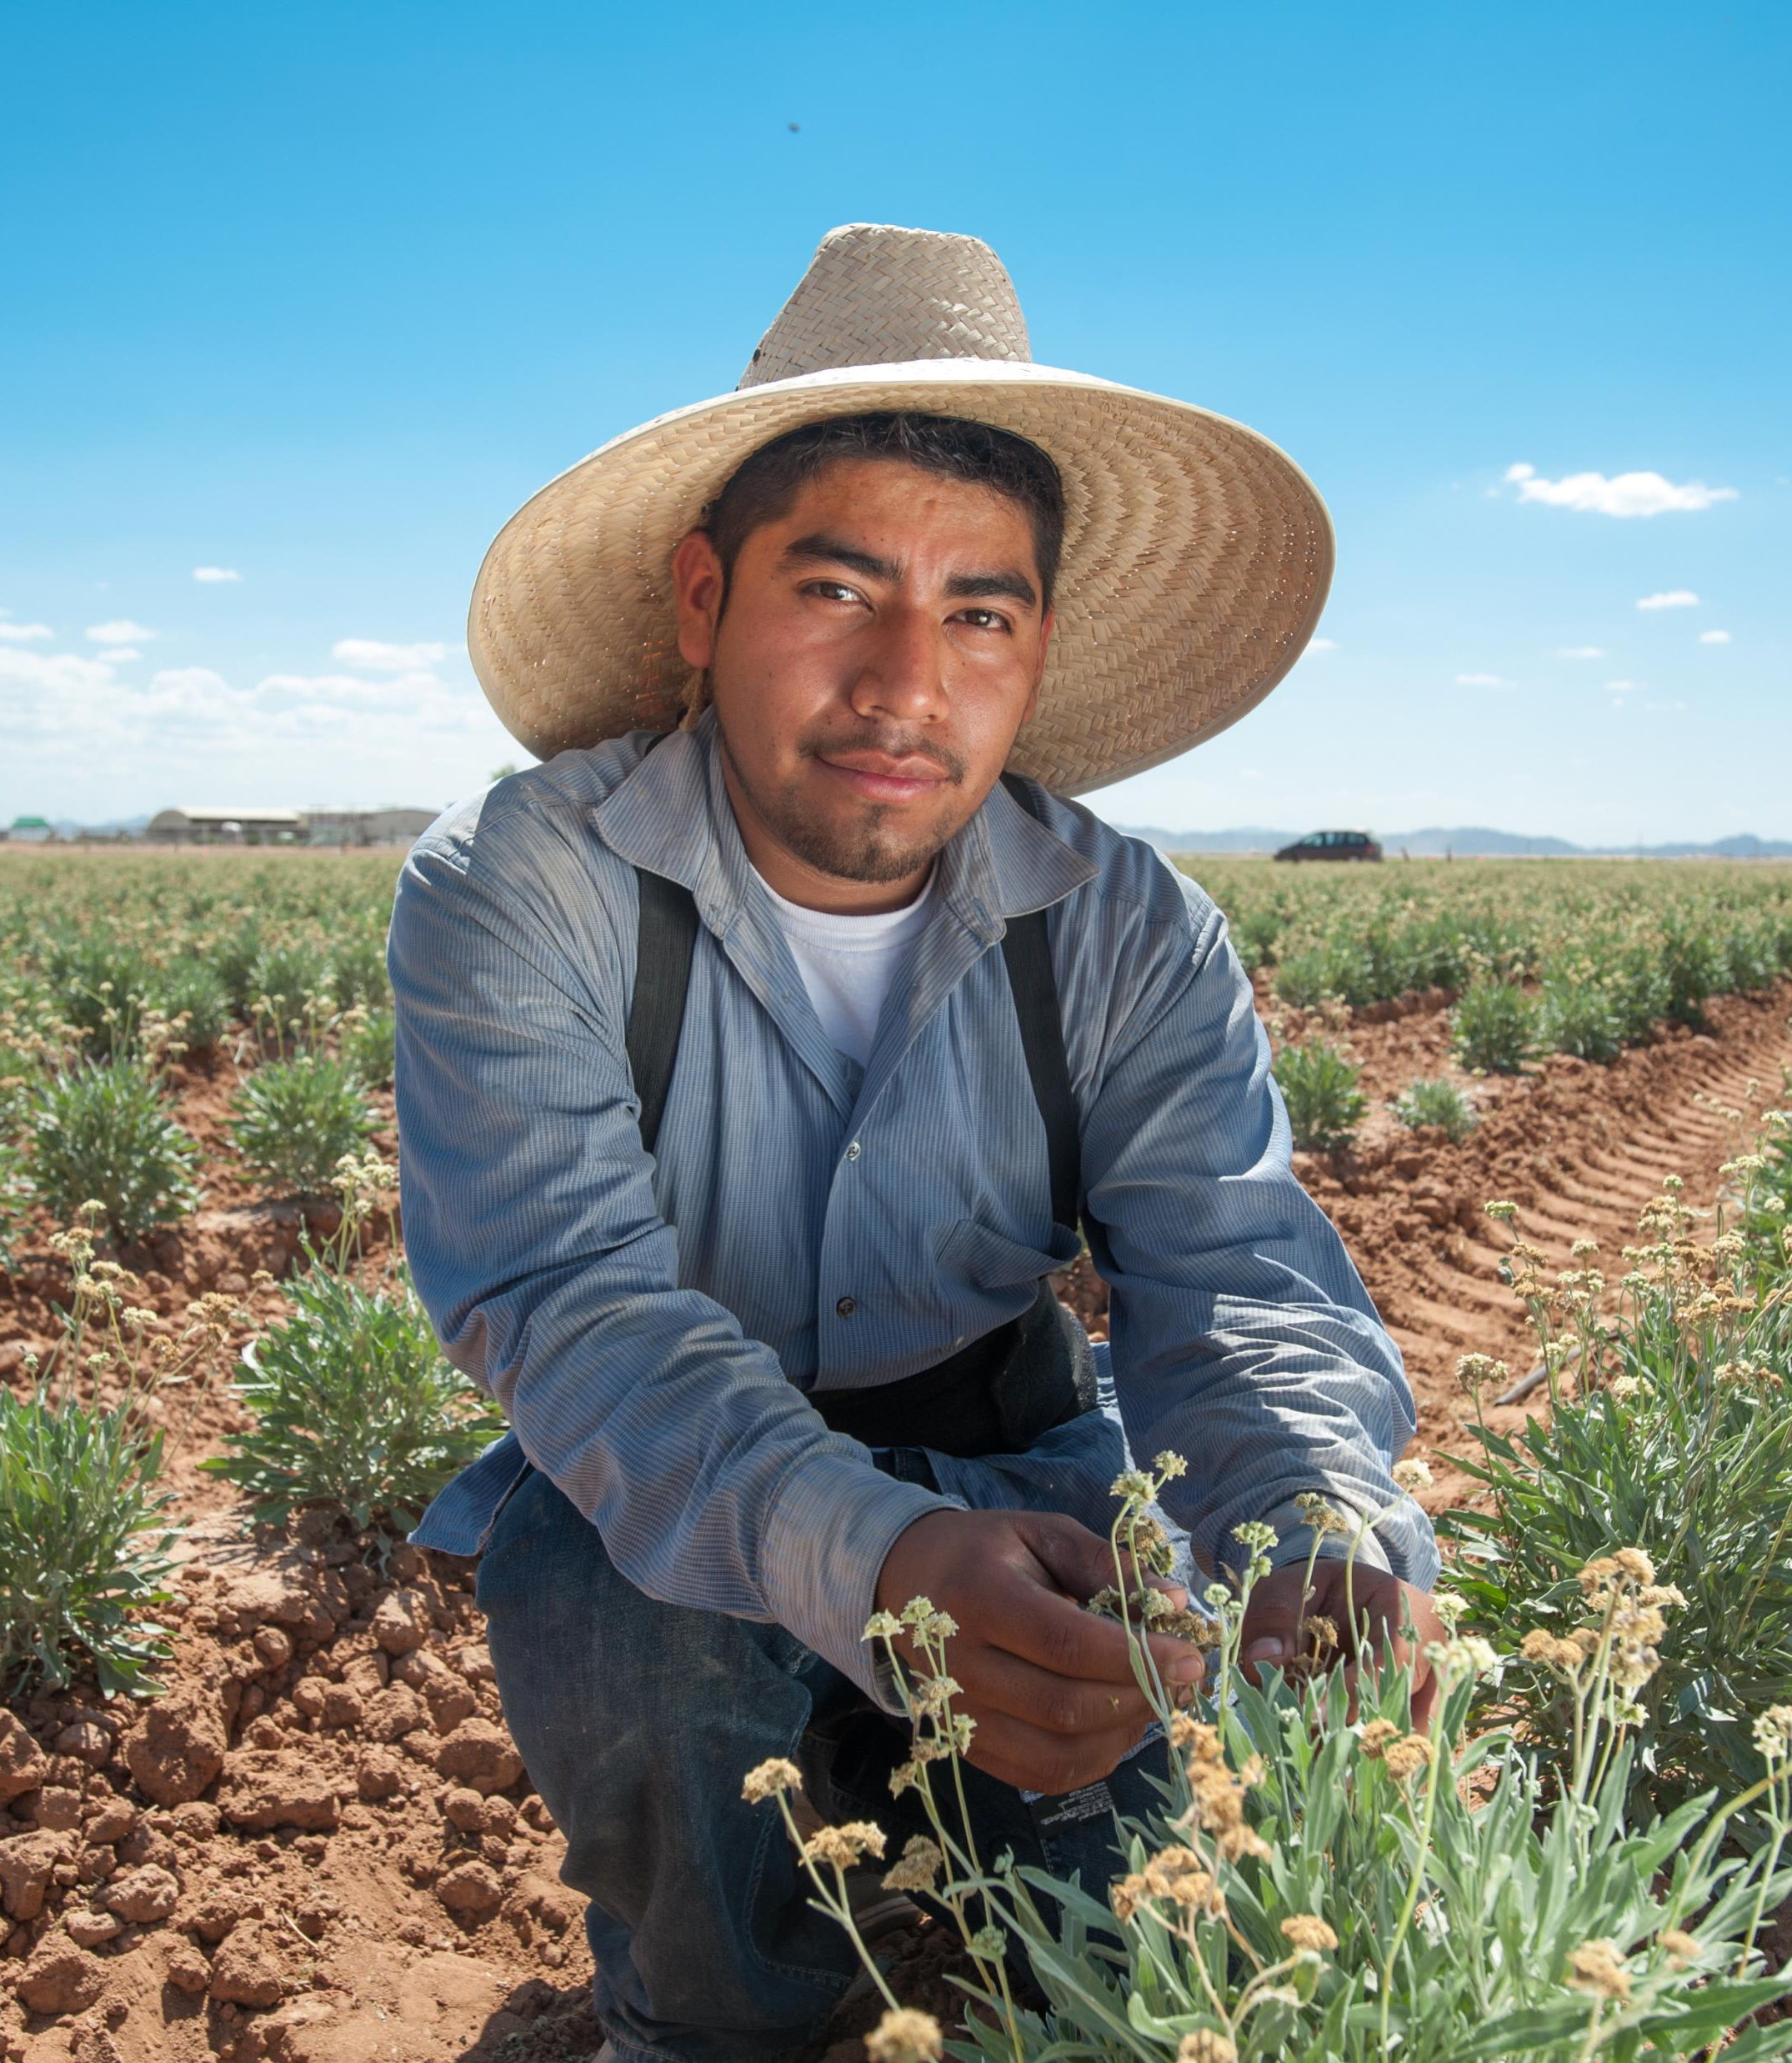
Resources:
Hiring & Onboarding
ALVSCE DEI Council (new website coming soon)
UArizona Office of Diversity & Inclusion
ALVSCE Employee Demographics
Arizona Population Data, Census
UArizona Hispanic Serving Institution Initiatives
UArizona Native American Advancement, Initiatives & Research

Slide 9
Learning Opportunities
LinkedIn Learning
Moving DEI from Intention to Impact with Ruchika Tulshyan
Diversity, Inclusion, and Belonging
Communicating about Culturally Sensitive Issues
Uncovering Unconscious Bias in Recruiting and Interviewing
Understanding Unconscious Bias (very short YouTube)
Books
Inclusify: The Power of Uniqueness and Belonging to Build Innovative Teams by Stefanie K. Johnson
And many more…point is to be open minded and start.

Slide 10

Thank YOU!

