Slide 1
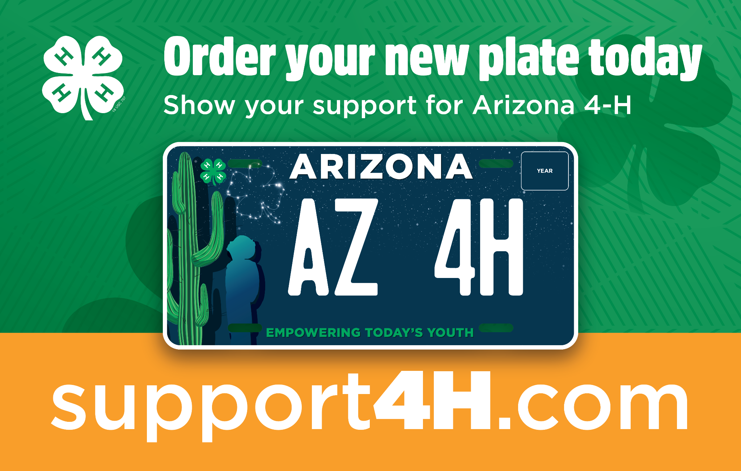

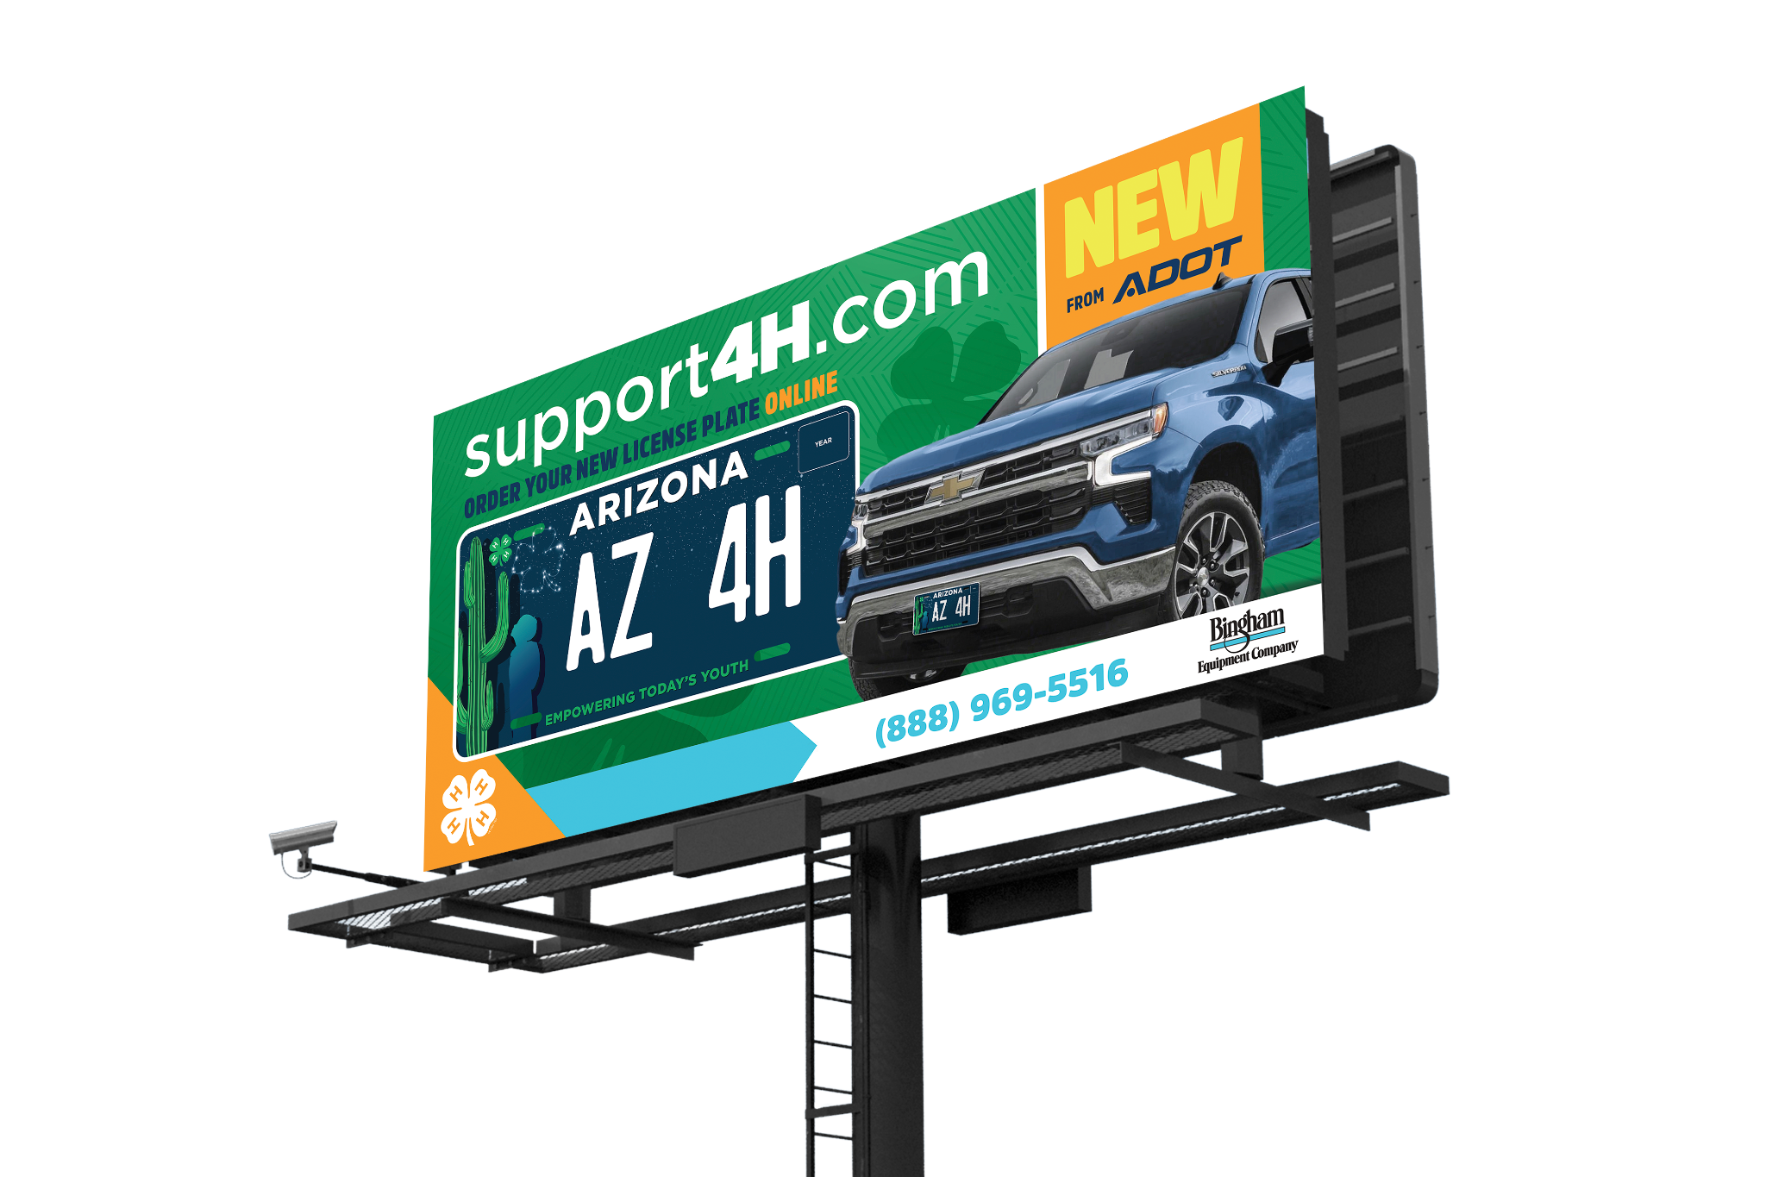
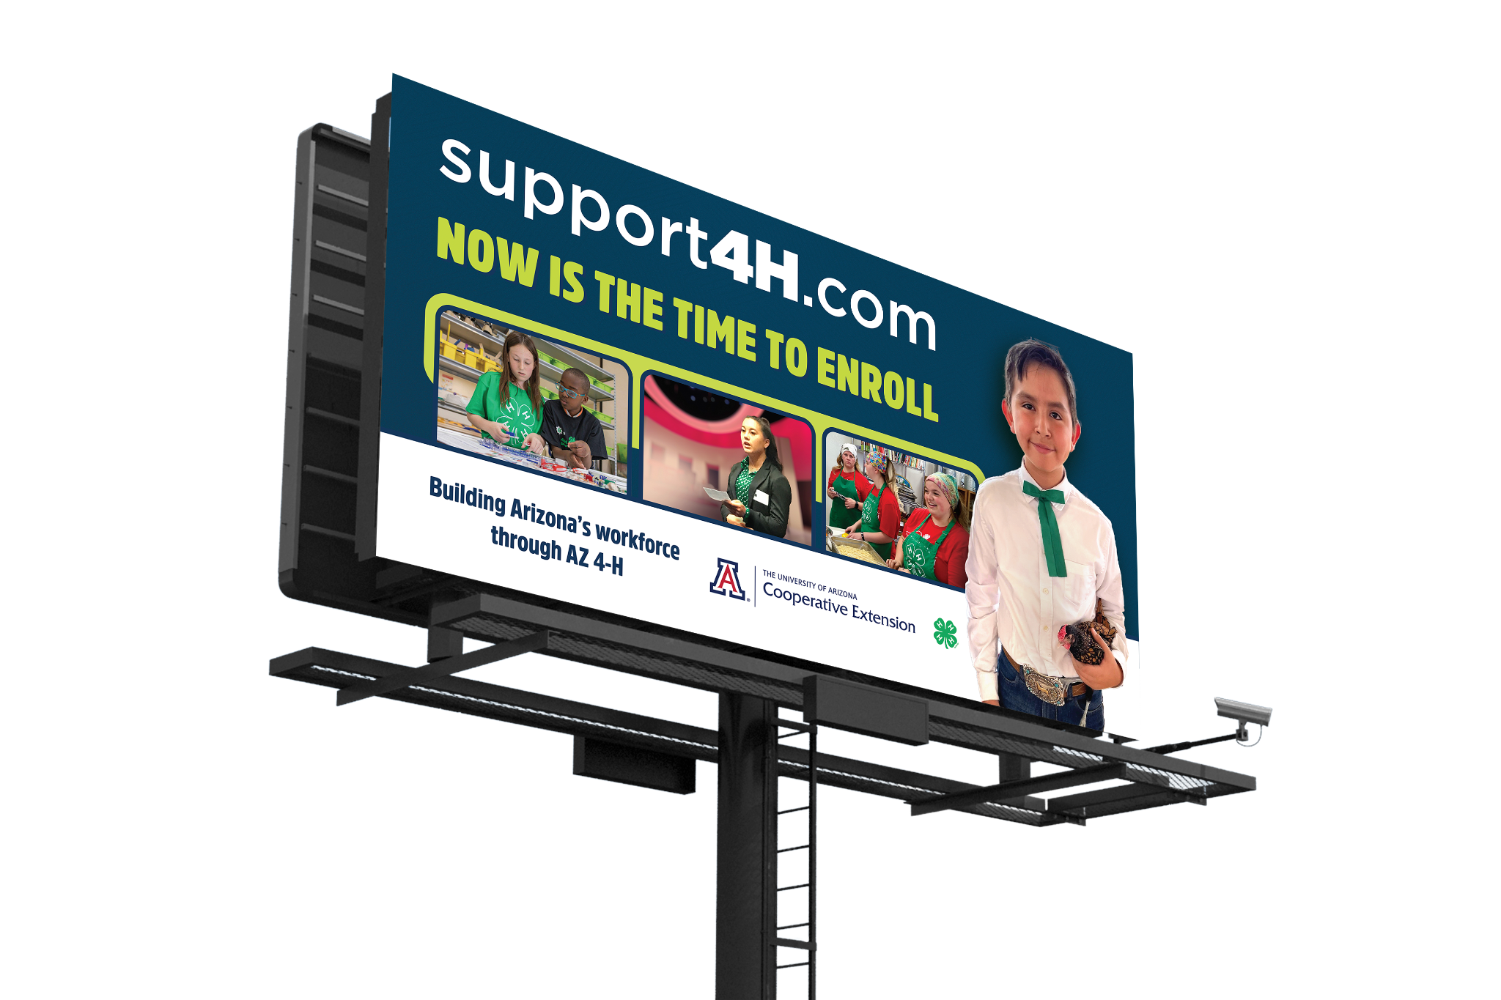

LICENSE PLATE & ENROLLMENT MARKETING
Fall 2022

Slide 2


LICENSE PLATE BILLBOARDS
Placement and Partnership
Arizona State Fair
Phoenix
Eloy
Tucson
Yuma
Meteor Crater
Spider Web Ranch
Total Project Budget $20,500

Slide 3
LICENSE PLATE BILLBOARDS
Placement and Partnership
Arizona State Fair
2' x 3'
September 15 - January 15
1,589,951 Visitors
$1,500 Total

Slide 4

LICENSE PLATE BILLBOARDS
Placement and Partnership
Phoenix
14' x 48'
November 1 - December 31
187,772 Weekly Impressions
$5,000 Total
$2,500 Corporate Sponsorship

Slide 5
LICENSE PLATE BILLBOARDS
Placement and Partnership
Eloy
12' x 40'
November 1 - December 31
177,946 Weekly Impressions
$5,000 Total
$2,500 Corporate Sponsorship

Slide 6

LICENSE PLATE BILLBOARDS
Placement and Partnership
Tucson
12' x 40'
November 1 - December 31
244,623 Weekly Impressions
$5,000 Total
$2,500 Corporate Sponsorship

Slide 7
LICENSE PLATE BILLBOARDS
Placement and Partnership
Yuma
12' x 40'
November 1 - December 31
149,439 Weekly Impressions
$4,000 Total
$2,500 Corporate Sponsorship

Slide 8
LICENSE PLATE BILLBOARDS
Placement and Partnership
Meteor Crater Road
2' x 3'
October 1, 2022 - October 1, 2023
250,000 Total Views
Bar T Bar partnership
Bar T Bar Bull Sale
Ambassadors and Deb at Annual Bull Sale @ Ranch,
2nd Saturday in April.
Babbitt Ranch Horse Sale
July

Slide 9
ENROLLMENT BILLBOARDS
Placement and Partnership
Arizona State Fair
Kingman
Wilcox
Santa Cruz
Sanders Area
Meteor Crater
Total Project Budget $20,000

Slide 10
ENROLLMENT BILLBOARDS
Placement and Partnership
Arizona State Fair
2' x 3'
September 15 - January 15
1,589,951 Visitors
$1,500 Total

Slide 11

ENROLLMENT BILLBOARDS
Placement and Partnership
Kingman
12' x 42'
November 1 - December 31
197,287 Weekly Impressions
$4,000 Total

Slide 12
ENROLLMENT BILLBOARDS
Placement and Partnership
Willcox
12' x 42'
November 1 - December 31
68,322 Weekly Impressions
$4,000 Total

Slide 13
ENROLLMENT BILLBOARDS
Placement and Partnership
Santa Cruz
12' x 40'
November 1 - December 31
618,214 Weekly Impressions
$5,000 Total

Slide 14
ENROLLMENT BILLBOARDS
Placement and Partnership
Sanders Area (I-40)
12' x 40'
November 1 - December 31
197,287 Weekly Impressions
$5,000 Total

Slide 15
ENROLLMENT BILLBOARDS
Placement and Partnership
Meteor Crater Road
2' x 3'
October 1, 2022 - October 1, 2023
250,000 Total Views
$500 Total
Bar T Bar partnership

Slide 16

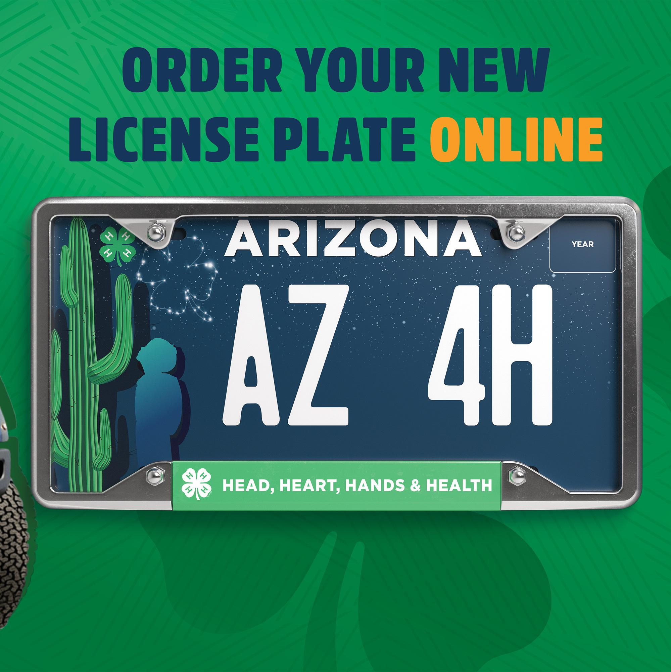
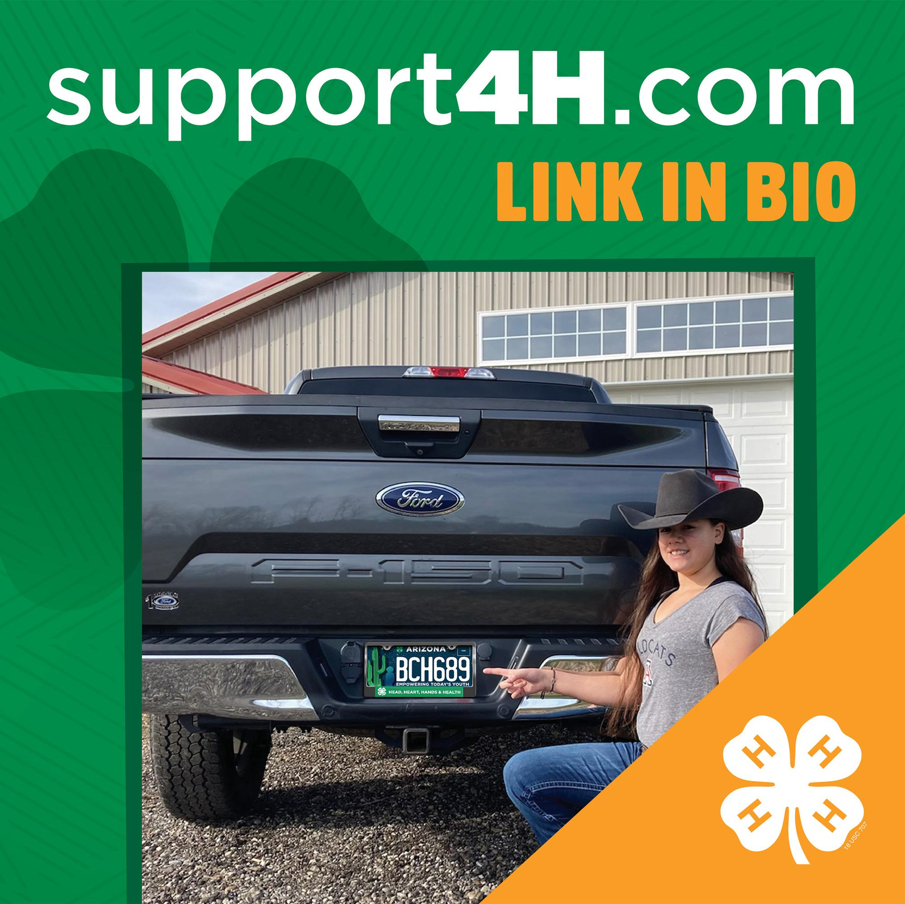
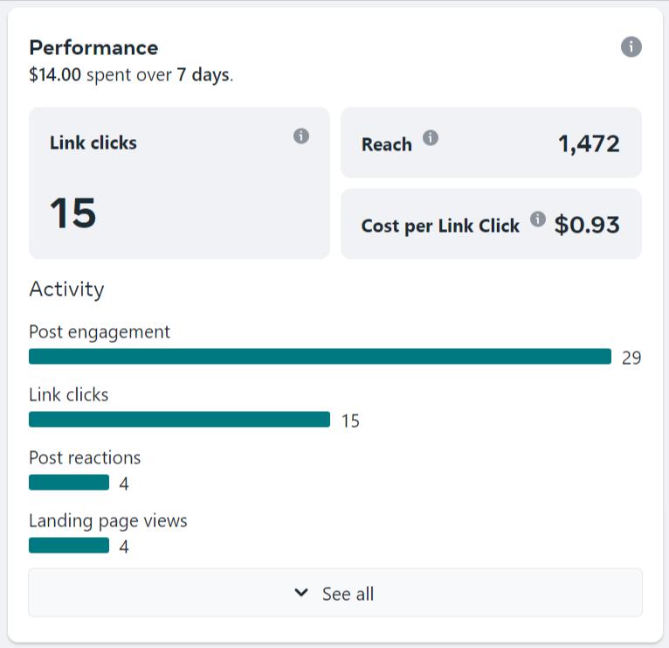
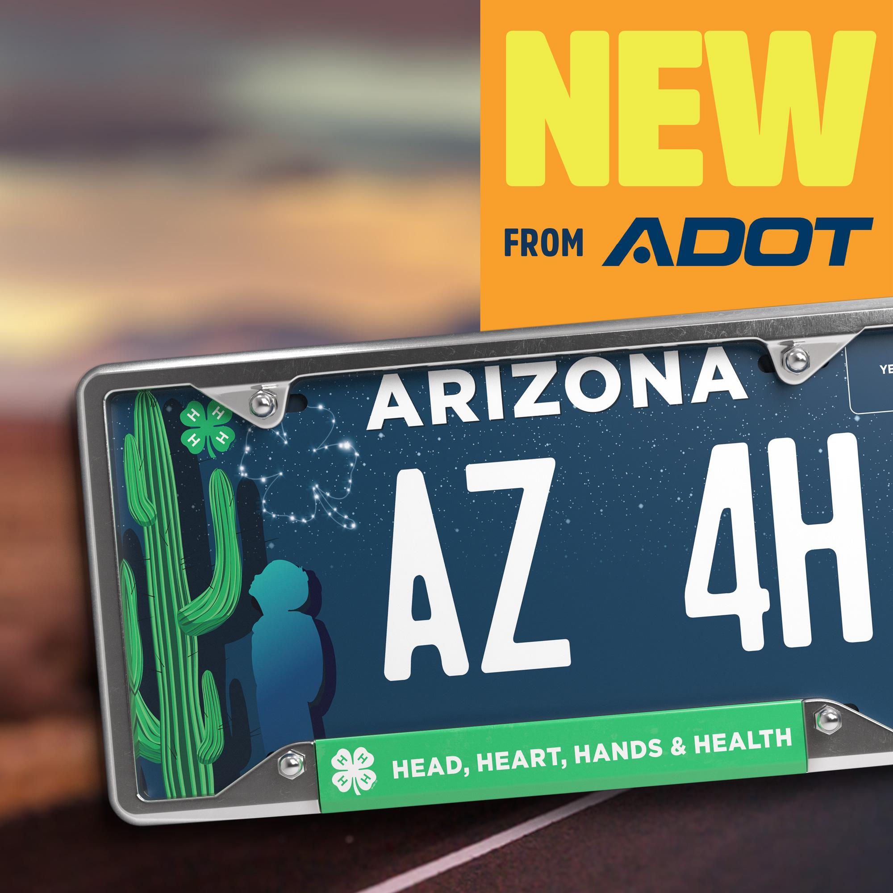
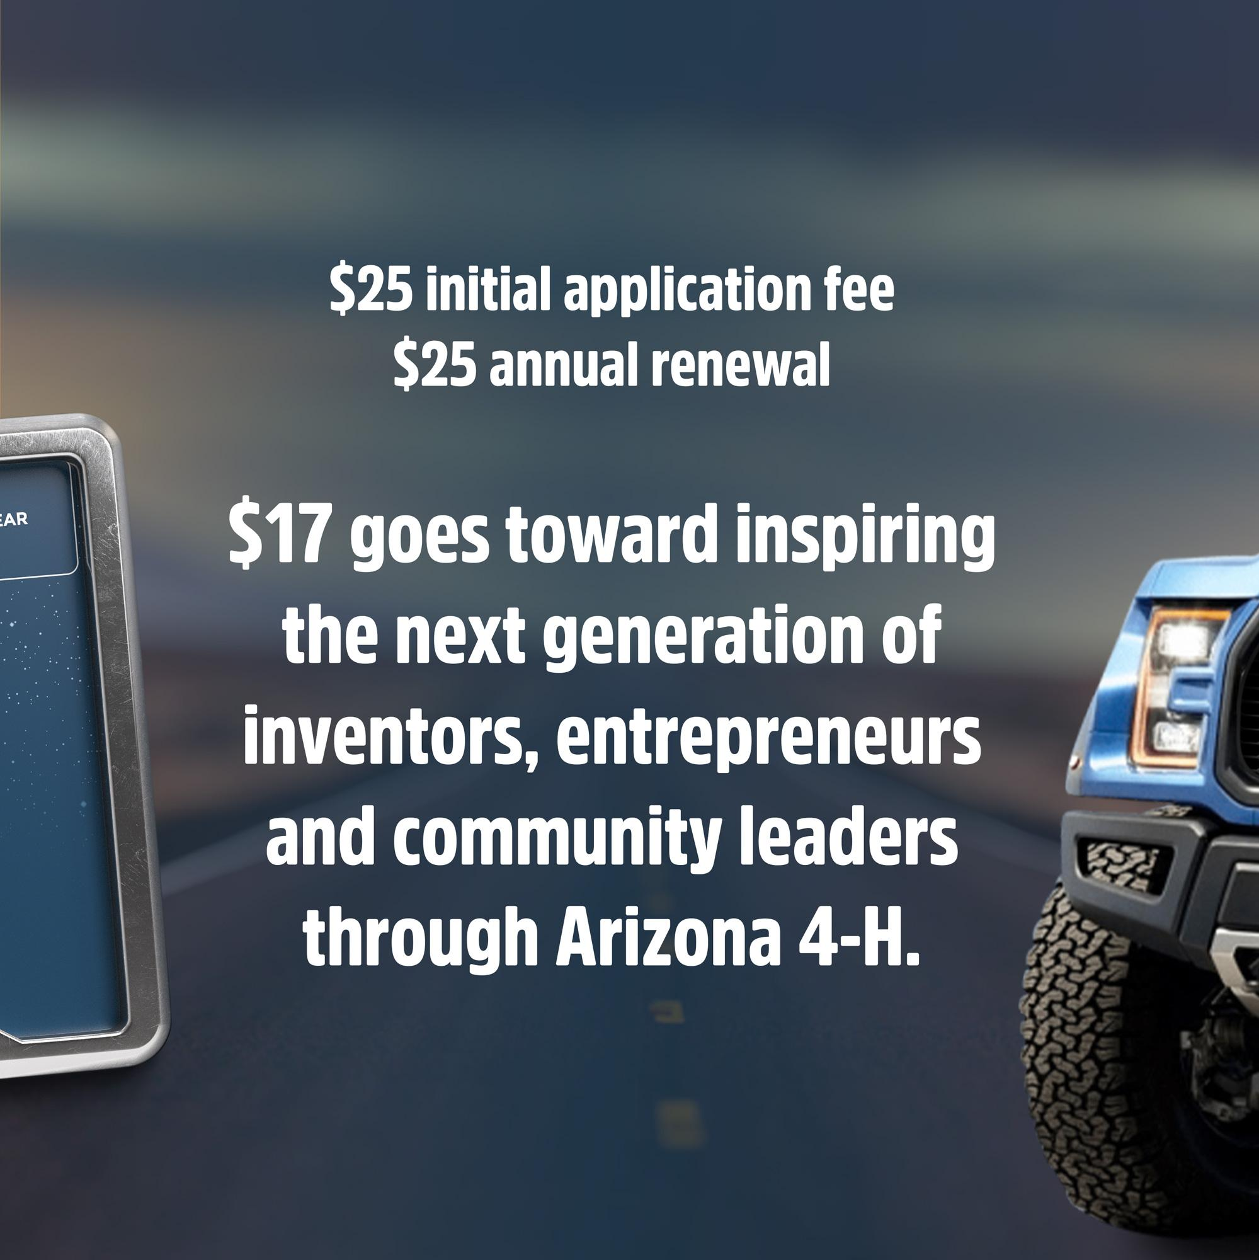
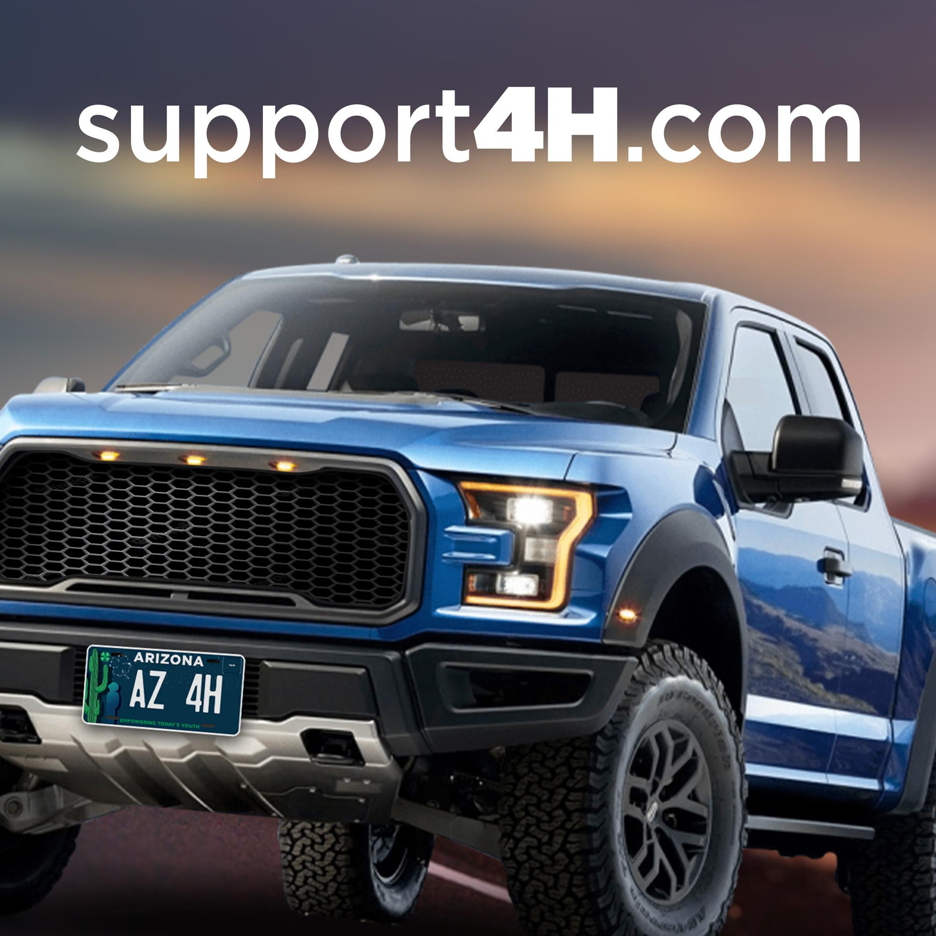
SOCIAL MARKETING
Preliminary Tests

Slide 17
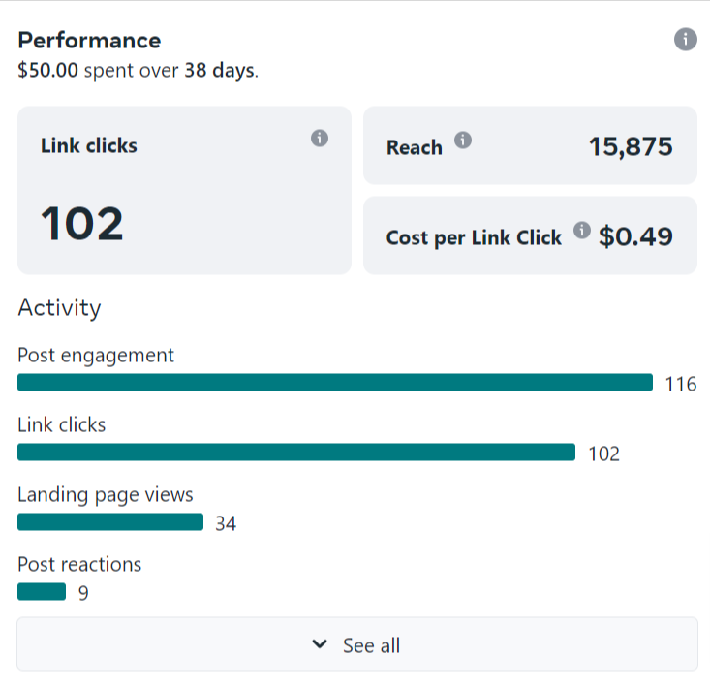
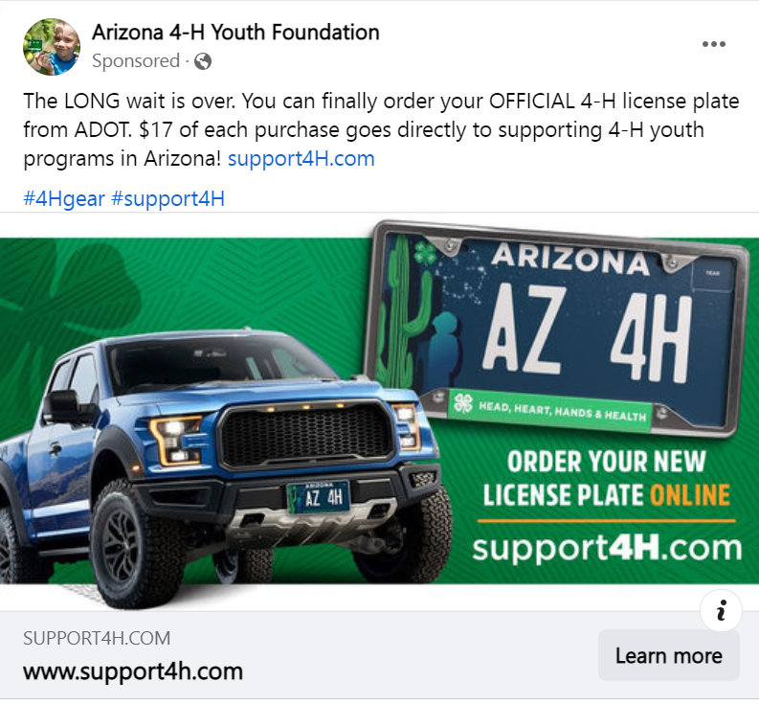
SOCIAL MARKETING
Preliminary Tests

Slide 18
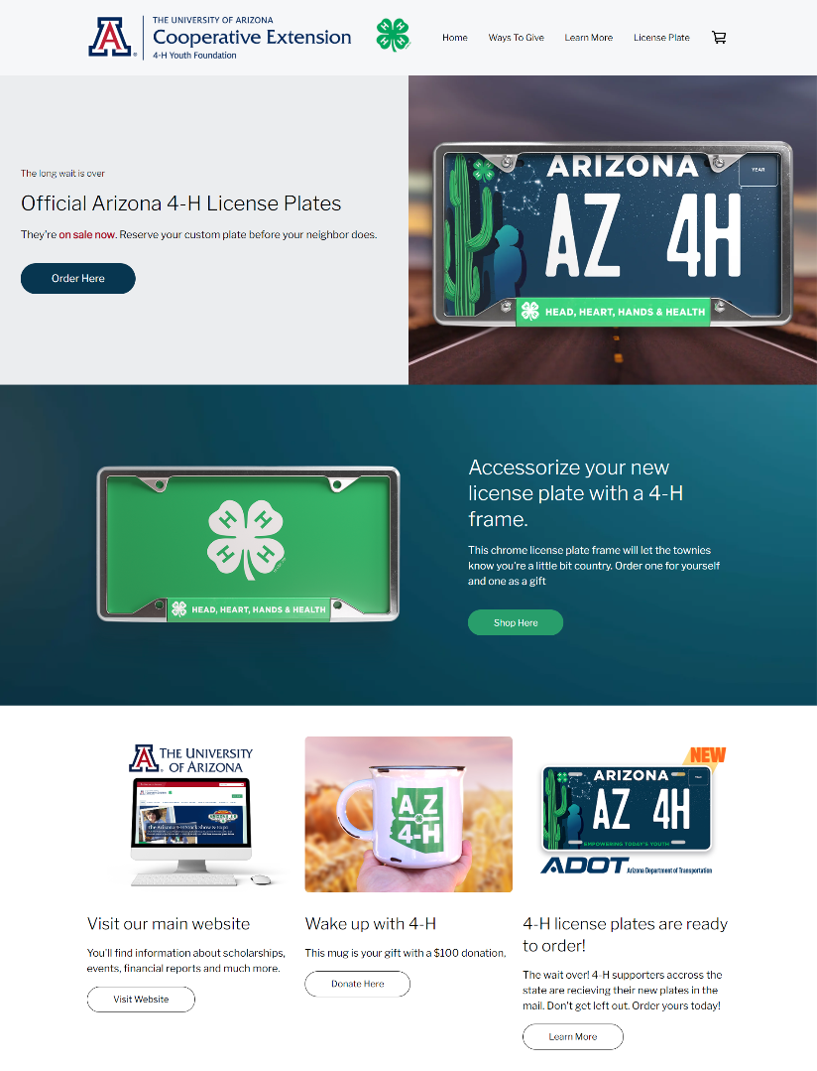

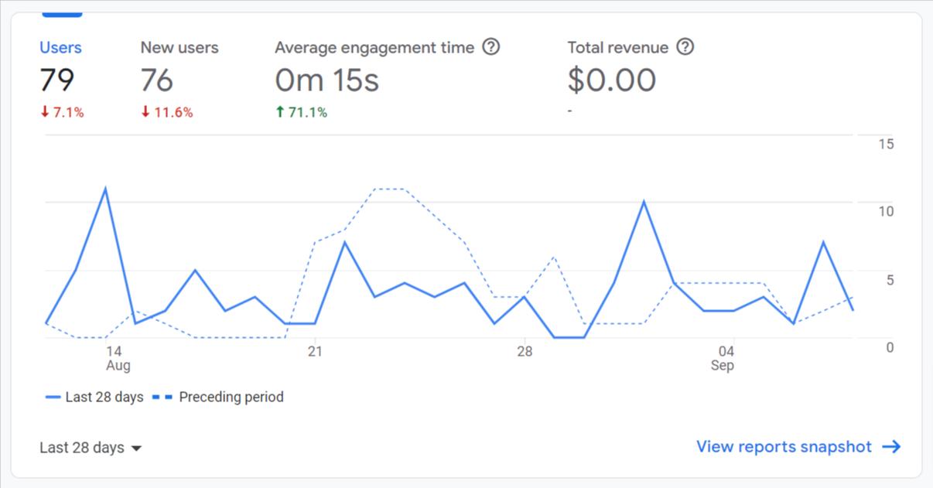
E-COMMERCE WEBSITE
Baseline

