Slide 1
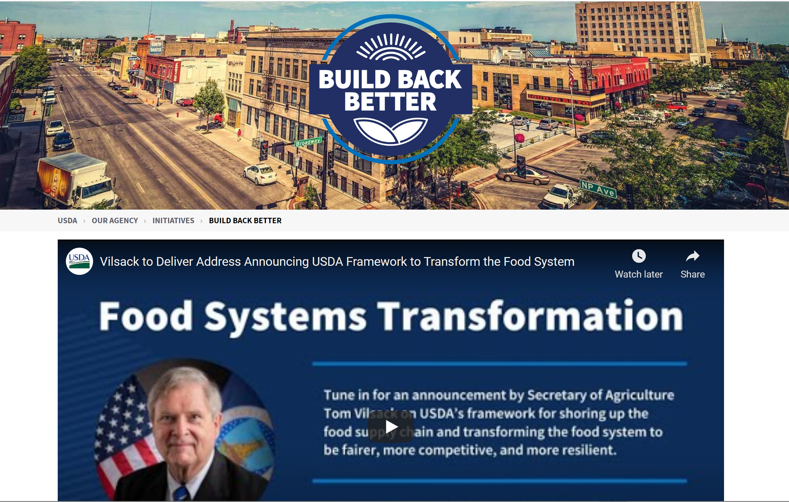
USDA.GOV/Build-Back-Better

Slide 2
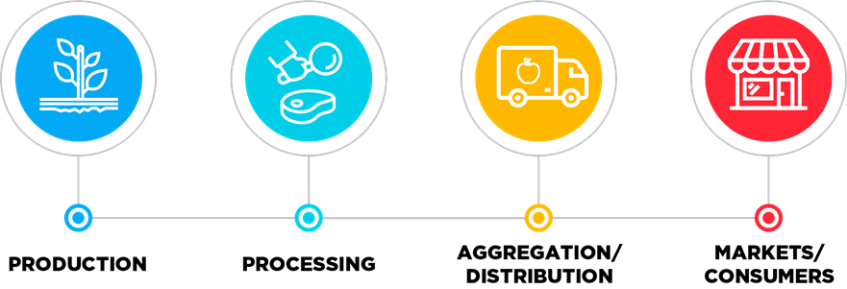
Four Elements of the Food Systems Transformation Framework
The investments made in the Framework, through all four elements, seek to sustainably grow and raise commodities and livestock with net zero greenhouse gas emissions while also raising farm and rural income, build greater resilience across the entire food supply chain, provide access to nutritious food for all, and guarantee equity of opportunity for all.

Slide 3
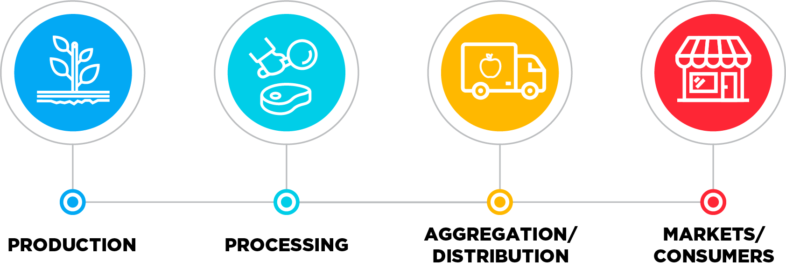
$500 million through a new grant program this summer to support independent, innovative and sustainable American fertilizer production to supply American farmers.
Up to $300 million in a new Organic Transition Initiative to provide comprehensive support for farmers to transition to organic production.
The Food Supply Chain Loan Guarantee Program deployed $100 million to make more than $1 billion in guaranteed loans available immediately to back private lenders that invest in independently owned food processing, distribution and aggregation infrastructure, and other projects along the middle of the supply chain.
USDA.GOV/Build-Back-Better

Slide 4
Creation of a robust technical assistance network to ensure that participants in USDA’s meat and poultry supply chain initiatives have access to a full range of technical assistance to support their project development and success.
$200 million for Food Safety Certification for Specialty Crops Program for specialty crop operations that incur eligible on-farm food safety program expenses.
Investment of $400 million to create regional food business centers that will provide coordination, technical assistance, and capacity building support to small and mid-size food and farm businesses, particularly focused on processing, distribution and aggregation, and market access challenges.
USDA.GOV/Build-Back-Better

Slide 5
Deployment of up to $375 million in support for independent meat and poultry processing plant projects that fill a demonstrated need for more diversified processing capacity.
Increase the number of counties eligible for double cropping insurance, so that we can boost food production by allowing more farmers to plant a second crop on the same land in the same year, like wheat followed by soybeans or use of cover crops to preserve soil and sequester carbon.
Increasing technical assistance for precision agriculture, allows farmers to use less fertilizer without reducing yields, saving farmers money over time and extending critical products in short supply worldwide.
USDA.GOV/Build-Back-Better

Slide 6
Addressing Climate Change via Climate Smart Agriculture, Forestry, and Clean Energy
Announced a $1 billion investment in partnerships to support America’s climate-smart farmers, ranchers and forest landowners through the new Partnerships for Climate-Smart Commodities Program.
With the right policies and incentives, climate-smart agriculture, forestry and rural clean energy solutions will create new revenue opportunities for producers and strengthen rural communities, speeding the transition to a circular economy, rather than one based on extracting resources from rural areas, only to see the value added to those resources flow to urban centers.
Ensuring that science and rigorous monitoring underpins everything we’re doing, and that historically underserved communities and small and medium-sized farmers participate, benefit and prosper in this important department-wide effort.
USDA.GOV/Build-Back-Better

Slide 7
Addressing Climate Change via Climate Smart Agriculture, Forestry, and Clean Energy
Overhauled the Conservation Reserve Program to improve climate benefits, with more than 41,000 producers enrolling 4.6 million acres into the program in 2021.
Provided almost $60 million to 49,000-plus producers to plant 12.2 million acres of cover crops through the Pandemic Cover Crop Program. of 4 million acres.
New partnership with Farmers for Soil Health to advance use of soil health practices – especially cover crops – on corn and soybean farms, with the goal of doubling the acres using cover crops to 30 million acres by 2030.
Invested $405 million through the Regional Conservation Partnership Program, including more than 200 awards to address climate change, improve water quality, combat drought, enhance soil health, support wildlife habitat and protect agriculture.
USDA.GOV/Build-Back-Better

Slide 8
Advancing Racial Justice, Equity and Opportunity
USDA is taking accountability for its past history of discrimination and its role today by ensuring that its leaders and programs are taking a hard look at its systems, processes, and policies.
The President’s issuance of Executive Order on Advancing Racial Equity and Support for Underserved Communities paved the way for USDA to meaningfully listen to internal and external stakeholders, understand where barriers to accessing USDA programs and services exist, and assess data to identify actions to advance equity.
Established a 15-member Equity Commission and Subcommittee on Agriculture comprised of external stakeholders that provide recommendations to the Secretary on policies, programs, and actions needed to address equity issues, including racial equity issues, within the Department and its programs.

