Slide 1
Provost Investment Fund Webinar
September 16, 2021

Slide 2
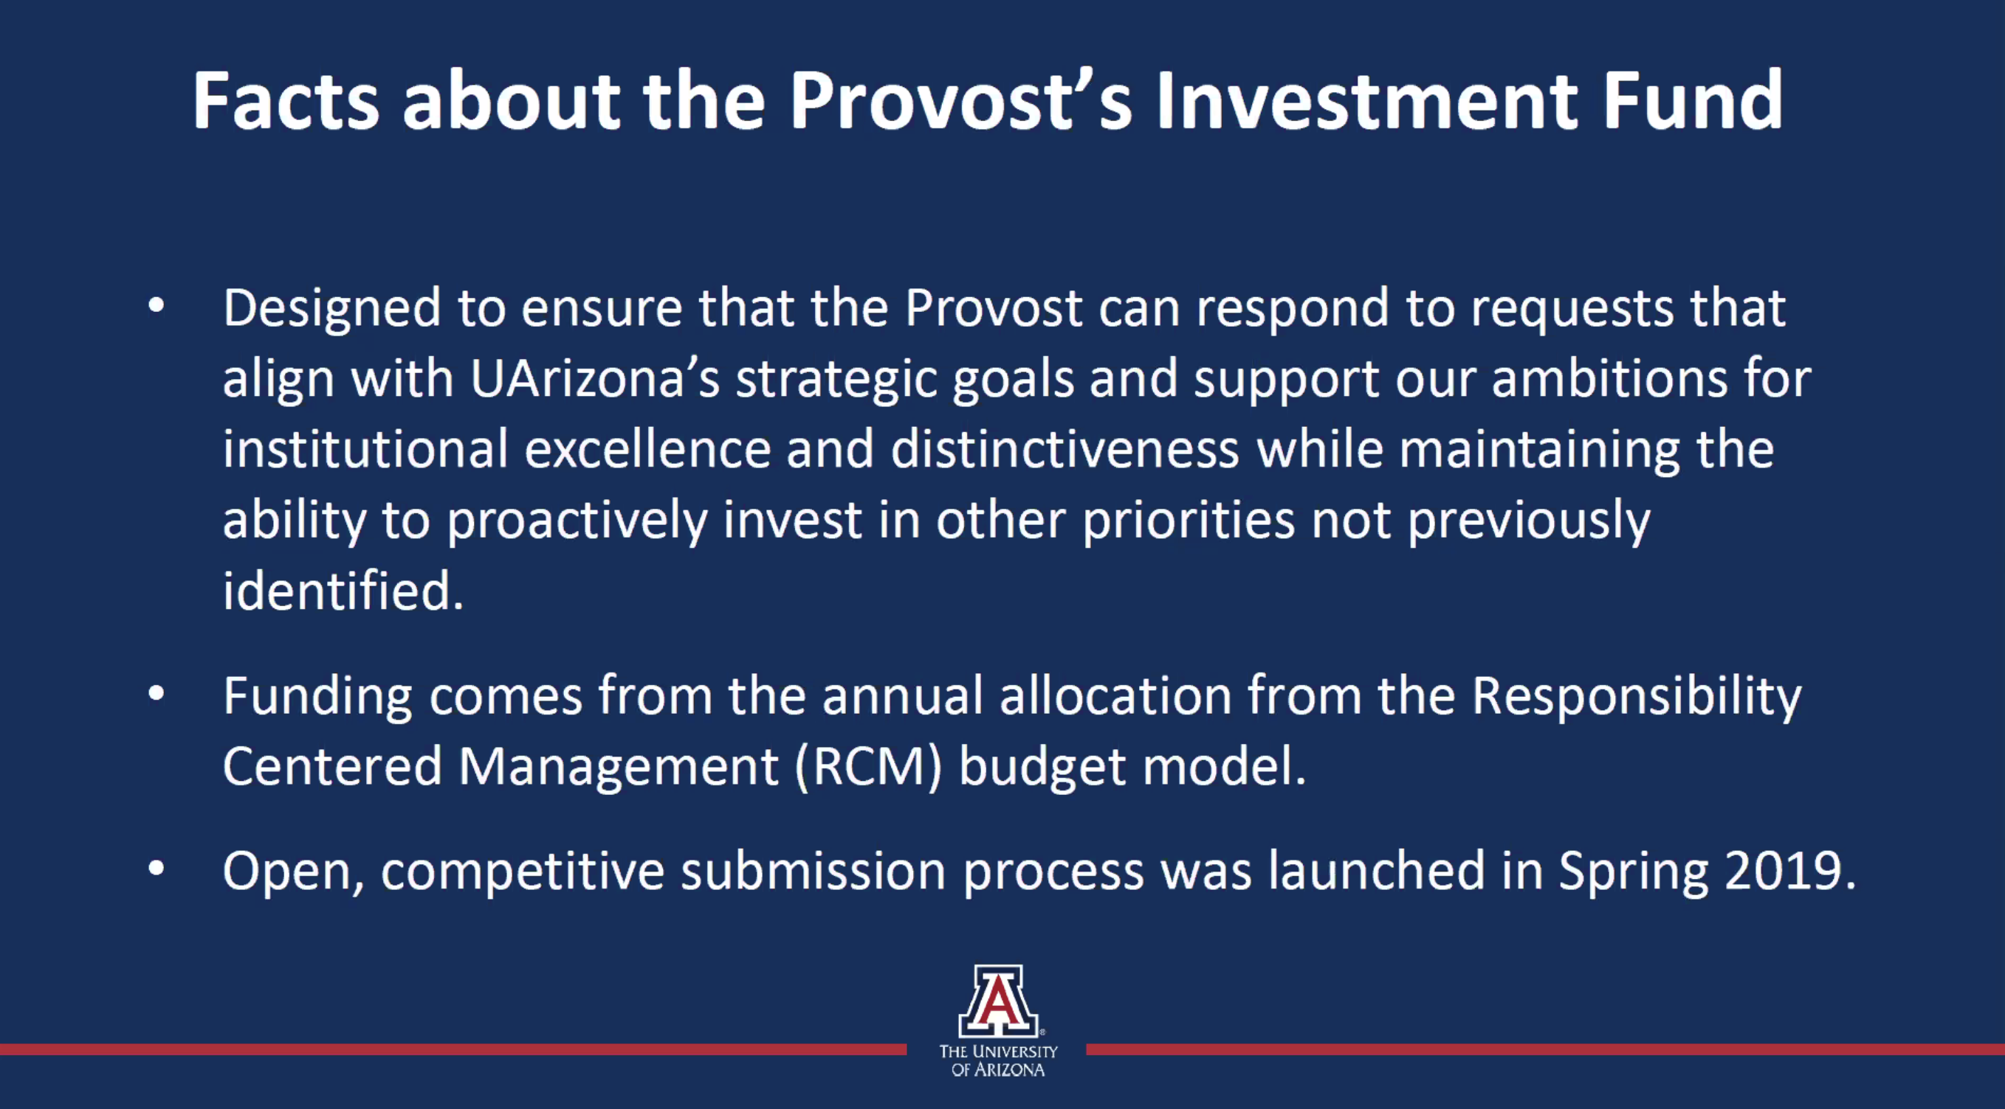

Slide 3
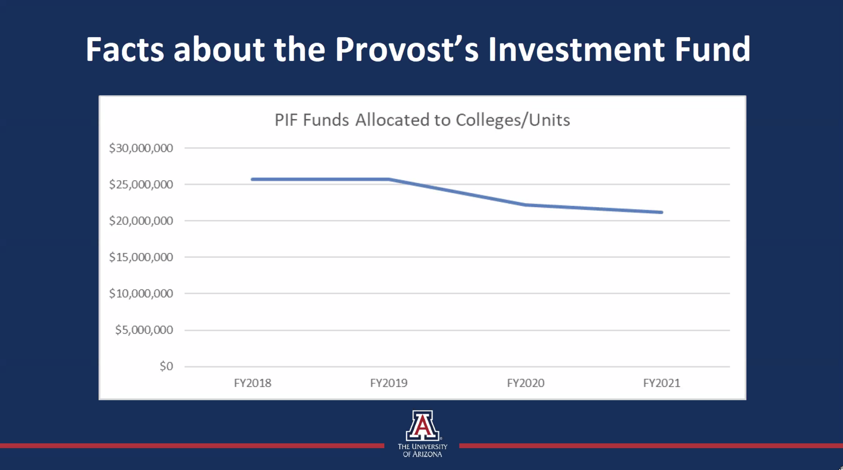

Slide 4
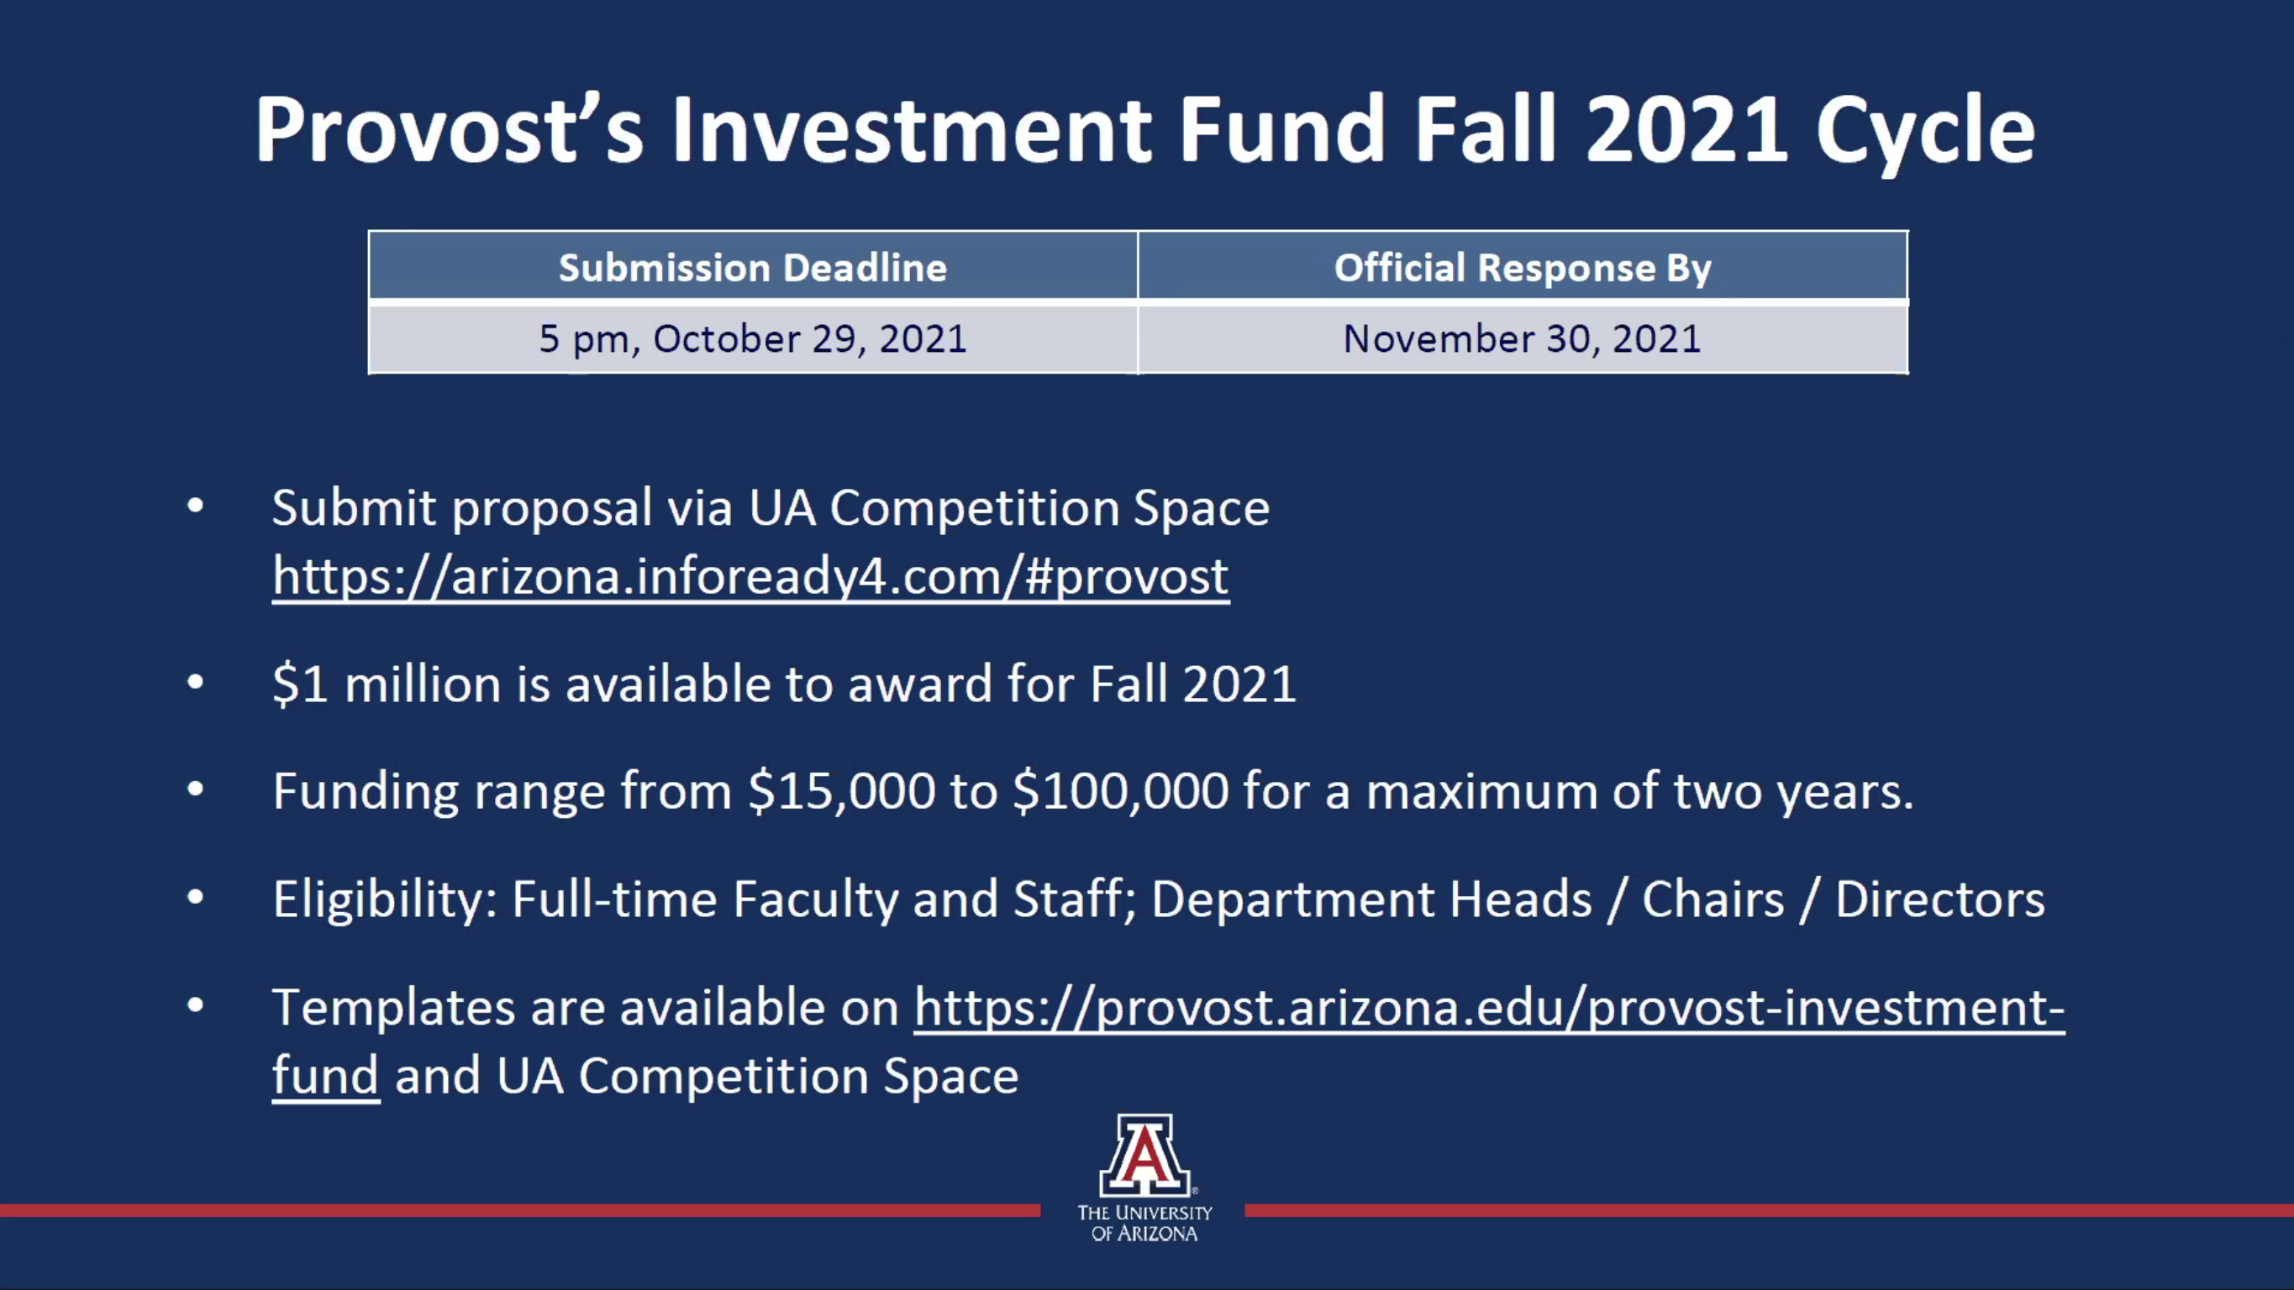

Slide 5
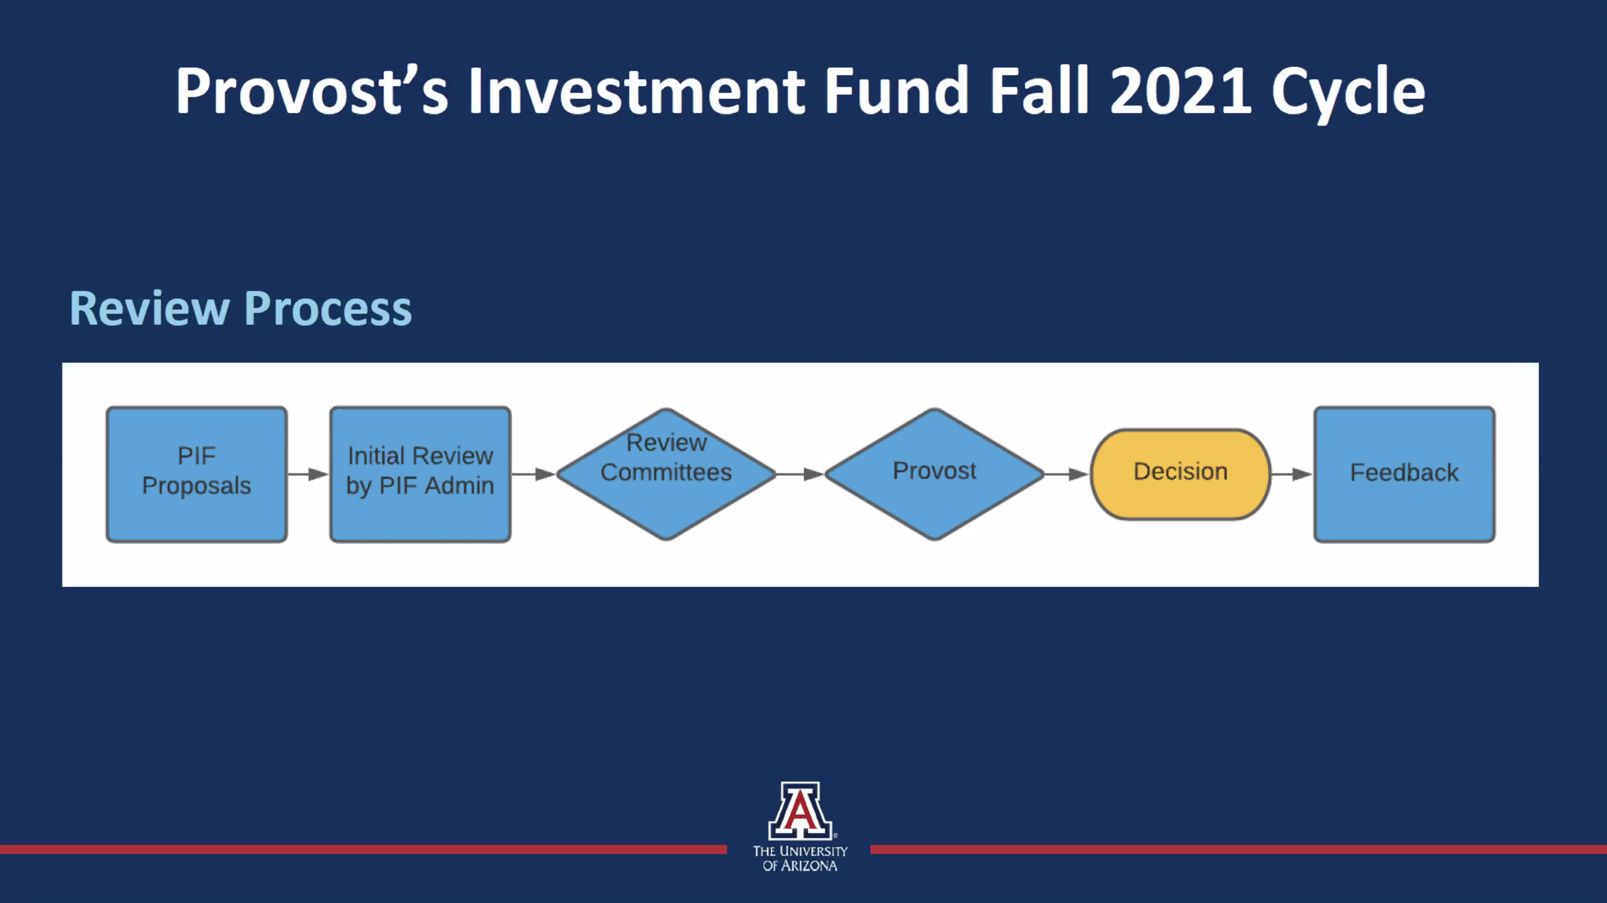

Slide 6
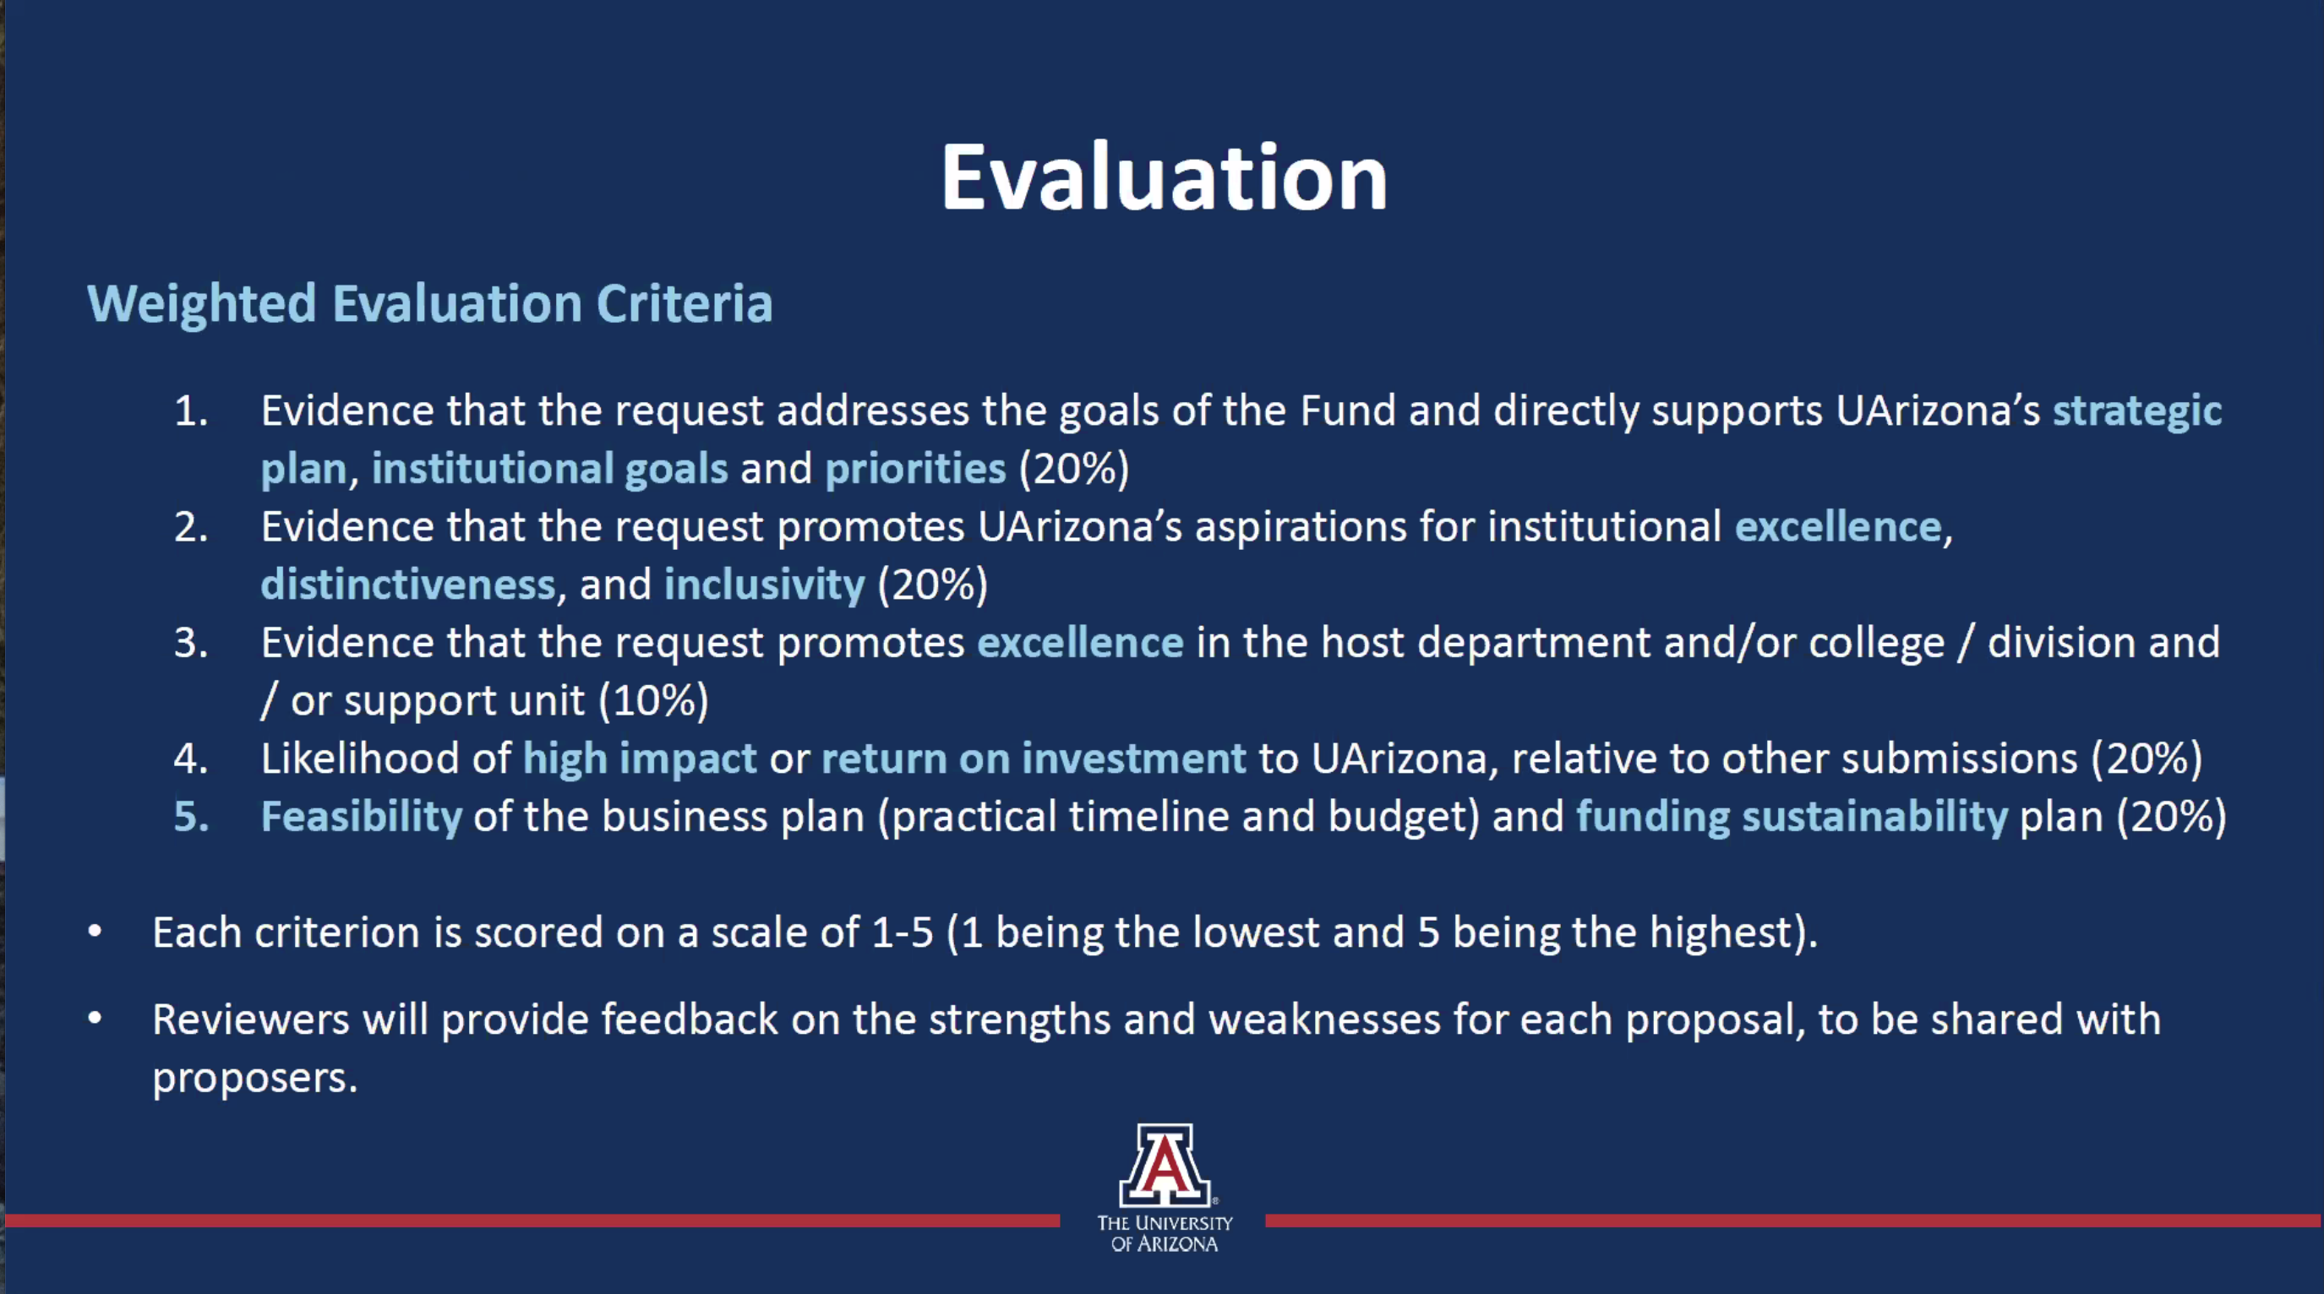

Slide 7
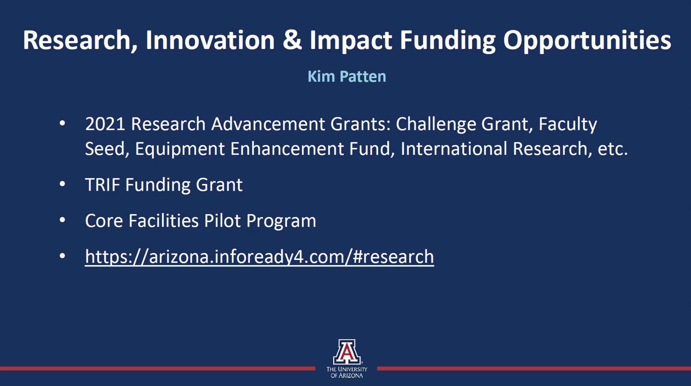

Slide 8
RII Internal Funding Web Portal:
https://research.arizona.edu/development/find-funding/internal-funding

Slide 9
