Slide 1

4-H Year 2021-22 Arizona 4-H Program Fee Program
Jeremy Elliott-Engel, Ph.D.
Associate Director, 4-H Youth Development
Arizona Cooperative Extension
The University of Arizona

Slide 2
Proposal
4-H enrollment fees will be waived for 4-H Year 2021-2022. UACE distributions will be made equal to 4-H Year 2019-2020.

Slide 3
Why?
Administratively clean
Supports the 20,000 True Leaders by 2025 Strategic plan by “reducing barriers to youth participation.”
Provides a tool to welcome and encourage 4-H participation.

Slide 4
Distribution of Program Fees
Arizona Cooperative Extension System Administration Distributions
County | Program Participation Fee | Number of Enrolled Youth* | County Program Fee Total
Apache | $15.00 | 243 | $3645
Cochise | $20.00 | 303 | $6,060
Coconino | $15.00 | 296 | $4,440
Gila | $20.00 | 207 | $4,140
Graham | $15.00 | 116 | $1,740
Greenlee | $15.00 | 35 | $525
La Paz | $15.00 | 173 | $2595
Maricopa | $20.00 | 764 | $15,280
Mohave | $15.00 | 212 | $3180
Navajo | $15.00 | 193 | $2,895
Pima | $15.00 | 1122 | $16,830
Pinal | $20.00 | 391 | $7,820
Santa Cruz | $15.00 | 100 | $1,500
Yavapai | $20.00 | 196 | $3,920
Yuma | $15.00 | 823 | $12,345
State | $5.00 | 5,174 | $25,870
Total |  |  | $112,785
*Adjusted for members in good standing who completed the 4-H Year in 2019-2020.

Slide 5
Other Initiatives
For 4-H Year 2021-22 and for the next 6 years, DPS fees will be covered for new and returning authorized 4-H adults*
Investments in marketing (Summer & Fall 2021)- #inspiringkidstodo
Investments in volunteer thank you and training
*Specific details will be forthcoming.

Slide 6

20,000 True Leaders by 2025

Slide 7
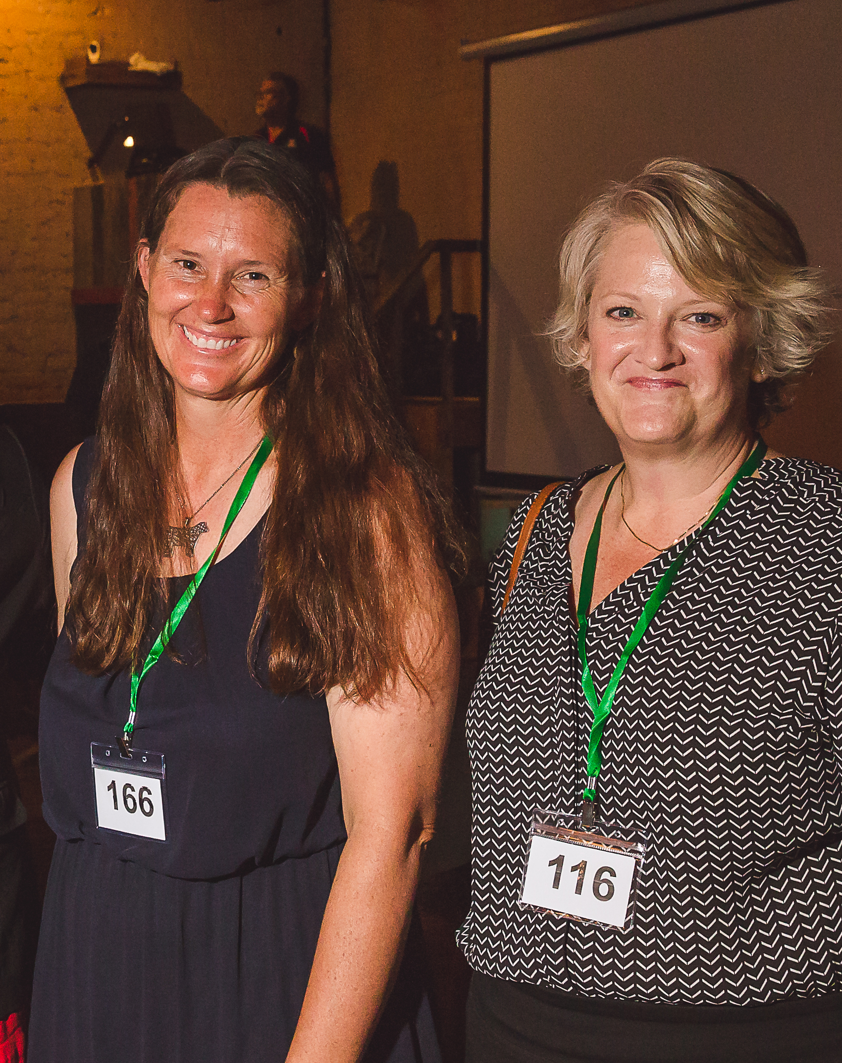
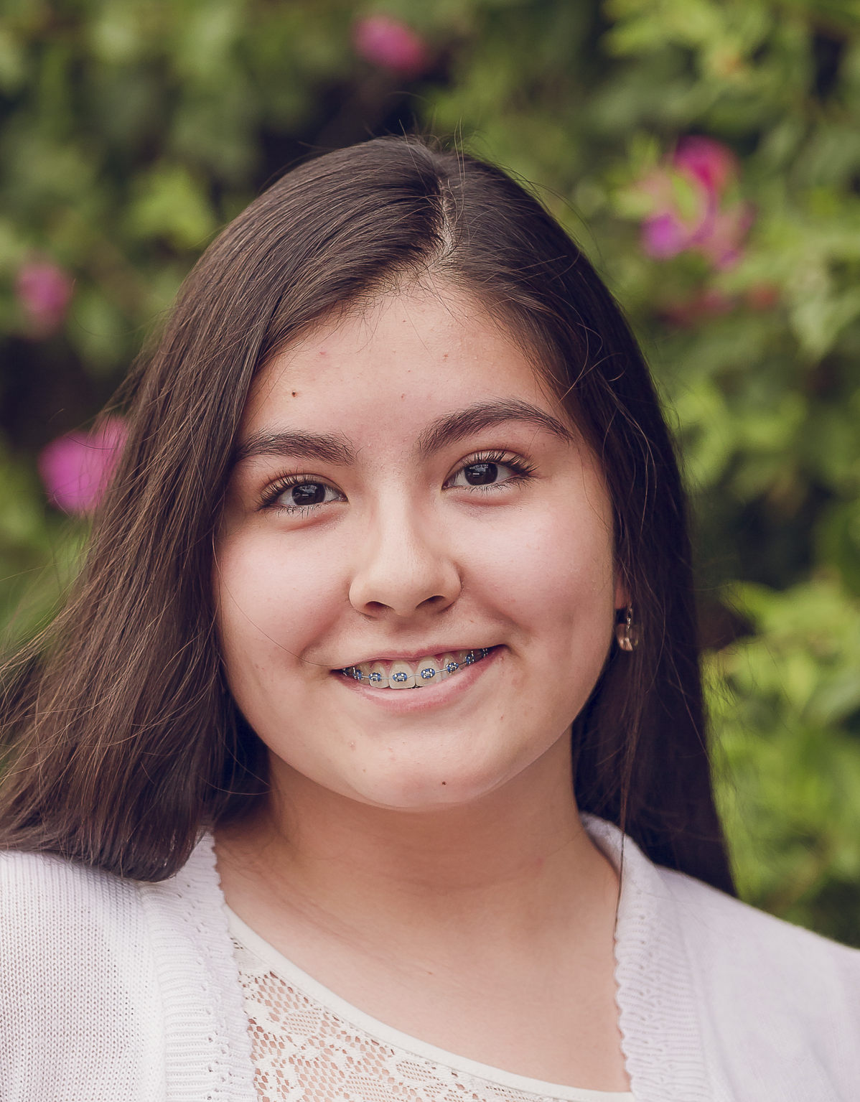
5,000 authorized 4-H adults are the base of the program
766% increase is needed statewide
Starting in 4-H Year 2021-22 DPS fees will be covered*
Demographically representative
Chartered 4-H clubs are essential for creating access Annual chartered club growth is expected and needed
Geographically representative, “4-H is in every community.”
20,000 enrolled 4-H youth members
227% increase is needed statewide Youth should be enrolled if they experience 4-H positive youth development in a 4-H Club, multiple session program, or overnight educational experience
Demographically representative

Slide 8
Timeline and Expectations*
April-May 2021
Review Strategic Plan Worksheet
Meet with Jeremy Elliott-Engel, CED, county-based 4-H staff (and, youth serving employees in the office).
Complete SWOT and establish attainable goals
June-July 2021
Present draft goals to Jeremy Elliott-Engel
Edit, Revise, and Resubmit
Fall 2021
Present goals to Extension Council, 4-H Leaders Council, and other key stakeholders
October 2021
Plan commences
*Time frames of work can be adjusted for county program requirements

Slide 9

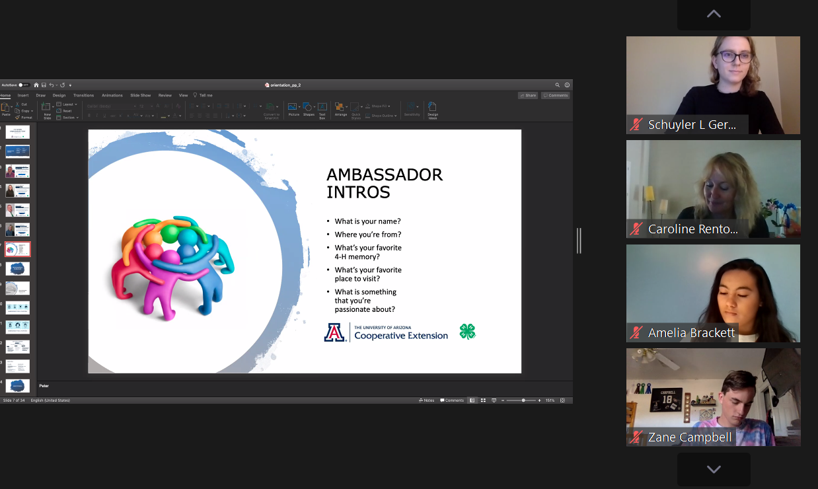


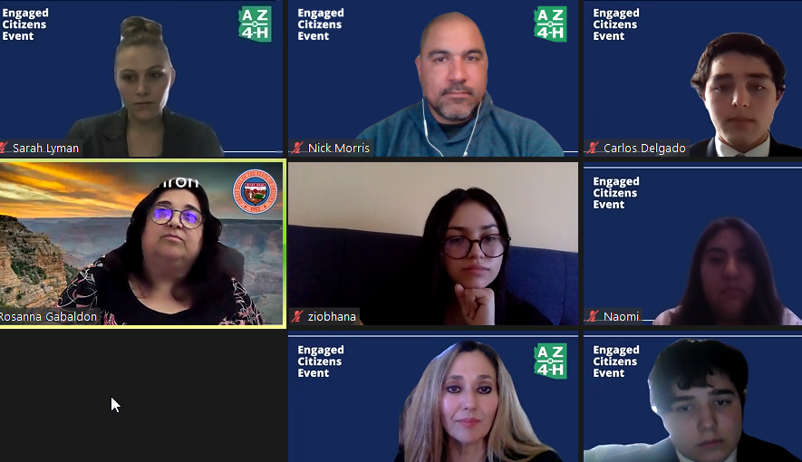
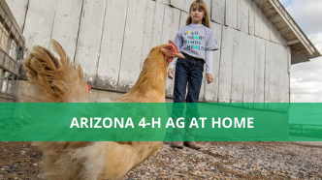

Thoughts?

