Slide 1

4-H Year 2021-22
Arizona 4-H Program Fee Program
Jeremy Elliott-Engel, Ph.D.
Associate Director, 4-H Youth Development
Arizona Cooperative Extension
The University of Arizona

Slide 2
Feedback from CEDs
Our volunteers and clubs need to be celebrated and we should make investments in clubs.
Our 4-H Councils have money to cover expenses, and they have already made this decision.

Slide 3
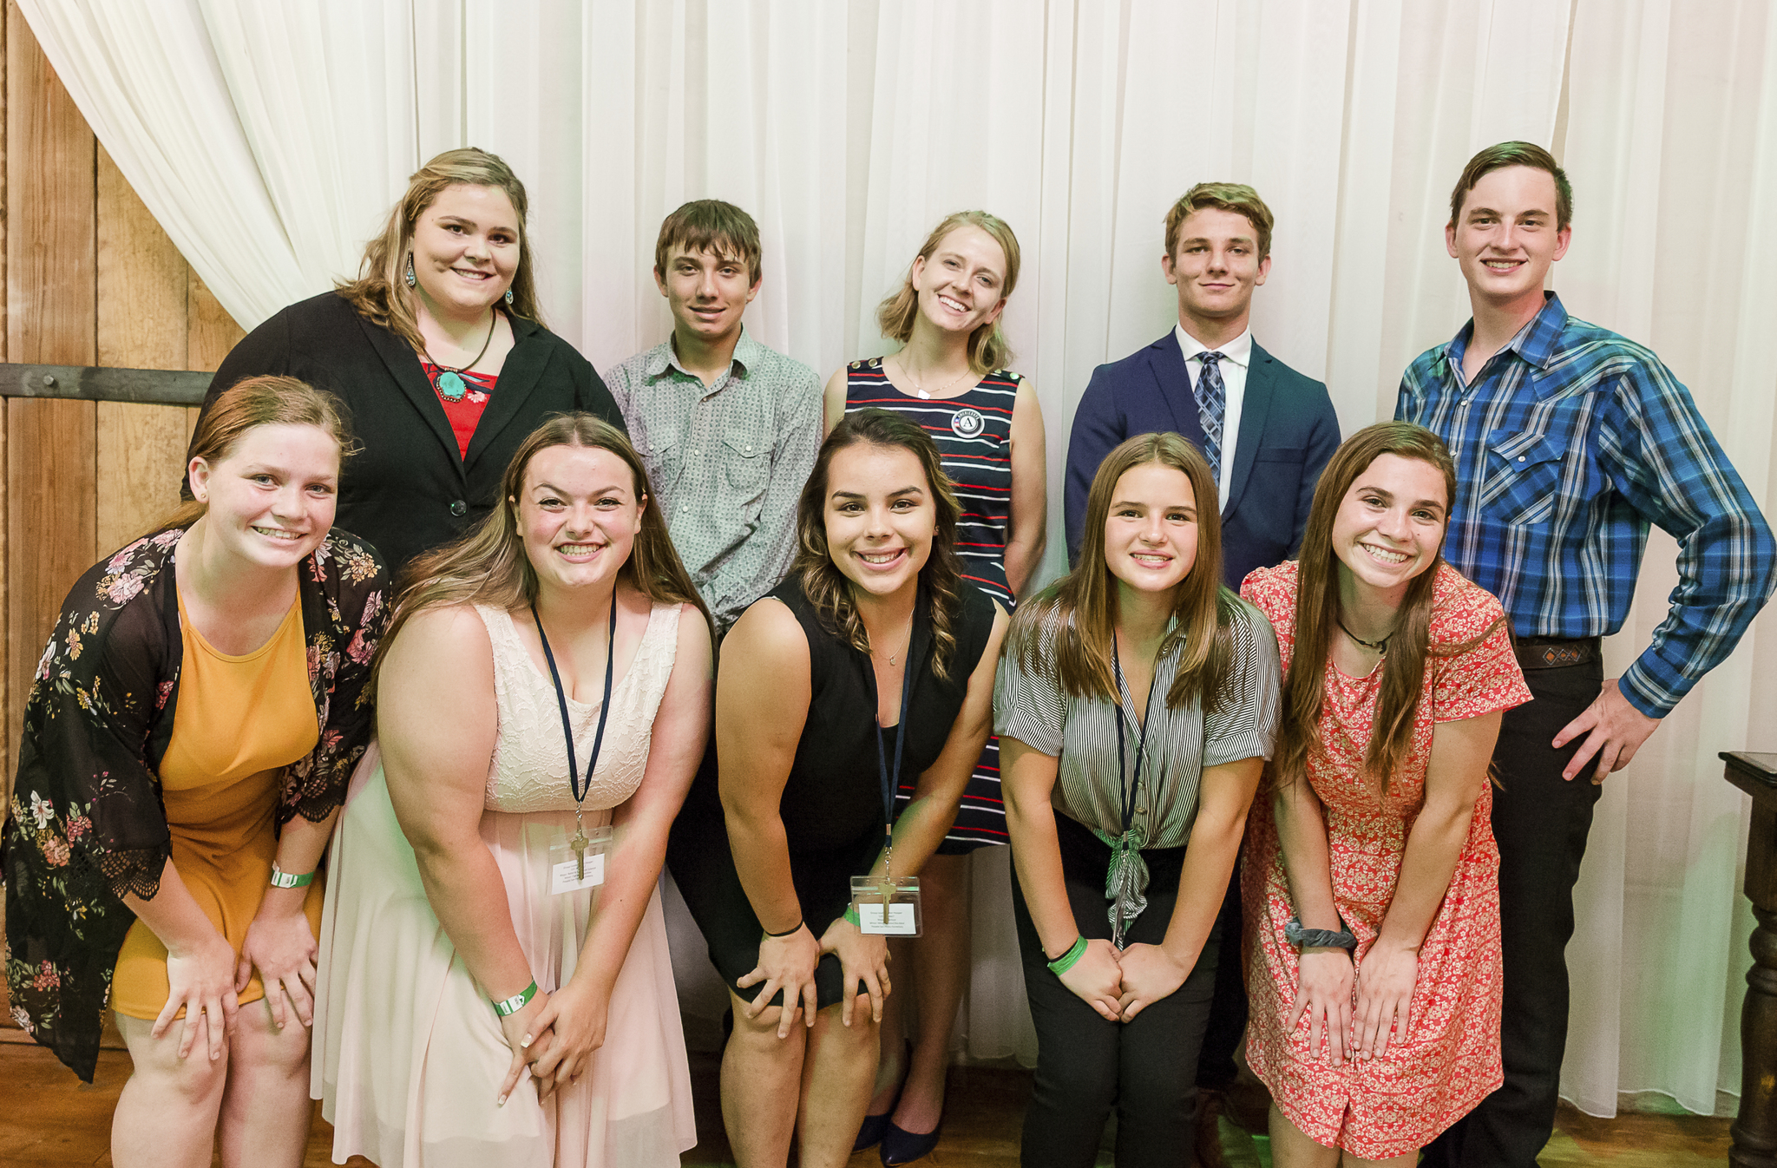

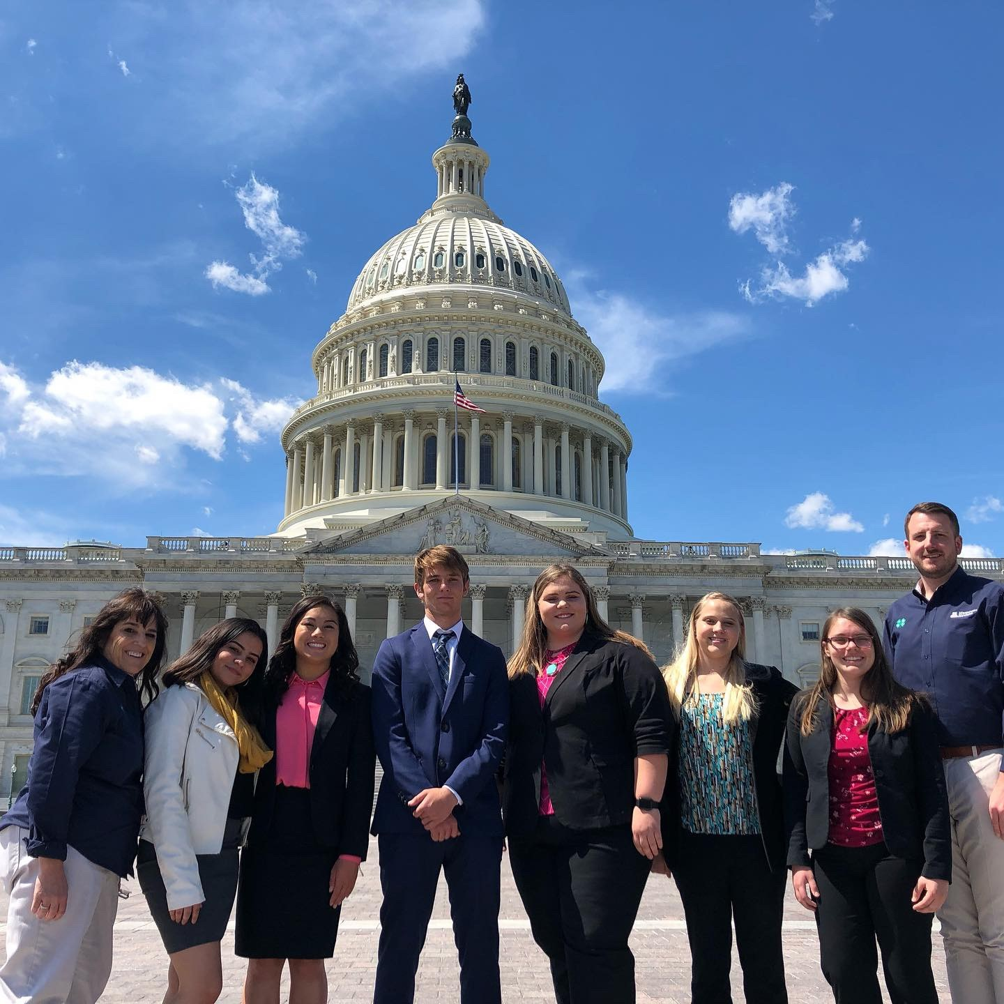
Re-imagining 4-H program fees?
To encourage re-enrollment
To encourage new enrollment
Thank those who have stayed with us
Acknowledge the Pandemic was hard for all of us

Slide 4
Which 4-H Year?
 | 4-H Year 2020 | 4-H Year 2021 | 4-H Year 2022
Calendar | October 2019-September 2020 | October 2020- September 2021 | September 2021-October 2022
Enrollment Status | Complete | Currently Enrolling (2/3rds already enrolled)

Slide 5
What is a 4-H Program Fee
County | County Fee in 4HOnline
Apache | $15.00
Cochise | $20.00
Coconino | $15.00
Gila | $20.00
Graham | $15.00
Greenlee | $15.00
La Paz | $15.00
Maricopa | $20.00
Mohave | $15.00
Navajo | $15.00
Pima | $15.00
Pinal | $20.00
Santa Cruz | $15.00
Yavapai | $20.00
Yuma | $15.00
Program fees are used at the state, county, and club to support the implementation of the Arizona 4-H program. In Arizona 4-H “enrolled 4-H member” pays a state enrollment fee ($5), a county program fee ($5-20), and a club program fee (Unknown range).

Slide 6
How many 4-H Program Fees are Collected Annually?
Arizona Cooperative Extension System Administration Distributions
County | Program Participation Fee | Number of Enrolled Youth* | County Program Fee Total
Apache | $15.00 | 243 | $3645
Cochise | $20.00 | 303 | $6,060
Coconino | $15.00 | 296 | $4,440
Gila | $20.00 | 207 | $4,140
Graham | $15.00 | 116 | $1,740
Greenlee | $15.00 | 35 | $525
La Paz | $15.00 | 173 | $2595
Maricopa | $20.00 | 764 | $15,280
Mohave | $15.00 | 212 | $3180
Navajo | $15.00 | 193 | $2,895
Pima | $15.00 | 1122 | $16,830
Pinal | $20.00 | 391 | $7,820
Santa Cruz | $15.00 | 100 | $1,500
Yavapai | $20.00 | 196 | $3,920
Yuma | $15.00 | 823 | $12,345
State | $5.00 | 5,174 | $25,870
Total |  |  | $112,785
*Adjusted for members in good standing who completed the 4-H Year in 2019-2020.

Slide 7




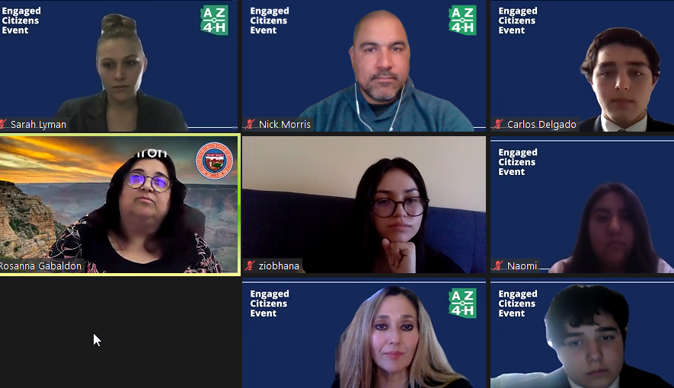


Thoughts?

Slide 8
Arizona 4-H 20,000 True Leaders by 2025 Strategic Plan
Intentional investments in supporting volunteers
  Join the AZ4-HYF in covering costs of DPS background check
Marketing
  Intentional investment in spreading the word of 4-H in your communities
Celebrating and thanking 4-H volunteers in April, National Volunteer Month.
What else can we do to ensure 4-H grows here?
Notes:
https://extension.arizona.edu/sites/extension.arizona.edu/files/sgermann/20%2C000%20True%20Leaders%20by%202025%20Plan.pdf

Slide 9
Homework that Remains
Program fees need to be assessed for need, use, cost recovery effectiveness, and standardization.
County 4-H Strategic Plan goals & efforts established (Next 3 months).
  Enrolled 4-H membership
  Chartered 4-H Clubs
  Authorized 4-H Volunteers

