Slide 1


Arizona 4-H
Gender Demographics
Jeremy Elliott-Engel

Slide 2
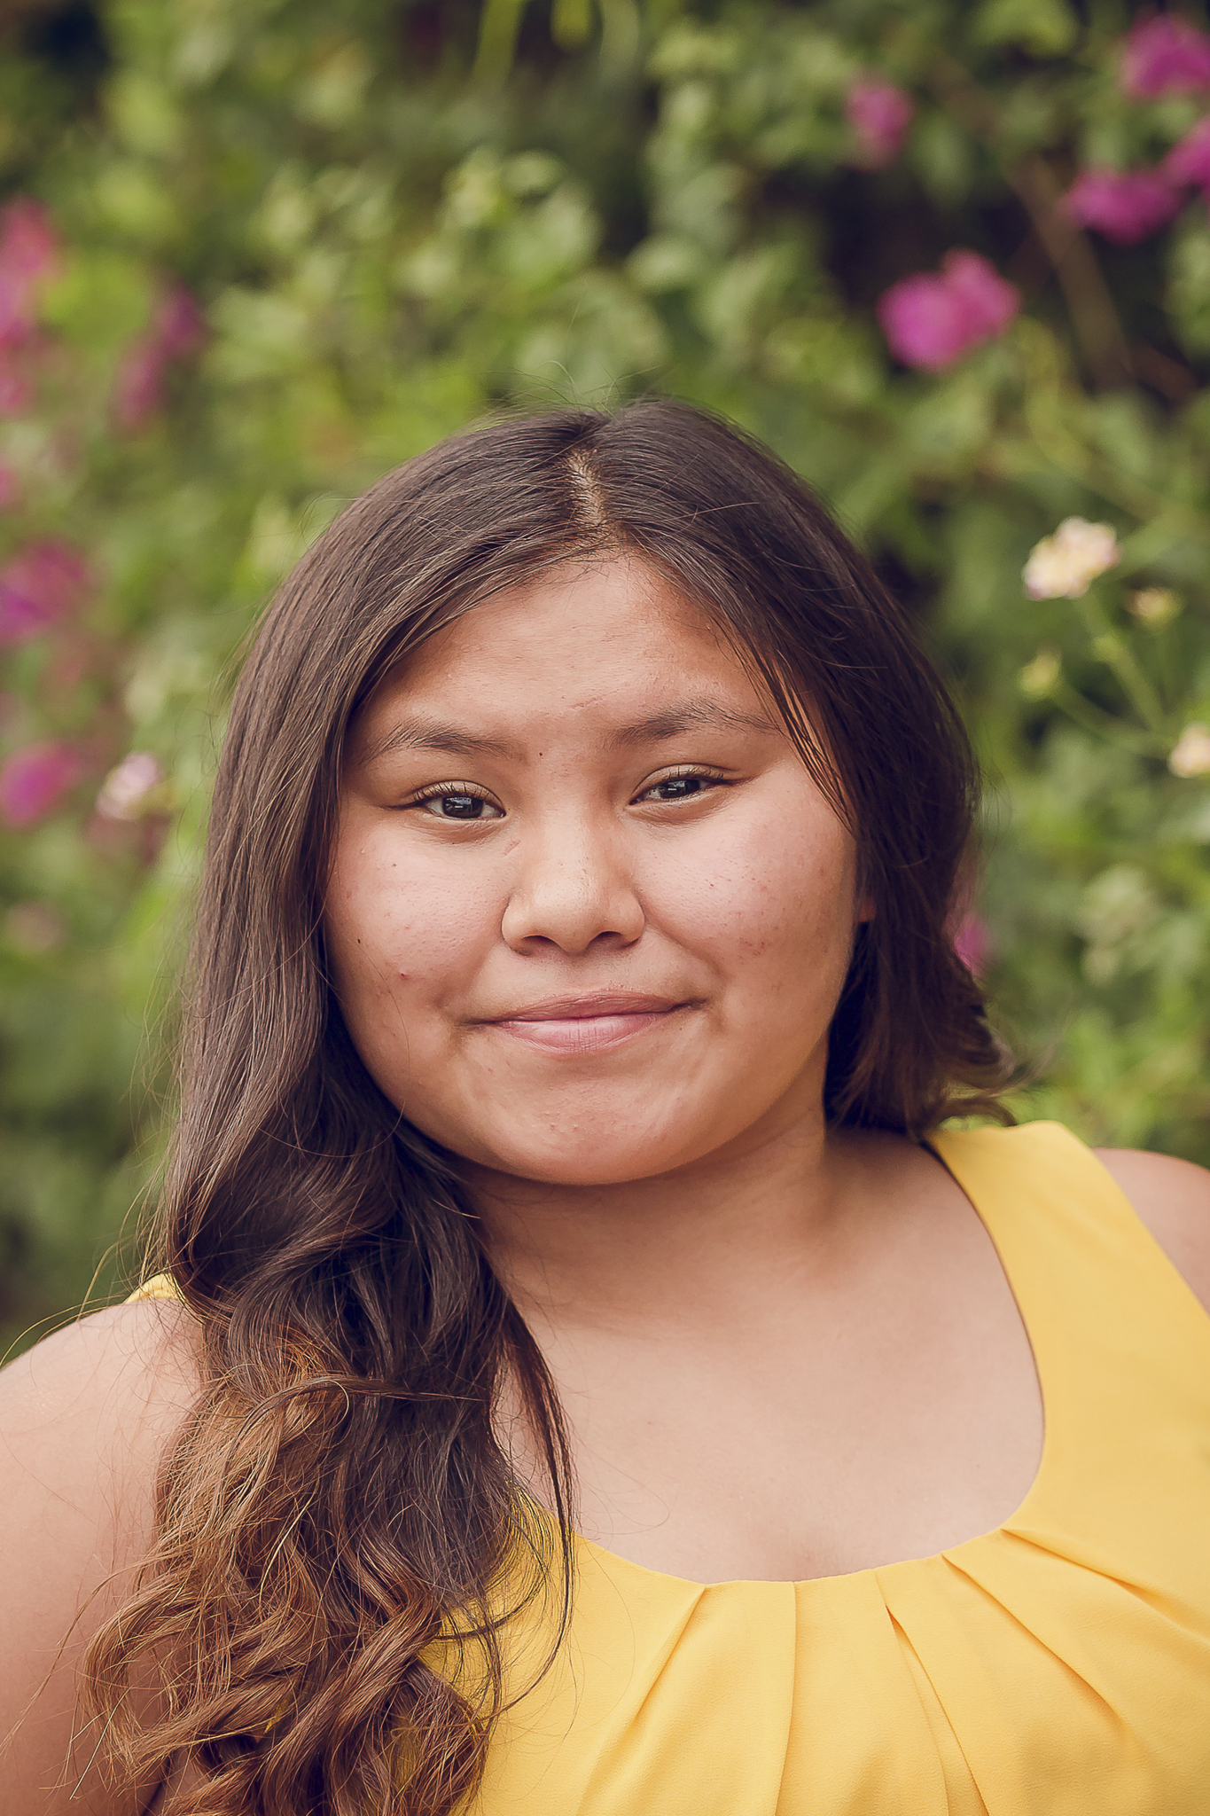



The Question
Why are demographic data collected?

Slide 3
Gender and Sexuality
Gender is the range of characteristics pertaining to, and differentiating between, femininity and masculinity. Depending on the context, these characteristics may include biological sex, sex-based social structures, or gender identity. (Terms: cisgender, transgender, non-binary, genderqueer)
vs.
Sexuality a person's sexual orientation or preference. (Terms: gay, straight, bisexual, pansexual)

Slide 4
Adapting for Gender Diversity Inclusion
2% of the Population Identifies as Gender non-Conforming
62.5% of TransgendereD 4-H Say Educators Do NOT Acknowledge Their Gender
.
Our commitment is to Ensure A Safe Environment for Youth Members; Safe From Emotional and Physical Harm. . .
OFFERING MULTIPLE GENDER CATEGORIES TO IMPROVE OUR KNOWLEDGE OF WHO IS IN OUR PROGRAM.

Slide 5
Besides doing the right thing: Systematic contributing factors
- We have always collected standard demographic data for all registration and events (e.g. Gender, Race, Ethnicity, Age, Military Family Affinity, Residential Location, etc.).
- Zingbooks allowed us to conduct all event registration within the system.
- Initial enrollment (account setup) data is pulled for all subsequent events.
- Parents are involved in the youth enrollment process, because the enrollment process is a computer system, with information like: Insurance, credit card for payment, and parental waivers.
- Transgendered Arizona 4-H members advocated for themselves and asked for their identity to be recognized.

Slide 6
Our Non-discrimination statement
Issued in furtherance of Cooperative Extension work, acts of May 8 and June 30, 1914, in cooperation with the U.S. Department of Agriculture, Jeffrey C. Silvertooth, Associate Dean & Director, Extension & Economic Development, The University of Arizona. The following affirmative action statement shall be placed on all 4-H correspondence, materials and publications.
The University of Arizona is an equal opportunity, affirmative action institution. The University does not discriminate on the basis of race, color, religion, sex, national origin, age, disability, veteran status, sexual orientation, gender identity, or genetic information in its programs and activities.

Slide 7
The Categories*
Male
Female
Prefer not to answer
*Since September 24,2020 per the directive from Dr. Jeff Silvertooth in coordination with support from Shane Burgess, Stephanie Rosenberg, Jocelyn Gehring.
Arizona 4-H using the frameworks provided by USDA, 4-H PLWG (ECOP), and the University of Arizona has adopted new categories.

Slide 8

The University of Arizona
ABOR and UA start with expecting that programs will at a minimum collect the data that is required to be reported to external funding and compliance agencies, such as the DOE, EEOC, OFCCP, USDA, etc. Beyond that, each university has the discretion to determine whether and how it will collect additional or varying data for internal purposes. At the UA, our programs are starting to coalesce around the concept of providing more options for gender – all the while discussing how to meet the compliance reporting requirements.
- Stephanie Rosenberg, Office of General Counsel

Slide 9

USDA
USDA-NIFA no longer requires statutory program reporting or 4-H members.
USDA-NIFA does require annual reporting for all capacity funding grants, including for youth participants.
Statutory reporting requirements are for Male or Female.

Slide 10
National 4-H Program Leaders Working Group (PLWG)
The PLWG is the reporting entity for National 4-H membership information, established by an MOU between USDA-NIFA, National 4-H Council, and ECOP.
Their system-wide collection requirement is*:
Male
Female
Nonbinary
Gender is not Listed
Prefer not to Answer
*4-Honline (our previous enrollment management) will be changing to these categories this 4-H year, without any flexibility at all.

Slide 11

Discussion
The University of Arizona is an equal opportunity, affirmative action institution. The University does not discriminate on the basis of race, color, religion, sex, national origin, age, disability, veteran status, sexual orientation, gender identity, or genetic information in its programs and activities.

