Slide 1

Transgender Minors on Campus Policy and Promising Practices for Safe and Inclusive Youth Programs

Slide 2


Jocelyn Gehring Director, Office of Youth Safety University of Arizona

Slide 3
Relevant Financial Disclosure
Jocelyn Gehring
I have nothing to disclose.

Slide 4


4:45pm Friday before a 3 day weekend.
“Do you have time for a quick question?”
Notes:
2016 Friday before 3 day weekend for 4th of July

Slide 5

University of California 4H
Notes:
With increasing visibility of the transgender population, and with more people openly identifying as transgender and expressing their gender nonconformity at younger ages, it is inevitable that camp administrators and staff will face the issue of inclusion of transgender campers at some point.

Slide 6
Session Outcomes
By the end of the session, attendees will have:
Working knowledge of the terms related to gender identity and expression
Knowledge of the risks and challenges faced by transgender youth participants and the importance of clear policies and practices to prevent, identify and report bullying and harassment.
Understanding of related legal obligations under federal, state and local statues
Access to model policies, templates and resources to create, review/ amend policies to support transgender and nonconforming youth on campus.
Notes:
With increasing visibility of the transgender population, and with more people openly identifying as transgender and expressing their gender nonconformity at younger ages, it is inevitable that camp administrators and staff will face the issue of inclusion of transgender campers at some point.

Slide 7
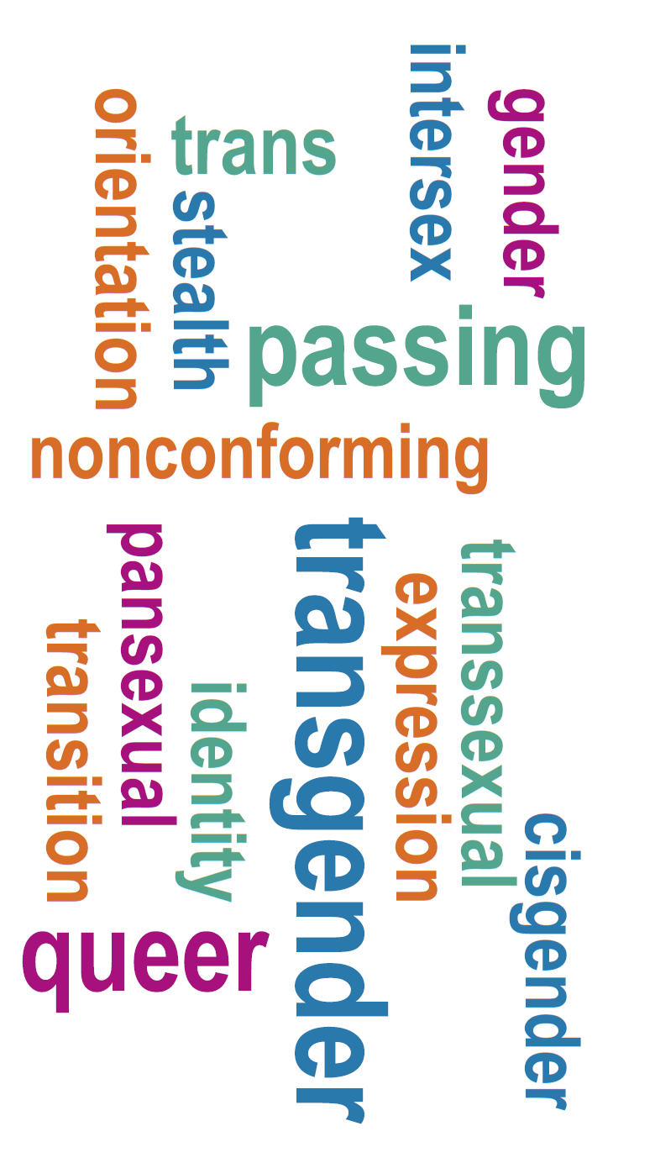
KEY TERMS
Notes:
Understanding the terminology associated with gender identity is important to providing a safe and supportive school environment for students whose rights are protected under the law.

Slide 8
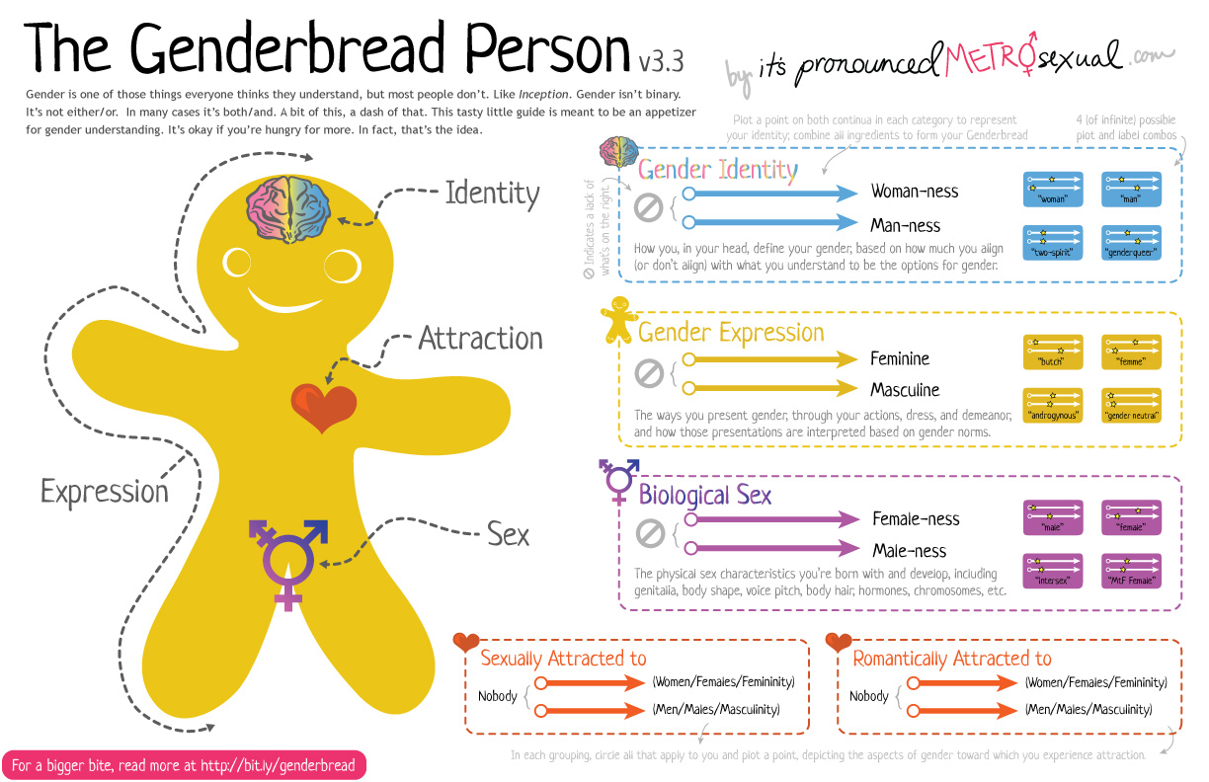

Slide 9
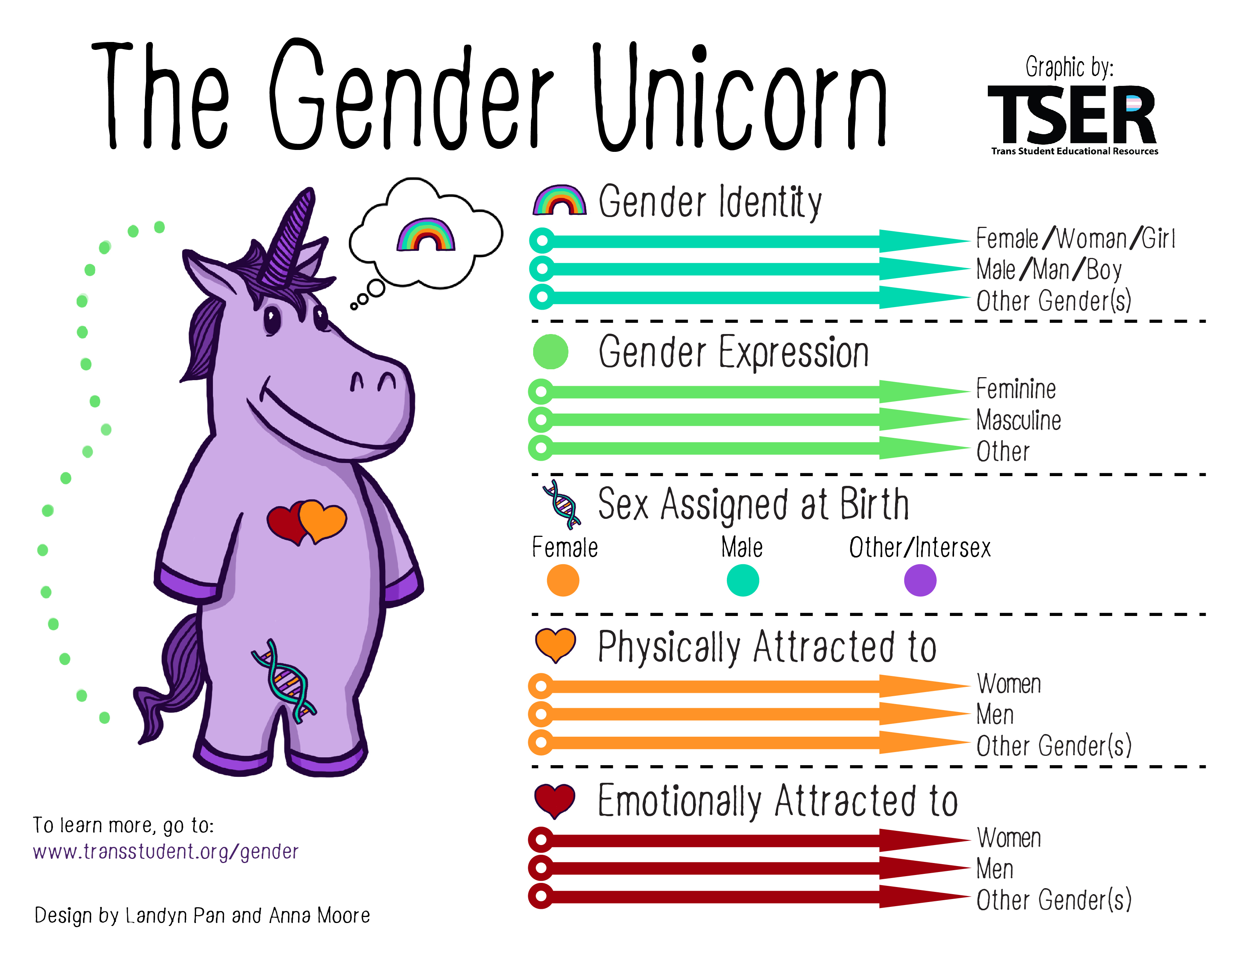

Slide 10
Terminology
Gender identity is a person’s deeply felt internal sense of being male or female, regardless of their sex assigned at birth.
Gender expression is the manner in which a person represents or expresses gender to others, often through behavior, clothing, hairstyles, activities, voice, or mannerisms.
Transgender is a general term used to describe a person whose gender identity or expression is different from that traditionally associated with the person’s sex assigned at birth.
Transitioning is the process in which a person changes their gender expression to better reflect their gender identity.
Gender nonconforming is a term for people whose gender expression differs from stereotypical expectations about how they should look or act based on the sex they were assigned at birth. This includes people who identify outside traditional gender categories or identify as both genders.
Terminology can differ based on region, language, race, ethnicity, age, culture, and many other factors.
Notes:
Terminology can differ based on region, language, race, ethnicity, age, culture, and many other factors.
Individuals use a number of words to describe their gendered experiences. Some people may refer to themselves as trans, transsexual, transgender, male-to-female (MTF), female-to-male (FTM), two-spirit, and a variety of other terms.

Slide 11

CREATING A SAFE AND WELCOMING ENVIRONMENT Risks, Needs and Effective Polices
Notes:
Understand risks and challenges faced by transgender youth
Identify common accommodation needs

Slide 12
Risks and challenges faced by trans youth on campus

Slide 13
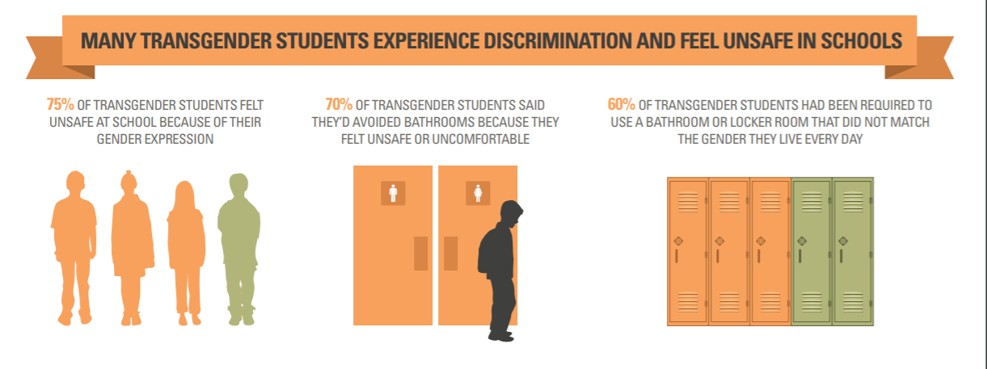
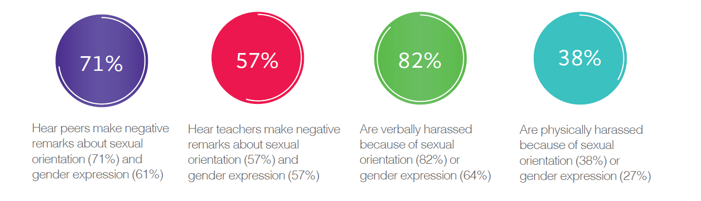
Notes:
transgender and GNC students enrolled in our
schools face disproportionately high rates of discrimination and harassment
Nearly 90% of trans students have experienced verbal
harassment as a result of their gender expression.
 53% have reported physical harassment
 School personnel seldom intervene when bullying occurs.
 Trans students experience psychological distress and
reduced feelings of safety as a result of harassment.

Slide 14
Needs of Transgender Youth on Campus
Facility Access
Restrooms
Locker rooms
Overnight Accommodations
Program Records
Registration Forms
Names/Pronouns
Privacy Concerns
Safe, Inclusive Environment
Policies to address bullying and harassment
Staff training
Clear and accessible reporting procedures
Notes:
With increasing visibility of the transgender population, and with more young people openly identifying as transgender and expressing their gender nonconformity at younger ages, it is inevitable that camp owners and administrators will face the issue of inclusion of transgender campers at some point. Camps should determine their policies regarding transgender campers in a proactive manner (Travers et al., 2010). One reason for proactive policy creation is that the absence of a policy of inclusion could be misperceived as a policy of exclusion and deter transgender campers from seeking to attend camp. Another reason is that attempting to create policy in the context of an individual camper’s case could put unwarranted burdens on that camper, such as unwanted publicity or exposure to negative comments and criticism. In contrast, policy formation in advance can promote deliberate 97
decision-making and allow time for outreach and education of camp staff, campers, parents, and other stakeholders.
Inclusion of transgender campers can be a risky business decision for people in camps worried about changing the status quo and potentially losing income from camper fees from families who do not support inclusive policies.

Slide 15
Facility Access Restrooms *Locker rooms Overnight Accommodations

Slide 16

Restrooms • Provide access to the restroom that corresponds to the student’s gender identity. • Designate any available single stall restroom with a locking door as a unisex/gender neutral restroom and as available to all students. If a single stall student restroom is not generally available, designate a private restroom such as one in the health suites for any student who requests increased privacy and safety, for any reason. This accommodation may be offered to all students. • Permit transgender and gender non-conforming students whose gender identity is not exclusively male or female to use facilities they believe are the most consistent with their safety and gender identity.

Slide 17
“A policy that requires an individual to use a bathroom that does not conform to his or her gender identity punishes that individual for his or her gender nonconformance, which in turn violates Title IX.” Whitaker v. Kenosha Unified School District, (7th U.S. Circuit Court of Appeals, May 30, 2017).

Slide 18

Locker Rooms Best practices: *Case-by-case assessment with the goal of maximizing the student’s social integration and equal opportunity, ensuring the student’s safety and comfort, and minimizing stigmatization of the student. *In most cases the student should have access to the locker room consistent with the gender identity the student consistently asserts at school. A reasonable alternative changing area should be made available to any student that wishes increased privacy, but no student should be required to use a locker room that conflicts with his/her gender identity.
Notes:
Accommodations for access to locker rooms is more nuanced

Slide 19
Overnight Accommodations Collective Wisdom! How have you addressed overnight accommodations for transgender youth on your campus?
Notes:
Accommodations for access to locker rooms is more nuanced

Slide 20
Program records Registration forms preferred names/pronouns privacy issues

Slide 21
Registration Forms
How does your program/university ask a program participant about their gender?

Slide 22
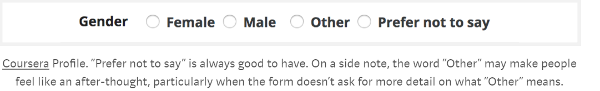
Registration Forms
1. Know why you are asking
2. Make it private, safe, and anonymous
Be mindful of who will see any identifying information.
3. If possible, make the question optional
Trust the student/parent to know what is best for the child and if they feel it is safe or appropriate to disclose the information based on the context.
4. Ask for pronouns instead, if that’s all you need to know
Instead of gender, consider asking for people’s preferred pronouns, and including the gender-neutral “They/their/theirs” as a singular pronoun.

Slide 23

Preferred Name/ Pronouns *Don’t assume student’s name or pronoun. *Ask the child and use the requested name and pronouns. *Students need not provide schools with legal documents to correct their first name or gender within their student records. *Avoid grouping students by gender “Girls line up here, boys line up over there”
Notes:
When students are referred to by the wrong pronoun by peers or school staff, students may feel intimidated, threatened, harassed or bullied. School staff can ensure a more respectful environment for all students when efforts are made to correct the misuse of pronouns, as well as names, in student records

Slide 24
Privacy and Confidentiality The individual has the right to keep one’s transgender status private. Without consent from the student, school personnel should not disclose a student’s transgender status to others, such as students, parents or other school personnel, unless there is a specific “need to know” (for example, a health emergency). A student’s transgender status may also be disclosed to others to the limited extent necessary to investigate and/or resolve a claim of discrimination or harassment brought by that student.
Notes:
When students are referred to by the wrong pronoun by peers or school staff, students may feel intimidated, threatened, harassed or bullied. School staff can ensure a more respectful environment for all students when efforts are made to correct the misuse of pronouns, as well as names, in student records

Slide 25
Safe, inclusive environment policies to address bullying and harassment staff training clear reporting procedures

Slide 26
Reviewing Existing University and/or Program Policies
Does your University and/or program anti-discrimination, harassment and bullying policy explicitly prohibit conduct based on one’s sexual orientation, gender identity, gender expression or transgender status?
Notes:
By including “gender identity and expression” in their nondiscrimination policies, camps formally commit to honoring campers’ self-declarations of their deeply held gender identities.
An increasing number of school districts are adding “gender identity and expression” to their nondiscrimination policies. This is a critical first step that sends a strong signal about equal treatment and conforms to the protections in effect in many jurisdictions.

Slide 27
Policy should include language related to:
Bullying, Harassment and Discrimination
Privacy/Confidentiality
Media & Community Communication
Official Records/Pronouns
Gender Segregated Activities/Areas & Dress Code
Training & Development

Slide 28
How does your institution/program measure up?
Has your school published guidelines to promote the respectful treatment of transgender students?
Are gender identity and expression included in your school’s nondiscrimination policy?
Do faculty/staff members respect and honor students’ gender identity and expression?
Are staff trained on transgender issues?
Do students know what to do and who to talk to if they’re intimidated, threatened or harassed because of their gender identity or expression?
Are restroom facilities safe and accessible for transgender students?
Notes:
The following questions will help you measure how effectively your school supports transgender youth. If you are not sure of the answers, check with teachers, your principal or your school board

Slide 29
Staff Training
Camp staff training should include topics related to
interventions for aggression and name calling
eliminating harassing behaviors
using preferred pronouns
discussing rights of young people to feel safe and the risks they face
Notes:
Professional Development for Staff Educate staff to understand the complexities of gender as well as specific methods to stop gender based harassment, bullying and hurtful teasing. Provide training for all school personnel—from teachers, aides and counselors to administrative staff, bus drivers, recess aides, and cafeteria worker

Slide 30

RESPONDING TO ANTI- LGBTQ BEHAVIOR
Address name-calling, bulling or harassment immediately
Name the behavior
Use this as a teachable moment, now or later, publically or privately
Support the minor being targeted. Ask them what they need/want
Enforce anti-bullying and discrimination policies in your program/campus.

Slide 31
Answering questions from parents
Listen to parents’ concerns and make sure they feel heard.
Take an educational approach to:
*Questions or misunderstandings about gender identity and expression.
*What information about other children can be shared.
*The variety of identities and viewpoints children are exposed to in such a camp setting and the value of diversity.
*University/program values and equal opportunity policies.
Be clear and consistent in your discussion
Keep notes on dates, times, and details of conversations

Slide 32
Legal landscape

Slide 33
Protections for Transgender Youth
The U.S. Department of Education (ED) has clarified that discrimination based on gender identity in schools violates Title IX of the 1964 Civil Rights Act.
US Department of ED, the Department of Justice (DOJ), and the Office of Civil Rights (OCR) has confirmed that sex discrimination in schools includes discrimination based on “gender identity, gender expression, and nonconformity with gender stereotypes.”

Slide 34
Protections for Transgender Youth
On July 24, 2013, the DOJ resolved a settlement with a school on behalf of a 12-year-old transgender boy who was told to use a restroom in the nurse’s office instead of the boy’s restroom and locker room, and told he could not room with the cisgender boys on a field trip.
○This treatment made the student the target of awkward questions and teasing that interfered with his ability to focus at school.
The 2013 settlement requires the School District to:
○Grant the student access to the same facilities as any other male student
○Develop transgender-inclusive nondiscrimination policies
○Put its staff through anti-discrimination trainings
○Undergo monitoring and reporting
Student v. Arcadia Unified School District

Slide 35
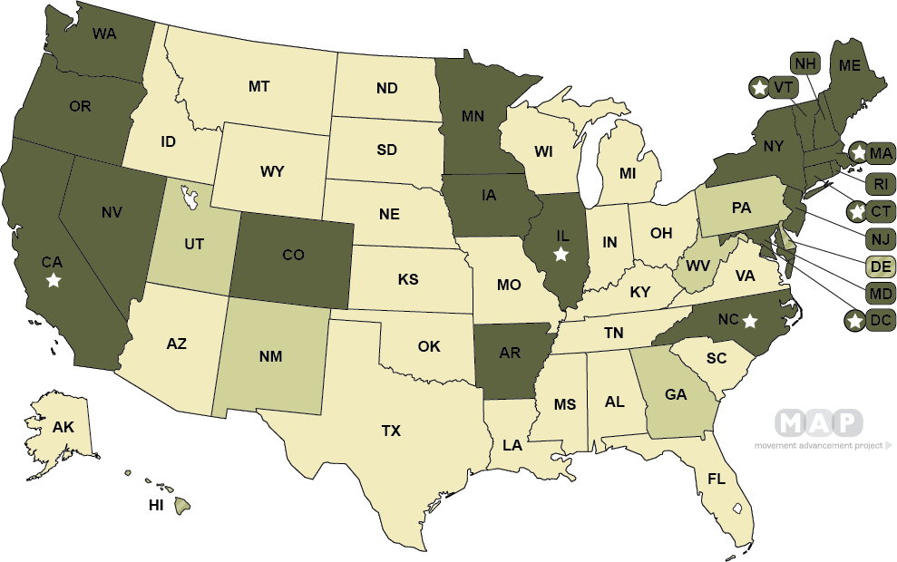
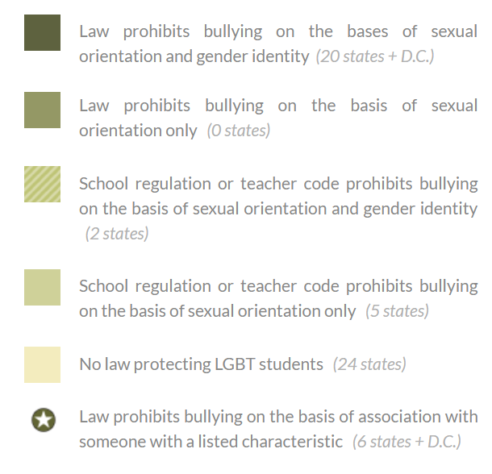

Slide 36
resources

Slide 37
Guidance Documents
U.S. Department of Education, Office of Elementary and Secondary Education, Office of Safe and Healthy Students, Examples of Policies and Emerging Practices for Supporting Transgender Students
https://www2.ed.gov/about/offices/list/oese/oshs/emergingpractices.pdf
School District of Palm Beach County LGBTQ+ Critical Support Guide https://www.palmbeachschools.org/safeschools/wp-content/uploads/sites/80/2016/03/LGBTQ_Critical_Support_Guide.pdf
Resource Guide: Working with Transgender and Gender-Nonconforming Students and Staff
https://www.fwps.org/cms/lib/WA01919399/Centricity/domain/1202/pdfs/Working-with-Transgender-and-Gender-Non-Conforming-Students-and-Staff.pdf
American Psychological Association: Just the Facts About Sexual Orientation & Youth: A Primer for Principals, Educators and School Personnel.
http://www.apa.org/pi/lgbc/publications/justthefacts.html
Safe Schools Research Brief 13: Understanding School Safety for Transgender Students
http://www.transstudent.org/what-we-do/policy/downloads/CSSC_Research_Brief_13-1.pdf

Slide 38
Model Policies
Model School District Policy Regarding Transgender and Gender Nonconforming Students
Model Anti-Harassment Policy (NCLR)
Administrative Regulation and Notice (Gender) (San Francisco Unified School District)
Oakland Unified School District Board Policy on Sexual Orientation
Anti-Slur Policies (Berkeley, San Francisco Unified School Districts)
Hate-Motivated Behavior Policy
Uniform Complaint Procedures Board Policy

Slide 39
Legal Resources and Guidance Documents
ABA: Legal Issues Surrounding Sexual Orientation and Gender Identity in Middle School Youth
https://www.americanbar.org/content/dam/aba/administrative/young_lawyers/meetings/2016/midyear/legal_issues_middle_school_gender_identity.pdf
Dealing with Legal Matters Surrounding Students’ Sexual Orientation and Gender Identity
https://www.nsba.org/sites/default/files/reports/Dealing%20with%20Legal%20Matters%20Surrounding%20Students%E2%80%99%20Sexual%20Orientation%20and%20Gender%20Identity.pdf
State by State Safe School Laws
http://lgbtmap.org/equality-maps/safe_school_laws

Slide 40
State Specific Legal Resources and Guidance Documents
Guidelines for Connecticut Schools to Comply with Gender Identity and Expression Non-Discrimination Laws: Frequently Asked Questions” http://www.ct.gov/chro/lib/chro/Guidelines_for_Schools_on_Gender_Identity_and_Expression_final_4-24-12.pdf
One Colorado, Guidance for Educators Working with Transgender and Gender Nonconforming Students https://one-colorado.org/wp-content/uploads/2017/02/TransResourceGuide_2016.pdf
Massachusetts Department of Elementary and Secondary Education, “Guidance for Massachusetts Public Schools Creating a Safe and Supportive School Environment”
http://www.doe.mass.edu/sfs/lgbtq/GenderIdentity.html
New York State Education Department, “Guidance to School Districts for Creating a Safe and Supportive School Environment for Transgender and Gender Nonconforming Students”
http://www.p12.nysed.gov/dignityact/resources.html
Texas Association of School Boards, “Legal Issues Related to Transgender Students”
https://www.tasb.org/Services/Legal-Services/TASB-School-Law-eSource/Students/documents/legal_issues_related_to_transgender_students.pdf

Slide 41
Additional Resources
Positively Supporting Transgender Youth at Summer Camp, Nancy Willard, M.S., J.D.
http://www.embracecivility.org/wpcontent/uploadsnew/2011/10/TransgenderCamper.pdf
Effectively Engaging Trans Campers and Participants, YMCA Camp Takodah
https://www.camptakodah.org/wp-content/uploads/2018/02/Trans-Camper-Policy.pdf
BENDING THE MOLD: AN ACTION KIT FOR TRANSGENDER STUDENTS https://www.lambdalegal.org/sites/default/files/publications/downloads/btm_bending-the-mold_0.pdf

Slide 42
Q & A

Slide 43
Thank you!
Jocelyn Gehring Director, Office of Youth Safety University of Arizona jocelyngehring@email.arizona.edu

