Slide 1

Considerations for Waiving Arizona 4-H Program Fees
Jeremy Elliott-Engel, Ph.D.
Associate Director, 4-H Youth Development
Arizona Cooperative Extension
The University of Arizona

Slide 2


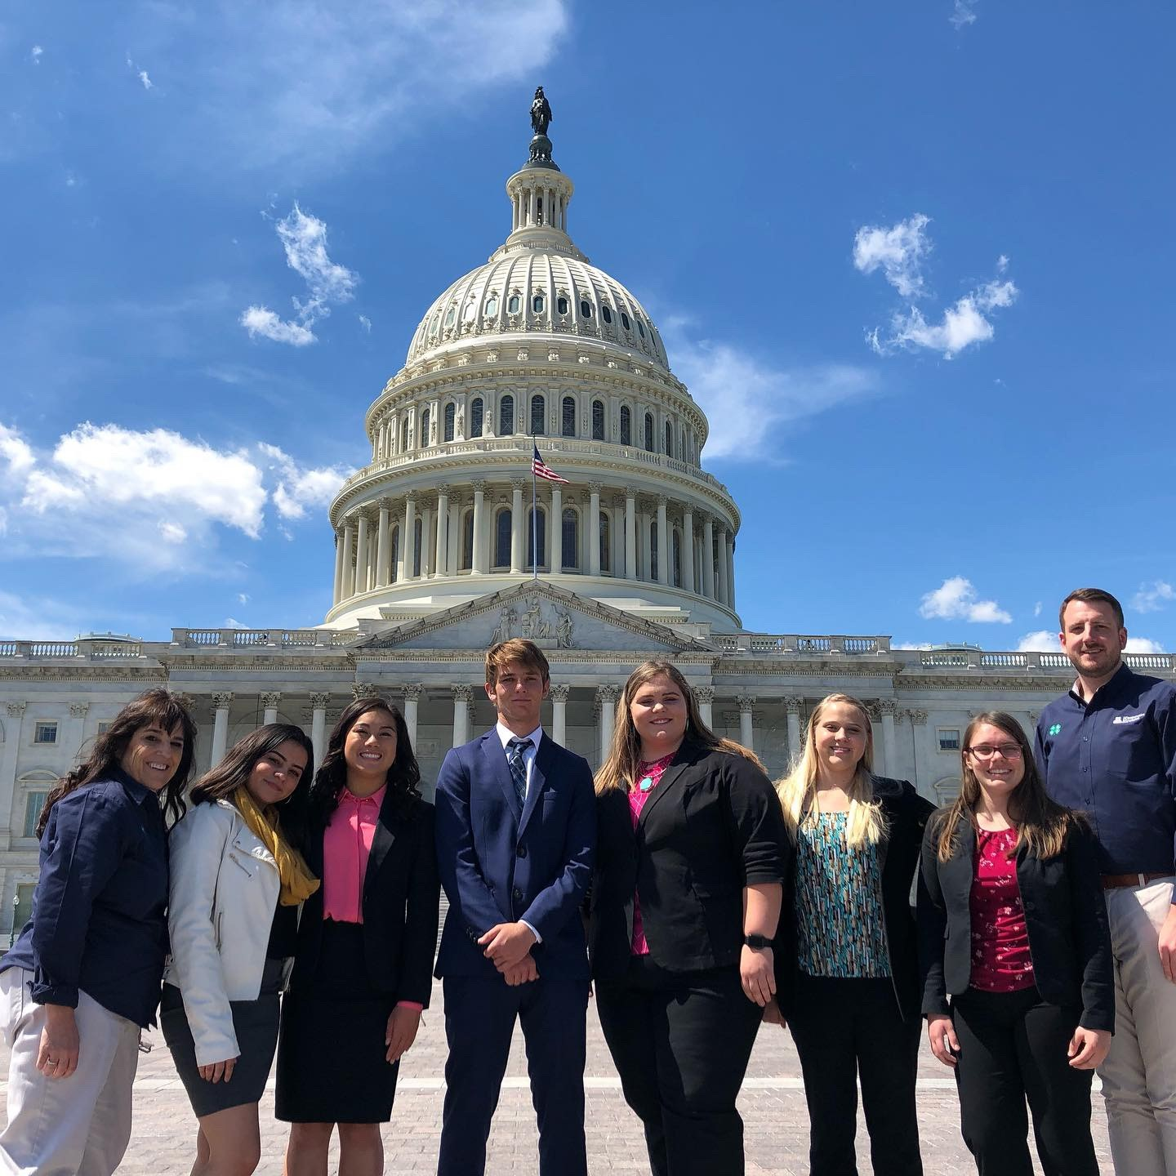
Why re-imagine 4-H program fees?
To encourage re-enrollment?
Other…

Slide 3
What is a 4-H Program Fee
County | County Fee in 4HOnline
Apache | $15.00
Cochise | $20.00
Coconino | $15.00
Gila | $20.00
Graham | $15.00
Greenlee | $15.00
La Paz | $15.00
Maricopa | $20.00
Mohave | $15.00
Navajo | $15.00
Pima | $15.00
Pinal | $20.00
Santa Cruz | $15.00
Yavapai | $20.00
Yuma | $15.00
Program fees are used at the state, county, and club to support the implementation of the Arizona 4-H program. In Arizona 4-H “enrolled 4-H member” pays a state enrollment fee ($5), a county program fee ($5-20), and a club program fee (Unknown range).

Slide 4
Current Organizational Position: No Refunds
Complex number of entities utilize 4-H enrollment fees (State Office, County Offices, and some County 4-H Councils).
Refunds to individuals would require a heavy paperwork burden to establish each individual recipient as an ICON, an individual check for each person.
Refunds undermine the ability to deliver high-quality programming at the very time we need to deliver effective programming.
Refunds indicate our programs stopped or were unsatisfactory during an awesome effort to respond to an unprecedented pandemic. The 4-H teams' effort has been excellent and does not warrant to be discredited.
Discussed at EAT, February 2nd

Slide 5
Who Handles & Keeps 4-H Program Fees?
Location | Type of Transaction that are Deposited Originally | Final Allocation of Funds
UArizona State 4-H Office | All Credit Card payments | $5 Enrollment Fee for all Enrolled 4-H Members (billed once a year).
UArizona County Office | Cash and Check Enrollment Fees | County Program Fees (if the county uses office accounts)
County 4-H Council | Cash and Check Enrollment Fees | County Program Fees (if the county uses County 4-H Council)* This is under the AZ4-HYF Financial purview.
Clubs | Cash and Check Enrollment Fees | Club Program Fees (Never paid by credit card).

Slide 6
How many 4-H Program Fees are Collected Annually?
County | County Fee in 4HOnline | Number of Enrolled Youth | County Program Fees
Apache | $15.00 | 243 | $3,645.00
Cochise | $20.00 | 297 | $5,940.00
Coconino | $15.00 | 296 | $4,440.00
Gila | $20.00 | 562 | $11,240.00
Graham | $15.00 | 116 | $1,740.00
Greenlee | $15.00 | 35 | $525.00
La Paz | $15.00 | 173 | $2,595.00
Maricopa | $20.00 | 863 | $17,260.00
Mohave | $15.00 | 212 | $3,180.00
Navajo | $15.00 | 193 | $2,895.00
Pima | $15.00 | 1122 | $16,830.00
Pinal | $20.00 | 391 | $7,820.00
Santa Cruz | $15.00 | 100 | $1,500.00
Yavapai | $20.00 | 219 | $4,380.00
Yuma | $15.00 | 823 | $12,345.00
 |  |  | $96,335.00 | Total County Program Fees
 | Total 2019-2020 4-H Enrollment | 5645 | $ 28,225.00 | Total State Enrollment Fees
 |  |  | $124,560.00 | Total of Fees Collected Annually
$124,560

Slide 7
Which 4-H Year?
 | 4-H Year 2020 | 4-H Year 2021 | 4-H Year 2022
Calendar | October 2019-September 2020 | October 2020- September 2021 | September 2021-October 2022
Enrollment Status | Complete | Currently Enrolling (2/3rds already enrolled)

Slide 8
Refund, Voucher, Waived Fee
 | Refund | Voucher | Waived Fee
Record Management | Must establish a record of financial payment (3 possible sources for these records: UArizona county –or- state office; County 4-H Council). | Must establish a record of financial payment; create a record of credit; distribute to each individual for future use. | Set the fees in Zingbooks at zero
Team Effort | Enormous team effort; every business UACE County Business officer, county-based 4-H professional. | Zingbooks would allow us to create a Coupon Code for each county to distribute. Fairly easy distribution; complex accounting and budgeting for the reduction: tracking payments and conversing with clients will be a significant implementation cost. | Approximately 37 clicks from Ashley Parra; and, business officer distribution of checks.
Other Requirements | ICON Form for every 4-H youth. | Establish criteria for waiver.

Slide 9

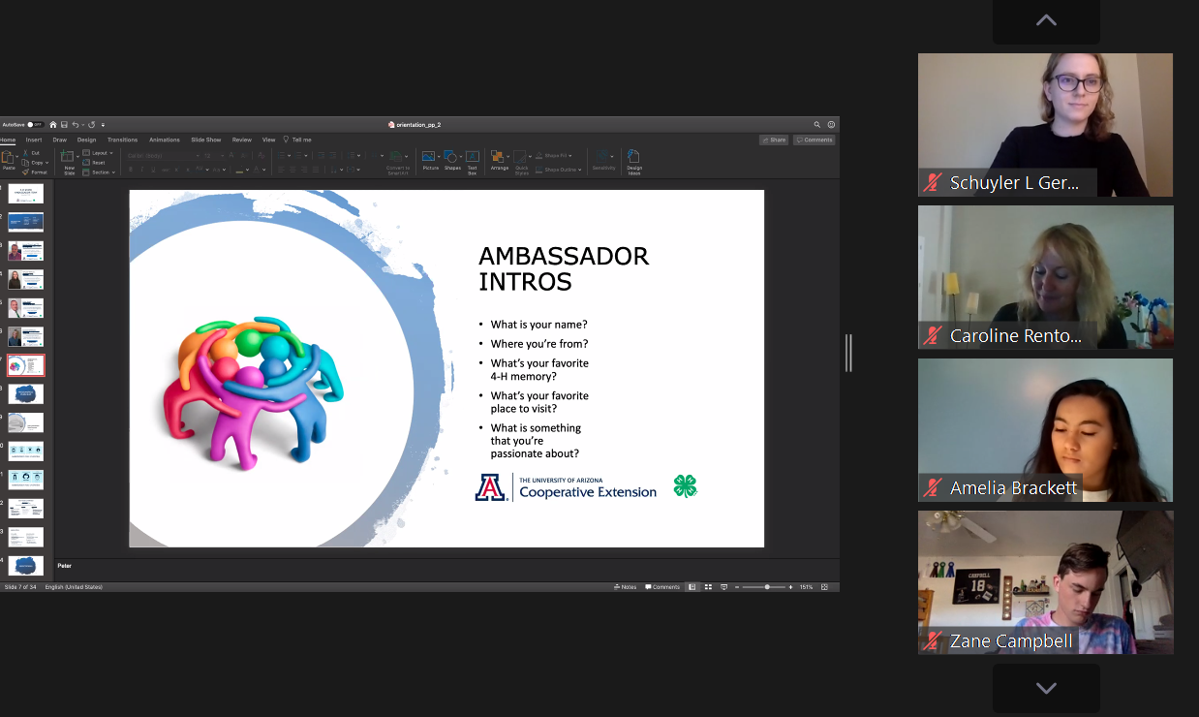


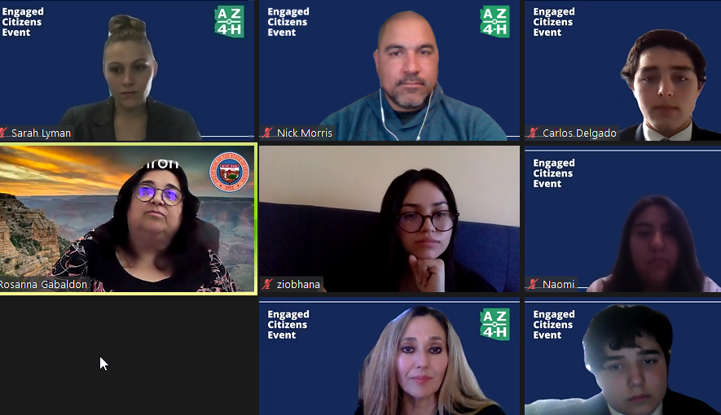


Thoughts?

