Slide 1

Masks Work! Use Them
Jeffrey C. Silvertooth
Associate Dean
Director for Economic Development and Extension

Slide 2
COVID-19/SARS-CoV-2 Wins Virulent Virus Trifecta
Note: Morbidity is the state of being symptomatic or unhealthy for a disease or condition.

Slide 3
Dr. Timothy Lant & Dr. Joshua LaBaer, ASU

Slide 4
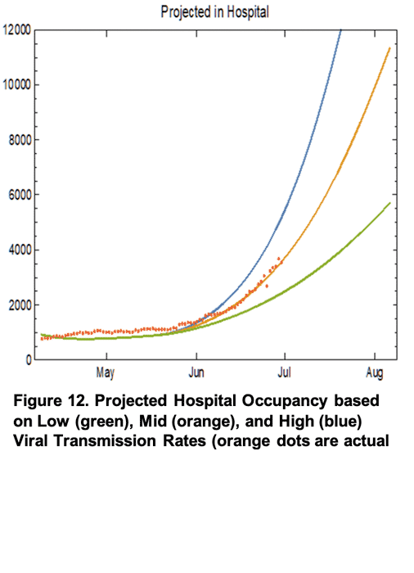
Created by: Joe K. Gerald, MD, PhD (Associate Professor, Zuckerman College of Public Health, with gratitude to Patrick Wightman, PhD, MPP from the UA Center for Population Health Sciences for assistance with data analysis.

Slide 5
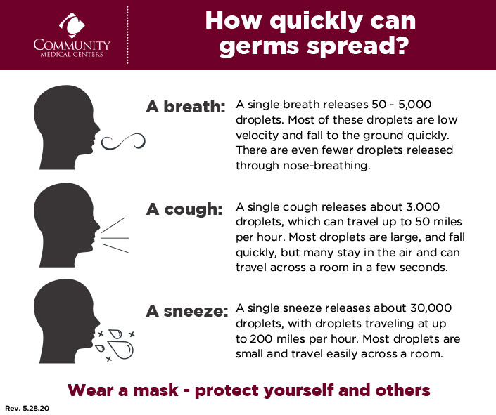

Slide 6
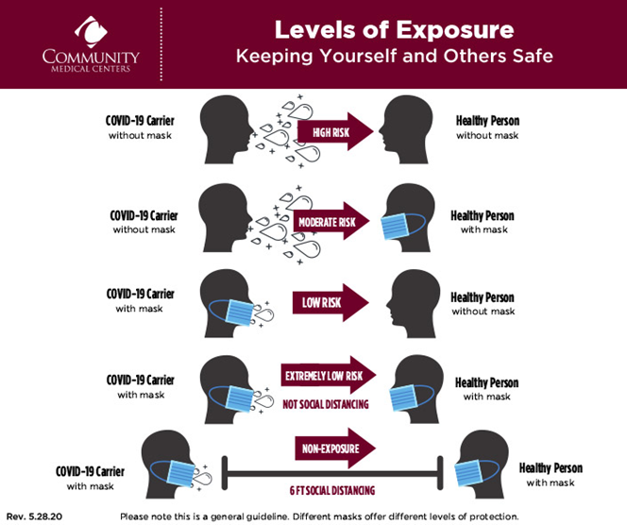
Masks Work – Use Them!

Slide 7
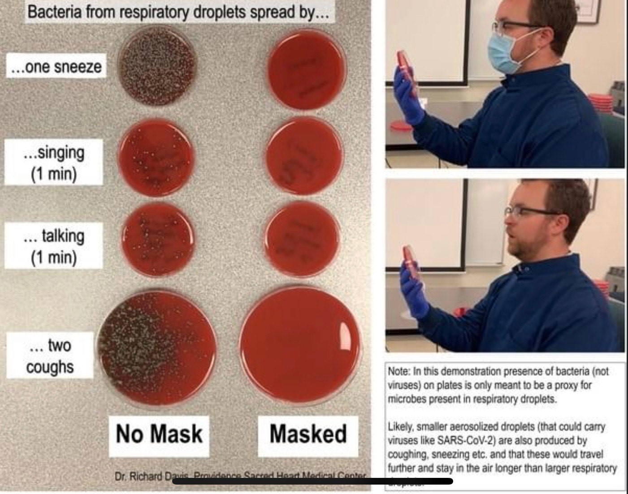

Slide 8
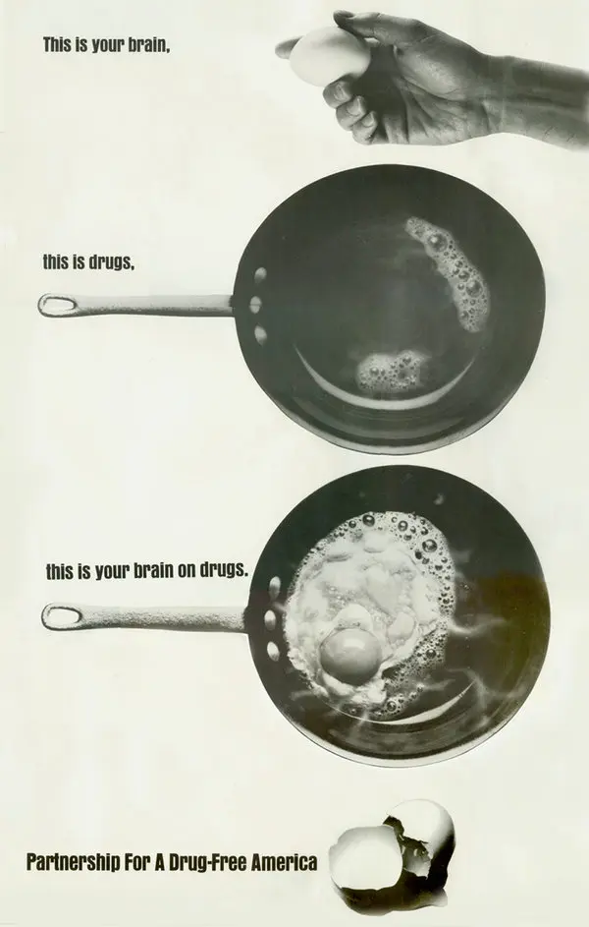
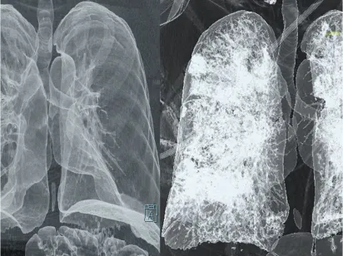
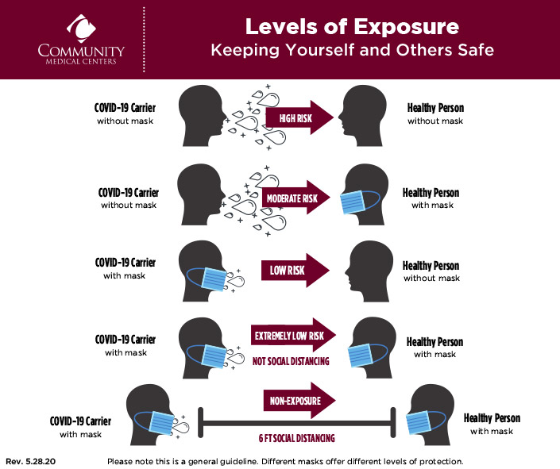
Healthy Lungs
Masks Work!
Lungs Damaged by COVID-19

Slide 9
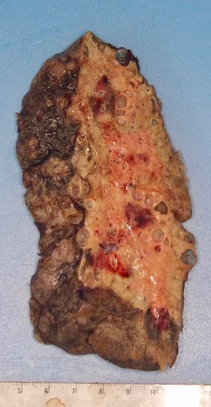
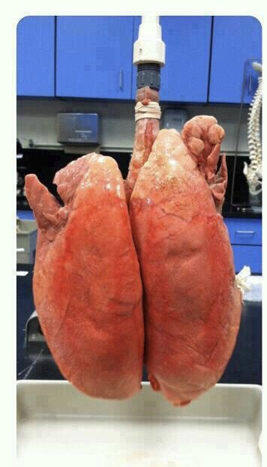
Healthy Lungs
Lung Damaged by COVID-19

Slide 10
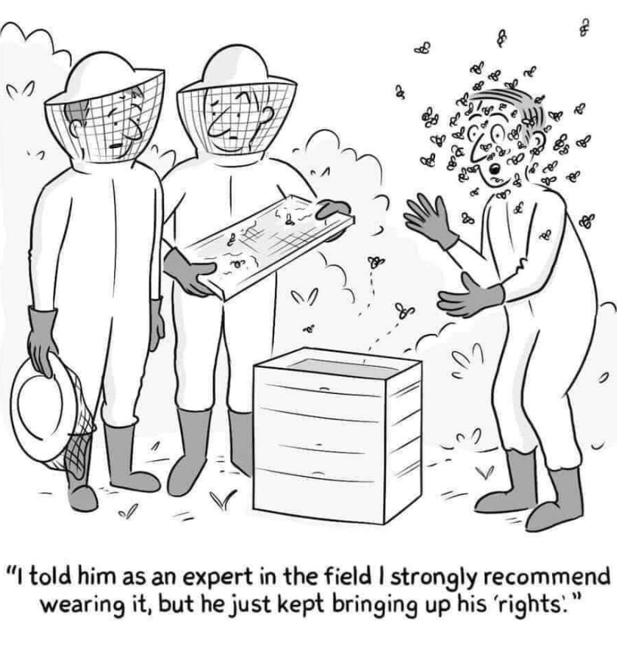
Masks Work!

Slide 11
Masks Work – Use Them!

